Slide 1
Revision TG July 2018 San Diego Meeting Agenda
Date: 2018-07-10
Authors:
Notice: This document has been prepared to assist IEEE 802.19. It is offered as a basis for discussion and is not binding on the contributing individual(s) or organization(s). The material in this document is subject to change in form and content after further study. The contributor(s) reserve(s) the right to add, amend or withdraw material contained herein.

Slide 2
Agenda graphic

Slide 3
Meeting protocol
Please announce your affiliation when you first address the group during a meeting slot

Slide 4
Attendance
https://imat.ieee.org/my-site/home
Register
Indicate attendance

Slide 5
Agenda items for this week
Approval of meeting minutes
Opening report
Results of sponsor ballot
Comments resolutions
Press release
Motions

Slide 6
Tuesday AM1

Slide 7
Agenda for Tuesday AM1
Meeting called to order
Call for secretary
Call for submissions and discussions
Approval of agenda
IEEE IPR statement
Approval of March 2018 Revision TG meeting and teleconference minutes
Revision TG Opening report
Results of sponsor ballot
Comments resolutions
Press release
Recess

Slide 8
Call for secretary
Looking for volunteer of recording secretary

Slide 9
Call for submissions
DCN 19-18/0050r0: P802.19.1 2nd recirculation Comments and Resolutions (C. Sun)
DCN 19-18/0057r0: Press Release for IEEE 802.19.1 Revision (N. Sato)

Slide 10
Approval of agenda
Motion to approve the agenda of the July 2018 Revision TG meeting, document 19-18/0051r1.
  Approved by unanimous consensus

Slide 11
Patent Policy
http://standards.ieee.org/about/sasb/patcom/materials.html

Slide 12
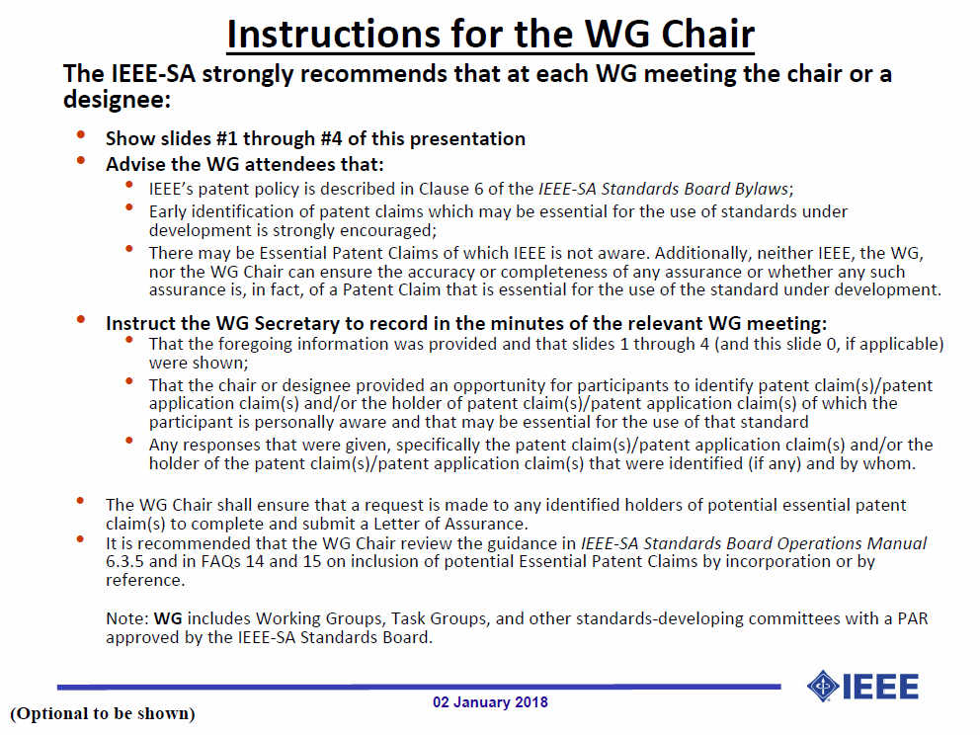

Slide 13
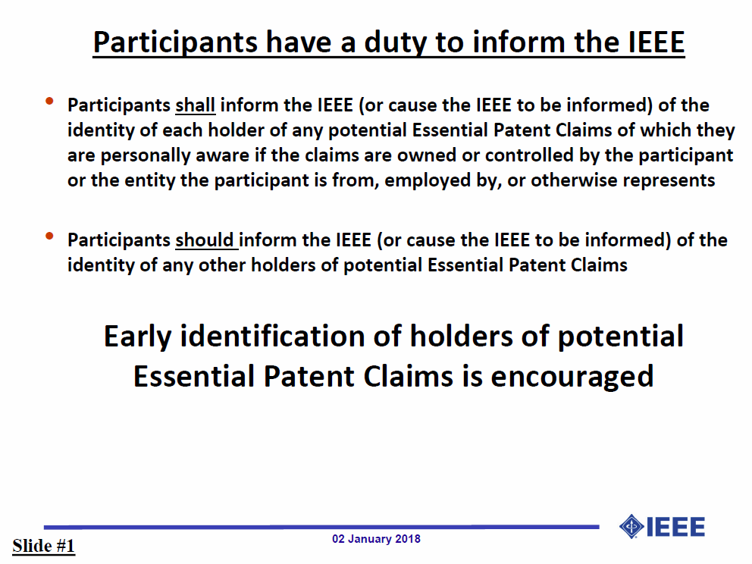

Slide 14
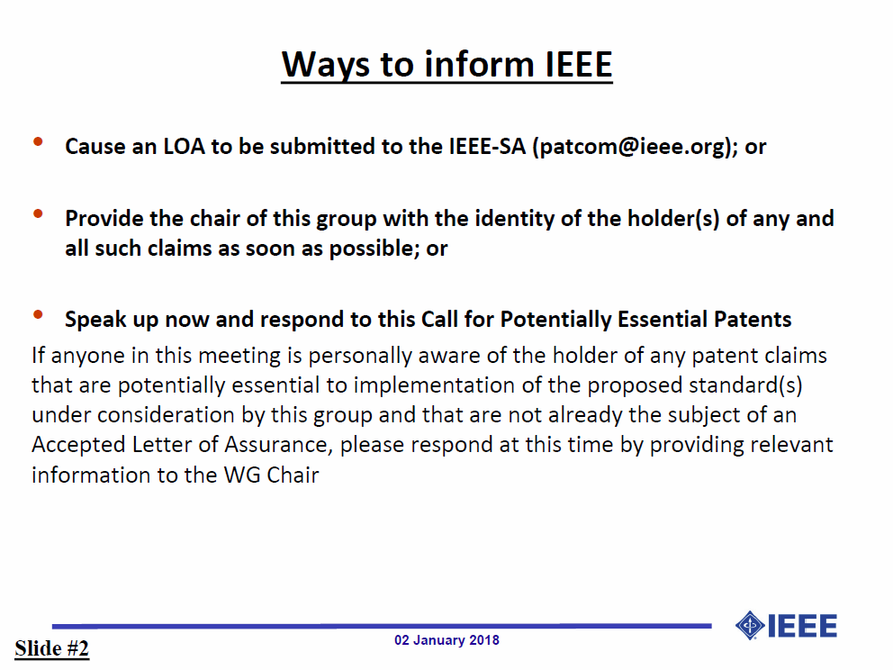

Slide 15


Slide 16
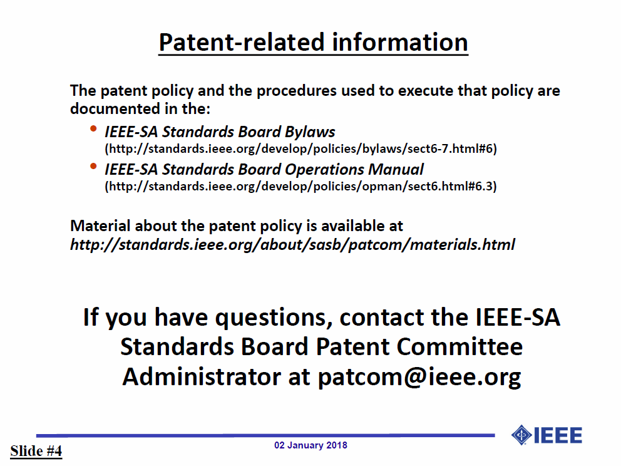

Slide 17
Approval of minutes
Motion to approve the minutes from the March 2018 Revision TG meeting, DCN 19-18/0019r0, the May 16, 2018 BRC teleconference, DCN 19-18/0016r0, the May 30, 2018 BRC teleconference, DCN 19-18/0036r1 and the June 20, 2018 teleconference, DCN 19-18/0046r0
  Approved by unanimous consensus

Slide 18
Revision TG Opening report
July 2018 Revision TG Opening Report (DCN 19-18/0052r0)

Slide 19
Results of second recirculation SB
IEEE P802.19.1-2018 D3.0 recirculation Sponsor Ballot
  Response rate: 87%
  Approval rate: 96%
  Abstain rate: 4%
Total 1 comment was received
  General: 0, Editorial: 1, Technical: 0

Slide 20
Comments resolutions
DCN 19-18/0050r0: P802.19.1 2nd recirculation Comments and Resolutions (C. Sun)

Slide 21
Motion #1
Approve resolution comments in DCN 19-18/0050r1.
  Move: C. Sun
  Second: S. Furuichi
  Approved by unanimous consensus

Slide 22
Motion #2
Approve to ask working group chairman to request the 802 Executive Committee to approve forwarding IEEE P802.19.1 revision D3.0 to IEEE-SA RevCom.
  Move: S. Furuichi
  Second: C. Sun
  Y: 2/N: 0/A: 0

Slide 23
Press release
DCN 19-18/0057r0: Press Release for IEEE 802.19.1 Revision (N. Sato)

Slide 24
Agenda for Thursday PM1
Meeting called to order
Press release
Adjourn

Slide 25
Adjourn

Slide 26
BRC teleconference
Schedule (1hour)
  Wednesday, xxx. xx, 2018: 2am EDT (Wednesday, Apr. 18, 2018 7am CET, 2pm CST, 3pm JST/KST)
Meeting Logistics
  Use “Join Me”
    Join the meeting: https://join.me/ieeesawg802.19
    On a computer, use any browser. Nothing to download.
    On a phone or tablet, launch the join.me app and enter meeting code:ieeesawg802.19
    Join the audio conference:
    Dial a phone number and enter access code, or connect via internet.
  The chair will send out a notification to IEEE 802.19 reflector in advance of the meeting

Slide 27
Time difference
Winter
  1am EST (6am UTC, 3pm JST/KST)
  7am EST (noon UTC, 9pm JST/KST)
  5pm EST (10pm UTC, 7am JST/KST + 1day)
Summer
  2am EDT (6am UTC, 3pm JST/KST)
  8am EDT (noon UTC, 9pm JST/KST)
  6pm EDT (10pm UTC, 7am JST/KST + 1day)

