Slide 1
Ballot Resolution Committee (BRC)
June 20, 2018 teleconference Agenda
Date: 2018-06-20
Authors:
Notice: This document has been prepared to assist IEEE 802.19. It is offered as a basis for discussion and is not binding on the contributing individual(s) or organization(s). The material in this document is subject to change in form and content after further study. The contributor(s) reserve(s) the right to add, amend or withdraw material contained herein.

Slide 2
Meeting information
Time & Date: 2am EDT, Wednesday, June 20, 2018
Join the meeting: https://join.me/ieeesawg802.19
On a computer, use any browser. Nothing to download.
On a phone or tablet, launch the join.me app and enter meeting code:ieeesawg802.19
Join the audio conference:
Dial a phone number and enter access code, or connect via internet.
By phone:
United States - Los Angeles, CA +1.213.226.1066
United States - Washington, DC +1.202.602.1295
Canada - Ottawa +1.613.699.9318
Germany - Berlin +49.30.2240.3071
Japan - Tokyo +81.3.4579.5983
Korea, Republic of - South Korea +82.26.022.2310
Sweden - Stockholm +46.8.4030.8819
Sweden - Stockholm +46.8.4030.9107
Access Code 543-324-473#
Other international numbers available
By computer via internet:
Join the meeting, click the phone icon and select 'Call via internet'. A small download might be required.
Start time by time zones

Slide 3
Meeting protocol
Please announce your affiliation when you first address the group during a meeting slot

Slide 4
Agenda for June 20
Meeting called to order
Call for submissions, discussions and approval of agenda
IEEE IPR statement
Results of recirculation sponsor ballot
Comments resolution
Discussion Timeline
Motions
AOB
Adjourn

Slide 5
Call for submissions, discussions and approval of agenda
Submissions
  19-18/0045r1: 1st recirculation comment resolutions (C. Sun)
Approve the agenda of the BRC June 20, 2018 teleconference, document 19-18/0043r1
  Approved by unanimous consent

Slide 6
Patent Policy
http://standards.ieee.org/about/sasb/patcom/materials.html

Slide 7
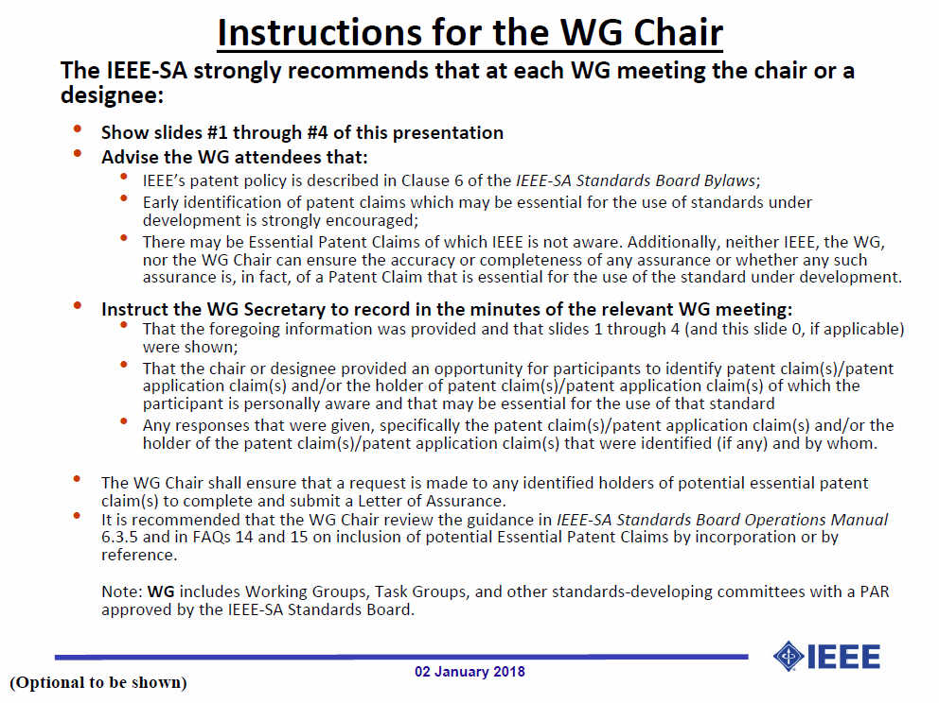

Slide 8
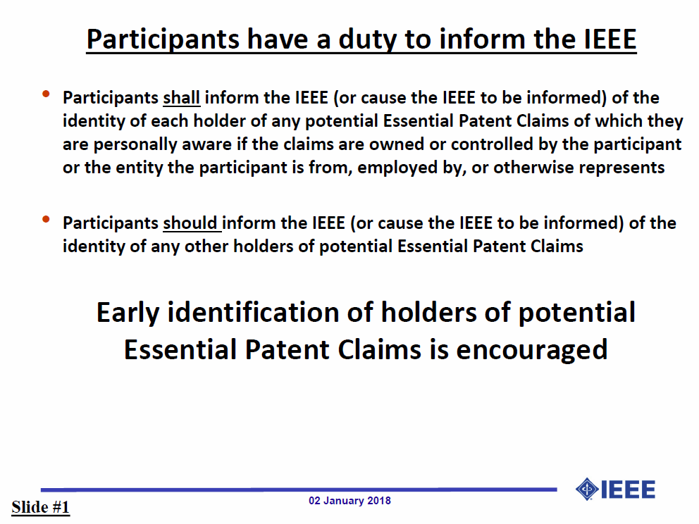

Slide 9
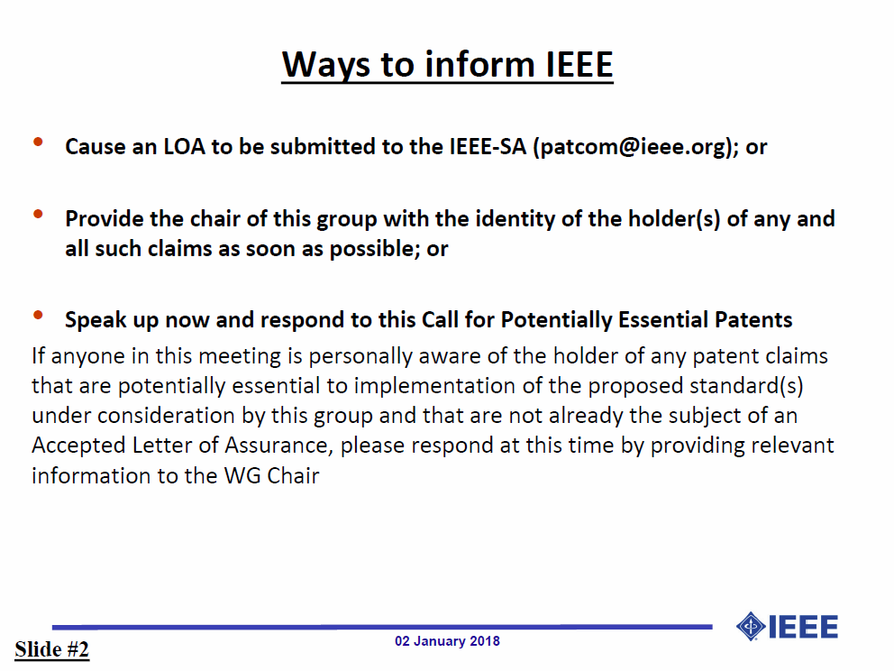

Slide 10
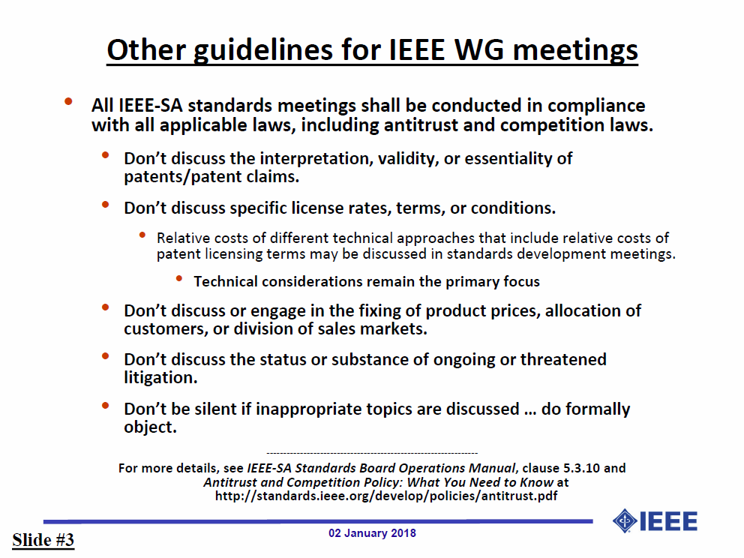

Slide 11
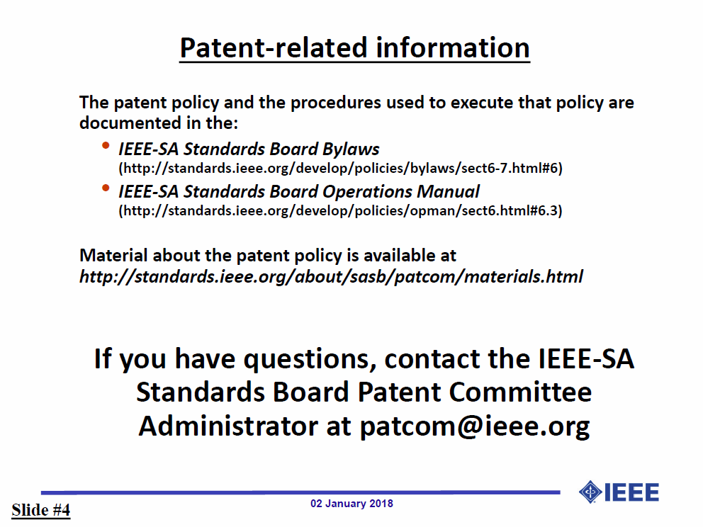

Slide 12
Results of recirculation sponsor ballot
IEEE P802.19.1-2018 D3.0 recirculation Sponsor Ballot
  Response rate: 87%
  Approval rate: 96%
  Abstain rate: 4%
Total 2 comments were received
  General: 0, Editorial: 1, Technical: 1

Slide 13
Comments resolution
19-18/0045r1: 1st recirculation comment resolutions (C. Sun)

Slide 14
Timeline Discussion (1/2)
Proposed timeline #1
  May 16: First BRC teleconference
  May 30: Second BRC teleconference
  Jun. 1: Create D3.0 for the first re-circulation ballot
  Jun. 1: 15 days for the first re-circulation ballot
  Week of Jun 18: Third BRC teleconference
  Jun 22: 15 days for the second re-circulation ballot with clean draft
  July meeting: Approve sending to REVCOM

Slide 15
Timeline Discussion (2/2)
Proposed timeline #2
  May 16: First BRC teleconference
  May 30: Second BRC teleconference
  Jun. 1: Create D3.0 for the first re-circulation ballot
  Jun. 1: 15 days for the first re-circulation ballot
  Week of Jun 18: Third BRC teleconference
  Jun 22: Create D4.0 for the second re-circulation ballot
  Jun 22: 15 days for the second re-circulation ballot
  July meeting: Comments resolution from the second re-circulation ballot and create D5.0
  Jul. 16: 15 days for the third re-circulation ballot
  Week of Aug. 6: Fourth BRC teleconference
  Aug. 13: 15 days for the fourth re-circulation ballot with clean draft
  September meeting: Approve sending to REVCOM

Slide 16
Motion #1
Approve to ask working group chairman to start the second recirculation sponsor ballot for 15 days using the IEEE P802.19.1 revision D3.0 clean version no later than June 24, 2018
  Move: C. Sun
  Second: S. Furuichi
  Approved by unanimous consent

Slide 17
AOB
Any Other Business?

Slide 18
Teleconference
Schedule (1hour)
  Wednesday, June 20, 2018: 2am ET (Wednesday, May 30, 2018 8am CEST, 2pm CST, 3pm JST/KST)
Meeting Logistics
  Use “Join Me”
    Join the meeting: https://join.me/ieeesawg802.19
    On a computer, use any browser. Nothing to download.
    On a phone or tablet, launch the join.me app and enter meeting code:ieeesawg802.19
    Join the audio conference:
    Dial a phone number and enter access code, or connect via internet.
  The chair will send out a notification to IEEE 802.19 reflector in advance of the meeting

Slide 19
Adjourn

Slide 20
Time difference
Winter
  1am EST (6am UTC, 3pm JST/KST)
  7am EST (noon UTC, 9pm JST/KST)
  5pm EST (10pm UTC, 7am JST/KST + 1day)
Summer
  2am EDT (6am UTC, 3pm JST/KST)
  8am EDT (noon UTC, 9pm JST/KST)
  6pm EDT (10pm UTC, 7am JST/KST + 1day)

