Slide 1
Interference Mitigation for Coexisting 802.15.4g and 802.11ah Networks
Date: 2018-05-08
Authors:
Notice: This document has been prepared to assist IEEE 802.19. It is offered as a basis for discussion and is not binding on the contributing individual(s) or organization(s). The material in this document is subject to change in form and content after further study. The contributor(s) reserve(s) the right to add, amend or withdraw material contained herein.

Slide 2
Abstract
Presentation to Sub-1 GHz (S1G) Band Coexistence Interest Group of the IEEE 802.19 Working Group on Interference Mitigation for Coexisting IEEE 802.15.4g and IEEE 802.11ah networks.

Slide 3
Background
Sub-1 GHz (S1G) band coexistence
  Deployed 802.15.4g based smart utility devices operate in the S1G band
  802.11ah, LoRa and SigFox are also designed to operate in the S1G band
  Ensure harmonious coexistence of these heterogeneous devices is crucial, especially normal function of the already deployed devices
Issue
  Spectrum allocation in S1G band is limited
  Channel hopping can be restricted
  Simulation shows that 802.11ah and 802.15.4g can interfere with each other
    802.15-17/0522r2
    802.19-17/0087r3
    802.19-18/0006r1
    802.19-18/0016r1
This presentation addresses interference mitigation by providing coexistence solutions for 802.11ah

Slide 4
Coexistence Mechanisms of 802.15.4g and 802.11ah
802.15.4g coexistence mechanism
  Define three PHY types
    MR-FSK
    MR-OFDM
    MR-O-QPSK
  Define common signaling mode (CSM) for coexistence between devices using different 802.15.4g PHYs
802.11ah S1G coexistence with non-IEEE-802.11 systems
  An S1G STA uses energy detection (ED) based CCA with a threshold of -75 dBm per MHz to improve coexistence with other S1G systems including 802.15.4 and 802.15.4g
  If a S1G STA detects energy above that threshold on its channel, then the following mechanisms might be used to mitigate interference
    Change of operating channel
    Sectorized beamforming
    Change the schedule of restricted access windows (RAW), target wake time (TWT) service periods, or subchannel selective transmission (SST) operating channels
    Defer transmission for a particular interval

Slide 5
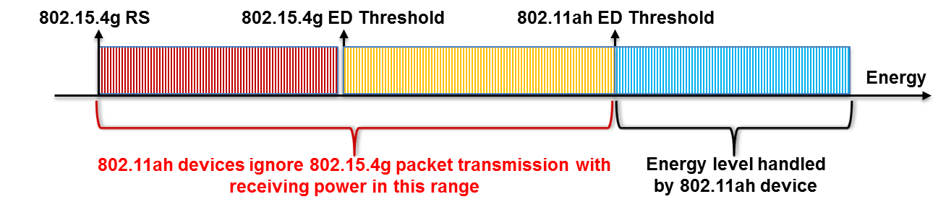
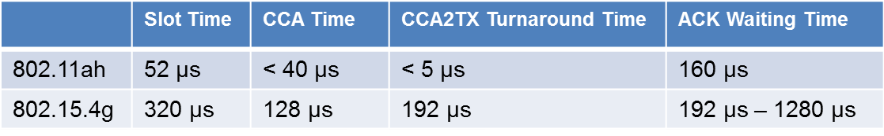
802.15.4g Packet Loss Caused by 802.11ah Interference
Collision caused by the higher ED threshold of 802.11ah
Collision caused by the faster backoff of 802.11ah
  802.11ah device may start packet transmission when 802.15.4g device performs CCA-to-TX turnaround, which causes data packet collision
  802.11ah device may start packet transmission when 802.15.4g device is waiting for ACK packet, which causes ACK packet collision
Access failure caused by 802.11ah packet transmission
For example for 62.5 ksymbols/s

Slide 6
Mitigate Interference by Higher ED Threshold of 802.11ah
If the energy level detected by 802.11ah falls in [802.15.4g Receiver Sensitivity, 802.11ah ED Threshold]
  Should 802.11ah ED-CCA report idle or busy?
    From 802.15.4g perspective, it should report busy if the energy source is 802.15.4g and reports idle otherwise
  Problem is that 802.11ah may not be able to identify the source of the energy, which could be
    802.15.4g system, far away 802.11 system and other systems
Proposed solution: α-Fairness based ED-CCA
  The α-fairness is a technique proposed for network resource sharing
  Apply this technique to wireless medium sharing between 802.11ah and 802.15.4g
    If the detected energy level is outside of [802.15.4g Receiver Sensitivity, 802.11ah ED Threshold], 802.11ah ED-CCA reports channel status as specified by 802.11ah
    Otherwise, apply probabilistic ED-CCA approach, i.e., 802.11ah ED-CCA reports channel status based on a probability generate by the α-fairness technique

Slide 7
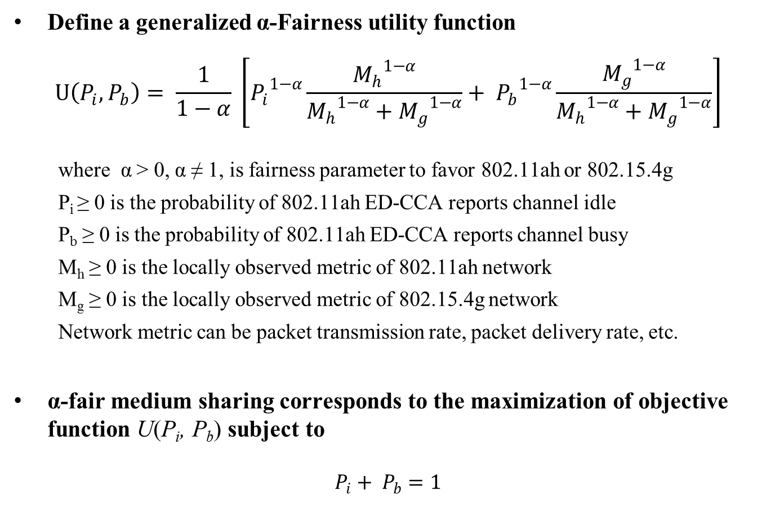
α-Fairness ED-CCA
Define a generalized α-Fairness utility function
$$U\left(P_{i}, P_{b}\right)= \frac{1}{1−α} \left[{P_{i}}^{1−α}\frac{{M_{h}}^{1−α}}{{M_{h}}^{1−α}+{M_{g}}^{1−α}}+ {P_{b}}^{1−α}\frac{{M_{g}}^{1−α}}{{M_{h}}^{1−α}+{M_{g}}^{1−α}}\right]$$
where α > 0, α ≠ 1, is fairness parameter to favor 802.11ah or 802.15.4g
P_{i} ≥ 0 is the probability of 802.11ah ED-CCA reports channel idle
P_{b} ≥ 0 is the probability of 802.11ah ED-CCA reports channel busy
M_{h} ≥ 0 is the locally observed metric of 802.11ah network
M_{g} ≥ 0 is the locally observed metric of 802.15.4g network
Network metric can be packet transmission rate, packet delivery rate, etc.
α-fair medium sharing corresponds to the maximization of objective function U(P_{i}, P_{b}) subject to
$$P_{i}+ P_{b}=1$$

Slide 8
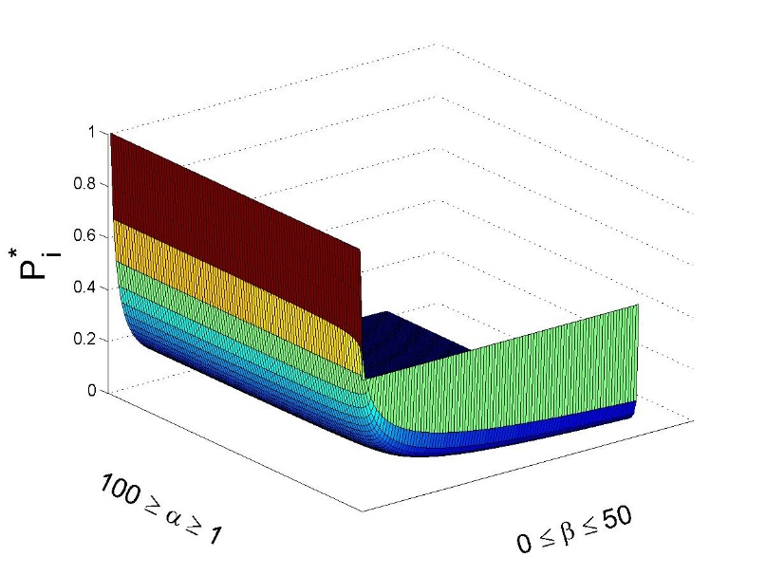
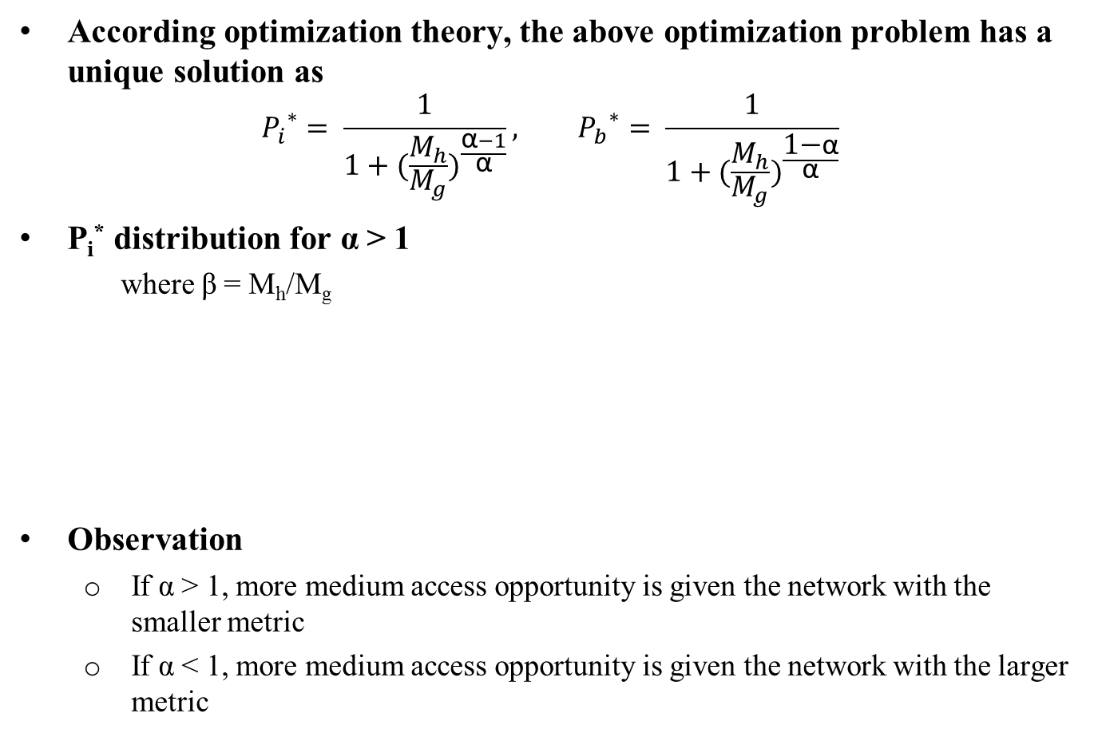
α-Fairness ED-CCA
According optimization theory, the above optimization problem has a unique solution as
$${P_{i}}^{∗}= \frac{1}{1+{(\frac{M_{h}}{M_{g}})}^{\frac{\text{α}−1}{\text{α}}}}, {P_{b}}^{∗}= \frac{1}{1+{(\frac{M_{h}}{M_{g}})}^{\frac{\text{1−}\text{α}}{\text{α}}}}$$
P_{i}* distribution for α > 1
  where β = M_{h}/M_{g}
Observation
  If α > 1, more medium access opportunity is given the network with the smaller metric
  If α < 1, more medium access opportunity is given the network with the larger metric

Slide 9
Mitigate Interference by Faster Backoff of 802.11ah
Issue to be addressed
  When backoff counter (BC) reaches to 0 and 802.11ah ED-CCA reports idle channel, should 802.11ah transmit or not?
Problem
  802.11ah does not know if an 802.15.4g transmission procedure is in progress
  In addition, is the channel really idle?
Proposed solution: Q-Learning based backoff for 802.11ah
  Q-learning is a reinforcement learning technique to learn the optimal action selection to maximize the accumulated reward
Q-Learning based backoff
    If BC > 0 or ED-CCA reports busy channel, the backoff process continues as specified by 802.11ah
    If BC = 0 and ED-CCA reports idle channel, apply Q-Learning to make decision, i.e, transmit or re-backoff

Slide 10
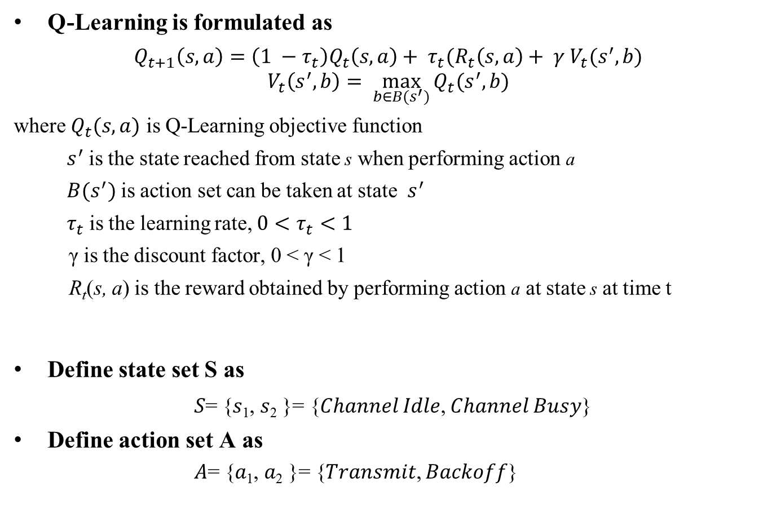
Q-Learning Backoff
Q-Learning is formulated as
$Q_{t+1}\left(s, a\right)=\left(1 −τ_{t}\right)Q_{t}\left(s, a\right)+ τ_{t}(R_{t}\left(s, a\right)+ γ V_{t}(s^{′}, b)$
$$V_{t}\left(s^{′}, b\right)= \max_{b∈B(s^{′})}{Q_{t}(s^{′}, b)}$$
where $Q_{t}(s, a)$ is Q-Learning objective function
$s^{′}$ is the state reached from state s when performing action a
${B(s}^{′})$ is action set can be taken at state $s^{′}$
$τ_{t}$ is the learning rate, ${0<τ}_{t}<1$
γ is the discount factor, 0 < γ < 1
R_{t}(s, a) is the reward obtained by performing action a at state s at time t
Define state set S as
𝑆= {𝑠₁, 𝑠₂ }= {𝐶ℎ𝑎𝑛𝑛𝑒𝑙 𝐼𝑑𝑙𝑒, 𝐶ℎ𝑎𝑛𝑛𝑒𝑙 𝐵𝑢𝑠𝑦}
Define action set A as
      𝐴= {𝑎₁, 𝑎₂ }= {𝑇𝑟𝑎𝑛𝑠𝑚𝑖𝑡, 𝐵𝑎𝑐𝑘𝑜𝑓𝑓}
Detected energy < 802.15.4g RS
802.15.4g RS <= Detected energy < 802.11ah ED Threshold

Slide 11
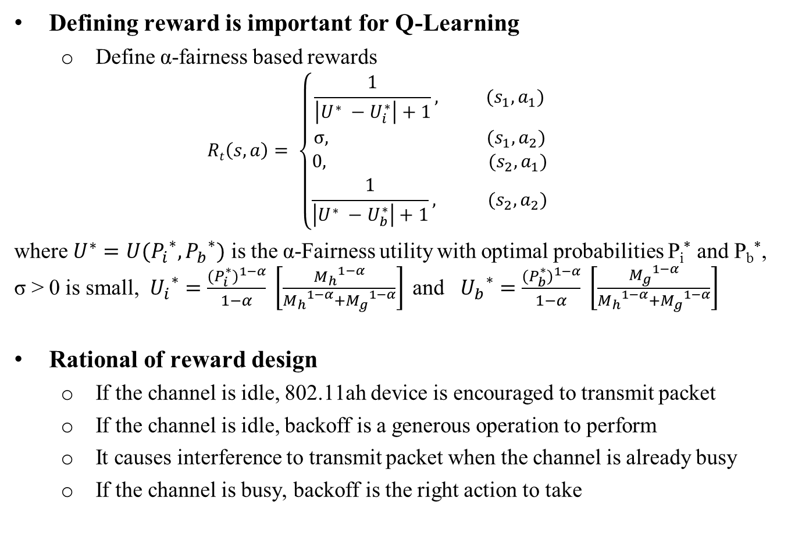
Q-Learning Backoff
Defining reward is important for Q-Learning
  Define α-fairness based rewards
  $$Rt\left(s, a\right)= \left\{\begin{aligned}\frac{1}{\left|U^{∗} −U_{i}^{∗}\right|+1}, (s_{1}, a_{1}) \\ σ, (s_{1}, a_{2}) \\ 0, (s_{2}, a_{1}) \\ \frac{1}{\left|U^{∗} −U_{b}^{∗}\right|+1}, (s_{2}, a_{2})\end{aligned}\right.$$
where $U^{∗}=U({P_{i}}^{∗}, {P_{b}}^{∗})$ is the α-Fairness utility with optimal probabilities P_{i}* and P_{b}*, σ > 0 is small,${U_{i}}^{∗}=\frac{{(P_{i}^{∗})}^{1−α}}{1−α} \left[\frac{{M_{h}}^{1−α}}{{M_{h}}^{1−α}+{M_{g}}^{1−α}}\right]$ and ${U_{b}}^{∗}=\frac{{(P_{b}^{∗})}^{1−α}}{1−α} \left[\frac{{M_{g}}^{1−α}}{{M_{h}}^{1−α}+{M_{g}}^{1−α}}\right]$
Rational of reward design
  If the channel is idle, 802.11ah device is encouraged to transmit packet
  If the channel is idle, backoff is a generous operation to perform
  It causes interference to transmit packet when the channel is already busy
  If the channel is busy, backoff is the right action to take

Slide 12
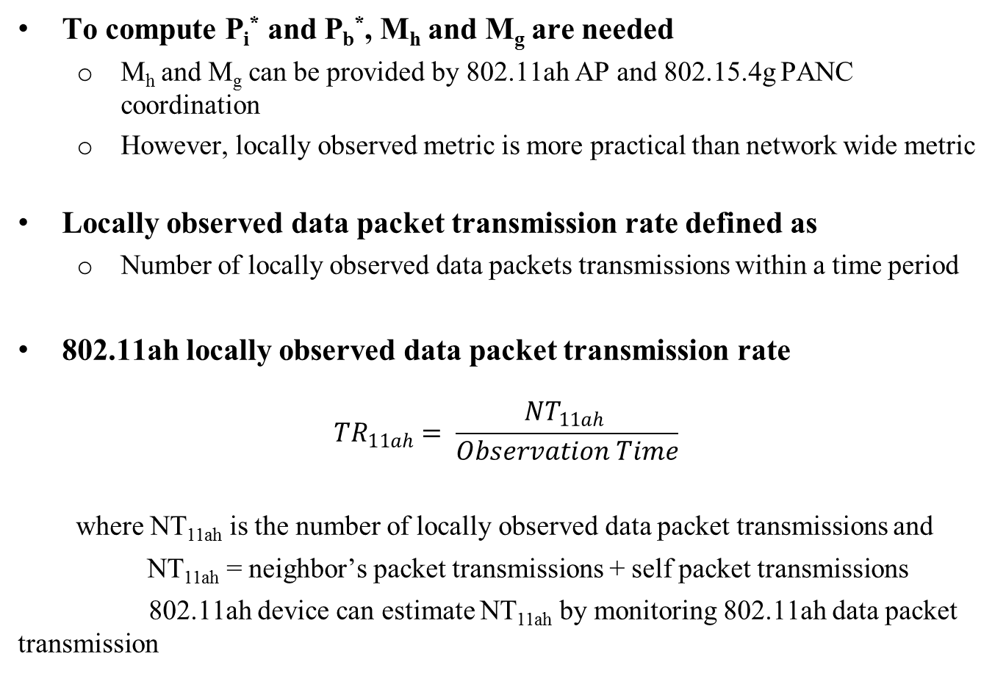
Locally Observed Data Packet Transmission Rate Estimation
To compute P_{i}* and P_{b}*, M_{h} and M_{g} are needed
  M_{h} and M_{g} can be provided by 802.11ah AP and 802.15.4g PANC coordination
  However, locally observed metric is more practical than network wide metric
Locally observed data packet transmission rate defined as
  Number of locally observed data packets transmissions within a time period
802.11ah locally observed data packet transmission rate
$${TR}_{11ah}= \frac{{NT}_{11ah} }{Observation Time}$$
where NT_{11ah} is the number of locally observed data packet transmissions and
NT_{11ah} = neighbor’s packet transmissions + self packet transmissions
802.11ah device can estimate NT_{11ah} by monitoring 802.11ah data packet transmission

Slide 13
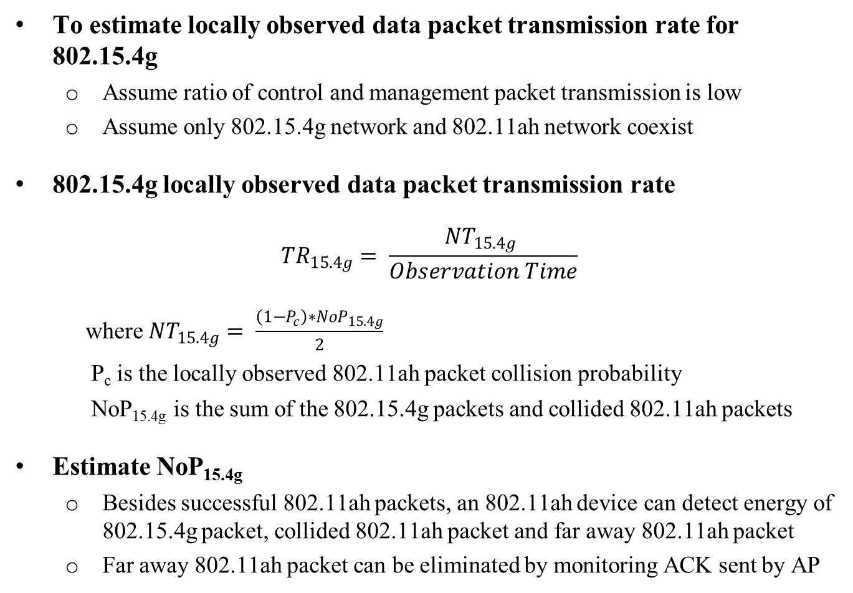
Locally Observed Data Packet Transmission Rate Estimation
To estimate locally observed data packet transmission rate for 802.15.4g
  Assume ratio of control and management packet transmission is low
  Assume only 802.15.4g network and 802.11ah network coexist
802.15.4g locally observed data packet transmission rate
$${TR}_{15.4g}= \frac{{NT}_{15.4g} }{Observation Time}$$
where ${NT}_{15.4g}= \frac{\left(1−P_{c}\right)∗{NoP}_{15.4g}}{2}$
P_{c} is the locally observed 802.11ah packet collision probability
NoP_{15.4g} is the sum of the 802.15.4g packets and collided 802.11ah packets
Estimate NoP_{15.4g}
  Besides successful 802.11ah packets, an 802.11ah device can detect energy of 802.15.4g packet, collided 802.11ah packet and far away 802.11ah packet
  Far away 802.11ah packet can be eliminated by monitoring ACK sent by AP

Slide 14
Simulation Parameters
NS3 simulator
Transmission power
  13 dBm for both 802.15.4g and 802.11ah (Based on ARIB STD-T108)
Energy detection threshold
  -80 dBm for 802.15.4g
  -75 dBm for 802.11ah
Receiver sensitivity
  -88 dBm both 802.15.4g
  -77 dBm for 802.11ah
Packet payload size
  256 bytes
α=10

Slide 15
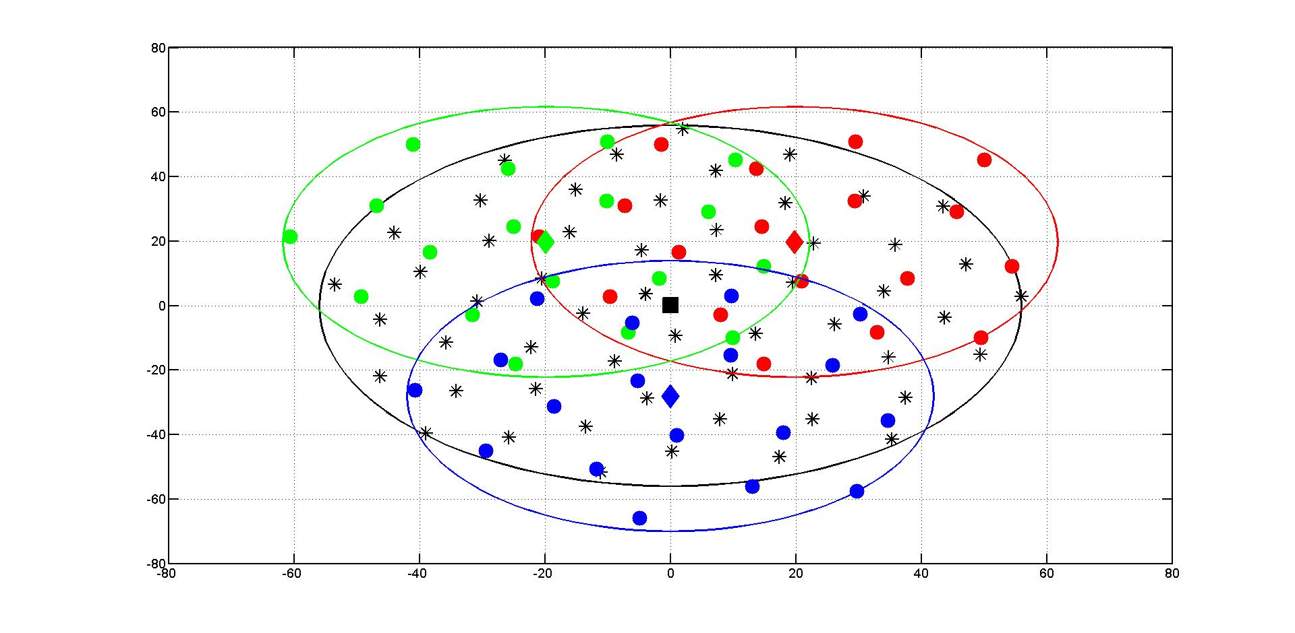
Network Topology 1: Partial Overlapping
802.11ah-2
18 STAs
802.11ah-1
18 STAs
802.15.4g
55 Nodes
18 STAS
802.11ah-3
802.15.4g PANC: black square
802.15.4g nodes: black stars
802.11ah APs: {red, green, blue} diamonds
802.11ah STAs: {red, green, blue} dots

Slide 16
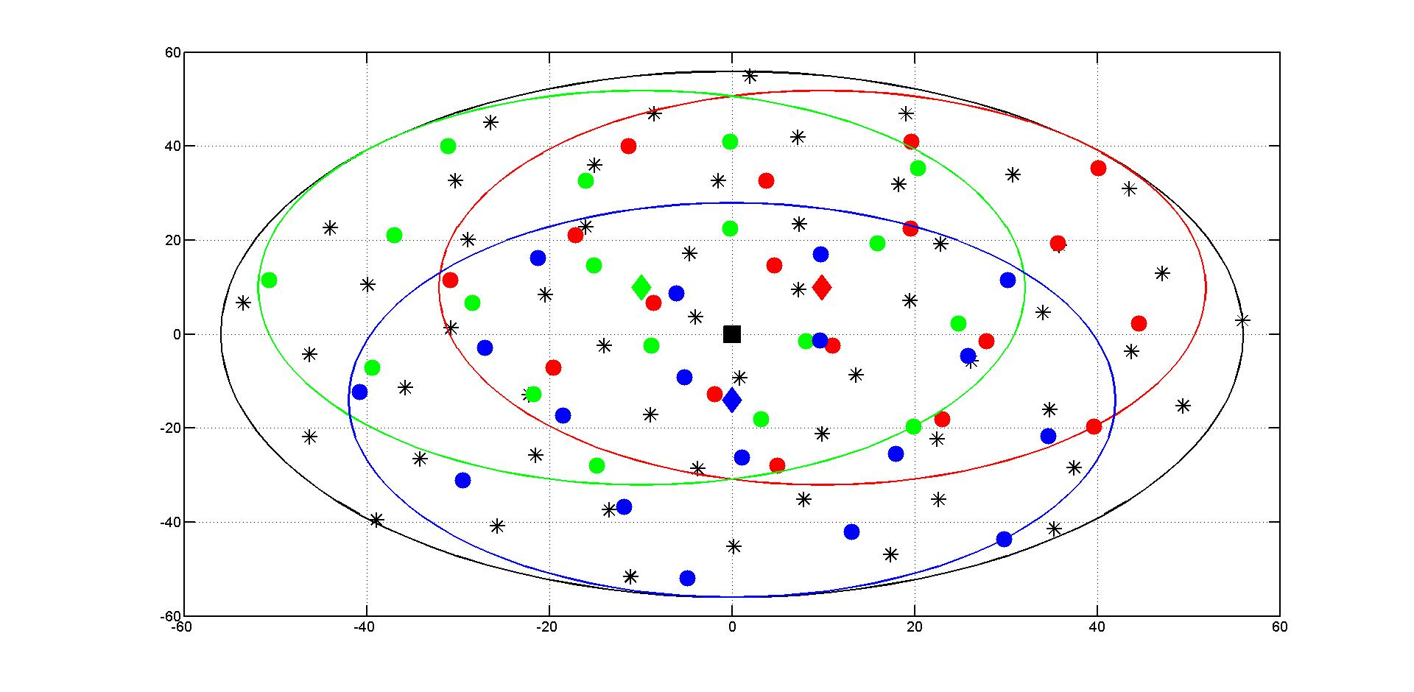
Network Topology 2: Complete Overlapping
802.11ah-2
18 STAs
802.11ah-1
18 STAs
18 STAS
802.11ah-3
802.15.4g
55 Nodes
802.15.4g PANC: black square
802.15.4g nodes: black stars
802.11ah APs: {red, green, blue} diamonds
802.11ah STAs: {red, green, blue} dots

Slide 17

Propagation Model
ITU-R P.1411-8 model for propagation between terminals from below roof-top height to near street level
  L_{urban} = 0 for suburban
TX power: 13dBm
11ah Receiver Sensitivity: -77dBm
920 MHz band
15.4g Receiver Sensitivity: -88dBm
802.11ah: 42m
11ah ED Threshold: -75dBm
15.4g ED Threshold: -80dBm
802.15.4g: 56m

Slide 18
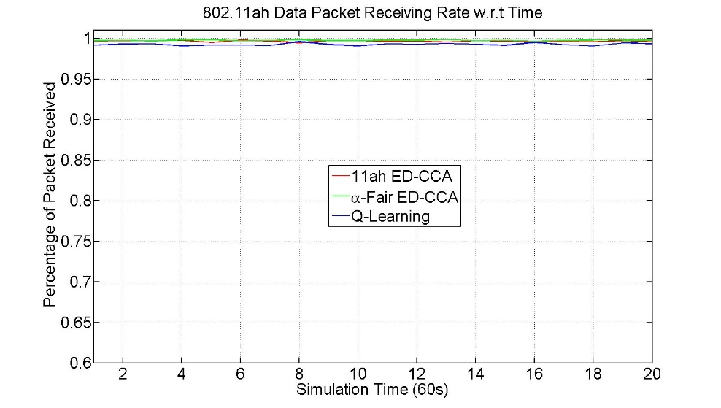
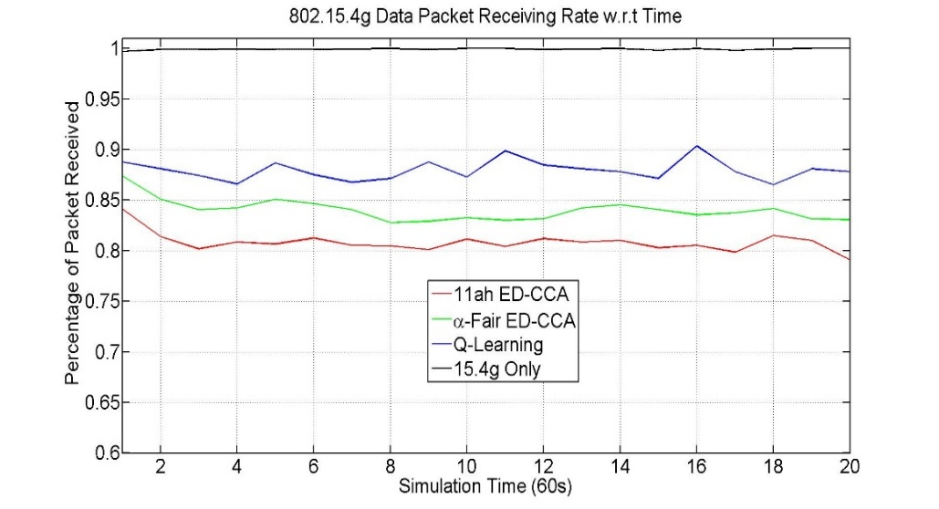
Simulation Result 1 for Topology 1
Parameters
  802.11ah PHY rate = 3mbps
  802.15.4g PHY rate 100kbps
  802.11ah packet generation rate = 3pkt/s
  802.15.4g packet generation rate = 0.5pkt/s
Observations
  Near 100% of packet delivery rate for 802.11ah network
  Near 100% of packet delivery rate for 802.15.4g network without 802.11ah
  Α-fair ED-CCA improves 802.15.4g packet delivery rate by about 4%
  Q-Learning backoff improves 802.15.4g packet delivery rate by about 7%

Slide 19
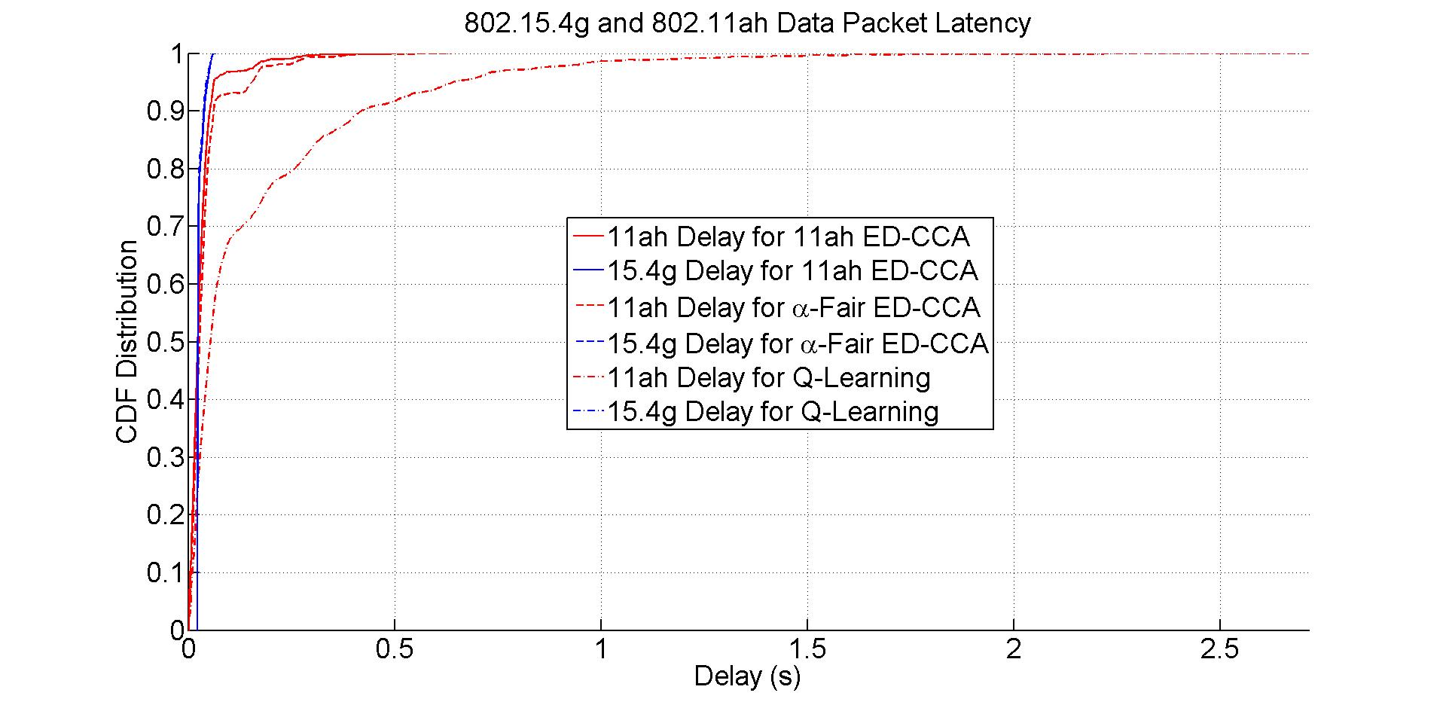
Simulation Result 2 for Topology 1
Parameters
  802.11ah PHY rate = 3mbps
  802.15.4g PHY rate 100kbps
  802.11ah packet generation rate = 3pkt/s
  802.15.4g packet generation rate = 0.5pkt/s
Observations
  802.15.4g packet delay is almost same for three methods
  Α-fair ED-CCA delays 802.11ah packet, but not much
  Q-Learning backoff delay 802.11ah packet more

Slide 20
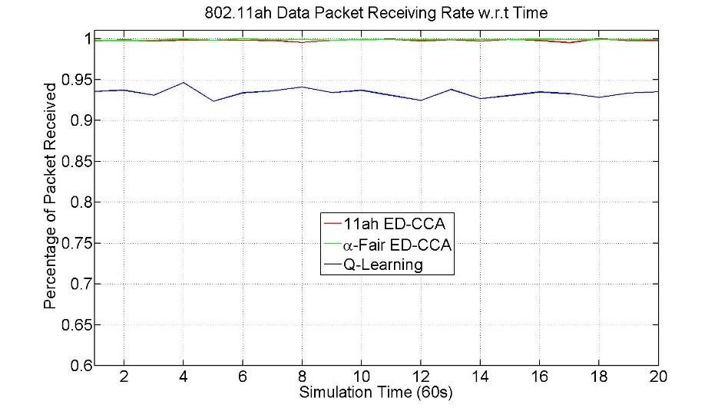
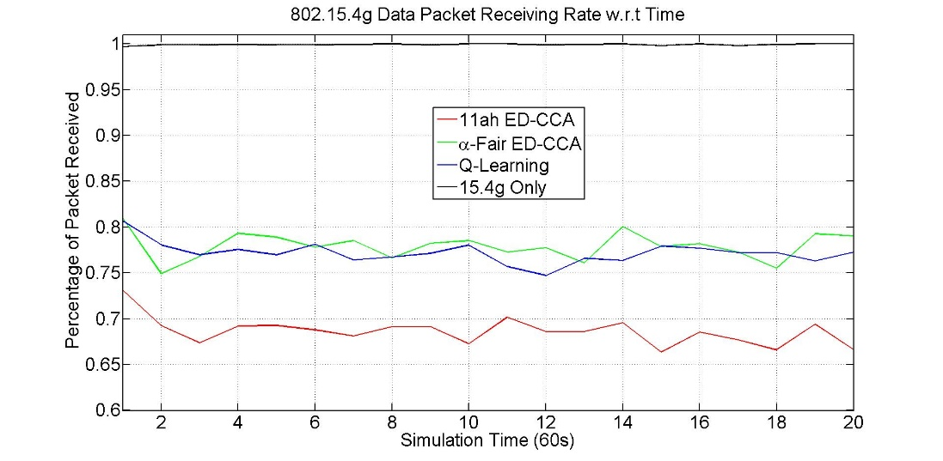
Simulation Result 1 for Topology 2
Parameters
  802.11ah PHY rate = 3mbps
  802.15.4g PHY rate 100kbps
  802.11ah packet generation rate = 3pkt/s
  802.15.4g packet generation rate = 0.5pkt/s
Observations
  Q-Learning backoff decreases 802.11ah packet delivery rate by about 6.5%
  Near 100% of packet delivery rate for 802.15.4g network without 802.11ah
  Α-fair ED-CCA improves 802.1.5.4g packet delivery rate by about 8%
  Q-Learning backoff improves 802.1.5.4g packet delivery rate by about 7%

Slide 21
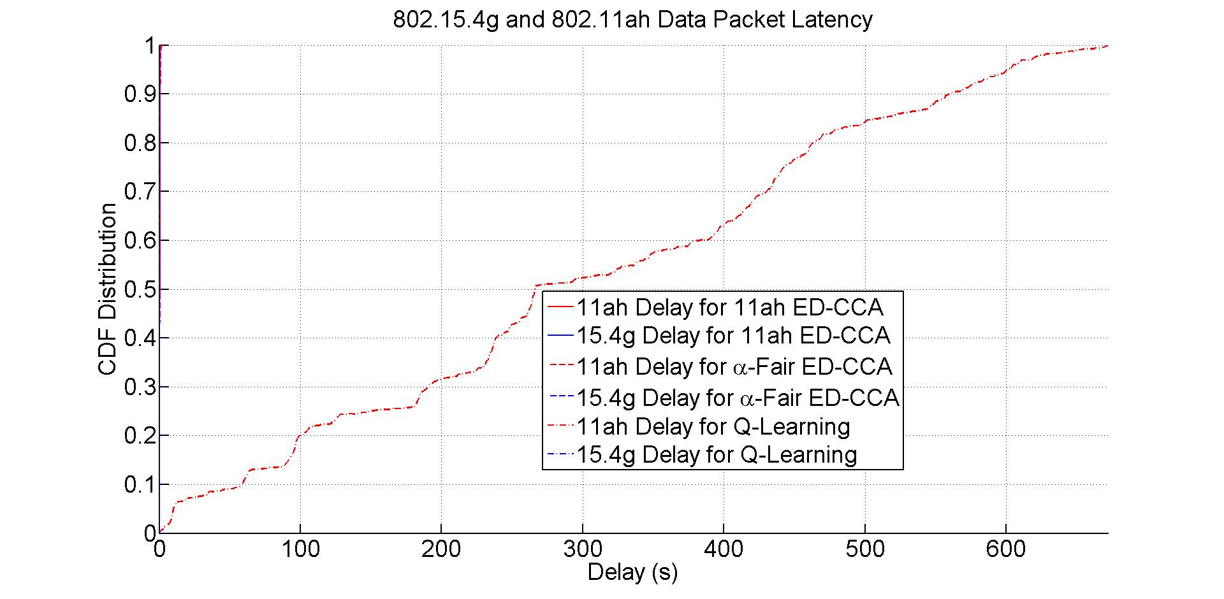
Simulation Result 2 for Topology 2
Parameters
  802.11ah PHY rate = 3mbps
  802.15.4g PHY rate 100kbps
  802.11ah packet generation rate = 3pkt/s
  802.15.4g packet generation rate = 0.5pkt/s
Observations
  802.15.4g packet delay is almost same for three methods
  Α-fair ED-CCA delays 802.11ah packet, but not much
  Q-Learning backoff delays 802.11ah packet significantly

Slide 22
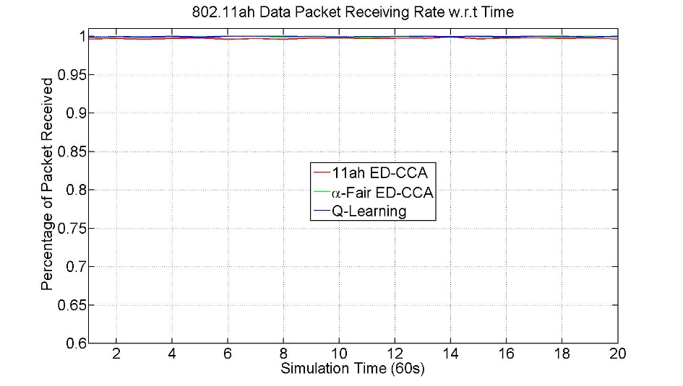
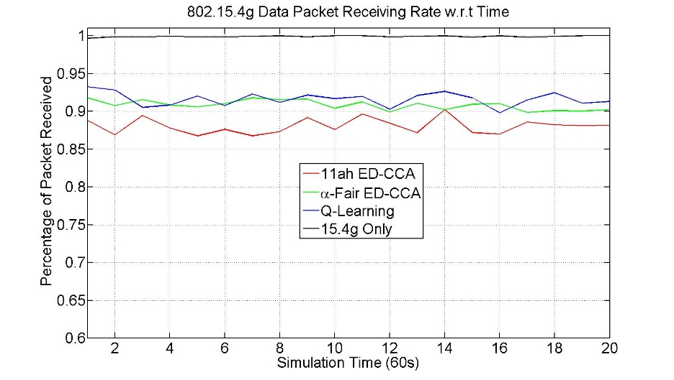
Simulation Result 3 for Topology 1
Parameters
  802.11ah PHY rate = 1.2mbps
  802.15.4g PHY rate 100kbps
  802.11ah packet generation rate = 1.5pkt/s
  802.15.4g packet generation rate = 0.5pkt/s
Observations
  Near 100% of packet delivery rate for 802.11ah network
  Near 100% of packet delivery rate for 802.15.4g network without 802.11ah
  Α-fair ED-CCA improves 802.1.5.4g packet delivery rate by about 3%
  Q-Learning backoff improves 802.1.5.4g packet delivery rate by about 4%

Slide 23
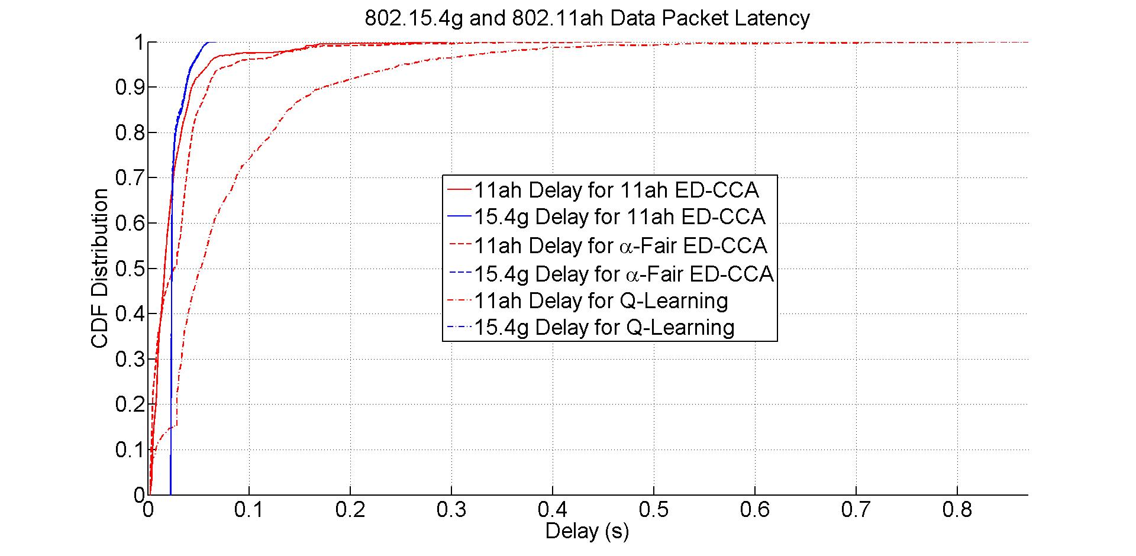
Simulation Result 4 for Topology 1
Parameters
  802.11ah PHY rate = 1.2mbps
  802.15.4g PHY rate 100kbps
  802.11ah packet generation rate = 1.5pkt/s
  802.15.4g packet generation rate = 0.5pkt/s
Observations
  802.15.4g packet delay is almost same for three methods
  Α-fair ED-CCA delays 802.11ah packet, but not much
  Q-Learning backoff delay 802.11ah packet more

Slide 24
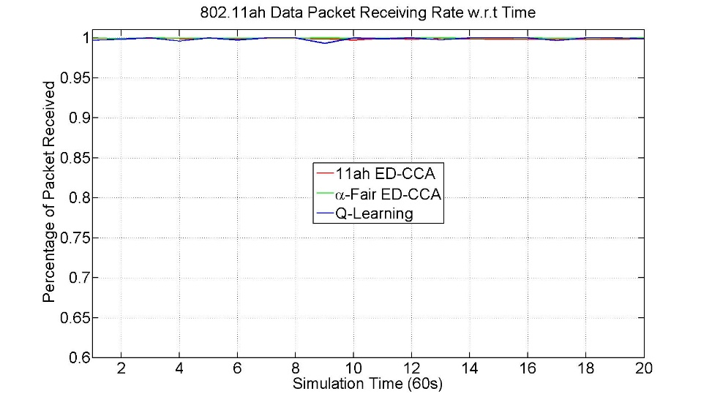
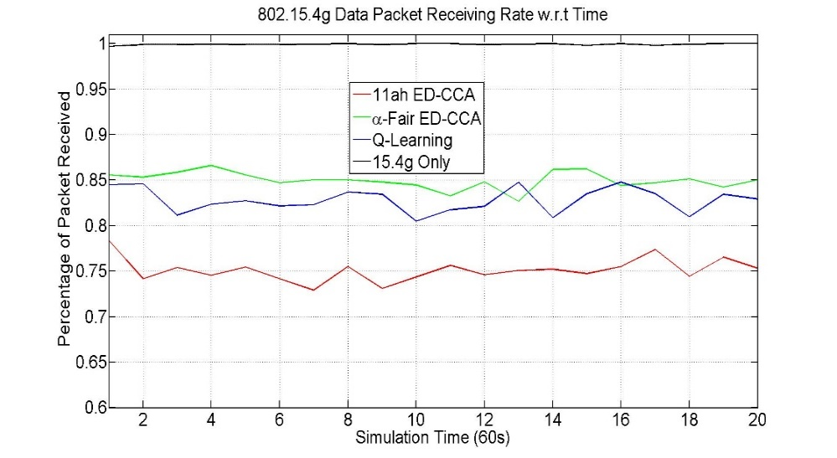
Simulation Result 3 for Topology 2
Parameters
  802.11ah PHY rate = 1.2mbps
  802.15.4g PHY rate 100kbps
  802.11ah packet generation rate = 1.5pkt/s
  802.15.4g packet generation rate = 0.5pkt/s
Observations
  Near 100% of packet delivery rate for 802.11ah
  Near 100% of packet delivery rate for 802.15.4g network without 802.11ah
  Α-fair ED-CCA improves 802.1.5.4g packet delivery rate by about 10%
  Q-Learning backoff improves 802.1.5.4g packet delivery rate by about 7%

Slide 25
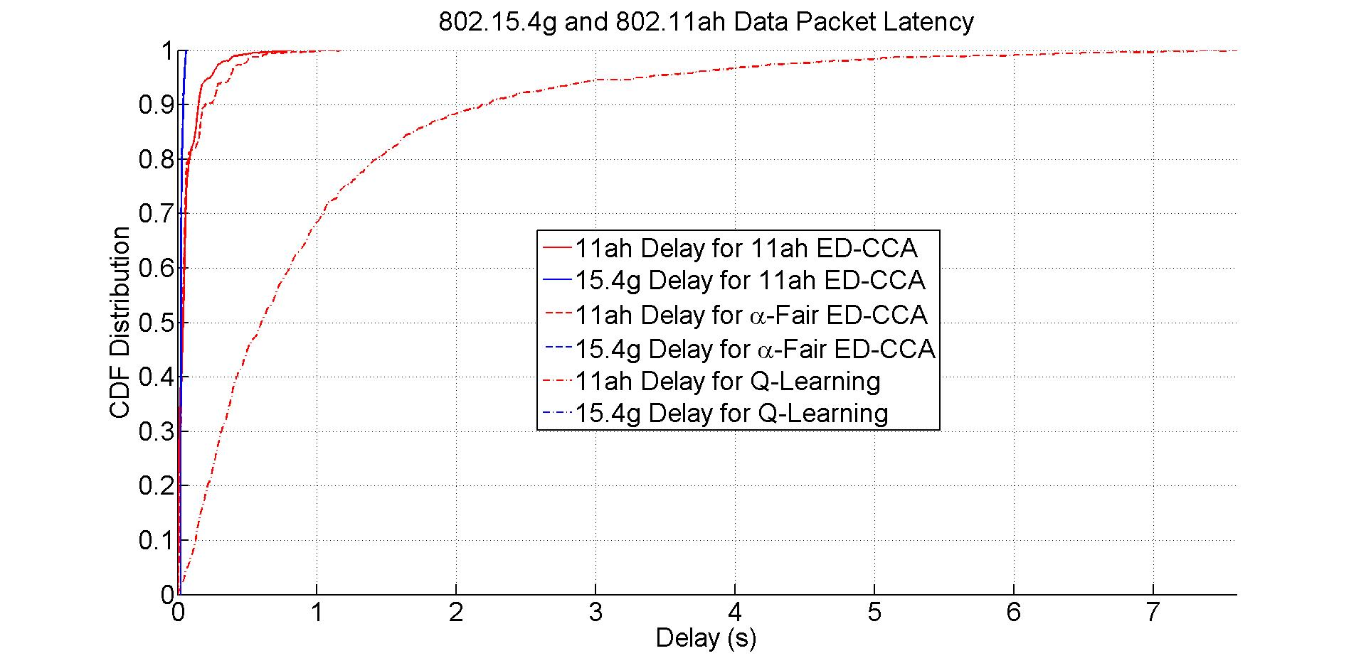
Simulation Result 4 for Topology 2
Parameters
  802.11ah PHY rate = 1.2mbps
  802.15.4g PHY rate 100kbps
  802.11ah packet generation rate = 1.5pkt/s
  802.15.4g packet generation rate = 0.5pkt/s
Observations
  802.15.4g packet delay is almost same for three methods
  Α-fair ED-CCA delays 802.11ah packet, but not much
  Q-Learning backoff delays 802.11ah packet more

Slide 26
Summary
802.11ah can interfere with 802.15.4g
Data packet delivery rate
  α-Fairness ED-CCA and Q-Learning backoff can improve 802.15.4g data packet delivery rate
  α-Fairness ED-CCA performs better when 802.11ah density is higher
  Q-Learning backoff perform better when 802.11ah density is lower
  α-Fairness ED-CCA does not affect 802.11ah network
  Q-Learning backoff affects 802.11ah network when 802.11ah density is higher
Data packet delay
  α-Fairness ED-CCA and Q-Learning backoff hardly delay 802.15.4g data packet
  α-Fairness ED-CCA causes small delay on 802.11ah packet
  Q-Learning backoff may significantly delay 802.11ah packet
Moving forward, develop coexistence technology for 802.15.4g

