Slide 1
Update on Coexistence Simulations, 802.15.4g and 802.11ah
Date: 2018-03-05
Authors:
Notice: This document has been prepared to assist IEEE 802.19. It is offered as a basis for discussion and is not binding on the contributing individual(s) or organization(s). The material in this document is subject to change in form and content after further study. The contributor(s) reserve(s) the right to add, amend or withdraw material contained herein.

Slide 2
Abstract
Presentation to IEEE 802.19 Working Group on simulation update of the coexisting IEEE 802.15.4g and IEEE 802.11ah networks in the Sub-1 GHz (S1G) Band

Slide 3
Motivation
802.15.4g based smart utility devices have been deployed
  Operate in the S1G band
802.11ah, LoRa and SigFox are also designed to operate in the S1G band
  Even LoRa and SigFox are narrowband technologies, 802.11ah channel is at least 1 MHz wide
Spectrum allocation in S1G band can be narrow
  Japan allocates 5.6 MHz spectrum for smart meter system as specified in ARIB STD-T108, Version 1.0 (Feb 14 2012).
Channel hopping can be limited
  Multiple systems may be deployed with high node density
Therefore, 802.15.4g coexistence with other systems needs to be investigated and addressed

Slide 4
Coexistence Mechanisms of 802.15.4g and 802.11ah
802.15.4g coexistence mechanism
  Define three PHY types
    MR-FSK
    MR-OFDM
    MR-O-QPSK
  Define common signaling mode (CSM) for coexistence between devices using different 802.15.4g PHYs
802.11ah S1G coexistence with non-IEEE-802.11 systems
  An S1G STA uses energy detection (ED) based CCA with a threshold of -75 dBm per MHz to improve coexistence with other S1G systems including 802.15.4 and 802.15.4g
  If a S1G STA detects energy above that threshold on its channel, then the following mechanisms might be used to mitigate interference
    Change of operating channel
    Sectorized beamforming
    Change the schedule of restricted access windows (RAW), target wake time (TWT) service periods, or subchannel selective transmission (SST) operating channels
    Defer transmission for a particular interval

Slide 5
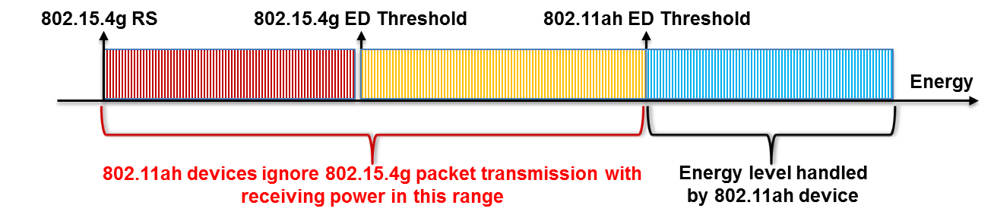
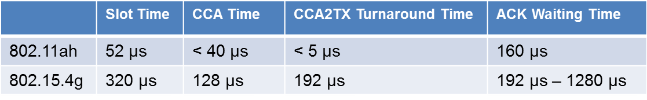
802.15.4g Packet Loss Caused By 802.11ah Interference
Collision caused by the higher ED threshold of 802.11ah
Collision caused by the faster backoff mechanism of 802.11ah
  802.11ah device may start packet transmission when 802.15.4g device performs CCA-to-TX turnaround, which causes data packet collision
  802.11ah device may start packet transmission when 802.15.4g device is waiting for ACK packet, which causes ACK packet collision
Access failure caused by 802.11ah packet transmission
62.5 ksymbols/s

Slide 6
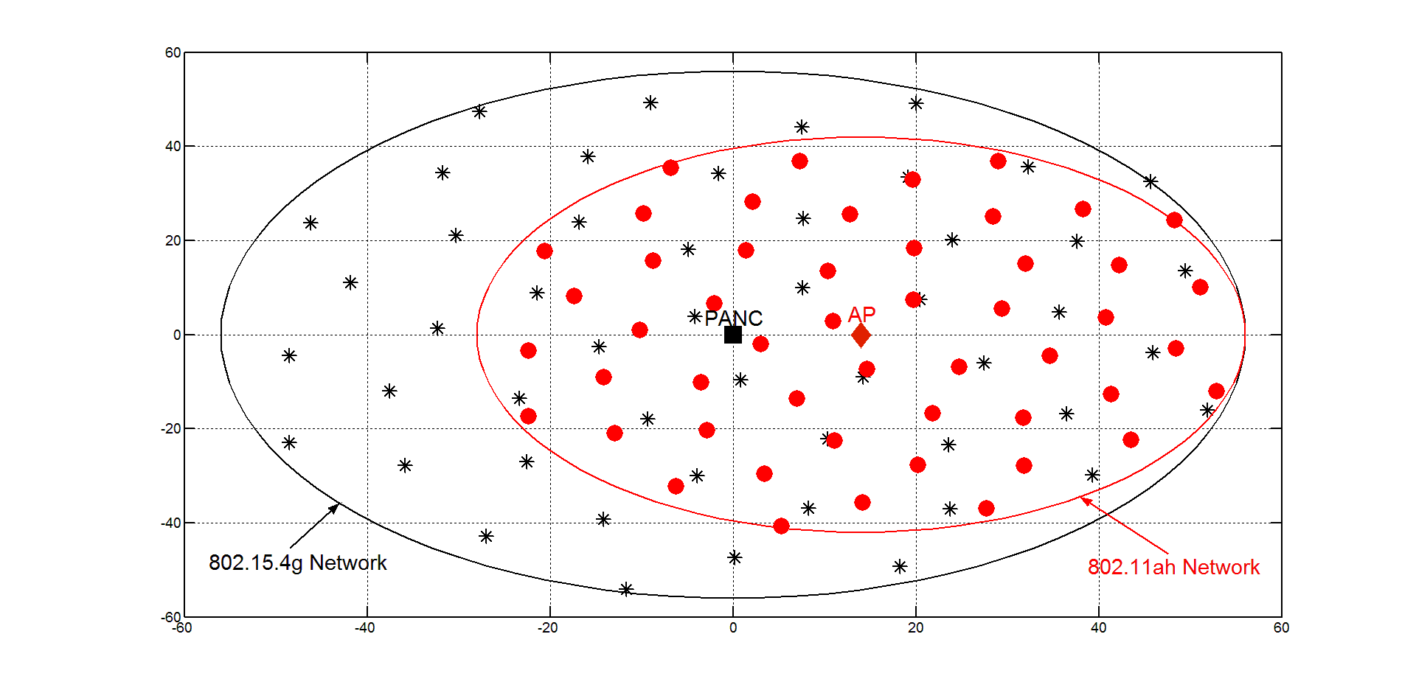
Simulation Network Configuration
Network topology
  Star network for 802.15.4g with uniform node placement
  Infrastructure network for 802.11ah with uniform node placement
Number of nodes per network
  Case 1
    10 nodes for 802.15.4g and 802.11ah
  Case 2
    20 nodes for 802.15.4g and 802.11ah
  Case 3
    50 nodes for 802.15.4g and 802.11ah
  Case 4
    80 nodes for 802.15.4g and 802.11ah
  Case 5
    100 nodes for 802.15.4g and 802.11ah

Slide 7
Simulation Parameters
  Use simulation parameter same as in documents 802.19-17/0087r3 and 802.19-18/0006r1
  Transmission power
    13 dBm for both 802.15.4g and 802.11ah (Based on ARIB STD-T108)
  PHY data rate
    100 kbps for 802.15.4g
    3000 kbps for 802.11ah
  Energy detection threshold
    -80 dBm for 802.15.4g
    -75 dBm for 802.11ah
  Receiver sensitivity
    -88 dBm both 802.15.4g
    -77 dBm for 802.11ah

Slide 8

Propagation Model
ITU-R P.1411-8 model for propagation between terminals from below roof-top height to near street level
  L_{urban} = 0 for suburban
TX power: 13dBm
11ah Receiver Sensitivity: -77dBm
920 MHz band
15.4g Receiver Sensitivity: -88dBm
802.11ah: 42m
11ah ED Threshold: -75dBm
15.4g ED Threshold: -80dBm
802.15.4g: 56m

Slide 9
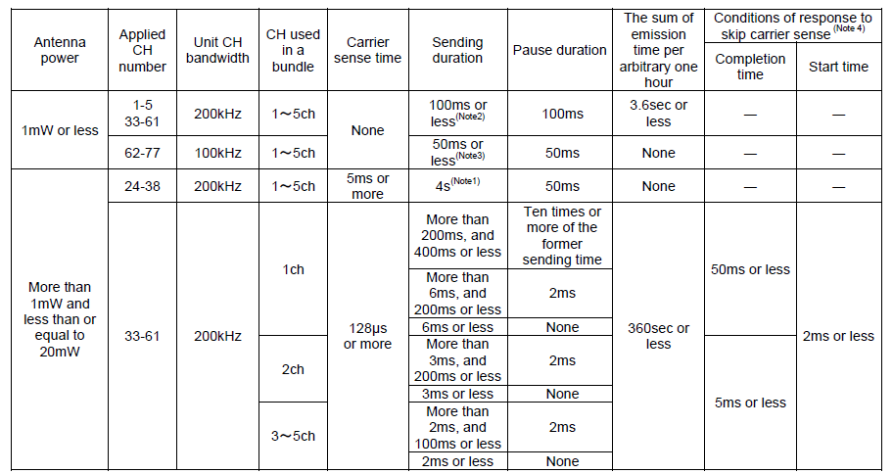
Low Power Radio Stations in Japan (ARIB STD-T108)
Two transmission power categories
  1mW (0 dBm) or less (for 916.6-916.8MHz and 928.15-929.65MHz)
  Greater than 1mW but less than or equal to 20mW (13 dBm) otherwise
Sending control
Transmission time control for 13 dBm transmission power
  360 seconds or less per arbitrary one hour, i.e., 10% duty cycle
  Response time is not included in the sum of TX time per arbitrary one hour

Slide 10
Traffic Rate (Workload)
Upper bound = 10% duty cycle (based on ARIB STD-T108 )
  10 kbps for 802.15.4g node with PHY layer data rate = 100 kbps
  300 kbps for 802.11ah station with PHY layer data rate = 3000 kbps
Workload based simulation scenario - Equal traffic rate (for the case if two networks used for same application)
  1 kbps
    1% duty cycle for 802.15.4g
    0.033% duty cycle for 802.11ah
Network capability based simulation scenario - Equal duty cycle (for the case if two networks used for different applications)
  0.1% duty cycle
    0.1 kbps for 802.15.4g
    3 kbps for 802.11ah
  1% duty cycle
    1 kbps for 802.15.4g
    30 kbps for 802.11ah

Slide 11
Packet Payload Size
802.15.4g
  100 bytes
  200 bytes
802.11ah
  100 bytes
  200 bytes
  500 bytes
  1000 bytes

Slide 12
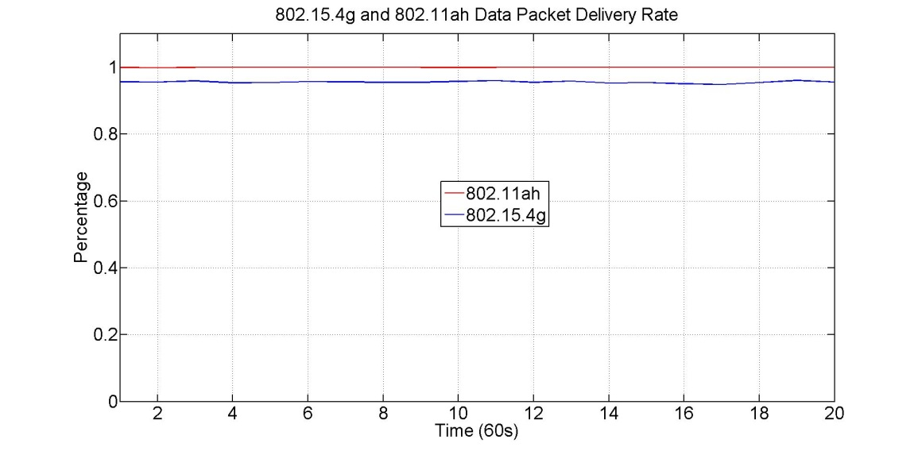
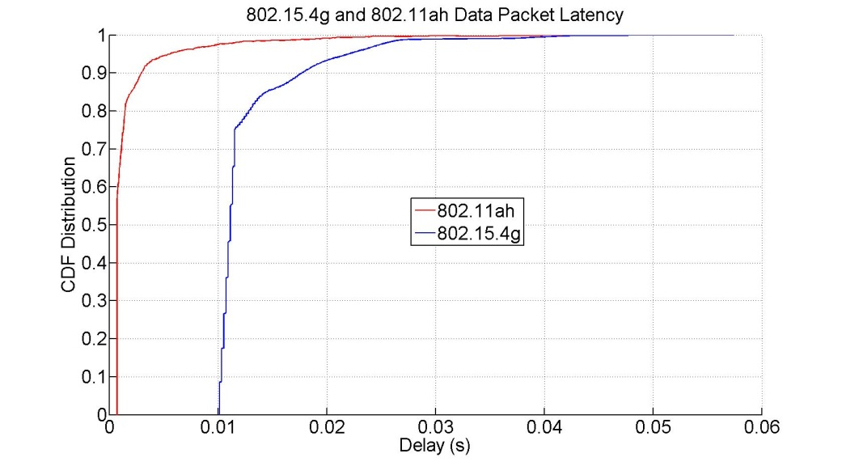
Simulation Results
Simulation 1 (equal traffic rate = 1 kbps)
  50 nodes for 802.15.4g and 802.11ah
  1 kbps traffic rate for 802.15.4g and 802.11ah
  100 bytes payload for 802.15.4g and 802.11ah
Observations
  100% of packet delivery rate for 802.11ah network
  About 95% of packet delivery rate for 802.15.4g network
  802.11ah packet latency is in between 0.72ms and 45.7ms
  802.15.4g packet latency is in between 10.1ms and 57.5ms
Good Performance

Slide 13
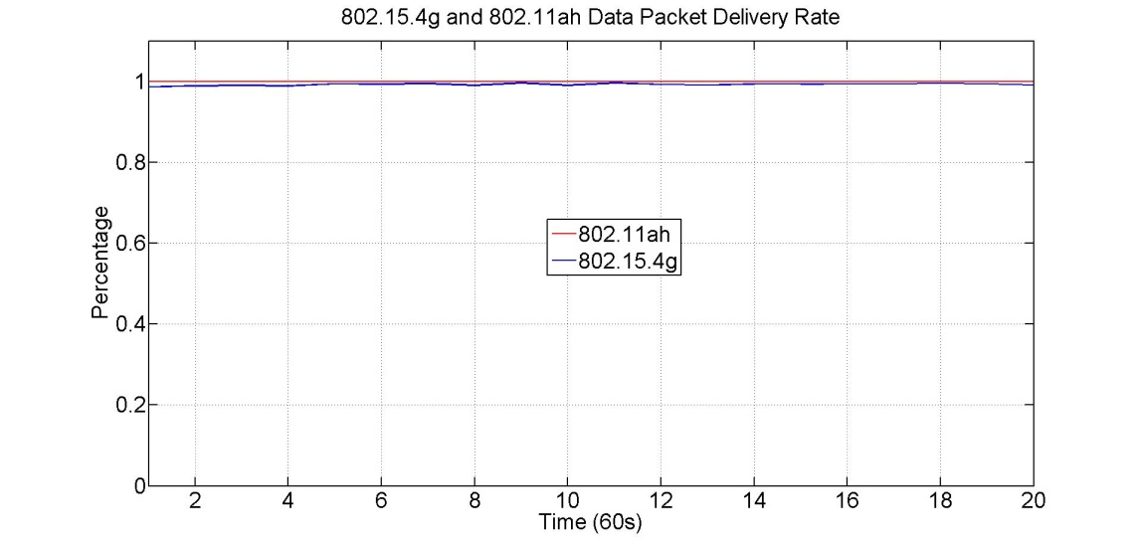
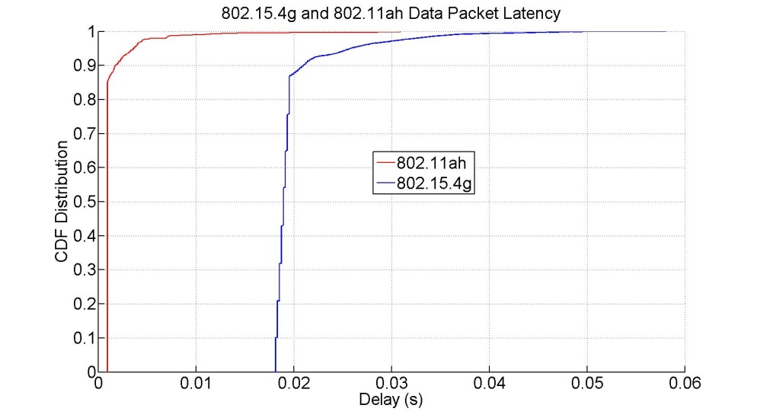
Simulation Results
Simulation 2 (equal traffic rate = 1 kbps)
  50 nodes for 802.15.4g and 802.11ah
  1 kbps traffic rate for 802.15.4g and 802.11ah
  200 bytes payload for 802.15.4g and 802.11ah
Observations
  100% of packet delivery rate for 802.11ah network
  About 99% of packet delivery rate for 802.15.4g network
  802.11ah packet latency is in between 0.96ms and 30.9ms
  802.15.4g packet latency is in between 18.1ms and 58.1ms
Good Performance

Slide 14
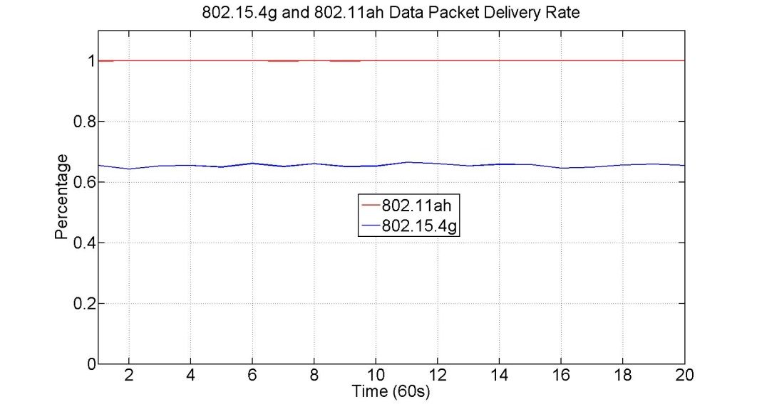
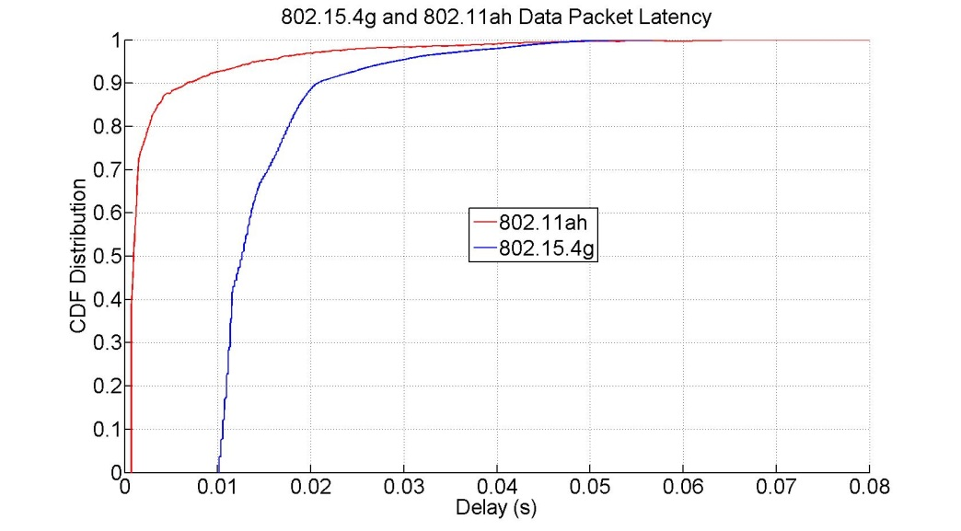
Simulation Results
Simulation 3 (equal traffic rate = 1 kbps)
  80 nodes for 802.15.4g and 802.11ah
  1 kbps traffic rate for 802.15.4g and 802.11ah
  100 bytes payload for 802.15.4g and 802.11ah
Observations
  100% of packet delivery rate for 802.11ah network
  About 65% of packet delivery rate for 802.15.4g network
  802.11ah packet latency is in between 0.72ms and 80.9ms
  802.15.4g packet latency is in between 10.1ms and 56.7ms
Low 802.15.4g packet delivery rate

Slide 15
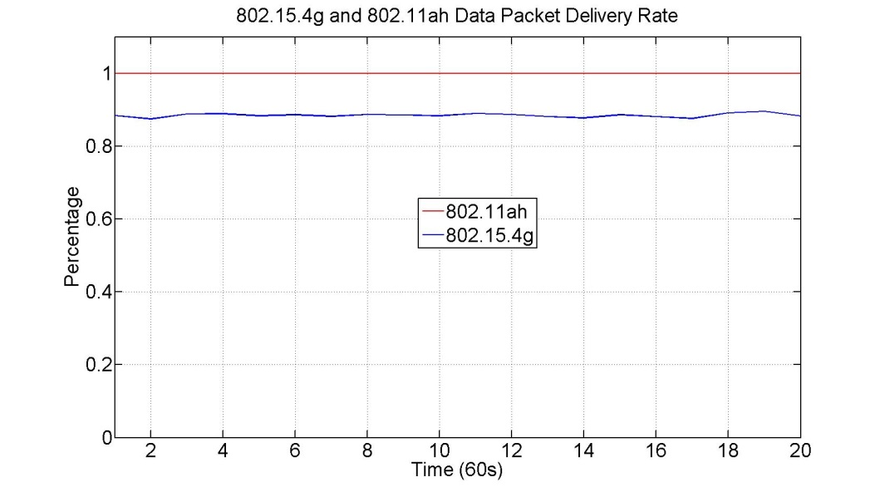
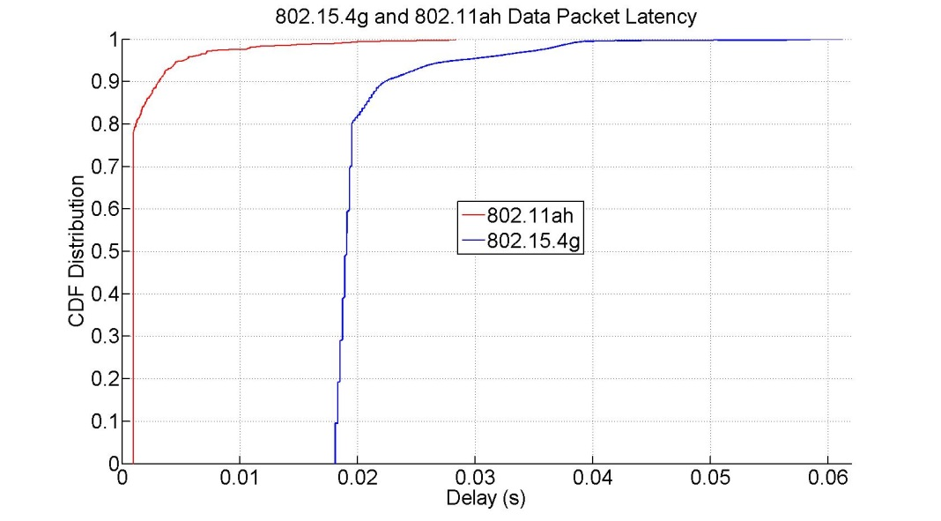
Simulation Results
Simulation 4 (equal traffic rate = 1 kbps)
  80 nodes for 802.15.4g and 802.11ah
  1 kbps traffic rate for 802.15.4g and 802.11ah
  200 bytes payload for 802.15.4g and 802.11ah
Observations
  100% of packet delivery rate for 802.11ah network
  About 88% of packet delivery rate for 802.15.4g network
  802.11ah packet latency is in between 0.96ms and 28.3ms
  802.15.4g packet latency is in between 18.1ms and 61.3ms
Low 802.15.4g packet delivery rate

Slide 16
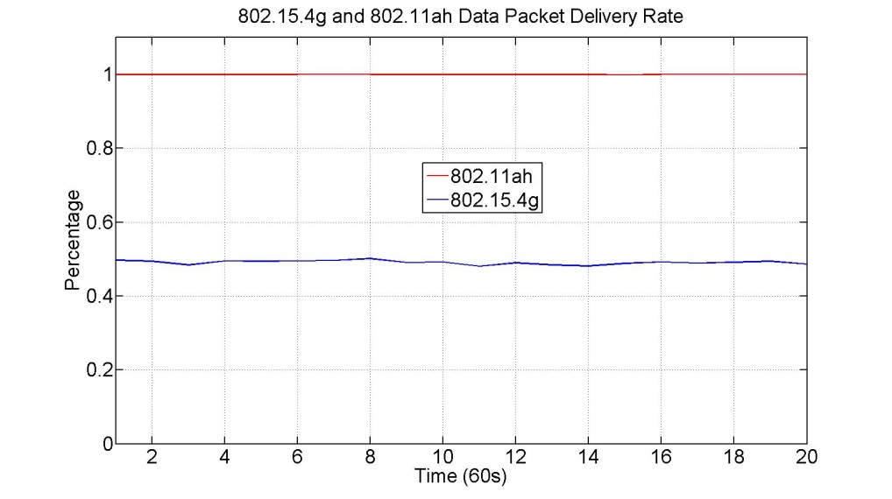
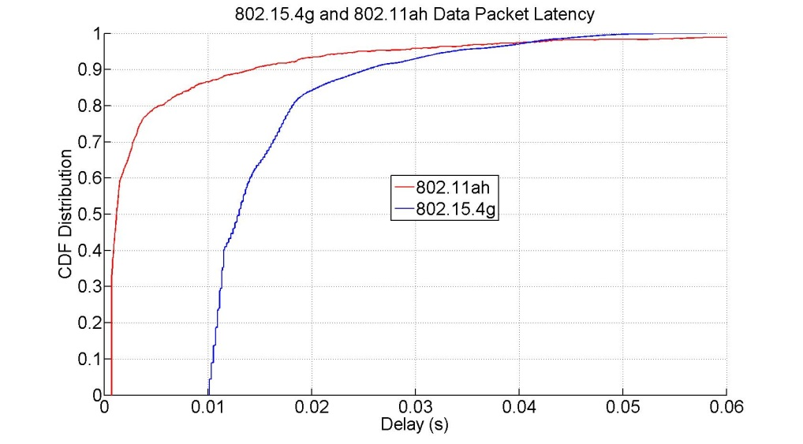
Simulation Results
Simulation 5 (equal traffic rate = 1 kbps)
  100 nodes for 802.15.4g and 802.11ah
  1 kbps traffic rate for 802.15.4g and 802.11ah
  100 bytes payload for 802.15.4g and 802.11ah
Observations
  100% of packet delivery rate for 802.11ah network
  About 50% of packet delivery rate for 802.15.4g network
  802.11ah packet latency is in between 0.72ms and 146.3ms
  802.15.4g packet latency is in between 10.1ms and 58.1ms
Low 802.15.4g packet delivery rate

Slide 17
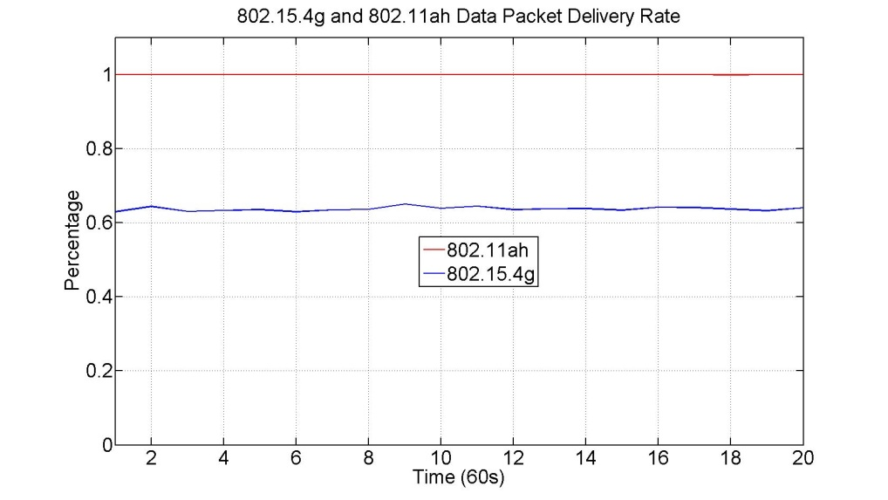
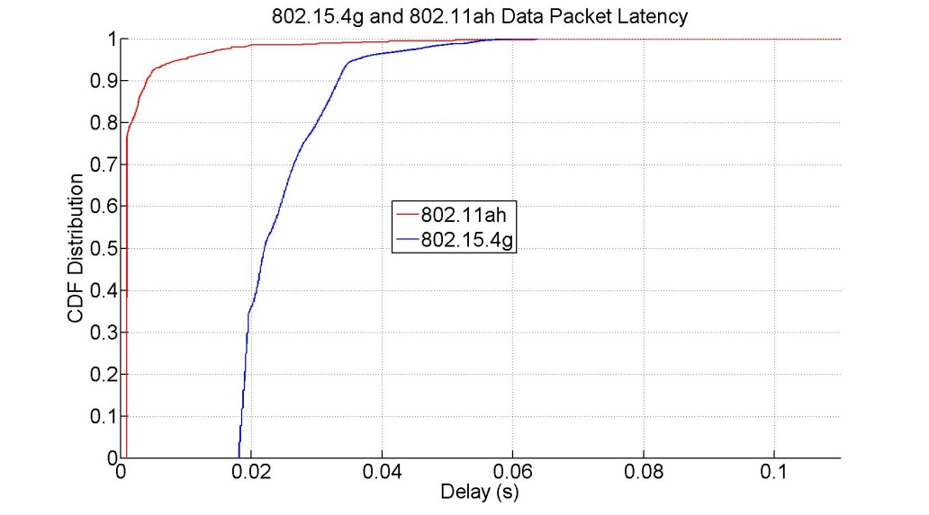
Simulation Results
Simulation 6 (equal traffic rate = 1 kbps)
  100 nodes for 802.15.4g and 802.11ah
  1 kbps traffic rate for 802.15.4g and 802.11ah
  200 bytes payload for 802.15.4g and 802.11ah
Observations
  100% of packet delivery rate for 802.11ah network
  About 64% of packet delivery rate for 802.15.4g network
  802.11ah packet latency is in between 0.96ms and 110.1ms
  802.15.4g packet latency is in between 18.1ms and 63.9ms
Low 802.15.4g packet delivery rate

Slide 18
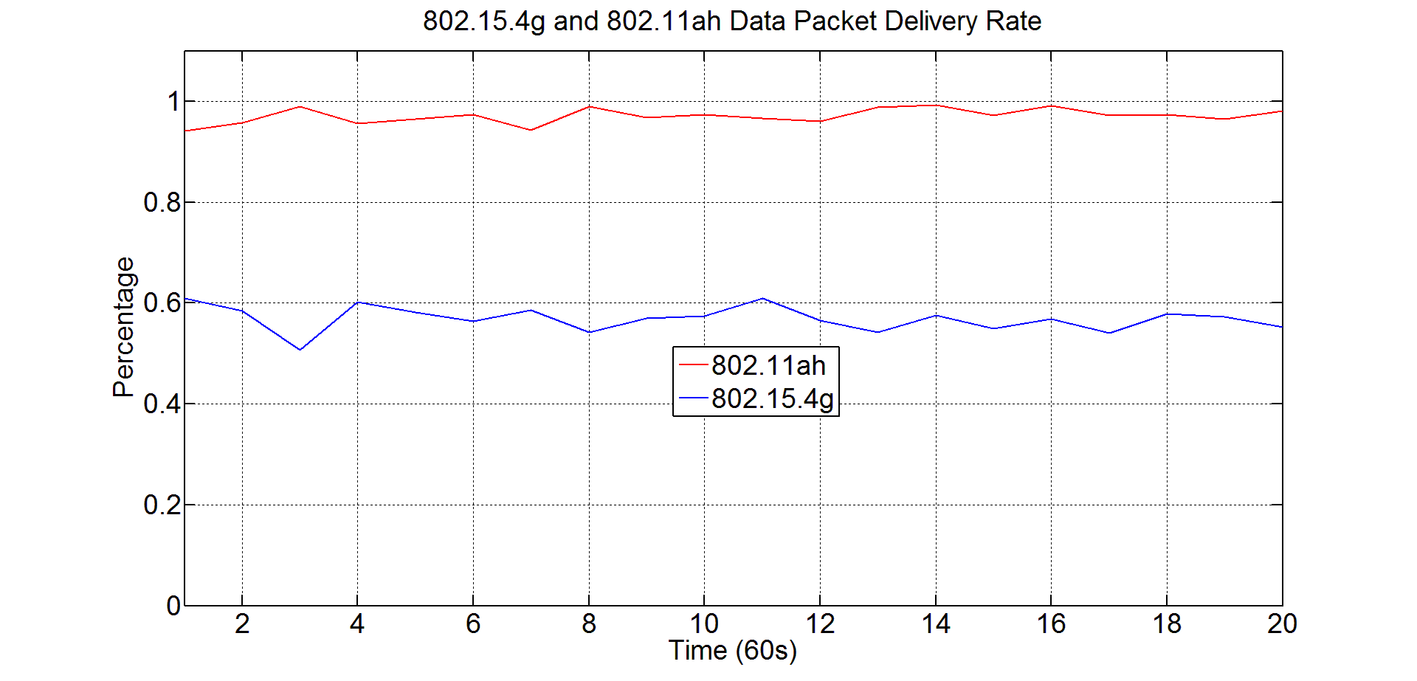
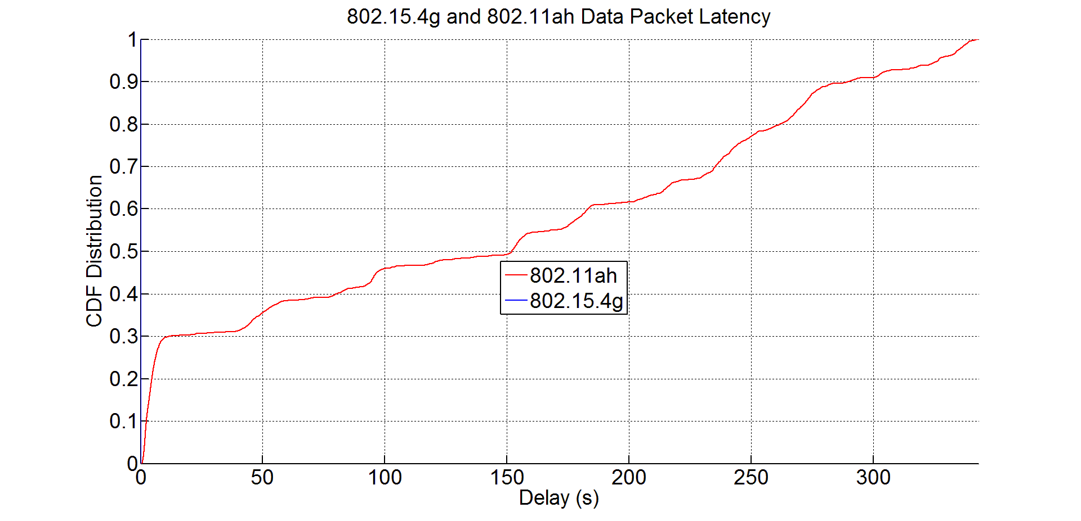
Simulation Results
Simulation 7 (equal duty cycle = 1% duty cycle)
  10 nodes for 802.15.4g and 802.11ah
  1 kbps traffic rate for 802.15.4g and 30 kbps traffic rate for 802.11ah
  100 bytes payload for 802.15.4g and 100 bytes payload for 802.11ah
Observations
  97.1% of packet delivery rate for 802.11ah network
  56.9% of packet delivery rate for 802.15.4g network
  802.11ah packet latency is in between 0.72ms and 343.1s
  802.15.4g packet latency is in between 10.1ms and 57.5ms
Low 802.15.4g packet delivery rate and long 802.11ah packet latency

Slide 19
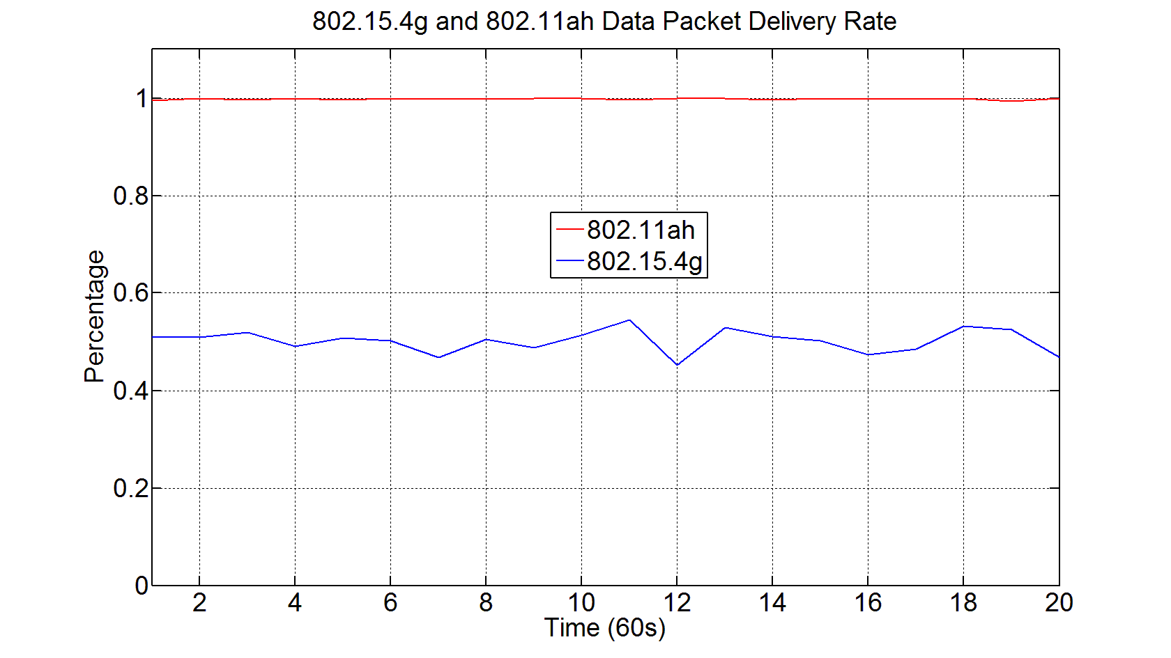
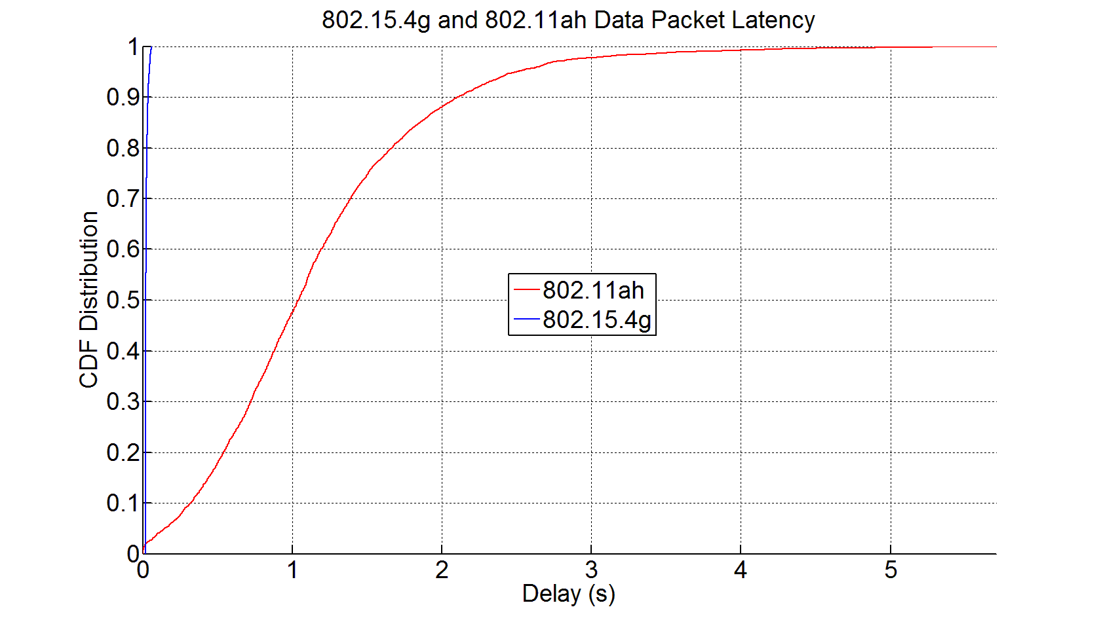
Simulation Results
Simulation 8 (equal duty cycle = 1% duty cycle)
  20 nodes for 802.15.4g and 802.11ah
  1 kbps traffic rate for 802.15.4g and 30 kbps traffic rate for 802.11ah
  200 bytes payload for 802.15.4g and 1000 bytes payload for 802.11ah
Observations
  99.85% of packet delivery rate for 802.11ah network
  50.18% of packet delivery rate for 802.15.4g network
  802.11ah packet latency is in between 3.1ms and 5.7s
  802.15.4g packet latency is in between 18.1ms and 64.5ms
Low 802.15.4g packet delivery rate

Slide 20
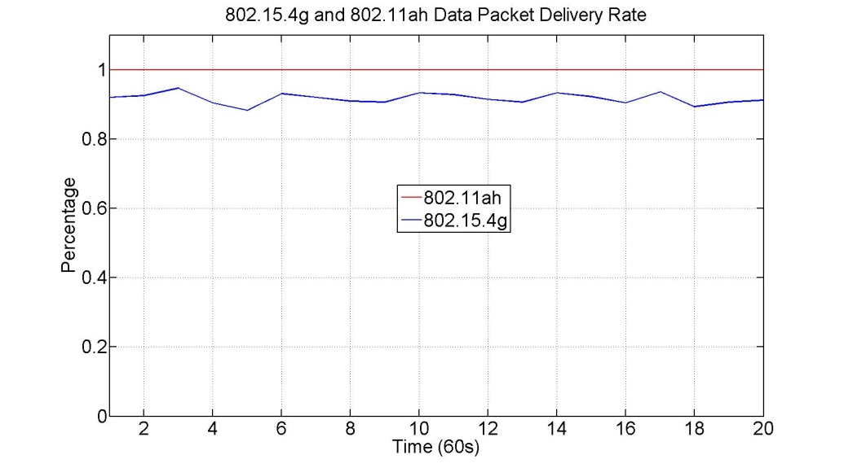
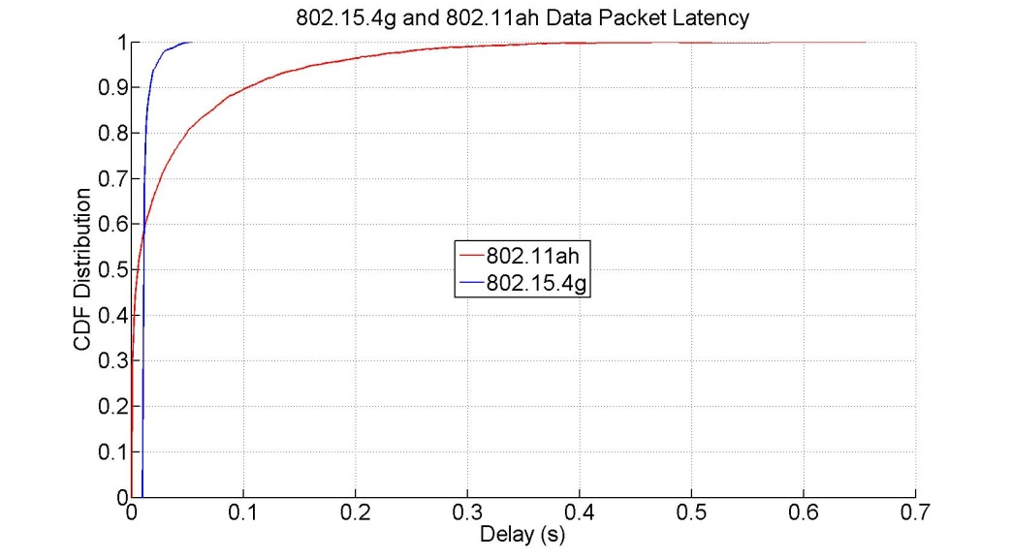
Simulation Results
Simulation 9 (equal duty cycle = 0.1% duty cycle)
  50 nodes for 802.15.4g and 802.11ah
  0.1 kbps traffic rate for 802.15.4g and 3 kbps traffic rate for 802.11ah
  100 bytes payload for 802.15.4g and 802.11ah
Observations
  100% of packet delivery rate for 802.11ah network
  About 91% of packet delivery rate for 802.15.4g network
  802.11ah packet latency is in between 0.72ms and 655.4ms
  802.15.4g packet latency is in between 10.1ms and 54.5ms
Good performance

Slide 21
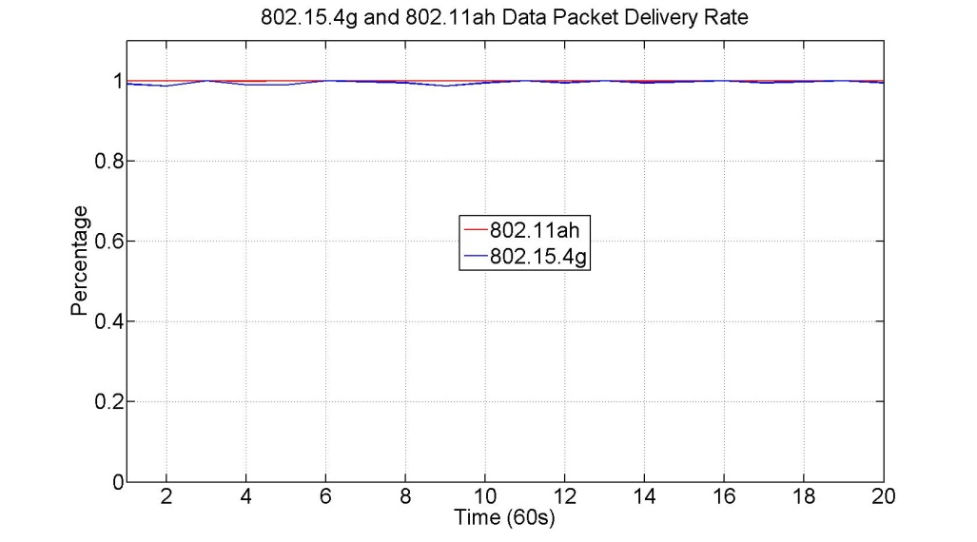
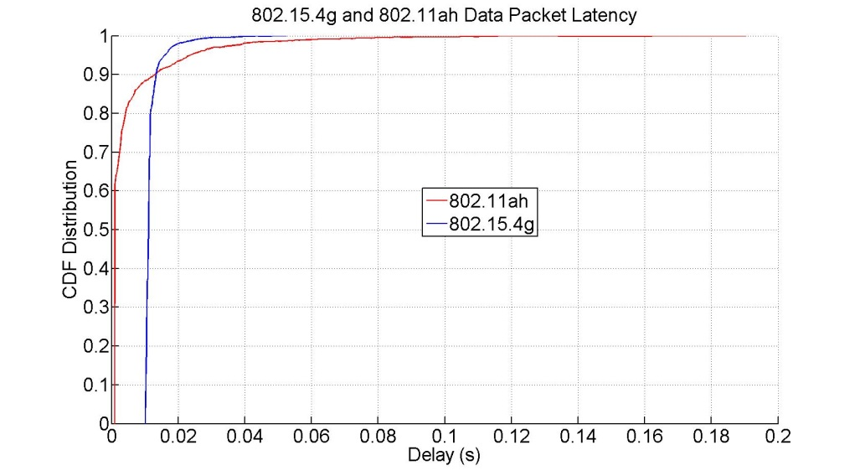
Simulation Results
Simulation 10 (equal duty cycle = 0.1% duty cycle)
  50 nodes for 802.15.4g and 802.11ah
  0.1 kbps traffic rate for 802.15.4g and 3 kbps traffic rate for 802.11ah
  100 bytes payload for 802.15.4g and 200 bytes payload for 802.11ah
Observations
  100% of packet delivery rate for 802.11ah network
  About 99% of packet delivery rate for 802.15.4g network
  802.11ah packet latency is in between 0.96ms and 190.4ms
  802.15.4g packet latency is in between 10.1ms and 52.5ms
Good performance

Slide 22
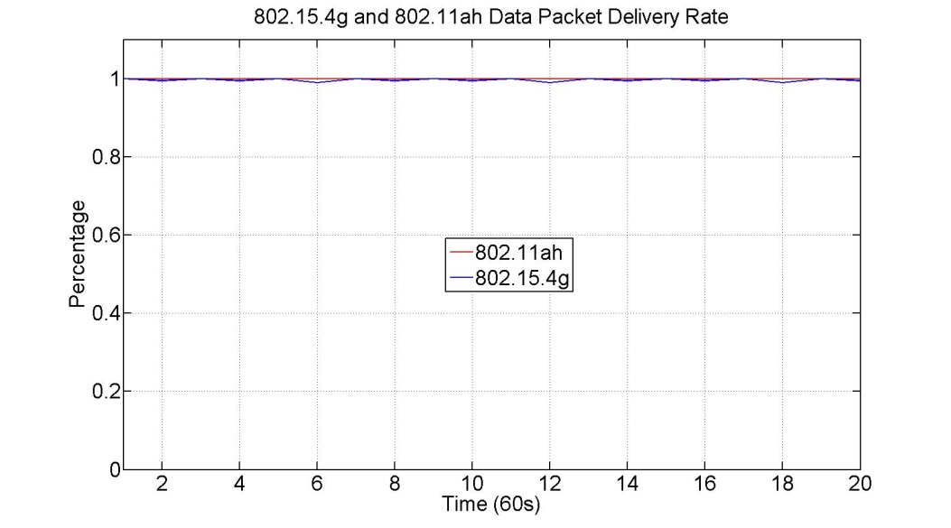
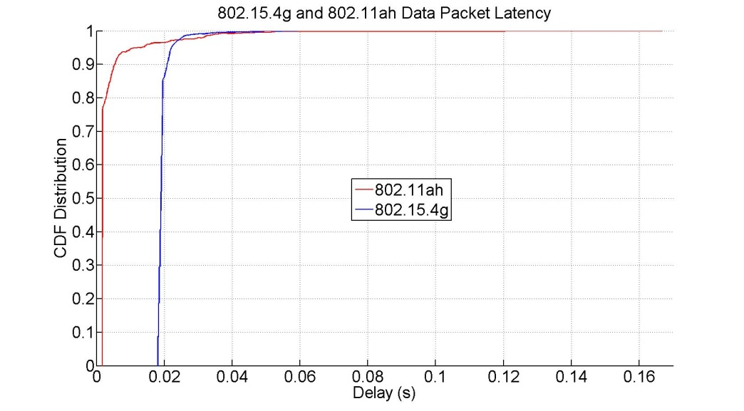
Simulation Results
Simulation 11 (equal duty cycle = 0.1% duty cycle)
  50 nodes for 802.15.4g and 802.11ah
  0.1 kbps traffic rate for 802.15.4g and 3 kbps traffic rate for 802.11ah
  200 bytes payload for 802.15.4g and 500 bytes payload for 802.11ah
Observations
  100% of packet delivery rate for 802.11ah network
  About 99.5% of packet delivery rate for 802.15.4g network
  802.11ah packet latency is in between 1.8ms and 166.7ms
  802.15.4g packet latency is in between 18.1ms and 59.1ms
Good performance

Slide 23
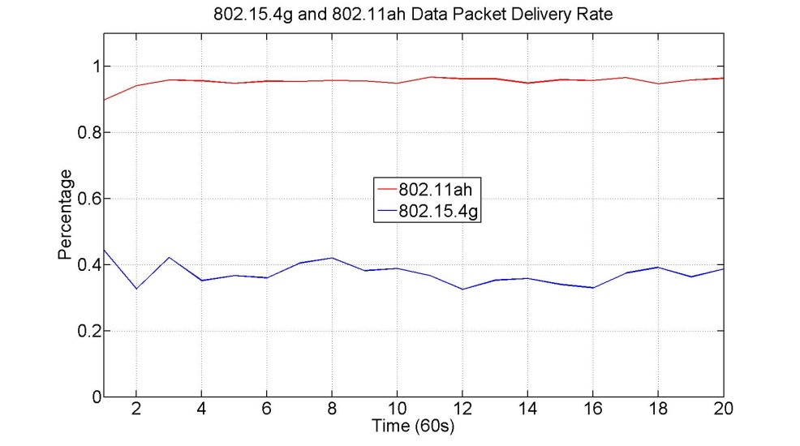
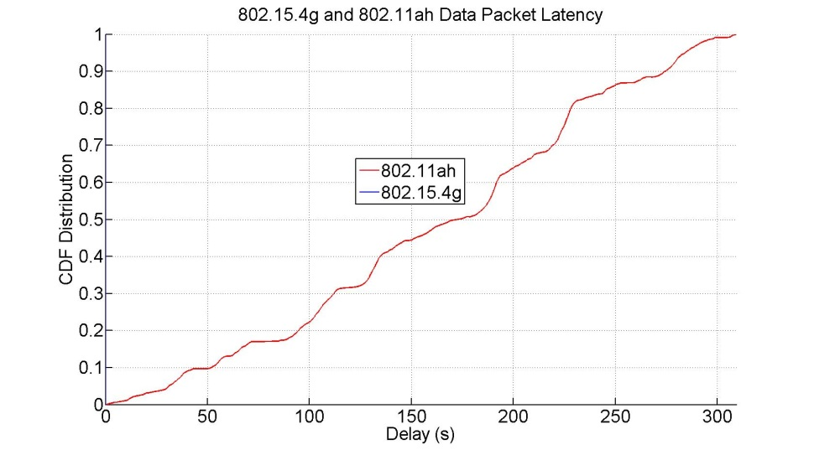
Simulation Results
Simulation 12 (equal duty cycle = 0.1% duty cycle)
  80 nodes for 802.15.4g and 802.11ah
  0.1 kbps traffic rate for 802.15.4g and 3 kbps traffic rate for 802.11ah
  100 bytes payload for 802.15.4g and 802.11ah
Observations
  About 95% of packet delivery rate for 802.11ah network
  About 37% of packet delivery rate for 802.15.4g network
  802.11ah packet latency is in between 13.8ms and 309.3s
  802.15.4g packet latency is in between 10.1ms and 54.7ms
Low 802.15.4g packet delivery rate and long 802.11ah packet latency

Slide 24
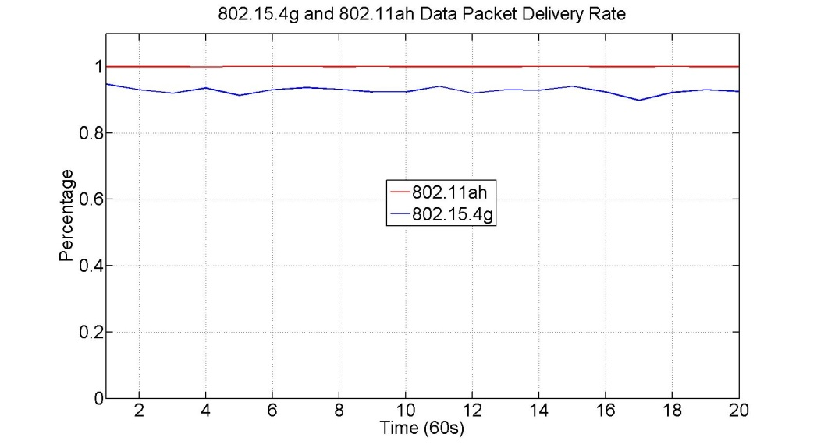
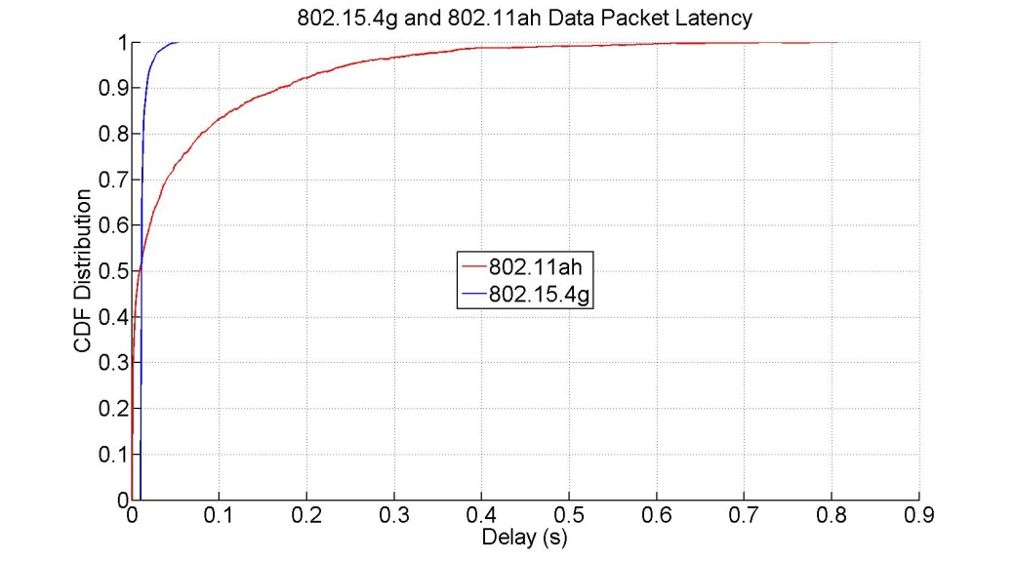
Simulation Results
Simulation 13 (equal duty cycle = 0.1% duty cycle)
  80 nodes for 802.15.4g and 802.11ah
  0.1 kbps traffic rate for 802.15.4g and 3 kbps traffic rate for 802.11ah
  100 bytes payload for 802.15.4g and 200 bytes payload for 802.11ah
Observations
  100% of packet delivery rate for 802.11ah network
  About 93% of packet delivery rate for 802.15.4g network
  802.11ah packet latency is in between 0.96ms and 806.9ms
  802.15.4g packet latency is in between 10.1ms and 53.3ms
Good performance

Slide 25
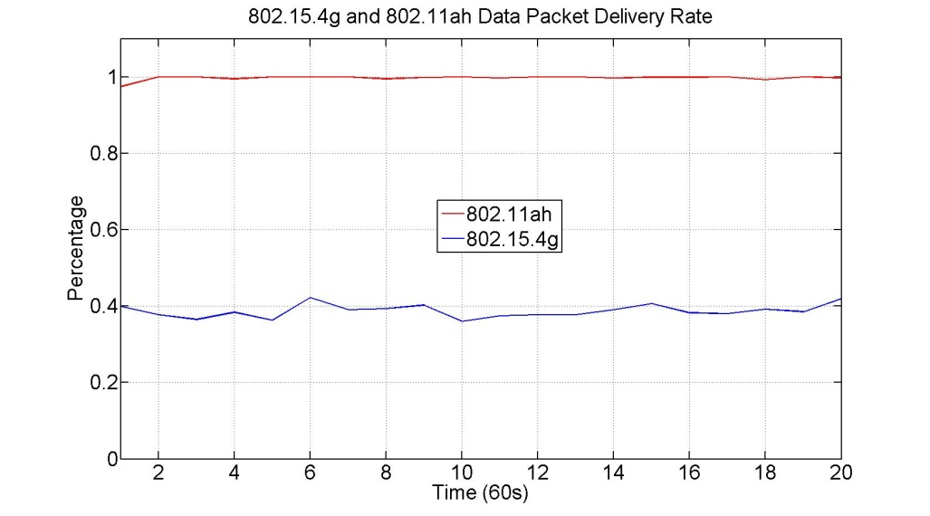
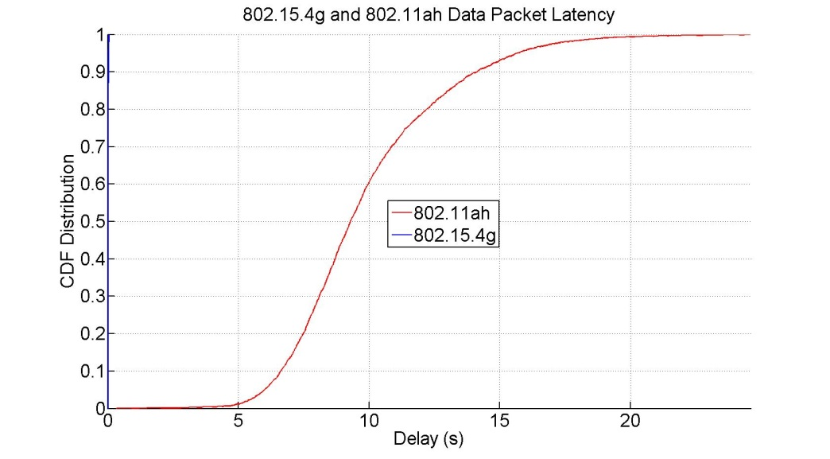
Simulation Results
Simulation 14 (equal duty cycle = 0.1% duty cycle)
  100 nodes for 802.15.4g and 802.11ah
  0.1 kbps traffic rate for 802.15.4g and 3 kbps traffic rate for 802.11ah
  100 bytes payload for 802.15.4g and 200 bytes payload for 802.11ah
Observations
  99.8% of packet delivery rate for 802.11ah network
  About 39% of packet delivery rate for 802.15.4g network
  802.11ah packet latency is in between 356.8ms and 24.568s
  802.15.4g packet latency is in between 10.1ms and 55.1ms
Low 802.15.4g packet delivery rate and long 802.11ah packet latency

Slide 26
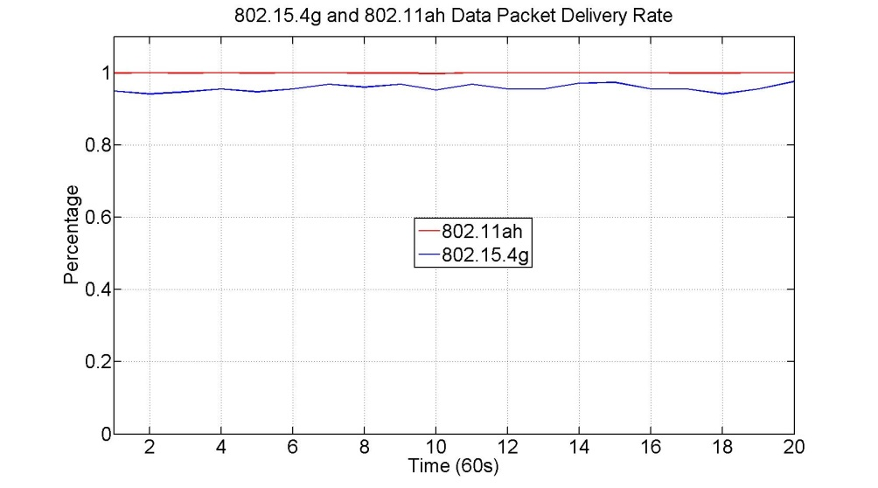
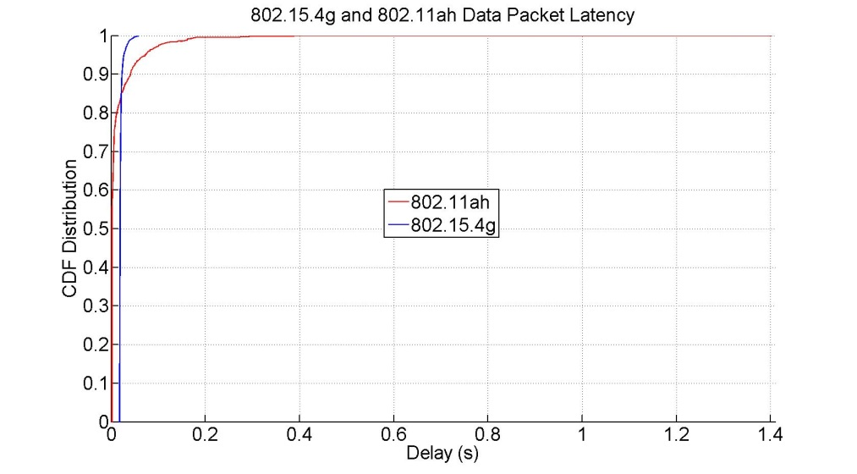
Simulation Results
Simulation 15 (equal duty cycle = 0.1% duty cycle)
  100 nodes for 802.15.4g and 802.11ah
  0.1 kbps traffic rate for 802.15.4g and 3 kbps traffic rate for 802.11ah
  200 bytes payload for 802.15.4g and 500 bytes payload for 802.11ah
Observations
  About 100% of packet delivery rate for 802.11ah network
  About 95% of packet delivery rate for 802.15.4g network
  802.11ah packet latency is in between 1.8ms and 1.403s
  802.15.4g packet latency is n between 18.1ms and 59.3ms
Good performance

Slide 27
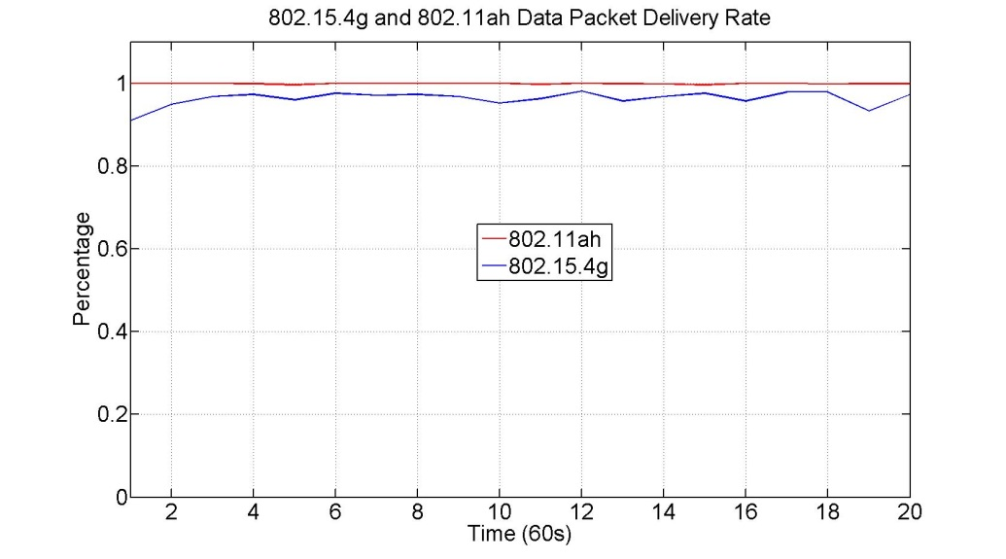
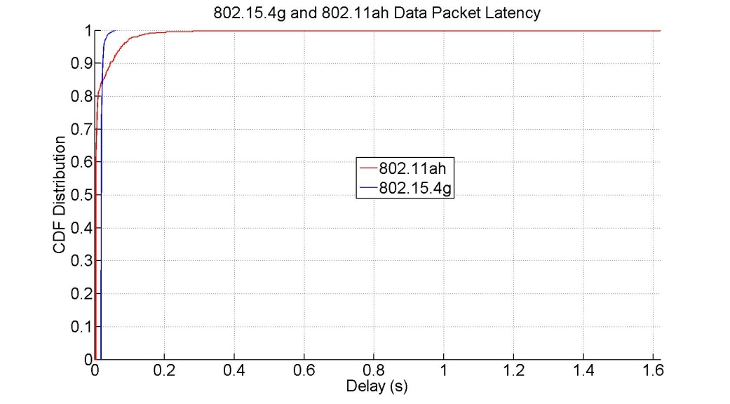
Simulation Results
Simulation 16 (equal duty cycle = 0.1% duty cycle)
  100 nodes for 802.15.4g and 802.11ah
  0.1 kbps traffic rate for 802.15.4g and 3 kbps traffic rate for 802.11ah
  200 bytes payload for 802.15.4g and 1000 bytes payload for 802.11ah
Observations
  About 100% of packet delivery rate for 802.11ah network
  About 96% of packet delivery rate for 802.15.4g network
  802.11ah packet latency is in between 3.1ms and 1.6197s
  802.15.4g packet latency is in between 18.1ms and 61.5ms
Good performance

Slide 28
Summary
Network performance closely depends on
  Number of nodes
  Application traffic rate
  Packet size
802.11ah network achieves higher packet delivery rate. However, 802.15.4g network has low packet delivery rate if
  Node density is higher or
  Application traffic rate is higher or
  Packet size is smaller
802.15.4g network achieves short packet latency. However, 802.11ah network may have long packet latency if
  Node density is higher or
  Application traffic rate is higher or
  Packet size is smaller
802.11ah network can severely interferes with 802.15.4g network for both equal traffic rate and equal duty cycle scenarios

Slide 29
Discussions
What is acceptable packet delivery rate for smart utility?
  80%?
What is acceptable packet delivery rate for traffic light and cameras in smart city?
  90%?
What is acceptable packet latency for smart utility?
  60s?
What is acceptable packet latency for traffic light and cameras in smart city?
  1s?
What is appropriate packet size?
Moving forward, should a S1G coexistence IG be created?

