Slide 1
Reliability of Coexisting 802.15.4g and 802.11ah Networks in the Sub-1 GHz Band
Date: 2018-01-15
Authors:
Notice: This document has been prepared to assist IEEE 802.19. It is offered as a basis for discussion and is not binding on the contributing individual(s) or organization(s). The material in this document is subject to change in form and content after further study. The contributor(s) reserve(s) the right to add, amend or withdraw material contained herein.

Slide 2
Abstract
Presentation to IEEE 802.19 Working Group to show network traffic and packet size impact on network reliability of coexisting IEEE 802.15.4g and IEEE 802.11ah networks in the Sub-1 GHz (S1G) Band

Slide 3
Motivation
802.15.4g based smart utility devices have been deployed
  Operate in the S1G band
802.11ah, LoRa and SigFox are also designed to operate in the S1G band
  Even LoRa and SigFox are narrowband technologies, 802.11ah channel is at least 1 MHz wide
Spectrum allocation in S1G band can be narrow
  Japan allocates 5.6 MHz spectrum for smart meter system as specified in ARIB STD-T108, Version 1.0 (Feb 14 2012).
Channel hopping can be limited
  Multiple systems may be deployed with high node density
Therefore, 802.15.4g coexistence with other systems needs to be investigated and addressed

Slide 4
Coexistence Mechanisms of 802.15.4g and 802.11ah
802.15.4g coexistence mechanism
  Define three PHY types
    MR-FSK
    MR-OFDM
    MR-O-QPSK
  Define common signaling mode (CSM) for coexistence between devices using different 802.15.4g PHYs
802.11ah coexistence mechanism
  An S1G STA uses energy detection (ED) based CCA with a threshold of -75 dBm per MHz to improve coexistence with other S1G systems including 802.15.4 and 802.15.4g
  If a S1G STA detects energy above that threshold on its channel, then the following mechanisms might be used to mitigate interference
    Change of operating channel
    Sectorized beamforming
    Change the schedule of restricted access windows, target wake time service periods, or subchannel selective transmission operating channels
    Defer transmission for a particular interval

Slide 5
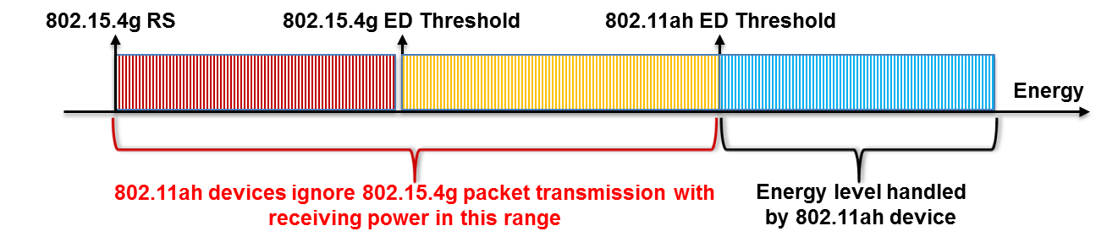
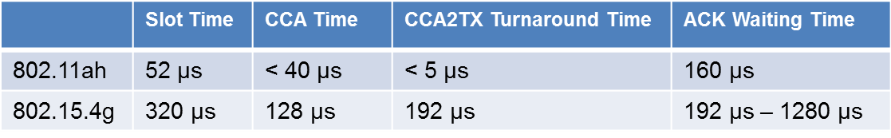
802.11ah Interference Impact on 802.15.4g Network
802.11ah networks can severely interfere with 802.15.4g network
  See 19-17-0087-03-0000-802-11ah-and-802-15-4g-coexistence
Interference cause 1: higher ED threshold of 802.11ah
Interference cause 2: faster backoff mechanism of 802.11ah
  802.11ah device may start packet transmission when 802.15.4g device performs CCA-to-TX turnaround, which causes data packet collision
  802.11ah device may start packet transmission when 802.15.4g device is waiting for ACK packet, which causes ACK packet collision
62.5 ksymbols/s

Slide 6
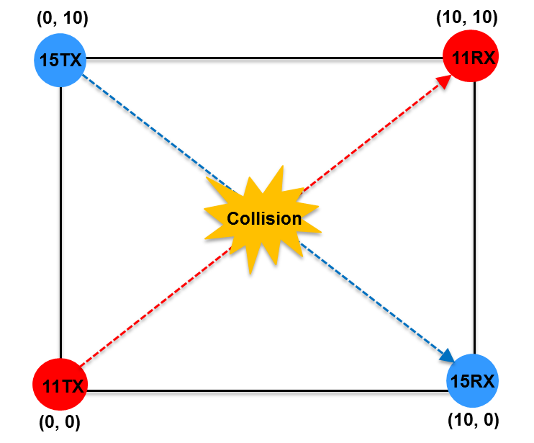
Objectives of This Presentation
Show network traffic impact on network reliability
  Network reliability is defined as data packet delivery rate by a network
Show packet size impact on network reliability
4-node network setup
  Minimum network size, minimum node density
  No interference/collision caused by node/STA within same network
    Interference/collision comes only from other network
  No channel access failure caused by node/STA within same network
    Channel access failure can only be caused by other network
PHY data rate
  802.15.4g: 100kbps
  802.11ah: 3000kbps
Simulator
  NS-3
Simulation time
  Each simulation runs 20 minutes

Slide 7

Propagation Model
ITU-R P.1411-8 model for propagation between terminals from below roof-top height to near street level
  L_{urban} = 0 for suburban
TX power: 13dBm
11ah Receiver Sensitivity: -87dBm
920 MHz band
15.4g Receiver Sensitivity: -88dBm
802.11ah: 42m
11ah ED Threshold: -75dBm
15.4g ED Threshold: -80dBm
802.15.4g: 56m

Slide 8
Network Traffic Impact on Network Reliability
Packet size = 256 bytes for both 802.15.4g and 802.11ah
802.11ah network packet delivery rate
  97.8% for 800 kbps traffic rate and near 100% for the rest of traffic rates
Observations
  802.11ah traffic can severely impact 802.15.4g network reliability
  802.15.4g traffic has no impact on 802.11ah reliability
  When 802.11ah traffic is higher, lowing 802.15.4g traffic does not always help
802.15.4g Network Traffic Rate (kbps)
 | 50 | 40 | 30 | 20 | 10 | 1 | 0.1
200 | 99.8% | 98.9% | 99.8% | 99.9% | 99.8% | 100% | 100%
300 | 99.1% | 99.1% | 99.2% | 99.2% | 99.2% | 99.5% | 100%
400 | 96.6% | 96.9% | 97.1% | 97.3% | 96.6% | 96.2% | 96.7%
500 | 73.7% | 89.4% | 89.3% | 89.0% | 89.0% | 87.4% | 88.5%
600 | 48.6% | 60.2% | 73.7% | 72.5% | 72.5% | 69.4% | 68.9%
700 | 36.6% | 43.7% | 56.4% | 58.3% | 57.9% | 55.7% | 42.6%
800 | 26.1% | 30.1% | 38.7% | 41.6% | 41.9% | 39.4% | 37.7%
802.15.4g Network Packet Delivery Rate
802.11ah Network Traffic Rate (kbps)

Slide 9
802.11ah Packet Size Impact on Network Reliability
Constant 802.11ah traffic rate
  600 kbps
Constant 802.15.4g traffic rate
  50 kbps
Constant 802.15.4g packet size
  256 bytes
Observations
  As 802.11ah packet size increases, number of 802.11ah packets, overhead and channel access demand decrease. Therefore,
    802.11ah packet delivery rate increases
    802.15.4g packet delivery rate increases
  Large 802.11ah packet size can improve network reliability
802.15.4g Packet Delivery Rate
802.11ah Packet Size (byte)
200 | 300 | 400 | 500 | 600 | 700 | 800 | 900 | 1000
28.3% | 60.7% | 86.0% | 95.1% | 96.7% | 98.4% | 98.6% | 98.4% | 98.4%
100% | 100% | 100% | 100% | 100% | 100% | 100% | 100% | 100%
802.11ah Packet Delivery Rate

Slide 10
802.11ah Packet Size Impact on Network Reliability
Constant 802.11ah traffic rate
  800 kbps
Constant 802.15.4g traffic rate
  50 kbps
Constant 802.15.4g packet size
  256 bytes
Observations
  As 802.11ah packet size increases, number of 802.11ah packets, overhead and channel access demand decrease. Therefore,
    802.11ah packet delivery rate increases
    802.15.4g packet delivery rate increases
  Large 802.11ah packet size can improve network reliability
802.15.4g Packet Delivery Rate
802.11ah Packet Size (byte)
200 | 300 | 400 | 500 | 600 | 700 | 800 | 900 | 1000
13.7% | 24.7% | 45.9% | 63.3% | 72.5% | 83.7% | 85.4% | 89.1% | 93.9%
81.6% | 100% | 100% | 99.9% | 99.9% | 100% | 100% | 100% | 100%
802.11ah Packet Delivery Rate

Slide 11
Simulation Result Indication
Consider a use case scenario
  Medium density network
    500 nodes for 802.15.4g
    500 STAs for 802.11ah
  Network traffic rate
    50 kbps for 802.15.4g network
    600 kbps for 802.11ah network
  Packet size
    256 bytes of 802.15.4g packet
    256 bytes payload for 802.11ah packet
  Number of packets transmitted by each node/STA per minute (60s)
    2.9 packets by an 802.15.4g node
    35.2 packets by an 802.11ah STA
Optimal packet delivery rate
  48.6% for 802.15.4g
  99.9997% for 802.11ah
Under normal network condition, 802.15.4g network can be severely interfered by other S1G systems

