Slide 1
Revision TG January 2018 Irvine Meeting Agenda
Date: 2018-01-16
Authors:
Notice: This document has been prepared to assist IEEE 802.19. It is offered as a basis for discussion and is not binding on the contributing individual(s) or organization(s). The material in this document is subject to change in form and content after further study. The contributor(s) reserve(s) the right to add, amend or withdraw material contained herein.

Slide 2
Agenda graphic

Slide 3
Meeting protocol
Please announce your affiliation when you first address the group during a meeting slot

Slide 4
Attendance
https://imat.ieee.org/my-site/home
Register
Indicate attendance

Slide 5
Agenda items for this week
Approval of meeting minutes
Opening report
Comments resolution from WG Letter Ballot
Technical presentations and text proposals
Review project timeline
Motions
Review objectives for next meeting
Schedule for teleconferences

Slide 6
Monday AM2

Slide 7
Agenda for Monday AM2
Meeting called to order
Call for secretary
Call for submissions and discussions
Approval of agenda
IEEE IPR statement
Approval of November 2017 Revision TG meeting minutes
Revision TG Opening report
Comments resolution from WG Letter Ballot
Recess

Slide 8
Call for secretary
Looking for volunteer of recording secretary

Slide 9
Call for submissions
Comments from Working group letter ballot
  19-17/0092r1: P802.19.1a 1st sponsor ballot Comments and Resolutions (C. Sun)

Slide 10
Approval of agenda
Motion to approve the agenda of the January 2018 Revision TG meeting, document 19-18/0003r2.
  Approved by unanimous consensus

Slide 11
Patent Policy
http://standards.ieee.org/about/sasb/patcom/materials.html

Slide 12


Slide 13


Slide 14
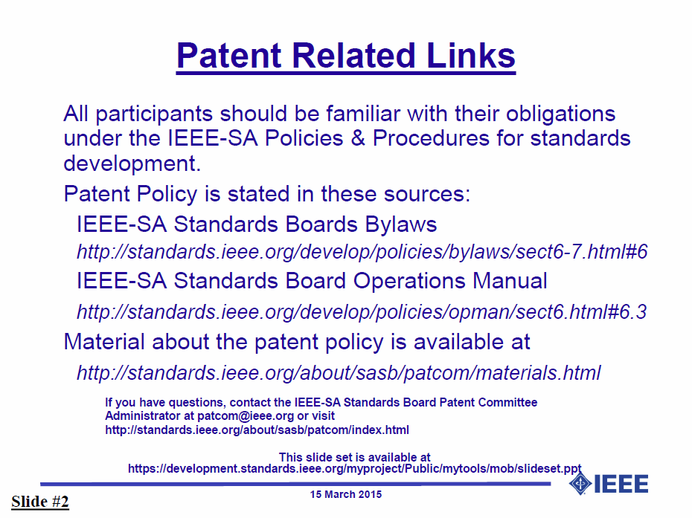

Slide 15


Slide 16


Slide 17
Approval of minutes
Motion to approve the minutes from the November 2017 Revision TG meeting, DCN 19-17/0089r0
  Approved by unanimous consensus

Slide 18
Revision TG Opening report
January 2018 Revision TG Opening Report (DCN 19-18/0004r1)

Slide 19
Comments resolution
19-17/0092r1: P802.19.1a 1st sponsor ballot Comments and Resolutions (C. Sun)

Slide 20
Motion #1
Move to approve IEEE P802.19.1 revision D2.0 which has implemented all changes in 19-17/0092r2
  Move: C. Sun
  Second: S. Furuichi
  Approved by unanimous consensus

Slide 21
Agenda for Tuesday PM1
Meeting called to order
Motions
Review the time line of the revision work
Review objectives for next meeting
Adjourn

Slide 22
Motion #2
Approve to ask working group chairman to start the working group recirculation ballot for 15 days using the IEEE P802.19.1 revision draft D2.0 no later than January 26, 2018
  Move: C. Sun
  Second: M. Takai
  Y: 3/N: 0/A: 0

Slide 23
Revision work timeline
Timeline document of IEEE 802.19.1 Revision
  Doc. 19-17/0064r1: Timeline document (N. Sato)

Slide 24
Review objectives for next meeting
Comments resolution from recirculation ballot
Move to sponsor ballot

Slide 25
Teleconference
Schedule (1hour)
  Wednesday, Feb. 21, 2018: 1am ET (Wednesday, Feb. 21, 2018 7am CET, 2pm CST, 3pm JST/KST)
Meeting Logistics
  Use “Join Me”
    Join the meeting: https://join.me/ieeesawg802.19
    On a computer, use any browser. Nothing to download.
    On a phone or tablet, launch the join.me app and enter meeting code:ieeesawg802.19
    Join the audio conference:
    Dial a phone number and enter access code, or connect via internet.
  The chair will send out a notification to IEEE 802.19 reflector in advance of the meeting

Slide 26
Adjourn

Slide 27
Time difference
Winter
  1am EST (6am UTC, 3pm JST/KST)
  7am EST (noon UTC, 9pm JST/KST)
  5pm EST (10pm UTC, 7am JST/KST + 1day)
Summer
  2am EDT (6am UTC, 3pm JST/KST)
  8am EDT (noon UTC, 9pm JST/KST)
  6pm EDT (10pm UTC, 7am JST/KST + 1day)

