Slide 1
Coexistence of 802.11ah and 802.15.4g in the S1G Band
Date: 2017-11-08
Authors:
Notice: This document has been prepared to assist IEEE 802.19. It is offered as a basis for discussion and is not binding on the contributing individual(s) or organization(s). The material in this document is subject to change in form and content after further study. The contributor(s) reserve(s) the right to add, amend or withdraw material contained herein.

Slide 2
Abstract
Presentation to IEEE 802.19 Working Group to raise awareness of coexistence issues between IEEE 802.11ah and IEEE 802.15.4g in the Sub-1 GHz (S1G) Band

Slide 3
Motivation
802.15.4g based smart utility devices have been deployed
  Operate in the Sub-1 GHz (S1G) band
802.11ah is also designed to operate in the S1G band
  802.11ah channel is at least 1 MHz wide
Spectrum allocation in S1G band can be narrow
  Japan allocates 5.6 MHz spectrum for smart meter system as specified in ARIB STD-T108, Version 1.0 (Feb 14 2012).
Channel hopping can be limited
  Multiple systems may be deployed with high node density, e.g., LoRa and SigFox also operate in the S1G band
As a result, 802.11ah and 802.15.4g coexistence issue needs to be investigated and addressed

Slide 4
Coexistence Mechanisms of 802.11ah and 802.15.4g
802.11ah coexistence mechanism
  An S1G STA uses energy detection (ED) based CCA with a threshold of -75 dBm per MHz to improve coexistence with other S1G systems including 802.15.4 and 802.15.4g
  If a S1G STA detects energy above that threshold on its channel, then the following mechanisms might be used to mitigate interference
    Change of operating channel
    Sectorized beamforming
    Change the schedule of RAW(s), TWT SP(s), or SST operating channels
    Defer transmission for a particular interval
802.15.4g coexistence mechanism
  Define three PHY types
    MR-FSK
    MR-OFDM
    MR-O-QPSK
  Define common signaling mode (CSM) for coexistence between devices using different 802.15.4g PHYs
RAW = Restricted access window
TWT = Target wake time
SP = Service period
SST = Subchannel Selective Transmission

Slide 5
Are Standard Defined Coexistence Mechanisms Sufficient?
A NS-3 simulation system is developed to evaluate coexistence of 802.11ah network and 802.15.4g network
IEEE document 802.11-11/0905r5 provides guidelines on evaluation methodology
  Application such as smart utility, location of devices, overlapped network, propagation model, etc.
One 802.15.4g network
  1 PANC located as (0, 0)
  55 nodes are uniformly placed in circle centered at (0, 0) with 56 meters of radius
Three overlapped 802.11ah networks
  3 APs are located at (28, 0), (-14, 24.248) and (-14, -24.248)
  Each AP associates with 18 STAs
  STAs of each AP are uniformly placed in circle centered at AP location with 42 meters of radius
Simulation results show that 802.11ah network can severely interfere with 802.15.4g network

Slide 6
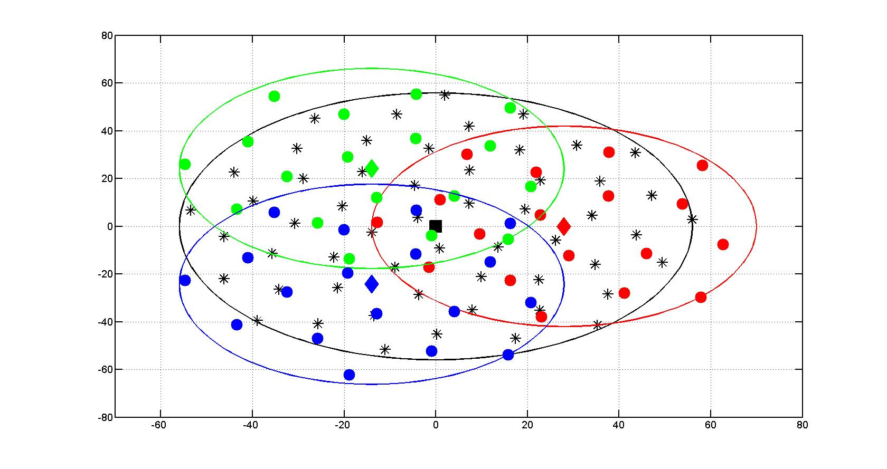
802.11ah and 802.15.4g Node Placement
802.15.4g PANC: black square
802.15.4g nodes: black stars
802.11ah APs: {red, green, blue} diamonds
802.11ah STAs: {red, green, blue} dots

Slide 7

Propagation Model
ITU-R P.1411-8 model for propagation between terminals from below roof-top height to near street level
  L_{urban} = 0 for suburban
TX power: 13dBm
11ah Receiver Sensitivity: -77dBm
920 MHz band
15.4g Receiver Sensitivity: -88dBm
11ah: 42m
11ah ED Threshold: -75dBm
15.4g ED Threshold: -80dBm
15.4g: 56m

Slide 8
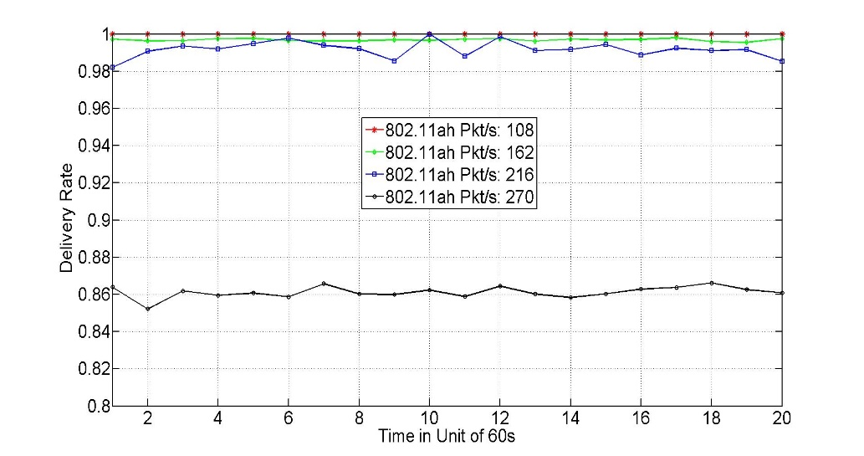
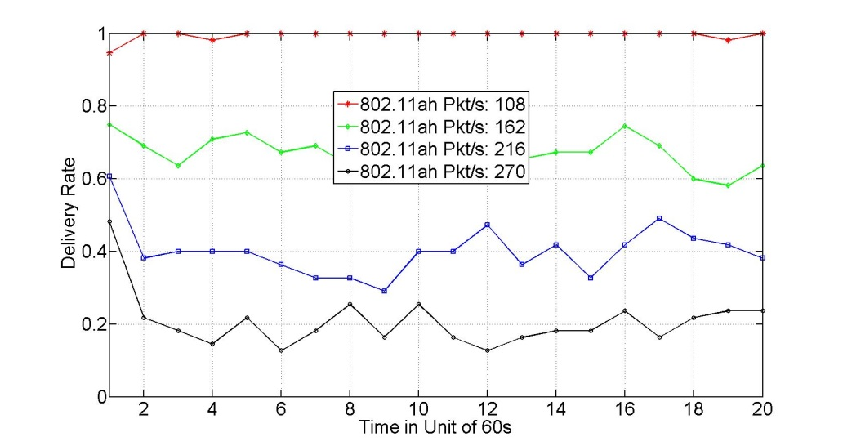
Simulation Results of 802.11ah and 802.15.4g Coexistence
Data packet generation rate
  802.15.4g: 1 packet per minutes with 256 bytes payload
  Variable 802.11ah packet generate with 256 bytes payload
PHY data rate
  802.15.4g: 100kbps, 802.11ah: 3000kbps
Data packet delivery rate (PDR)
  802.11ah network achieves more than 85% of PDR for four scenarios
  However, 802.15.4g network PDR decreases to about 40% when 802.11ah network packet generation rate is 216/s, i.e., 4 packets/s by each STA, to about 20% when 802.11ah network packet generation rate is 270/s, i.e., 5 packets/s by each STA
What are the causes of 802.11ah interference on 802.15.4g?
802.11ah PDR
802.15.4g PDR

Slide 9
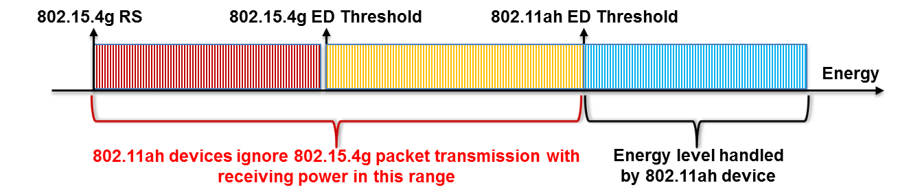
802.11ah Interference Cause I
Interference caused by higher ED threshold of 802.11ah
  802.11ah ED threshold: -75dBm
  802.15.4g ED threshold: -80dBm
802.15.4g receiver sensitivity (RS)
  -88dBm
Consequences
  Readable 802.15.4g packets with receiving power level within the range [802.15.4g RS, 802.11ah ED Threshold] are ignored by 802.11ah ED CCA mechanism, which result in
    802.15.4g packet collision
  802.11ah devices access channel more, which result in
    802.15.4g packet drop due to channel access failure

Slide 10
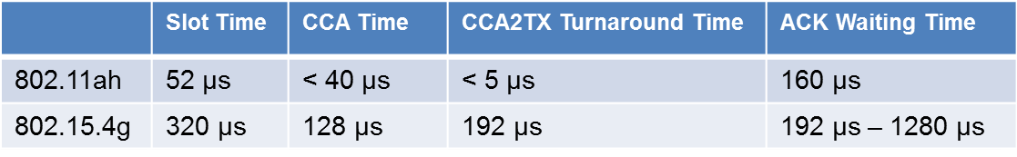
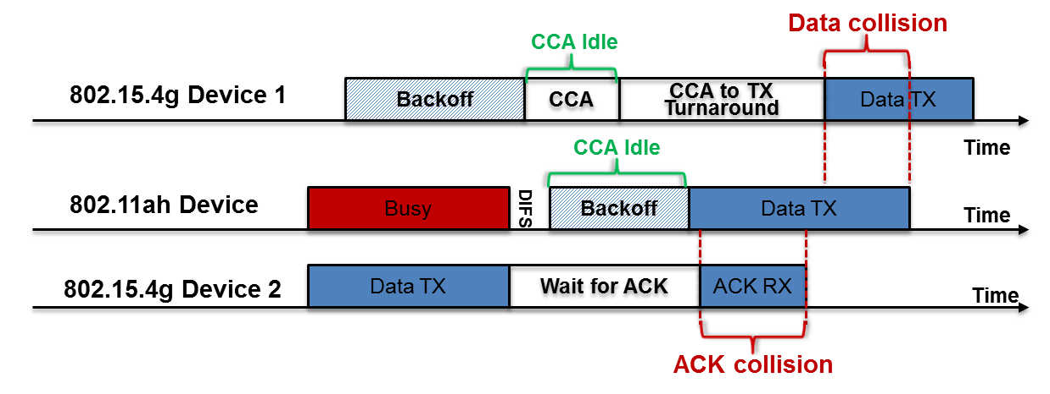
802.11ah Interference Cause II
Interference caused by faster backoff mechanism of 802.11ah
  802.11ah smaller time scales vs 802.15.4g larger time scales
Consequences
  802.11ah device may start packet transmission when 802.15.4g device performs CCA-to-TX turnaround, which causes data packet collision
  802.11ah device may start packet transmission when 802.15.4g device is waiting for ACK packet, which causes ACK packet collision
62.5 ksymbols/s

Slide 11
September 802.15 WG Straw Poll (1)
Do you think there are issues when 802.11ah network and 802.15.4g network are forced to coexist in the Sub-1 GHz band when channel hopping is not available or severely restricted?
Yes:23
No:0
Abstain:3

Slide 12
September 802.15 WG Straw Poll (2)
Would you like to participate in the resolution of coexistence of 802.11ah network and 802.15.4g network?
Yes:10
No:3
Abstain:12

Slide 13
September 802.15 WG Straw Poll (3)
Should IEEE 802.15 and/or 802.19 and/or 802.11 Working Group address issues (if any) in 802.11ah and 802.15.4g coexistence?
802.15: 6
802.19: 18
802.11: 16
Abstain: 6
None of above: 0

Slide 14
November 802.19 WG Straw Poll (1)
Should IEEE 802.19 Working Group create a study group or interest group to study coexistence between 802.15.4g and 802.11ah in the Sub-1 GHz band?
Yes:
No:
Abstain:

Slide 15
References
IEEE Standard 802.15.4g-2012 (Amendment to IEEE Standard 802.15.4-2011)
IEEE Standard 802.11ah-2016 (Sub-1 GHz Operation)
IEEE 802.11-11-05-00ah/0905r45, “TGah Functional Requirements and Evaluation Methodology”
L. Tian, S. Deronne, S. Latre, and J. Famaey, “An IEEE 802.11 ah Module for NS-3,” in Proceedings of the Workshop on ns-3. ACM, 2016, pp. 49–56
NS-3 version 3.23

