Slide 1
Revision TG September 2017 Waikoloa Meeting Agenda
Date: 2017-09-12
Authors:
Notice: This document has been prepared to assist IEEE 802.19. It is offered as a basis for discussion and is not binding on the contributing individual(s) or organization(s). The material in this document is subject to change in form and content after further study. The contributor(s) reserve(s) the right to add, amend or withdraw material contained herein.

Slide 2
Agenda graphic

Slide 3
Meeting protocol
Please announce your affiliation when you first address the group during a meeting slot

Slide 4
Attendance
https://imat.ieee.org/my-site/home
Register
Indicate attendance

Slide 5
Agenda items for this week
Opening report
Review the time line of the revision work
Review the revision draft
Motions
Review objectives for next meeting
Schedule for teleconferences

Slide 6
Tuesday AM1

Slide 7
Agenda for Tuesday AM1
Meeting called to order
Call for secretary
Call for submissions and discussions
Approval of agenda
IEEE IPR statement
Opening report
Review the time line of the revision work
Review the revision draft
Recess

Slide 8
Call for secretary
Looking for volunteer of recording secretary

Slide 9
Call for submissions
Technical discussion

Slide 10
Approval of agenda
Motion to approve the agenda of the September 2017 Revision TG meeting, document 19-17/0074r1.
  Approved by unanimous consensus

Slide 11
Patent Policy
http://standards.ieee.org/about/sasb/patcom/materials.html

Slide 12


Slide 13


Slide 14
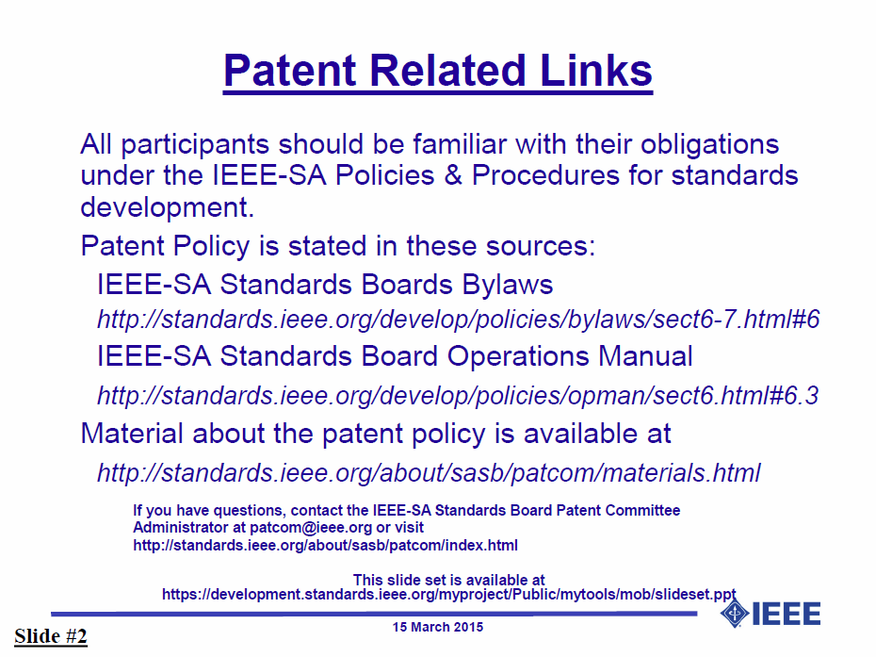

Slide 15


Slide 16


Slide 17
TG1a Opening report
September 2017 Revision TG Opening Report (DCN 19-17/0075r0)

Slide 18
Revision work timeline
Timeline document of IEEE 802.19.1 Revision
  Doc. 19-17/0064r0: Timeline document (N. Sato)

Slide 19
Review the revision draft

Slide 20
Agenda for Tuesday PM1
Meeting called to order
Review the revision draft
Recess

Slide 21
Agenda for Wednesday AM1
Meeting called to order
Review the revision draft
Recess

Slide 22
Agenda for Wednesday PM1
Meeting called to order
Review the revision draft
Recess

Slide 23
Agenda for Thursday PM1
Meeting called to order
Review the revision draft
Motions
Review the time line of the revision work
Review objectives for next meeting
Adjourn

Slide 24
Motion #1

Slide 25
Motion #2

Slide 26
Revision work timeline
Timeline document of IEEE 802.19.1 Revision
  Doc. 19-17/0064r1: Timeline document (N. Sato)

Slide 27
Review objectives for next meeting

Slide 28
Teleconference
Schedule (1hour)
  Wednesday, xxx. xx, 2017: 1am ET (Wednesday, Feb. 22, 2017 7am CET, 2pm CST, 3pm JST/KST)
Meeting Logistics
  Use “Join Me”
    Join the meeting: https://join.me/ieeesawg802.19
    On a computer, use any browser. Nothing to download.
    On a phone or tablet, launch the join.me app and enter meeting code:ieeesawg802.19
    Join the audio conference:
    Dial a phone number and enter access code, or connect via internet.
  The chair will send out a notification to IEEE 802.19 reflector in advance of the meeting

Slide 29
Adjourn

Slide 30
Time difference
Winter
  1am EST (6am UTC, 3pm JST/KST)
  7am EST (noon UTC, 9pm JST/KST)
  5pm EST (10pm UTC, 7am JST/KST + 1day)
Summer
  2am EDT (6am UTC, 3pm JST/KST)
  8am EDT (noon UTC, 9pm JST/KST)
  6pm EDT (10pm UTC, 7am JST/KST + 1day)

