Slide 1
TG1a May 2017 Meeting Agenda
Date: 2017-05-10
Authors:
Notice: This document has been prepared to assist IEEE 802.19. It is offered as a basis for discussion and is not binding on the contributing individual(s) or organization(s). The material in this document is subject to change in form and content after further study. The contributor(s) reserve(s) the right to add, amend or withdraw material contained herein.

Slide 2

Agenda graphic

Slide 3
Meeting protocol
Please announce your affiliation when you first address the group during a meeting slot

Slide 4
Attendance
https://imat.ieee.org/my-site/home
Register
Indicate attendance

Slide 5
Agenda items for this week
Approval of meeting minutes
TG1a Opening report
Sponsor Ballot comments resolutions
802.19.1 Revision PAR information
Review project timeline
Motions
Review objectives for next meeting
Schedule for teleconferences

Slide 6
Wednesday AM1

Slide 7
Agenda for Wednesday AM1
TG1a meeting called to order
Call for secretary
Call for submissions and discussions
Approval of agenda
IEEE IPR statement
Approval of March 2017 TG1a meeting minutes
TG1a Opening report
802.19.1 Revision PAR information
Results of the Sponsor Ballot
Recess

Slide 8
Call for secretary
Looking for volunteer of recording secretary

Slide 9
Call for submissions
Technical discussion

Slide 10
Approval of agenda
Motion to approve the agenda of the May 2017 TG1a meeting, document 19-17/0047r1.
Approved unanimously

Slide 11
Patent Policy
http://standards.ieee.org/about/sasb/patcom/materials.html

Slide 12


Slide 13


Slide 14
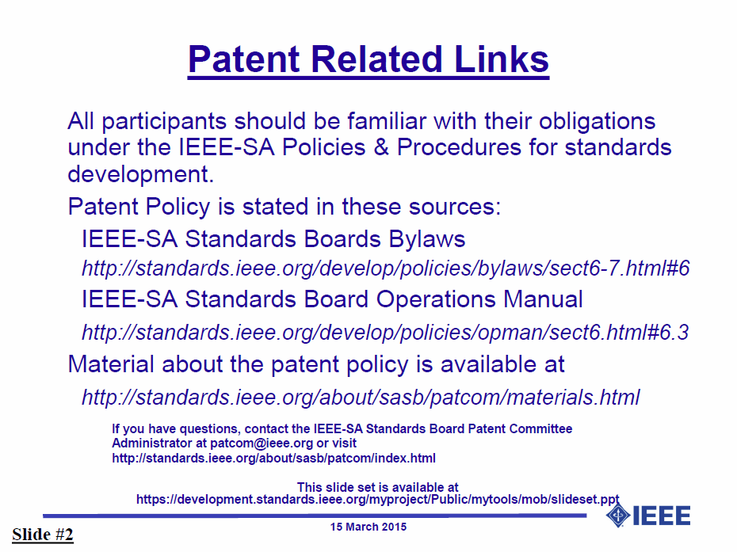

Slide 15


Slide 16


Slide 17
Approval of minutes
Motion to approve the minutes from the March 2017 TG1a meeting, DCN 19-17/0036r0.
Approved unanimously

Slide 18
TG1a Opening report
May 2017 TG1a Opening Report (DCN 19-17/0046r0)

Slide 19
802.19.1 Revision PAR information
May 4 received email from IEEE SA indicating that the revision PAR is in SASB email ballot (ten days).

Slide 20
Wednesday AM2

Slide 21
Agenda for Wednesday AM2
TG1a meeting called to order
Approval of agenda
IEEE IPR statement
Resolve the Sponsor Ballot comments
Recess

Slide 22
Thursday PM1

Slide 23
Agenda for Thursday PM1
TG1a meeting called to order
Approval of agenda
IEEE IPR statement
Review comment resolution
Review project timeline
Motions
Review objectives for next meeting
Schedule for teleconferences
Adjourn

Slide 24
Project timeline
Project timeline document
  Doc. 19-15/0096r2: Timeline document (N. Sato)

Slide 25
Motion

Slide 26
Review objectives for next meeting
Start to resolve comments from 2nd Sponsor Ballot

Slide 27
Teleconference
Schedule (1hour)
  Wednesday, xxx. xx, 2017: 1am ET (Wednesday, Feb. 22, 2017 7am CET, 2pm CST, 3pm JST/KST)
Meeting Logistics
  Use “Join Me”
    Join the meeting: https://join.me/ieeesawg802.19
    On a computer, use any browser. Nothing to download.
    On a phone or tablet, launch the join.me app and enter meeting code:ieeesawg802.19
    Join the audio conference:
    Dial a phone number and enter access code, or connect via internet.
  The chair will send out a notification to IEEE 802.19 reflector in advance of the meeting

Slide 28
Adjourn

Slide 29
Time difference
Winter
  1am EST (6am UTC, 3pm JST/KST)
  7am EST (noon UTC, 9pm JST/KST)
  5pm EST (10pm UTC, 7am JST/KST + 1day)
Summer
  2am EDT (6am UTC, 3pm JST/KST)
  8am EDT (noon UTC, 9pm JST/KST)
  6pm EDT (10pm UTC, 7am JST/KST + 1day)

