Slide 1
Bluetooth and WLAN coexistence in dense deployment scenarios
Date: 2017-03-14
Authors:
Notice: This document has been prepared to assist IEEE 802.19. It is offered as a basis for discussion and is not binding on the contributing individual(s) or organization(s). The material in this document is subject to change in form and content after further study. The contributor(s) reserve(s) the right to add, amend or withdraw material contained herein.

Slide 2
Abstract
This document presents Wi-Fi and Bluetooth measurements targeting dense deployment scenarios
Two typical Bluetooth applications in automobiles are considered:
Music Streaming using A2DP profile (ACL)
Hands-free calling using HFP profile (SCO)
Evaluate the performance of Bluetooth applications under simultaneous WLAN interference on the three WLAN non-overlapped channels

Slide 3
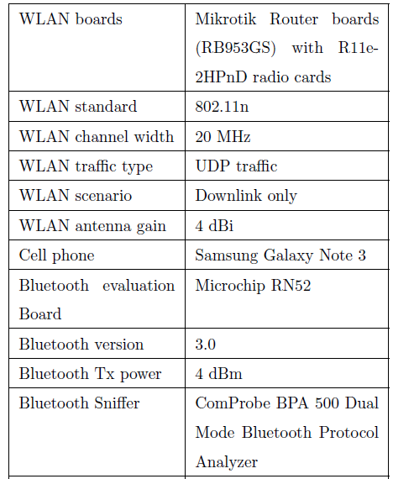
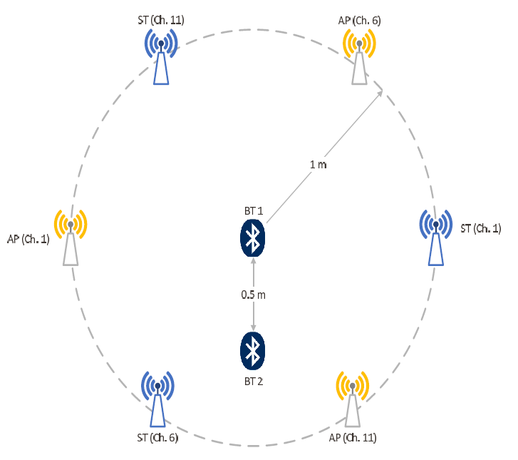
Measurements Setup
The test setup-shown in the figure- below was established in a lab
Three WLAN networks (AP and station) in addition to Bluetooth connection
Bluetooth sniffer was positioned near BT1
Measurements parameters and devices
Measurement setup

Slide 4
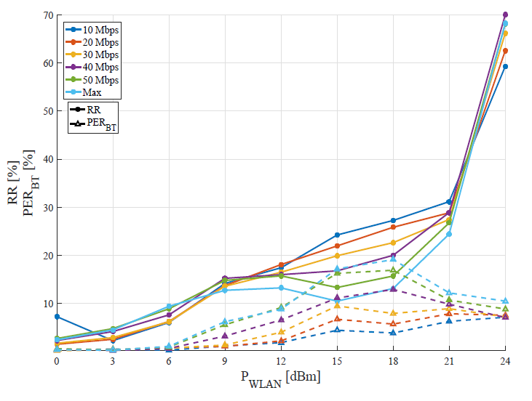
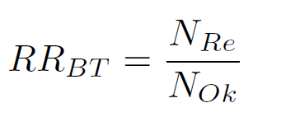
Music Streaming (1)
Bluetooth power level was fixed at 4 dBm
WLAN power level was changed between 0-24 dBm with 3 dB step size
WLAN traffic load was changed between 10-50 Mbps with 10 Mbps step size, in addition to the maximum achieved
Packet error rate and retransmission rate

Slide 5
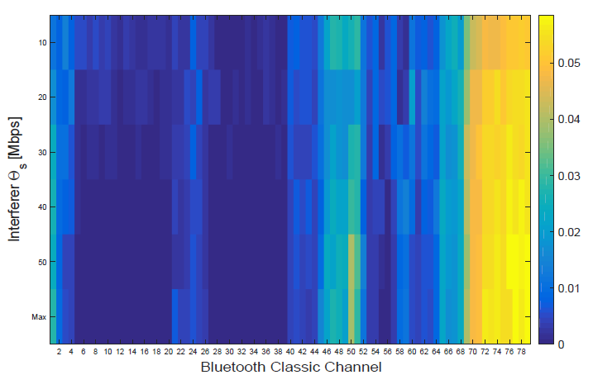
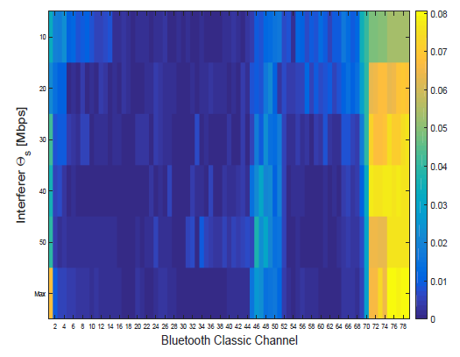
Music Streaming (2)
Bluetooth channels histogram as a function of WLAN traffic load for different WLAN power level
WLAN power Level 18 dBm
WLAN power Level 24 dBm

Slide 6
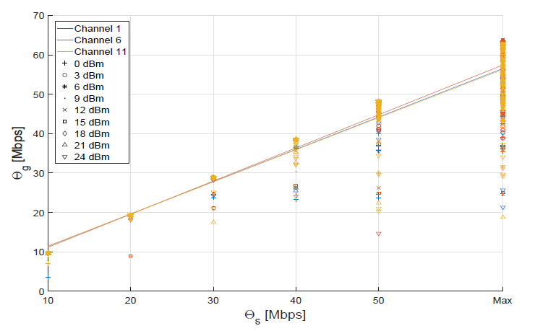
Music Streaming (3)
The Bluetooth effect on WLAN is small, especially for low WLAN traffic loads
Similar effect on all the three WLAN channels (1,6 and 11)
Achieved WLAN throughput Vs. Set WLAN throughput

Slide 7
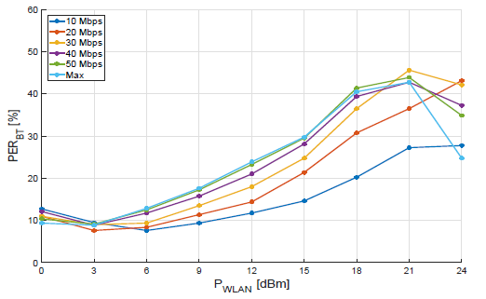
Hands-Free Calling (1)
Same test setup like in case of music streaming
Hands-Free Calling uses SCO link, which does not support any retransmissions
Packet error rate

Slide 8
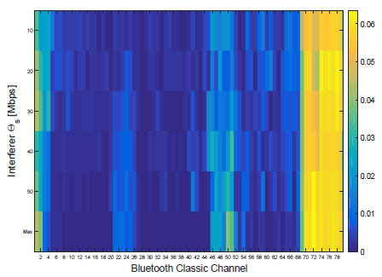
Hands-Free Calling (2)
Bluetooth channels histogram as a function of WLAN traffic load for WLAN power level of 24 dBm
WLAN power Level 24 dBm

Slide 9
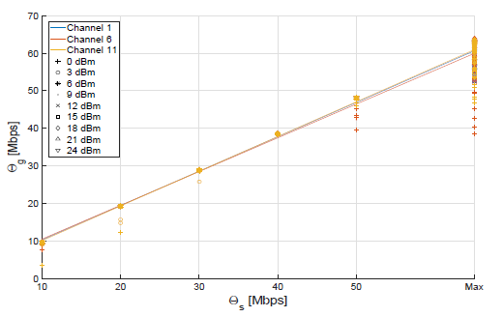
Hands-Free Calling (3)
The Bluetooth effect on WLAN is insignificant, and smaller than music streaming case
Similar effect on all the three WLAN channels (1,6 and 11)
Achieved WLAN throughput Vs. Set WLAN throughput

Slide 10
Observations and Conclusions
The Bluetooth performance will be strongly effected in WLAN dense deployment scenarios, like automotive environment
In this study, only the non-overlapped WLAN Channels (1,6 and 11) were considered, the Bluetooth performance will be worse in case other channels are used as well
Music streaming is more resilient than HFP to WLAN interference as a result of retransmissions
The Bluetooth effect on WLAN is insignificant. Only a small decrement in throughput is observed when networks function with high throughput

