Slide 1
TG1a January 2017 Atlanta Meeting Agenda
Date: 2017-01-17
Authors:
Notice: This document has been prepared to assist IEEE 802.19. It is offered as a basis for discussion and is not binding on the contributing individual(s) or organization(s). The material in this document is subject to change in form and content after further study. The contributor(s) reserve(s) the right to add, amend or withdraw material contained herein.

Slide 2
Agenda graphic

Slide 3
Meeting protocol
Please announce your affiliation when you first address the group during a meeting slot

Slide 4
Attendance
https://imat.ieee.org/my-site/home
Register
Indicate attendance

Slide 5
Agenda items for this week
Approval of meeting minutes
TG1a Opening report
Review and approve IEEE P802.19.1a-D1.0
Comments resolution from WG Letter Ballot
Technical presentations and text proposals
Review project timeline
Motions
Review objectives for next meeting
Schedule for teleconferences

Slide 6
Tuesday AM1

Slide 7
Agenda for Tuesday AM1
TG1a meeting called to order
Call for secretary
Call for submissions and discussions
Approval of agenda
IEEE IPR statement
Approval of November 2016 TG1a meeting and conference call minutes
TG1a Opening report
Review and approve IEEE P802.19.1a-D1.0
Comments resolution from TG reviews
Recess

Slide 8
Call for secretary
Looking for volunteer of recording secretary

Slide 9
Call for submissions
Comments resolutions
  DCN 19-17/0011r0: Comment resolutions on CID7, CID8, CID9 and CID10 (S. Furuichi)
  DCN 19-17/0012r0: Proposed resolution to CID 11 for D1.0 (C. Sun)
  DCN 19-17/0013r0: Proposed resolution to CID 12 for D1.0 (C. Sun)
  DCN 19-17/0014r0: Proposed resolution to CID 13 for D1.0 (C. Sun)

Slide 10
Approval of agenda
Motion to approve the agenda of the January 2017 TG1a meeting, document 19-17/0005r1.

Slide 11
Patent Policy
http://standards.ieee.org/about/sasb/patcom/materials.html

Slide 12


Slide 13


Slide 14
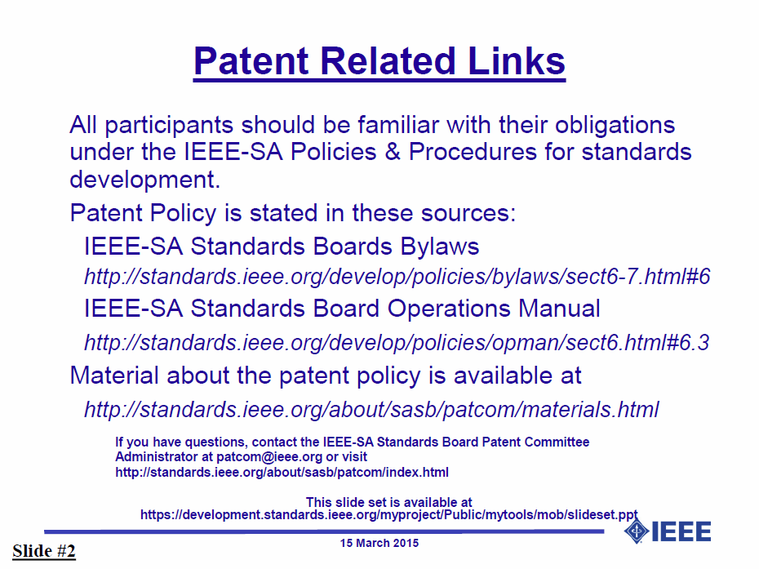

Slide 15


Slide 16


Slide 17
Approval of minutes
Motion to approve the minutes from the November 2016 TG1a meeting, DCN 19-16/0186r0, teleconference call minutes on Jan. 9, 2017, DCN 19-17/0004r0

Slide 18
TG1a Opening report
January 2017 TG1a Opening Report (DCN 19-17/0006r1)

Slide 19
Review IEEE P802.19.1a-D1.0
The latest draft is presented by Technical editor

Slide 20
Motion #1
Approve IEEE P802.19.1a-D1.0 as the candidate draft.

Slide 21
Result of the WG Letter Ballot
Letter Ballot on Draft 1.0 completed on January 6
  Results
    Yes: 17
    No: 0
    Abstain: 4
  WG Letter Ballot Passes
Total 13 comments were received
  Technical: 10
  Editorial: 3
See DCN 19-17/0009r0 “P802.19.1a TG1a D1.0 1st working group letter ballot Comments and Resolutions”

Slide 22
Comments resolution from WG LB
Comments resolutions
  DCN 19-17/0012r0: Proposed resolution to CID 11 for D1.0 (C. Sun)
  DCN 19-17/0013r0: Proposed resolution to CID 12 for D1.0 (C. Sun)

Slide 23
Tuesday PM1

Slide 24
Agenda for Tuesday PM1
TG1a meeting called to order
Technical presentations and text proposals
Recess

Slide 25
Comments resolution from WG LB
Comments resolutions
  DCN 19-17/0014r0: Proposed resolution to CID 13 for D1.0 (C. Sun)
  DCN 19-17/0011r0: Comment resolutions on CID7, CID8, CID9 and CID10 (S. Furuichi)

Slide 26
Wednesday AM1

Slide 27
Agenda for Wednesday AM1
TG1a meeting called to order
Technical presentations and text proposals
Recess

Slide 28
Comments resolution from WG LB

Slide 29
Wednesday PM1

Slide 30
Agenda for Wednesday PM1
TG1a meeting called to order
Revisit text proposals
Review project timeline
Recess

Slide 31
Revisit

Slide 32
Project timeline
Project timeline document
  Doc. 19-15/0096r0: Timeline document (N. Sato)

Slide 33
Thursday PM1

Slide 34
Agenda for Thursday PM1
TG1a meeting called to order
Revisit text proposals
Motions
Review objectives for next meeting
Schedule for teleconferences
Adjourn

Slide 35
Revisit

Slide 36
Motion #2

Slide 37
Motion #3

Slide 38
Motion #4

Slide 39
Review objectives for next meeting

Slide 40
Teleconference
Schedule (1hour)
  Wednesday, Feb. xx, 2017: 1am ET (Wednesday, Feb. xx, 2017 7am CET, 2pm CST, 3pm JST/KST)
Meeting Logistics
  Use “Join Me”
    Join the meeting: https://join.me/ieeesawg802.19
    On a compute4r, use any browser. Nothing to download.
    On a phone or tablet, launch the join.me app and enter meeting code:ieeesawg802.19
    Join the audio conference:
    Dial a phone number and enter access code, or connect via internet.
  The chair will send out a notification to IEEE 802.19 reflector in advance of the meeting

Slide 41
Adjourn

Slide 42
Time difference
Winter
  1am EST (6am UTC, 3pm JST/KST)
  7am EST (noon UTC, 9pm JST/KST)
  5pm EST (10pm UTC, 7am JST/KST + 1day)
Summer
  2am EDT (6am UTC, 3pm JST/KST)
  8am EDT (noon UTC, 9pm JST/KST)
  6pm EDT (10pm UTC, 7am JST/KST + 1day)

