Slide 1
TG1a November 2016 San Antonio Meeting Agenda
Date: 2016-11-10
Authors:
Notice: This document has been prepared to assist IEEE 802.19. It is offered as a basis for discussion and is not binding on the contributing individual(s) or organization(s). The material in this document is subject to change in form and content after further study. The contributor(s) reserve(s) the right to add, amend or withdraw material contained herein.

Slide 2
Agenda graphic

Slide 3
Meeting protocol
Please announce your affiliation when you first address the group during a meeting slot

Slide 4
Attendance
https://imat.ieee.org/my-site/home
Register
Indicate attendance

Slide 5
Agenda items for this week
Approval of meeting minutes
TG1a Opening report
Review and approve IEEE P802.19.1a-D0.5
Comments resolution from TG reviews
Technical presentations and text proposals
Review project timeline
Motions
Review objectives for next meeting
Schedule for teleconferences

Slide 6
Tuesday AM1

Slide 7
Agenda for Tuesday AM1
TG1a meeting called to order
Call for secretary
Call for submissions and discussions
Approval of agenda
IEEE IPR statement
Approval of November 2016 TG1a meeting and conference call minutes
TG1a Opening report
Review and approve IEEE P802.19.1a-D0.5
Comments resolution from TG reviews
Recess

Slide 8
Call for secretary
Looking for volunteer of recording secretary
  Hyunduk Kang for secretary in this week

Slide 9
Call for submissions
Comments resolutions
  DCN 19-16/0173r0: Comment resolution on CID89 in 1st TG review (S. Furuichi)
  DCN 19-16/0174r0: Supplemental Document for Comment Resolution on CID89 in 1st TG Review (S. Furuichi)
  DCN 19-16/0171r0: Proposed resolution of comment 109 for D0.4 (C. Sun)
  DCN 19-16/0175r0: Profile 1 based CM Operation (H. Kang)
  DCN 19-16/0176r0: Profile 1 based CE Operation (H. Kang)
  DCN 19-16/0177r0: Profile 1 based CDIS Operation (H. Kang)
  DCN 19-16/0178r0: Messages for profile 1 (H. Kang)
  DCN 19-16/0179r0: Primitives for profile 1 (H. Kang)
  DCN 19-16/0180r0: Data types for profile 1 (H. Kang)
  DCN 19-16/0181r0: A coexistence discovery algorithm for GCOs under inaccurate geo-location information (H. Kang)
  DCN 19-16/0182r0: A coexistence discovery algorithm for multi-band operating GCOs under inaccurate geo-location information (H. Kang)
  DCN 19-16/0183r0: A coexistence decision algorithm for GCOs operating over overlapped service coverage area (H. Kang)

Slide 10
Approval of agenda
Motion to approve the agenda of the November 2016 TG1a meeting, document 19-16/0168r1.
  Approved by unanimous consent

Slide 11
Patent Policy
http://standards.ieee.org/about/sasb/patcom/materials.html

Slide 12


Slide 13


Slide 14
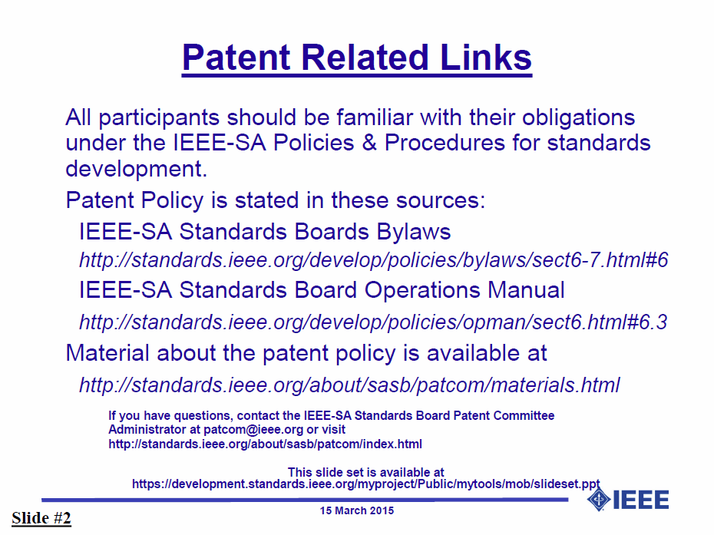

Slide 15


Slide 16


Slide 17
Approval of minutes
Motion to approve the minutes from the September 2016 TG1a meeting, document 19-16/0161r0, teleconference call minutes on Nov. 2, 2016, document 19-16/0167r0

Slide 18
TG1a Opening report
November 2016 TG1a Opening Report (doc. 19-16/0169r0)

Slide 19
Review IEEE P802.19.1a-D0.5
The latest draft is presented by Technical editor

Slide 20
Motion #1
Approve IEEE P802.19.1a-D0.5 as the candidate draft.
  Approved by unanimous consent

Slide 21
Comments from TG reviews
First TG review
  DCN 19-16/0115r5: TG1a D0.3 draft review comments and resolutions (C. Sun)
  Total 10 technical comments are needed to resolve
    CID 89, CID109, CID165, CID166, CID167, CID168, CID169, CID170, CID171 and CID172
Second TG review
  DCN 19-16/0170r1: TG1a D0.5 draft review comments and resolutions (C. Sun)
  Total 39 comments are received
    Technical: 18
    Editorial: 21

Slide 22
Comments resolution from TG reviews
First TG review
  DCN 19-16/0173r0: Comment resolution on CID89 in 1st TG review (S. Furuichi)
  DCN 19-16/0174r0: Supplemental Document for Comment Resolution on CID89 in 1st TG Review (S. Furuichi)
  DCN 19-16/0171r0: Proposed resolution of comment 109 for D0.4 (C. Sun)
Second TG review
  Editor shows modified draft (C. Sun)

Slide 23
Tuesday PM1

Slide 24
Agenda for Tuesday PM1
TG1a meeting called to order
Technical presentations and text proposals
Recess

Slide 25
Comments resolution from TG review
First TG review
  DCN 19-16/0175r0: Profile 1 based CM Operation (H. Kang)
  DCN 19-16/0176r0: Profile 1 based CE Operation (H. Kang)
  DCN 19-16/0177r0: Profile 1 based CDIS Operation (H. Kang)

Slide 26
Tuesday PM2

Slide 27
Agenda for Tuesday PM1
TG1a meeting called to order
Technical presentations and text proposals
Recess

Slide 28
Comments resolution from TG review
First TG review
  DCN 19-16/0178r0: Messages for profile 1 (H. Kang)
  DCN 19-16/0179r0: Primitives for profile 1 (H. Kang)
  DCN 19-16/0180r0: Data types for profile 1 (H. Kang)
  DCN 19-16/0183r0: A coexistence decision algorithm for GCOs operating over overlapped service coverage area (H. Kang)

Slide 29
Thursday AM2

Slide 30
Agenda for Thursday AM2
TG1a meeting called to order
Approval of agenda
Technical presentations and text proposals
Revisit
Recess

Slide 31
Approval of agenda
Motion to approve the agenda of the November 2016 TG1a meeting, document 19-16/0168r2.
  Approved by unanimous consent

Slide 32
Comments resolution from TG review
Second TG review
  DCN 19-16/0170r1: From CID26 to CID39 (C. Sun)
First TG review
  DCN 19-16/0181r1: A coexistence discovery algorithm for GCOs under inaccurate geo-location information (H. Kang)
  DCN 19-16/0182r1: A coexistence discovery algorithm for multi-band operating GCOs under inaccurate geo-location information (H. Kang)

Slide 33
Revisit
First TG review
  DCN 19-16/0183r1: A coexistence decision algorithm for GCOs operating over overlapped service coverage area (H. Kang)

Slide 34
Thursday PM1

Slide 35
Agenda for Thursday PM1
TG1a meeting called to order
Revisit text proposals
Review project timeline
Motions
Review objectives for next meeting
Schedule for teleconferences
Adjourn

Slide 36
Approval of agenda
Motion to approve the agenda of the November 2016 TG1a meeting, document 19-16/0168r3.
  Approved by unanimous consent

Slide 37
Revisit
First TG review
  DCN 19-16/0173r1: Comment resolution on CID89 in 1st TG review (S. Furuichi)
  DCN 19-16/0175r1: Profile 1 based CM Operation (H. Kang)
  DCN 19-16/0176r1: Profile 1 based CE Operation (H. Kang)
  DCN 19-16/0177r1: Profile 1 based CDIS Operation (H. Kang)
  DCN 19-16/0178r1: Messages for profile 1 (H. Kang)
  DCN 19-16/0179r2: Primitives for profile 1 (H. Kang)
  DCN 19-16/0180r1: Data types for profile 1 (H. Kang)
  DCN 19-16/0181r2: A coexistence discovery algorithm for GCOs under inaccurate geo-location information (H. Kang)
  DCN 19-16/0182r2: A coexistence discovery algorithm for multi-band operating GCOs under inaccurate geo-location information (H. Kang)
  DCN 19-16/0183r2: A coexistence decision algorithm for GCOs operating over overlapped service coverage area (H. Kang)

Slide 38
Project timeline
Plan of WG Letter Ballot
  DCN 19-16/0185r0: Plan of WG Letter Ballot (N. Sato)
Project timeline document
  Doc. 19-15/0096r0: Timeline document (N. Sato)

Slide 39
Motion #2
Instruct the TG editor to resolve editorial comments, and implement the resolutions for general and technical comments according to column K of DCN 19-16/0170r2
  Move: S. Furuichi
  Second: H. Kang
  Approved by unanimous consent

Slide 40
Motion #3
Approve text proposals in DCN 19-16/0171r0, 19-16/0173r1, 19-16/0175r1, 19-16/0176r1, 19-16/0177r1, 19-16/0178r1, 19-16/0179r2, 19-16/0180r1, 19-16/0181r2, 19-16/0182r2 and 19-16/0183r2 instruct the TG editor to implement approved text proposals and update to the IEEE P802.19.1a candidate draft D1.0 by December 6, 2016
  Move: H. Kang
  Second: C. Sun
  Approved by unanimous consent

Slide 41
Motion #4
Approve to ask working group chairman to start the working letter ballot using the IEEE P802.19.1a candidate draft D1.0 no later than December 9, 2016
  Move: C. Sun
  Second: H. Kang
  Approved by unanimous consent

Slide 42
Review objectives for next meeting
Start to resolve comments from WG Letter Ballot

Slide 43
Teleconference
Schedule (1hour)
  Tuesday, Jan. 10, 2017: 8pm ET (Wednesday, Jan 11, 2017 2am CET, 9am CST, 10am JST/KST)
Meeting Logistics
  Use “Join Me”
    Join the meeting: https://join.me/ieeesawg802.19
    On a compute4r, use any browser. Nothing to download.
    On a phone or tablet, launch the join.me app and enter meeting code:ieeesawg802.19
    Join the audio conference:
    Dial a phone number and enter access code, or connect via internet.
  The chair will send out a notification to IEEE 802.19 reflector in advance of the meeting

Slide 44
Adjourn

Slide 45
Time difference
Winter
  1am EST (6am UTC, 3pm JST/KST)
  7am EST (noon UTC, 9pm JST/KST)
  5pm EST (10pm UTC, 7am JST/KST + 1day)
Summer
  2am EDT (6am UTC, 3pm JST/KST)
  8am EDT (noon UTC, 9pm JST/KST)
  6pm EDT (10pm UTC, 7am JST/KST + 1day)

