Slide 1
WAC Sep. 2016 Warsaw Meeting Agenda
Date: 14/9/2016
Authors:
Notice: This document has been prepared to assist IEEE 802.19. It is offered as a basis for discussion and is not binding on the contributing individual(s) or organization(s). The material in this document is subject to change in form and content after further study. The contributor(s) reserve(s) the right to add, amend or withdraw material contained herein.

Slide 2
Agenda Graphics

Slide 3
Meeting protocol
Please announce your affiliation when you first address the group during a meeting slot

Slide 4
Attendance
https://imat.ieee.org/my-site/home
Register
Indicate attendance

Slide 5
Agenda items for this week
Approval of meeting minutes
WAC Opening report
Technical submissions
Review PAR document with updated comments (19-16/0143r0)
Review CSD document (19-16/130r2)
Motions
Review objectives for next meeting
Schedule for teleconferences

Slide 6
Wednesday PM2

Slide 7
Agenda for Wednesday PM2
WAC meeting called to order
Call for submissions and discussions
Approval of agenda
IEEE IPR statement
Approval of July 2016 WAC meeting minutes
Approval of September 2016 WAC conference call minutes
WAC Opening report
Technical submissions
Review of CSD document
Review of PAR document
Recess

Slide 8
Approval of agenda
Motion to approve the agenda of the September 2016 WAC meeting, document 19-16/0158r0.
  Unanimous consent

Slide 9
Patent Policy
http://standards.ieee.org/about/sasb/patcom/materials.html

Slide 10


Slide 11


Slide 12
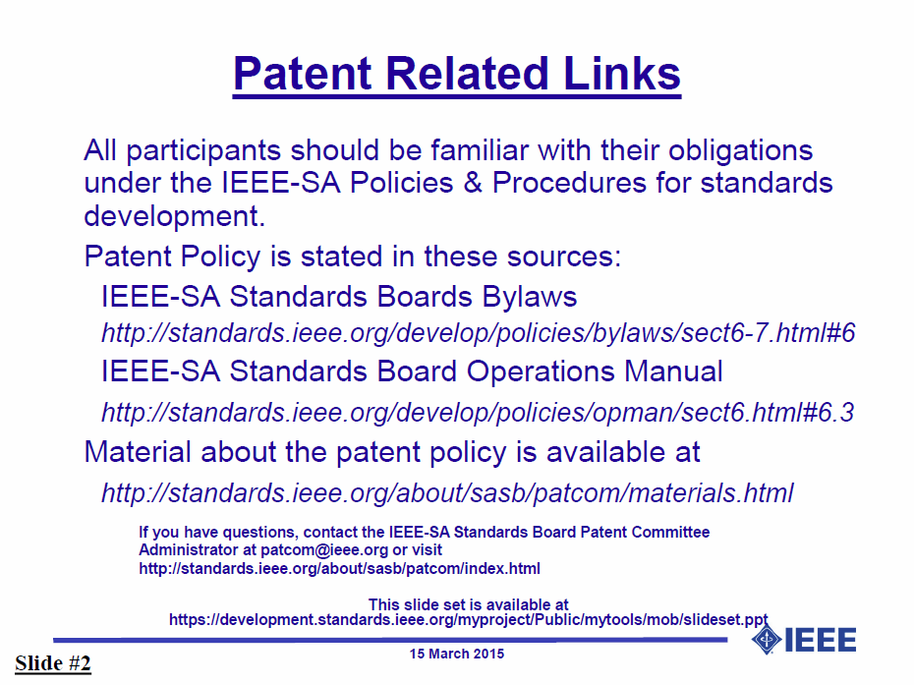

Slide 13


Slide 14


Slide 15
Approval of minutes
Motion to approve the minutes from the July 2016 WAC meeting, document 19-16/0129r1, teleconference call minutes, document 19-16/0144r1
  Unanimous consent

Slide 16
Call for submissions (1/2)
Technical submissions
  Naotaka Sato, 19-16/0156r0
    Straw Poll - passed
  Igal Kotzer, 19-16/0157r0
PAR document
  19-16/0099r4
CSD document
  19-16/0130r2

Slide 17
Call for submissions (2/2)
Discussions
  None

Slide 18
Recess

Slide 19
Thursday AM2

Slide 20
Agenda for Thursday AM2
WAC meeting called to order
Approval of agenda
Submission
Motion to approve PAR and CSD
Adjourn

Slide 21
Approval of agenda
Motion to approve the agenda of the September 2016 WAC meeting, document 19-16/0158r1.
  Unanimous consent

Slide 22
Call for submissions
PAR document
  19-16/0099r5
CSD document
  19-16/0130r3

Slide 23
Approval of PAR and CSD
Motion to approve the PAR document 19/16-0099r6 and CSD document 19/0130r4.
  Mover: Naotaka Sato
  Second: Steve Shellhammer
  Result (Y/N/A): 10/0/2
    Motion passes

Slide 24
Adjourn

