Slide 1
CID163 resolution: Priority Based Coexistence Management
Date: 2016-09-11
Authors:
Notice: This document has been prepared to assist IEEE 802.19. It is offered as a basis for discussion and is not binding on the contributing individual(s) or organization(s). The material in this document is subject to change in form and content after further study. The contributor(s) reserve(s) the right to add, amend or withdraw material contained herein.

Slide 2
Abstract
This document proposes priority based coexistence management for IEEE P802.19.1a in order to improve efficiency of the spectrum utilization.

Slide 3
Motivation: Why we need priority based coexistence management
PCAST indicates “The number of mobile devices could rise to 50 billion by 2020…One of the other important directions that spectrum policy must take is to create a marketplace that can accommodate the widest range of commercial users” [1]
We need to accommodate the large number of devices/networks.
Due to the distribution variety of the channels in use, for a certain GCO, the available channels have different impact to current system performance as well as succeeding resource allocation.
To accommodate more GCOs raises the need of fine-grained resource allocation, which prioritizes available spectrum considering the prospective impact of their usage to the system capacity.
➔ No resource allocation considering such variety of channel use in IEEE P802.19.1a so far.

Slide 4
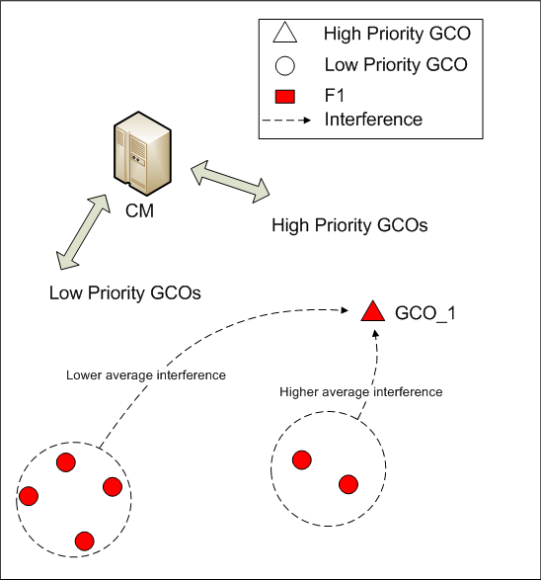
Example scenario
CM manages GCOs with different priorities (high/low).
New entrant low-priority GCO requires channel.
Given interference tolerance for the high priority GCO, the lower interference is caused, the more low priority GCO will be accommodated.
Fig 1. Example Problem

Slide 5
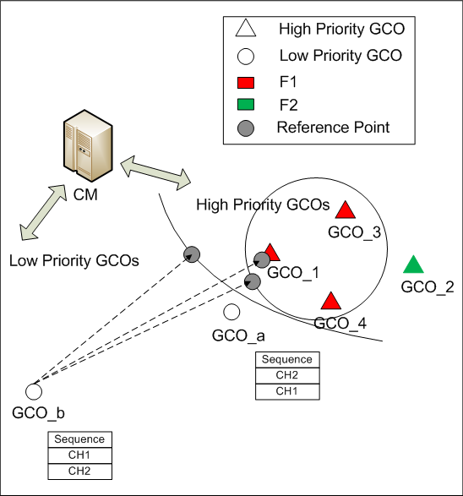
Solution
The priority based resource allocation could be launched by CM in the condition that there has no interference-free available frequency for the target GCO.
Prospective interference level: the amount of interference that would be caused by the allocation of that particular frequency to be used by the target GCO.
CM sorts the recommended operation frequencies to be used by target CGO in decreasing order of its prospective interference level to high priority GCO operating on the same channel.
GCO estimates sequentially if the selected frequency can satisfy the GCO’s SINR requirement.
GCO feedbacks the information of new operating frequencies to CM for further coexistence discovery
Fig 1. Example Solution

Slide 6
Flowchart

Slide 7
Conclusion
Priority based coexistence management is able to reduce interference from low priority GCO to high priority GCO
Priority based coexistence management scheme as well as related data, procedure, message should be introduced into IEEE 802.19.1a system

Slide 8
Reference
[1] PCAST, “REALIZING THE FULL POTENTIAL OF GOVERNMENT-HELD SPECTRUM TO SPUR ECONOMIC GROWTH,” July 2012

