Slide 1
CID162 resolution
Graph based resource allocation
Date: 2016-09-11
Authors:
Notice: This document has been prepared to assist IEEE 802.19. It is offered as a basis for discussion and is not binding on the contributing individual(s) or organization(s). The material in this document is subject to change in form and content after further study. The contributor(s) reserve(s) the right to add, amend or withdraw material contained herein.

Slide 2
Abstract
This document proposes graph based resource allocation for IEEE P802.19.1a in order to improve efficiency of the spectrum utilization.

Slide 3
Motivation/Introduction
  Most studies focus on the interference management among GCOs controlled by single spectrum coordinator (CM).
  Serious co-channel interference needs to be mitigated among GCOs controlled by multiple CMs.

Slide 4
Scenarios under consideration:
Multiple CM managed GCO networks
Overlapping area to be coordinated by CMs
Note: CMs may be developed for the different geographical areas/services/networks/users or spectrum policies, resulting various coexistence scenarios!

Slide 5

Formulated Problem
How to increase the number of satisfied GCOs (i.e., $SINR≥{SINR}_{th}$) and reduce the co-channel interference in the overlapping area with different CMs?
The co-channel interference of the i-th GCO receiver is defined by:
Note: A includes the index of all co-channel GCO transmitters in the overlapping area

Slide 6
Proposed Initial Solution/Algorithm
Cluster-based joint power and spectrum allocation scheme through the cooperation among CMs, while subject to power limitation. Each cluster uses the same frequency
B: index set including all co-channel GCO receivers
D: index set including all co-channel GCO transmitters

Slide 7
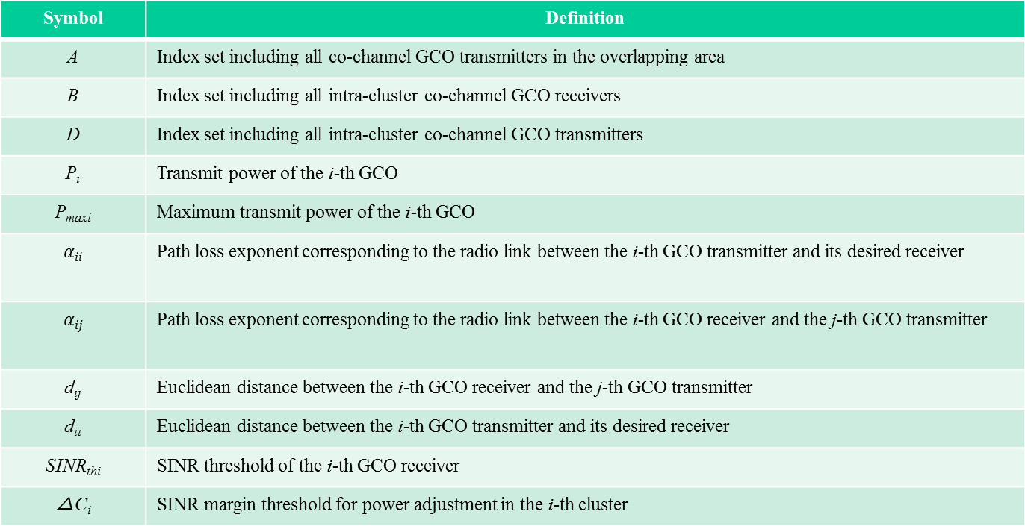
List of Parameters/Notations
Symbol | Definition
A | Index set including all co-channel GCO transmitters in the overlapping area
B | Index set including all intra-cluster co-channel GCO receivers
D | Index set including all intra-cluster co-channel GCO transmitters
P_{i} | Transmit power of the i-th GCO
P_{maxi} | Maximum transmit power of the i-th GCO
$$αii$$ | Path loss exponent corresponding to the radio link between the i-th GCO transmitter and its desired receiver
$$αij$$ | Path loss exponent corresponding to the radio link between the i-th GCO receiver and the j-th GCO transmitter
d_{ij} | Euclidean distance between the i-th GCO receiver and the j-th GCO transmitter
d_{ii} | Euclidean distance between the i-th GCO transmitter and its desired receiver
SINR_{thi} | SINR threshold of the i-th GCO receiver
△C_{i} | SINR margin threshold for power adjustment in the i-th cluster

Slide 8
Block Diagram of the Proposed Solution/Algorithm

Slide 9
Procedure of Forming Clusters (1/2)
Weighted graph-based cluster considering the SINR thresholds, maximum transmit power and locations of GCOs
Form an undirected weighted graph G=(V, E, W)
V: Collections of Tx-Rx pair
E: Collections of the edge between two Tx-Rx pairs
W: Collections of the weight (i.e., w_{ij}) in each edge
W={w_{ij}}
The weight is normalized by the respective SINR threshold. The bigger weight, the smaller relative interference to its SINR requirement.

Slide 10
Procedure of Forming cochannel Clusters (2/2)
Procedure of adding as many GCOs to co-channel cluster until the SINR threshold is reached.

Slide 11
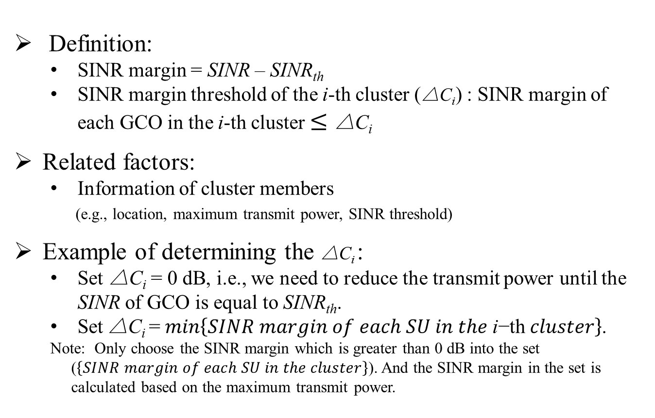
Determine the SINR margin threshold
of each cluster
Definition:
  SINR margin = SINR – SINR_{th}
  SINR margin threshold of the i-th cluster (△C_{i}) : SINR margin of each GCO in the i-th cluster $≤\text{△}\text{C}\text{i}$
Related factors:
  Information of cluster members
  (e.g., location, maximum transmit power, SINR threshold)
Example of determining the △C_{i} :
  Set $\text{△}\text{C}\text{i}$ = 0 dB, i.e., we need to reduce the transmit power until the SINR of GCO is equal to SINR_{th}.
  Set$\text{△}\text{C}\text{i} \text{=} min\left\{SINR margin of each SU in the \text{i}\text{−}\text{th} cluster\right\}$.
  Note: Only choose the SINR margin which is greater than 0 dB into the set ($\left\{SINR margin of each SU in the cluster\right\}$). And the SINR margin in the set is calculated based on the maximum transmit power.

Slide 12
Simulation Scenario
Multiple GCOs in the overlapping area coexist, and at a given time instance in each system there is only one pair of users.
GCOs in the overlapping area are different prioritized small cells, and the radius of each GCO is 20 m.
The transmitter is in the center and the receiver is in the edge.
Path loss and uniformly random distribution are assumed.

Slide 13
Simulation Settings
Parameters | Value
Number of Tx-Rx pairs (N_{p}) | 12
Number of available channels/spectrum (N_{c}) | 3
Noise Figure at GCO receiver (NF) | 5 dB
SINR threshold (SINR_{th}) | 9 dB ~ 20 dB
Maximum transmit power of the former six GCOs (P_{max1}) | 3 dBm
Maximum transmit power of the latter six GCOs (P_{max2}) | 0 dBm
Path loss exponent ( ) | 2.5
Path loss exponent ( ) | 3.5
SINR margin threshold of each cluster (△C_{i}) | 0 dB
13

Slide 14
Objective of Simulation
To exhibit the different clustering results under different weight settings.
To verify our method can increase the number of satisfied users.
To show our method can ensure different SINR based on the different SINR requirement settings.
To demonstrate our method can reduce the co-channel interference between GCOs in the overlapping area.
14

Slide 15
Comparison of Clustering Result
Using the proposed clustering procedure with different weight settings:
Existing [*] :
Proposed :
Different weight settings result in different clustering:
Red: Cluster 1 (C₁);
Blue: Cluster 2 (C₂);
Green: Cluster 3 (C₃).
[*] S. Chen and R. S. Cheng, “Clustering for interference alignment in a multiuser interference channel,” in Proc. IEEE VTC, Yokohama, Japan, May 2012, pp. 1–5.
15

Slide 16
Comparison of Number of Satisfied GCOs
Change the locations of the 12 GCOs (10000 simulation runs), and get the probability of satisfying all GCOs’ SINR requirements:
Baseline Approach: Sequential Coloring | Using the Proposed Clustering Procedure with Existing Weight Setting (w/o power adjustment) | Using the Proposed Clustering Procedure with Proposed Weight Setting (w/o power adjustment) | Using the Proposed Clustering Procedure with Proposed Weight Setting (with power adjustment)
82% | 84% | 95% | 96%
The total number of satisfied GCOs can be increased with the proposed weight setting.
16

Slide 17
CDF of SINR of GCO₁
Only change the locations of the 12 GCOs (10000 simulation runs):
(1) The proposed weight shows better performance than the existing weight in ensuring different SINR based on the different SINR requirement settings.
(2) The probability of failing to meet the SINR requirement is about 6% with sequential coloring and with the existing weight setting, while it is 0% with the proposed weight setting.
17

Slide 18
CDF of sum of Interference
Sum of intra-cluster interference:
Only change the locations of the 12 GCOs (10000 simulation runs).
The proposed algorithm shows better performance in terms of sum interference.
18

Slide 19
Conclusion
Proposed cluster-based spectrum allocation scheme to increase the number of satisfied users and reduce the co-channel interference in the overlapping area controlled by different CMs.
The algorithm builds on the interference relationship among GCOs, which is represented by graph
Proposed a new weight design considering different QoS requirements of GCOs in the weighted graph -based cluster algorithm.
Proposed SINR margin threshold-based power adjustment scheme.

