Slide 1
Automotive Wireless Coexistence, Sept. 6th Teleconference Agenda
Date: 2016-09-06
Authors:
Notice: This document has been prepared to assist IEEE 802.19. It is offered as a basis for discussion and is not binding on the contributing individual(s) or organization(s). The material in this document is subject to change in form and content after further study. The contributor(s) reserve(s) the right to add, amend or withdraw material contained herein.

Slide 2
Teleconference information
Time & Date: 10am EST, July 5th, 2016
Conference ID: 84837094
This is an online meeting for Skype for Business, the professional meetings and communications app formerly known as Lync.
Join by phone
AAA (UCTEMEA21) +49 (89) 358 903 20098
Austria (AT) +43 (7252) 888-3700
BBB (UCTEMEA33) +49 (89) 358 903 20098
Braslien (BR) +55 (47) 3016-1100
Canada (CA) +1 (905) 428-5444
China (CN) +86 (10) 8455-3000
Germany (DE) +49 (89) 382-42001
South Africa (ZA) +27 (12) 522-3700
United Kingdom (UK) +44 (1865) 8-28000
United States (US) +1 (864) 802-2700
+1 (201) 571-5100
+1 (614) 789-7300
ZoneX (ZX) +49 (89) 358903-20099

Slide 3
Attendance
Please send your name and affiliation to alaa.mourad@bmw.de

Slide 4
Agenda for July 5th
Study Group meeting called to order
IEEE IPR statement
Call for submissions, discussions and approval of agenda
Discuss PAR document: 802.19-16/0099r4
Discuss CSD document: 802.19-16/0130r1
  Discussion (all)
AOB
Adjourn

Slide 5
Patent Policy
http://standards.ieee.org/about/sasb/patcom/materials.html

Slide 6


Slide 7


Slide 8
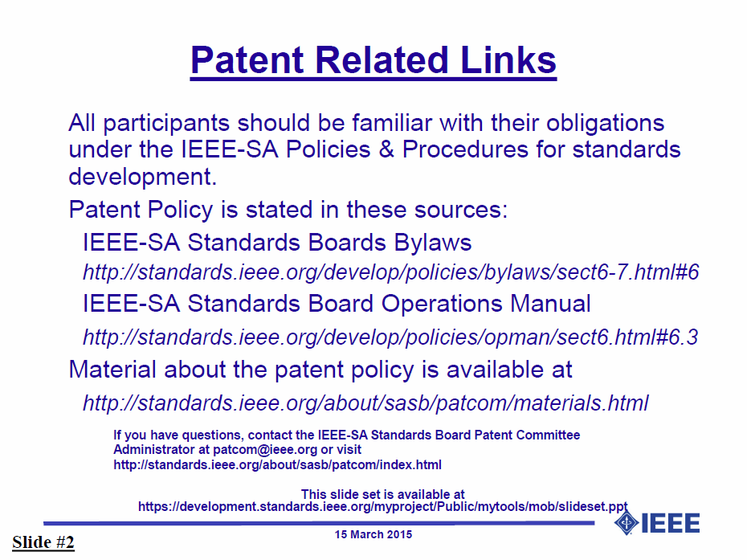

Slide 9


Slide 10
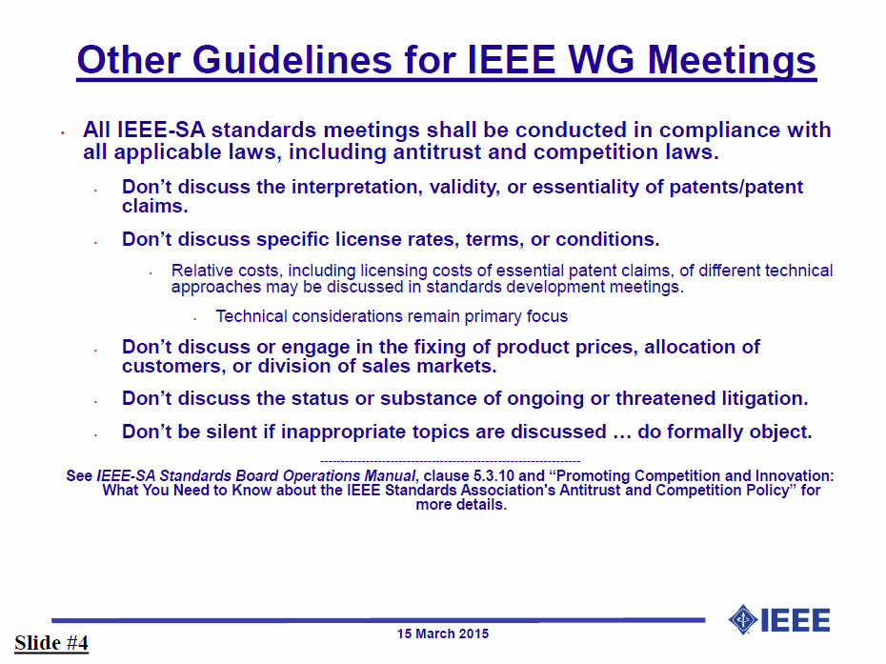

Slide 11
AOB
Any Other Business?

Slide 12
Next Meeting
The next meeting will be in Warsaw, Poland (11-16th September 2016)
The Auto SG has two time slots:
  Wednesday, 14th ,16:00-18:00
  Thursday, 15th ,10:30-12:30

Slide 13
Adjourn

