Slide 1
Testing for wireless coexistence: Methods and tools
Date: 2016-07-25
Authors:
Notice: This document has been prepared to assist IEEE 802.19. It is offered as a basis for discussion and is not binding on the contributing individual(s) or organization(s). The material in this document is subject to change in form and content after further study. The contributor(s) reserve(s) the right to add, amend or withdraw material contained herein.

Slide 2
Introduction
Motivation:
  Ensure successful operation of coexisting devices.
  In some cases, satisfy requirements by regulators.
Confusion with EMC testing!
Testing Objective:
  Threshold(s) of interference.

Slide 3
Groups and Standards
IEEE 802.19 Wireless Coexistence Technical Advisory Group (TAG).
International Electrotechnical Commission (IEC) 62657-2:2013 Coexistence in industrial automation application.
Association for the Advancement of Medical Instrumentation (AAMI) standard committee work group SM/WG-06 on Wireless Medical Device Coexistence.
American National Standards Institute (ANSI) C63.27 Standard for Evaluation of Wireless Coexistence.

Slide 4
Why Testing?
Reports of coexistence evaluation in literature include:
  Analytical: Models relying on assumptions to derive an optimized performance metric.
  Experimental: Diverse setups, experiment variables and monitored performance metrics.
Focus is on technology (e.g., Wi-Fi vs Bluetooth) rather than universal physical parameters.
Focus on system design (i.e., how to make a system that coexists well with others) more than coexistence evaluation of available systems.

Slide 5
Coexistence Factors^{[1]}

Slide 6
Conducted Testing^{[2]}

Slide 7
Radiated Using Anechoic Chambers^{[3]}

Slide 8
Radiated Open Environment^{[4]}

Slide 9
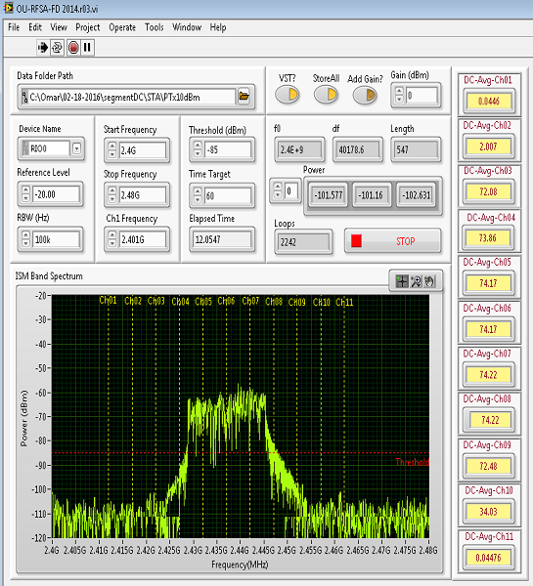
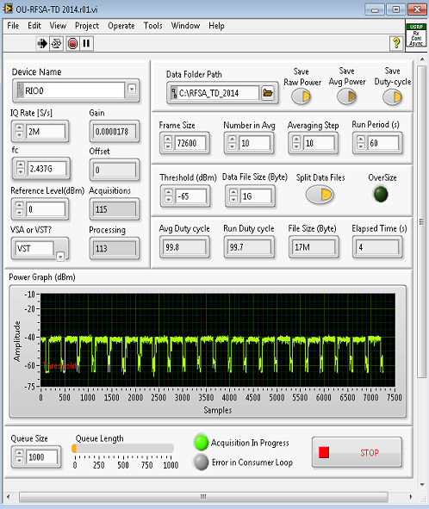
Channel Utilization (CU)^{[5]}
Frequency Domain Analysis
Time Domain Analysis

Slide 10
Classification of CU using machine learning
Example:
EUT 802.11n operating at 10 Mbps for 30 seconds.
Interfering network is 802.11n operating at Low (10 Mbps), Medium (30 Mbps), or High (60 Mbps) throughput.

Slide 11
Classification of CU using machine learning
Collisions vs. Time
Collision Examples

Slide 12
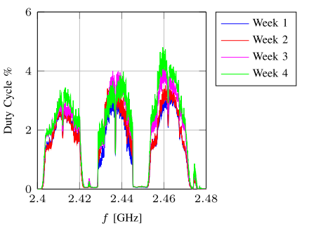
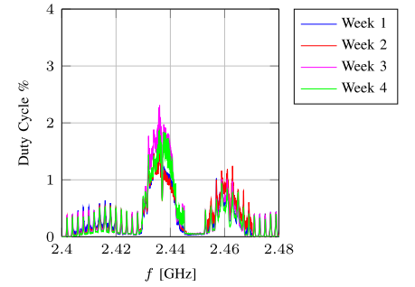
Environments Characterization: Hospital^{[6]}
Surgery Recovery Room
ICU

Slide 13
Conclusion and future trends
Testing for coexistence offers manufacturers a way to evaluate the performance of their devices when operating in real-life interference scenarios.
Projection of testing problem into three essential coexistence parameters allows for seamless implementation of testing methods across labs and equipment manufacturers.
The future is already here:
  The arrival of LTE-U.
  Wireless coexistence in the vehicular world.

Slide 14
References
[1] S. Seidman and N. LaSorte, “An experimental method for evaluating wireless coexistence of a Bluetooth medical device,” IEEE Electromagn. Compat. Mag., vol. 3, no. 3, pp. 49–54, 2014.
[2] Young, W. F., Coder, J. B., & Gonzalez, L. A. (2015). A review of wireless coexistence test methodologies. In 2015 IEEE Symposium on Electromagnetic Compatibility and Signal Integrity (pp. 69–74).
[3] K. A. Remley and W. F. Young, “Test methods for RF-based electronic safety equipment: Part 2 — Development of laboratory-based tests,” IEEE Electromagn. Compat. Mag., vol. 2, no. 1, pp. 70–80, 2013.
[4] N. J. LaSorte, S. a Rajab, and H. H. Refai, “Developing a reproducible non-line-of-sight experimental setup for testing wireless medical device coexistence utilizing ZigBee.,” IEEE Trans. Biomed. Eng., vol. 59, no. 11, pp. 3221–9, Nov. 2012.

Slide 15
References
[5] W. Balid, M. O. Al Kalaa, S. Rajab, H. Tafish, and H. H. Refai, “Development of Measurement Techniques and Tools for Coexistence Testing of Wireless Medical Devices,” in Wireless Communications and Networking Conference Workshops (WCNCW), 2016 IEEE, 2016.
[6] M. O. Al Kalaa, G. Butron, W. Balid, H. H. Refai, and N. J. Lasorte, “Long Term Spectrum Survey of the 2 . 4 GHz ISM Band in Multiple Hospital Environments,” in Wireless Communications and Networking Conference Workshops (WCNCW), 2016 IEEE, 2016.

