Slide 1
Auto SG July 2016 San Diego Meeting Agenda
Date: 2016-07-21
Authors:
Notice: This document has been prepared to assist IEEE 802.19. It is offered as a basis for discussion and is not binding on the contributing individual(s) or organization(s). The material in this document is subject to change in form and content after further study. The contributor(s) reserve(s) the right to add, amend or withdraw material contained herein.

Slide 2
Agenda graphic

Slide 3
Meeting protocol
Please announce your affiliation when you first address the group during a meeting slot

Slide 4
Attendance
https://imat.ieee.org/my-site/home
Register
Indicate attendance

Slide 5
Agenda items for this week
Approval of meeting minutes
SG Opening report
Technical presentations
Update the PAR
Start working on CSD
Motions
Review objectives for next meeting
Schedule for teleconferences

Slide 6
Call for secretary
Looking for volunteer of recording secretary

Slide 7
Approval of agenda
Motion to approve the agenda of the July 2016 Auto SG meeting, document 19-16/120r0

Slide 8
Patent Policy
http://standards.ieee.org/about/sasb/patcom/materials.html

Slide 9


Slide 10


Slide 11
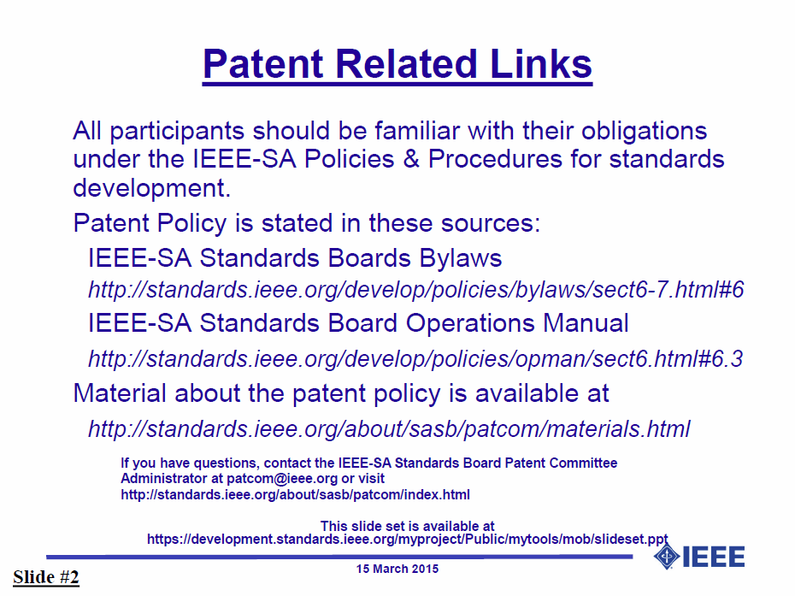

Slide 12


Slide 13


Slide 14
Auto SG Opening report
July 2016 TG1a Opening Report (doc. 19-16/121r0)

Slide 15
Tuesday PM2

Slide 16
Agenda for Tuesday PM2
SG meeting called to order
Call for secretary
Call for submissions and discussions
Approval of agenda
IEEE IPR statement
SG Opening report
Technical presentations
Recess

Slide 17
Thursday AM2

Slide 18
Agenda for Thursday AM2
SG meeting called to order
Agenda review and update
Update the PAR document
Start working on the CSD document
Recess

Slide 19
Review objectives for next meeting

Slide 20
Teleconference
Schedule (1hour)
  xxx, xxx, 2016: 10am EDT
Meeting Logistics
  Skype for business
  The chair will send out a notification to IEEE 802.19 reflector in advanced

Slide 21
Adjourn

