Slide 1
Wi-Fi Network Signal Strength Field Data
Date: 2016-07-04
Authors:
Notice: This document has been prepared to assist IEEE 802.19. It is offered as a basis for discussion and is not binding on the contributing individual(s) or organization(s). The material in this document is subject to change in form and content after further study. The contributor(s) reserve(s) the right to add, amend or withdraw material contained herein.

Slide 2
Abstract
This document presents data captured in a variety of venues that show how detected energy from an overlapping network (OBSS) impacts a Wi-Fi network at detect levels above, at and below -72 dBm
This is presented for information only

Slide 3
Summary
Ericsson indoor Wi-Fi RSSI measurements have shown median UL/DL RSSI for MyBSS associated STAs of -46/-51 dBm for indoor enterprise case
Ericsson measurements at a 50,000 seat stadium have shown median UL RSSI for MyBSS associated STAs of -56 dBm for “authenticated sessions” and asserted DL RSSI from best serving AP > -50 dBm based on AirMagnet survey data
These results confirm expectations that MyBSS STAs in highly planned dense deployments should generally be above the roaming threshold of typical client devices. For Apple IOS this is -70 dBm.
OBSS traffic RSSI is far more important than MyBSS STA RSSI due to 802.11 CSMA algorithm which asserts channel busy for valid PLCP preambles down to the RX sensitivity threshold (typically below -90 dBm in modern clients and APs)
This contribution includes both MyBSS and OBSS signal measurements in multiple locations at two large indoor enterprise WLANs and one 68K seat stadium. We find significant OBSS traffic below -72 dBm
We conclude that WFA’s -77dBm test level is critical to evaluating fair coexistence in real world networks

Slide 4
Measurements Sites and Conditions: Indoor Enterprise
Site 1: Bay Area Enterprise
  Indoor office environment: 430,000 ft² (37,680 m²); 2,800 employees; 203 APs
  5 sets of packet capture data captured over periods of ~15 minutes directly under serving APs operating on 5GHz 40MHz channels 36+, 44+, 52+, 108+, and 157+ during morning busy hour (10am - 11am)
  Data capture method: Air capture
  Data capture tool: 11ac 3SS MacBook Pro (Wireless Diagnostic Tool)
  Includes upstream and downstream data, control, and management traffic
Site 2: Microsoft Enterprise Network
  Indoor office environment 276,000 ft² (25,640 m²); 840 employees; 300 APs
  2 sets of packet capture data over periods of ~5 minutes from APs operating on 5GHz 40MHz channels 149+, and 161-
  Data capture method: Aruba AP RPcap
  Data capture tool: AP-225 3x3:3 802.11ac Wave1 AP
  Includes upstream and downstream data, control, and management traffic

Slide 5
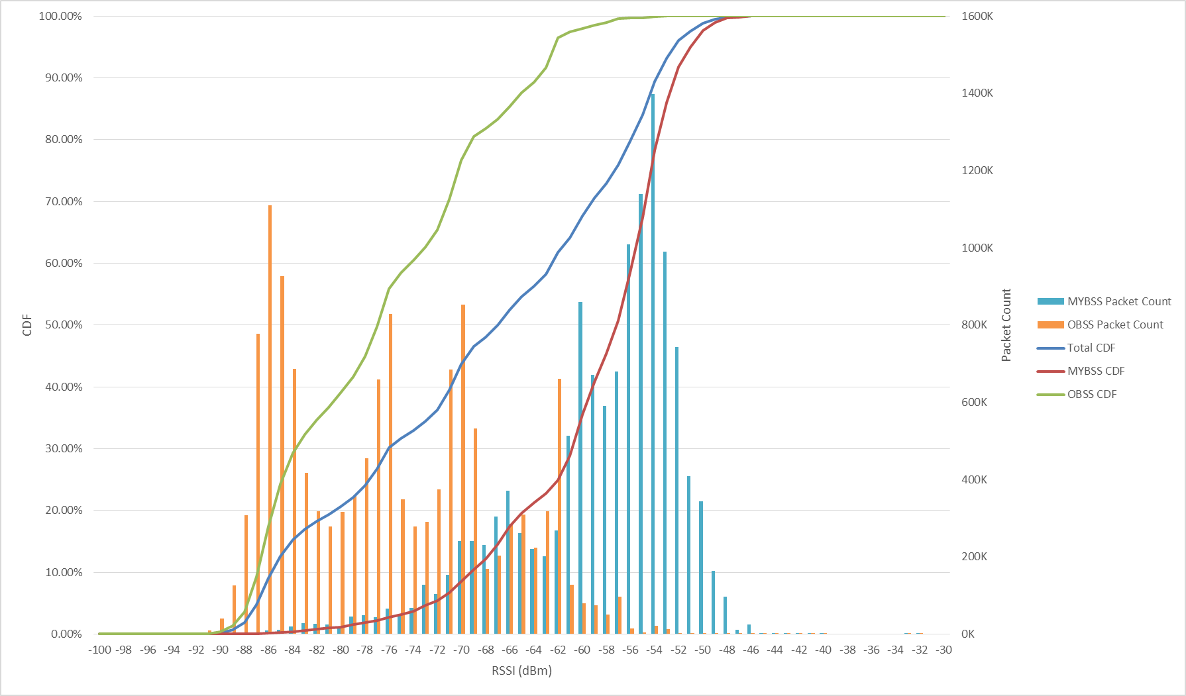
Measurement Results: Bay Area Enterprise (All Channels)
Channels: 36+, 44+, 52+, 108+ and 157+
Duration: ~15 min on each channel
Noise floor: -92dBm
MyBSSID Count: 15
OBSSID Count: 199
My STA Count: 378
OBSS STA Count: 1157
Packets Captured:
  MyBSS: 12,839,489
  OBSS: 13,631,534
  Total: 26,471,023
Traffic below -72dBm:
  MyBSS: 5.4%
  OBSS: 65%
  MyBSS+OBSS: 36%
HP Enterprise

Slide 6
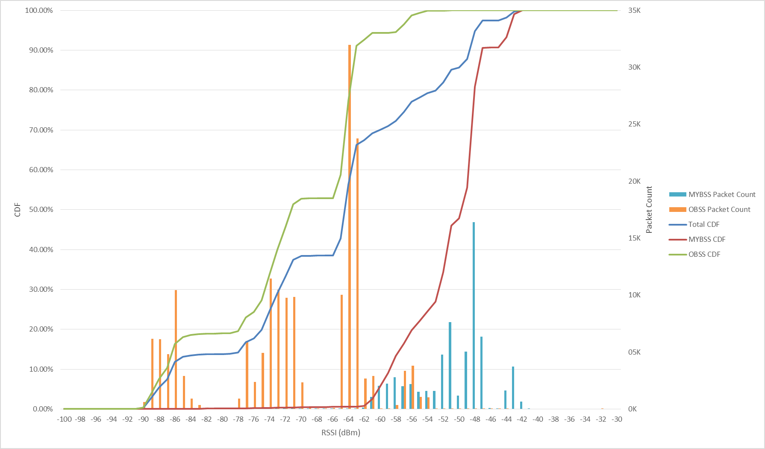
Measurement Results: Microsoft Enterprise Network (All Channels)
Channels: 149+ and 161-
Duration: ~5 min on each channel
Noise floor: -97dBm
MyBSSID Count: 5
OBSSID Count: 97
My STA Count: 6
OBSS STA Count: 18
Packets Captured:
  MyBSS: 65,134
  OBSS: 172,236
  Total: 237,370
Traffic below -72dBm:
  MyBSS: 0.4%
  OBSS: 46%
  MyBSS+OBSS: 33%
HP Enterprise

Slide 7
Measurements Sites and Conditions: 68,500 Seat Stadium
Site 3: Levi’s Stadium
  American football stadium. 68,500 seat capacity
  Event: Copa America Centenario, USA vs. Colombia 6/3/2016. Attendance = 67,439 (98.5% full)
  Underseat picocell deployment. 802.11ac Wave 1 3x3:3 APs; 20 MHz channels
  3 sets of packet capture data taken at midfield on three different levels:
      Section 115, Row 31, Seat 2, Channel 157 – 15 minutes
      Section 216, Row 4, Seat 7, Channel 161 – 17 minutes
      Section 405, Row 21, Seat 15, Channel 149 – 10 minutes
  Data capture method: Air capture, sitting directly on top of picocell AP
  Data capture tool: 11ac 3SS MacBook Pro (Wireless Diagnostic Tool)
  Includes upstream and downstream data, control, and management traffic

Slide 8
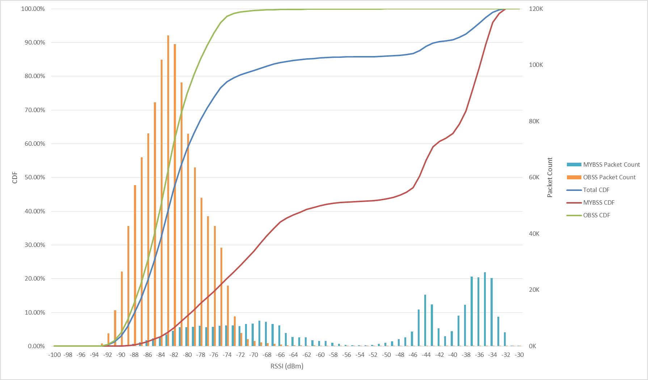
Measurement Results: Levi’s Stadium (All Channels)
Channels: 149, 157, and 161
Duration: 10 - 17 min on each channel
Noise floor: -92dBm
MyBSSID Count: 3
OBSSID Count: 259
My STA Count: 35
OBSS STA Count: 829
Packets Captured:
  MyBSS: 381,277
  OBSS: 1,151,515
  Total: 1,532,792
Traffic below -72dBm:
  MyBSS: 24%
  OBSS: 99%
  MyBSS+OBSS: 80%
HP Enterprise

Slide 9
Observations and Conclusions
Our measurements of the signal level distribution of MyBSS traffic are consistent with indoor data previously presented by Ericsson
However, previously presented data showed only the distribution of signal levels among associated STAs and neglected other Wi-Fi traffic audible to the serving APs
Here we observe significant OBSS traffic at levels well below -72dBm
This is crucial to fair coexistence because MyBSS STAs must defer to OBSS Wi-Fi traffic above RX sensitivity level, however LTE-U/LAA nodes are not required to defer to other LTE-U/LAA eNBs or UEs below -72 dBm.
The disruption of Wi-Fi networks by LTE-U systems that do not take this traffic into consideration deserves further scrutiny
Testing and grading of LTE-U / Wi-Fi coexistence at signal levels below the -72dBm level should be mandatory

Slide 10
Indoor Enterprise
Bay Area Enterprise Network
HP Enterprise

Slide 11
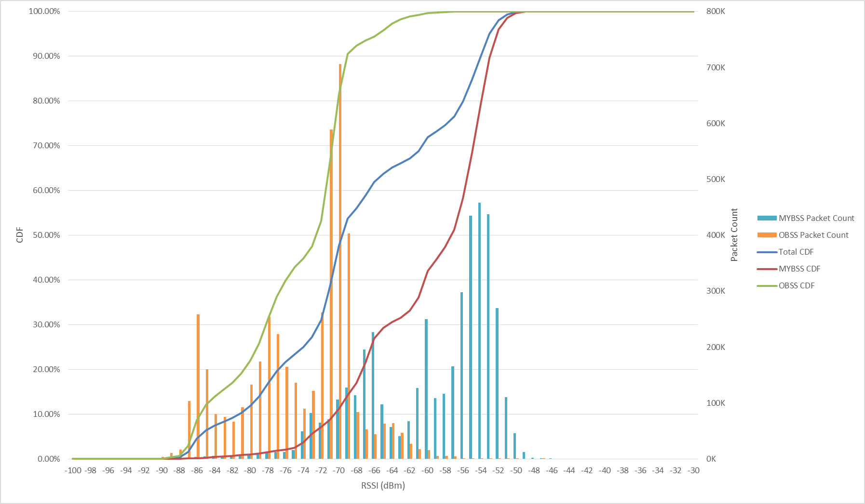
Measurement Results: Bay Area Enterprise (Channel 36+)
Duration: 26 min
Noise floor: -92dBm
MyBSSID Count: 3
OBSSID Count: 54
My STA Count: 129
OBSS STA Count: 340
Packets Captured:
  MyBSS: 4,244,735
  OBSS: 4,561,745
  Total: 8,806,480
Traffic below -72dBm:
  MyBSS: 7.1%
  OBSS: 53%
  MyBSS+OBSS: 31%
HP Enterprise

Slide 12
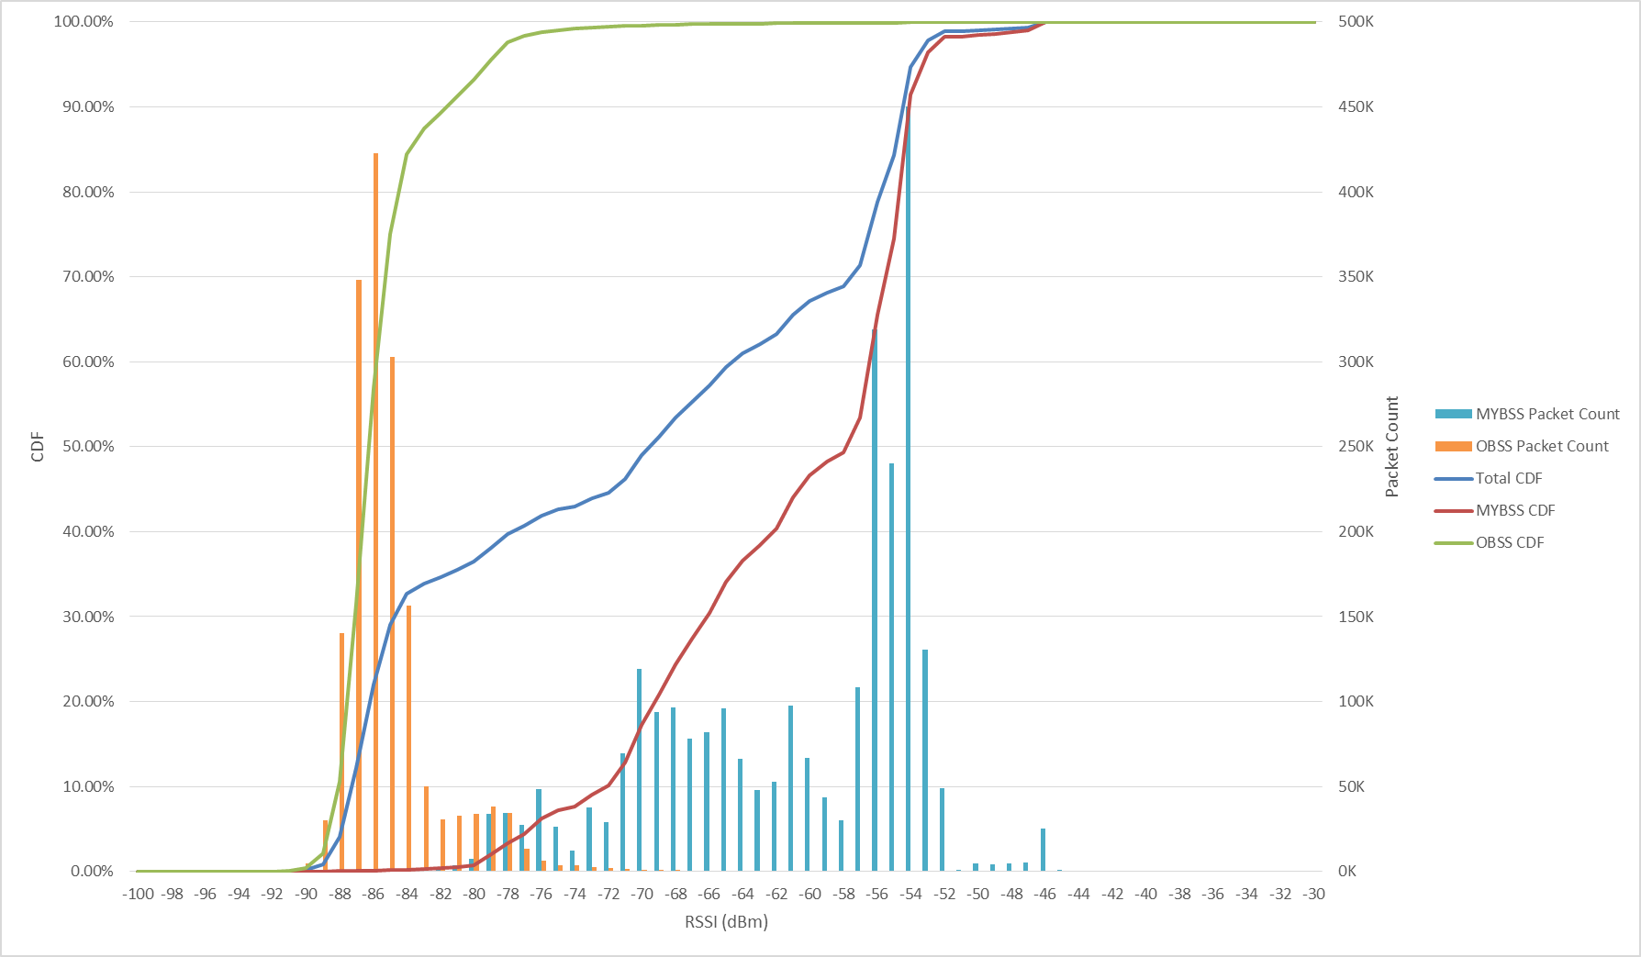
Measurement Results: Bay Area Enterprise (Channel 44+)
Duration: 14 min
Noise floor: -92dBm
MyBSSID Count: 3
OBSSID Count: 32
My STA Count: 89
OBSS STA Count: 199
Packets Captured:
  MyBSS: 2,653.603
  OBSS: 1,666,859
  Total: 4,320,462
Traffic below -72dBm:
  MyBSS: 10%
  OBSS: 99%
  MyBSS+OBSS: 45%
HP Enterprise

Slide 13
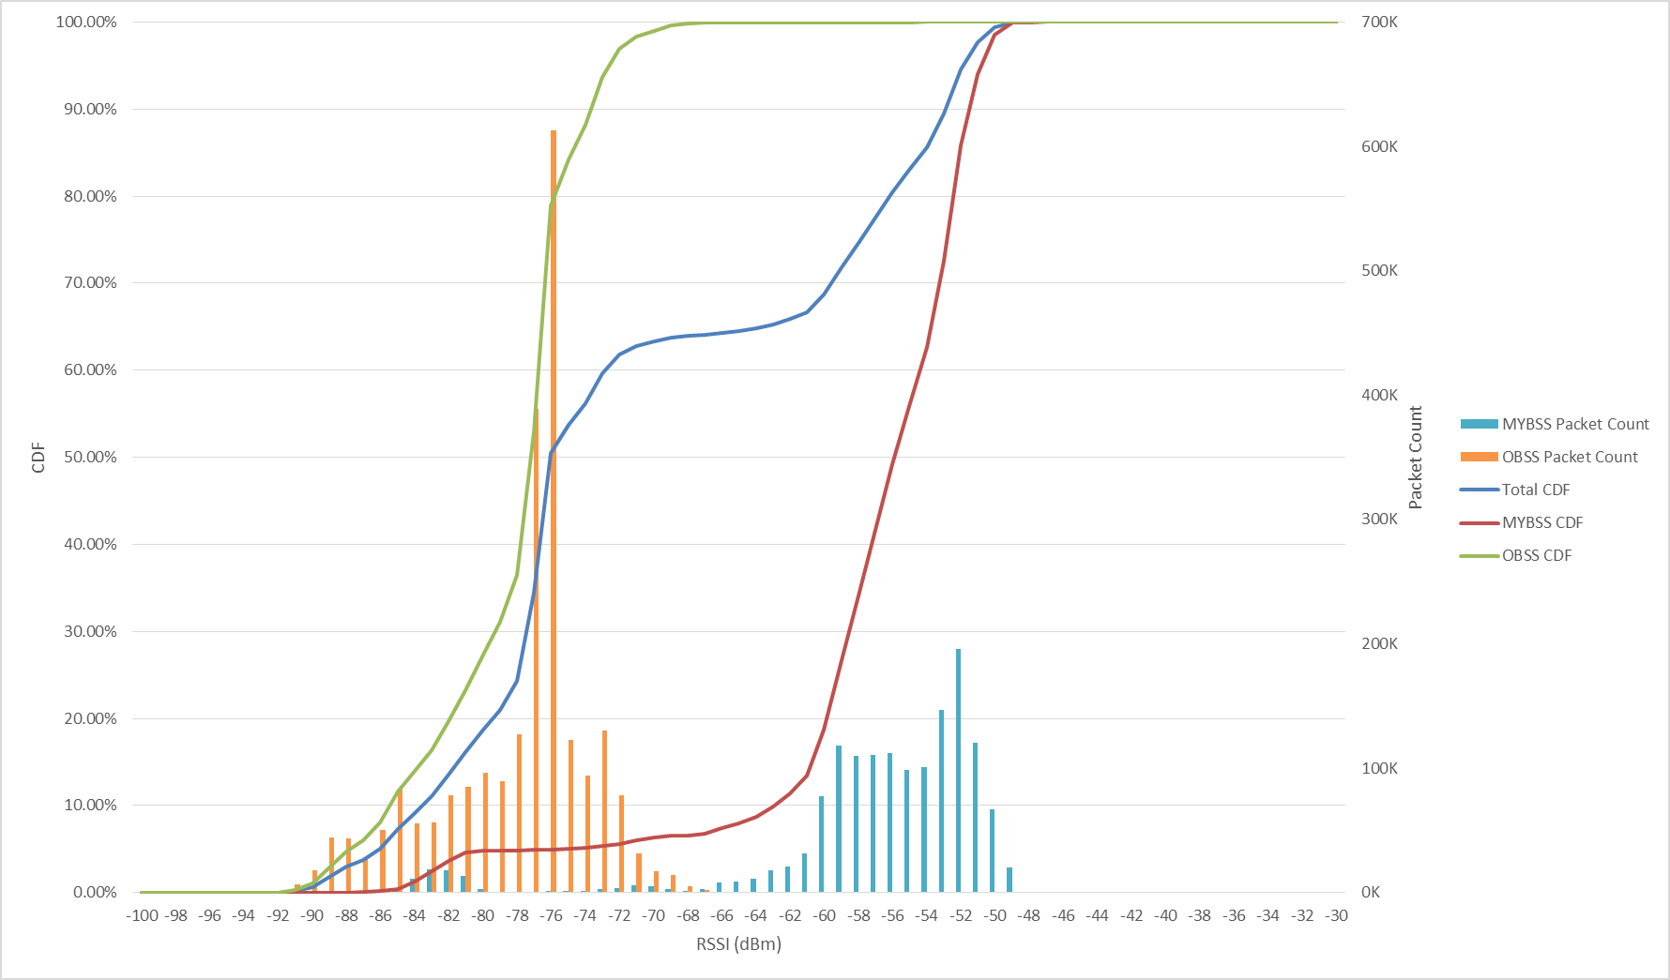
Measurement Results: Bay Area Enterprise (Channel 52+)
Duration: 15 min
Noise floor: -92dBm
MyBSSID Count: 3
OBSSID Count: 24
My STA Count: 30
OBSS STA Count: 101
Packets Captured:
  MyBSS: 1,478,798
  OBSS: 2,361,358
  Total: 3,840,156
Traffic below -72dBm:
  MyBSS: 5.5%
  OBSS: 97%
  MyBSS+OBSS: 62%
HP Enterprise

Slide 14
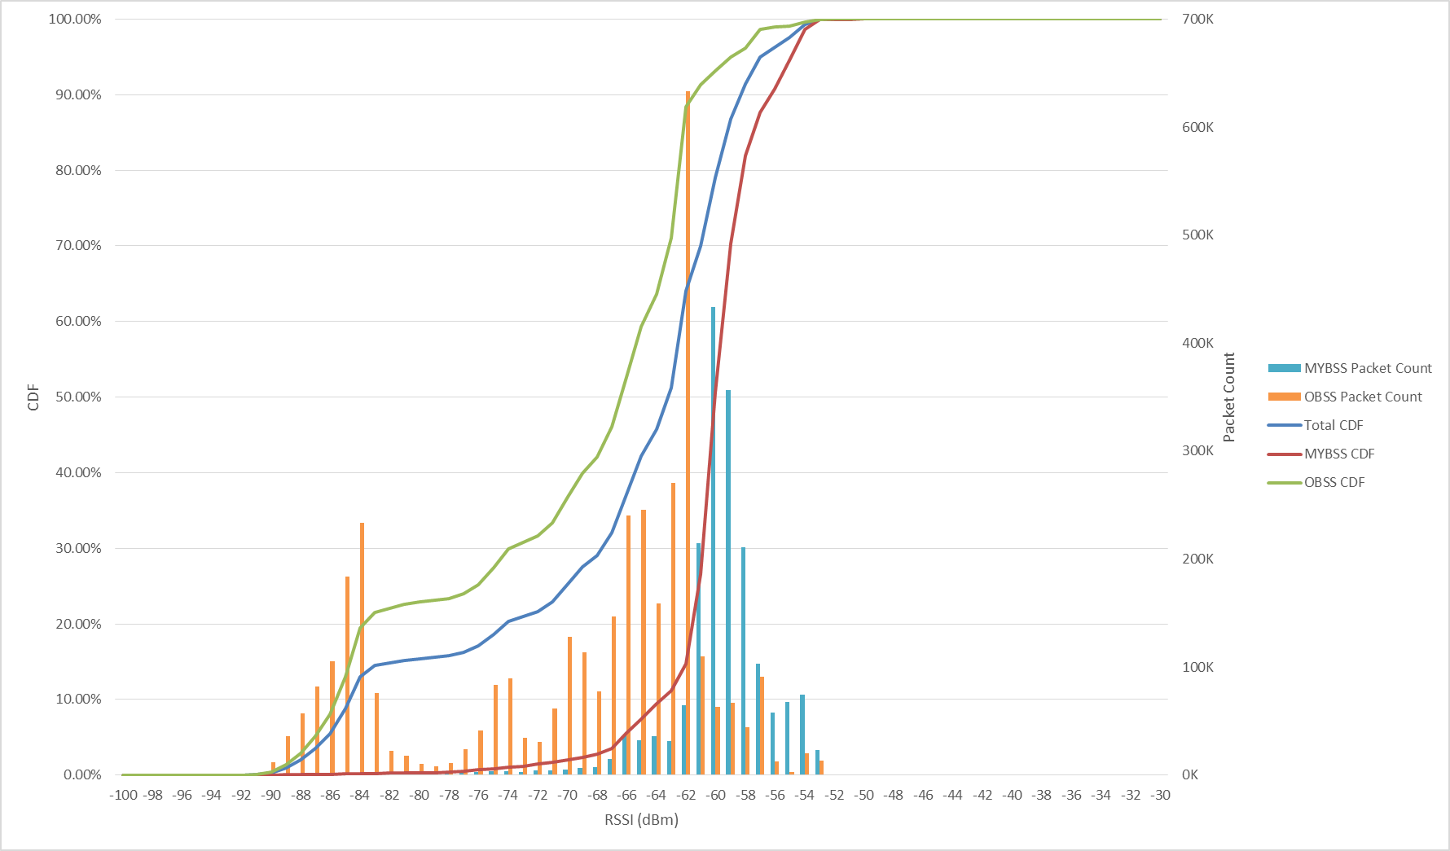
Measurement Results: Bay Area Enterprise (Channel 108+)
Duration: 16 min
Noise floor: -92dBm
MyBSSID Count: 3
OBSSID Count: 38
My STA Count: 67
OBSS STA Count: 267
Packets Captured:
  MyBSS: 1,809,392
  OBSS: 3,660,724
  Total: 5,470,116
Traffic below -72dBm:
  MyBSS: 1.4%
  OBSS: 32%
  MyBSS+OBSS: 22%
HP Enterprise

Slide 15
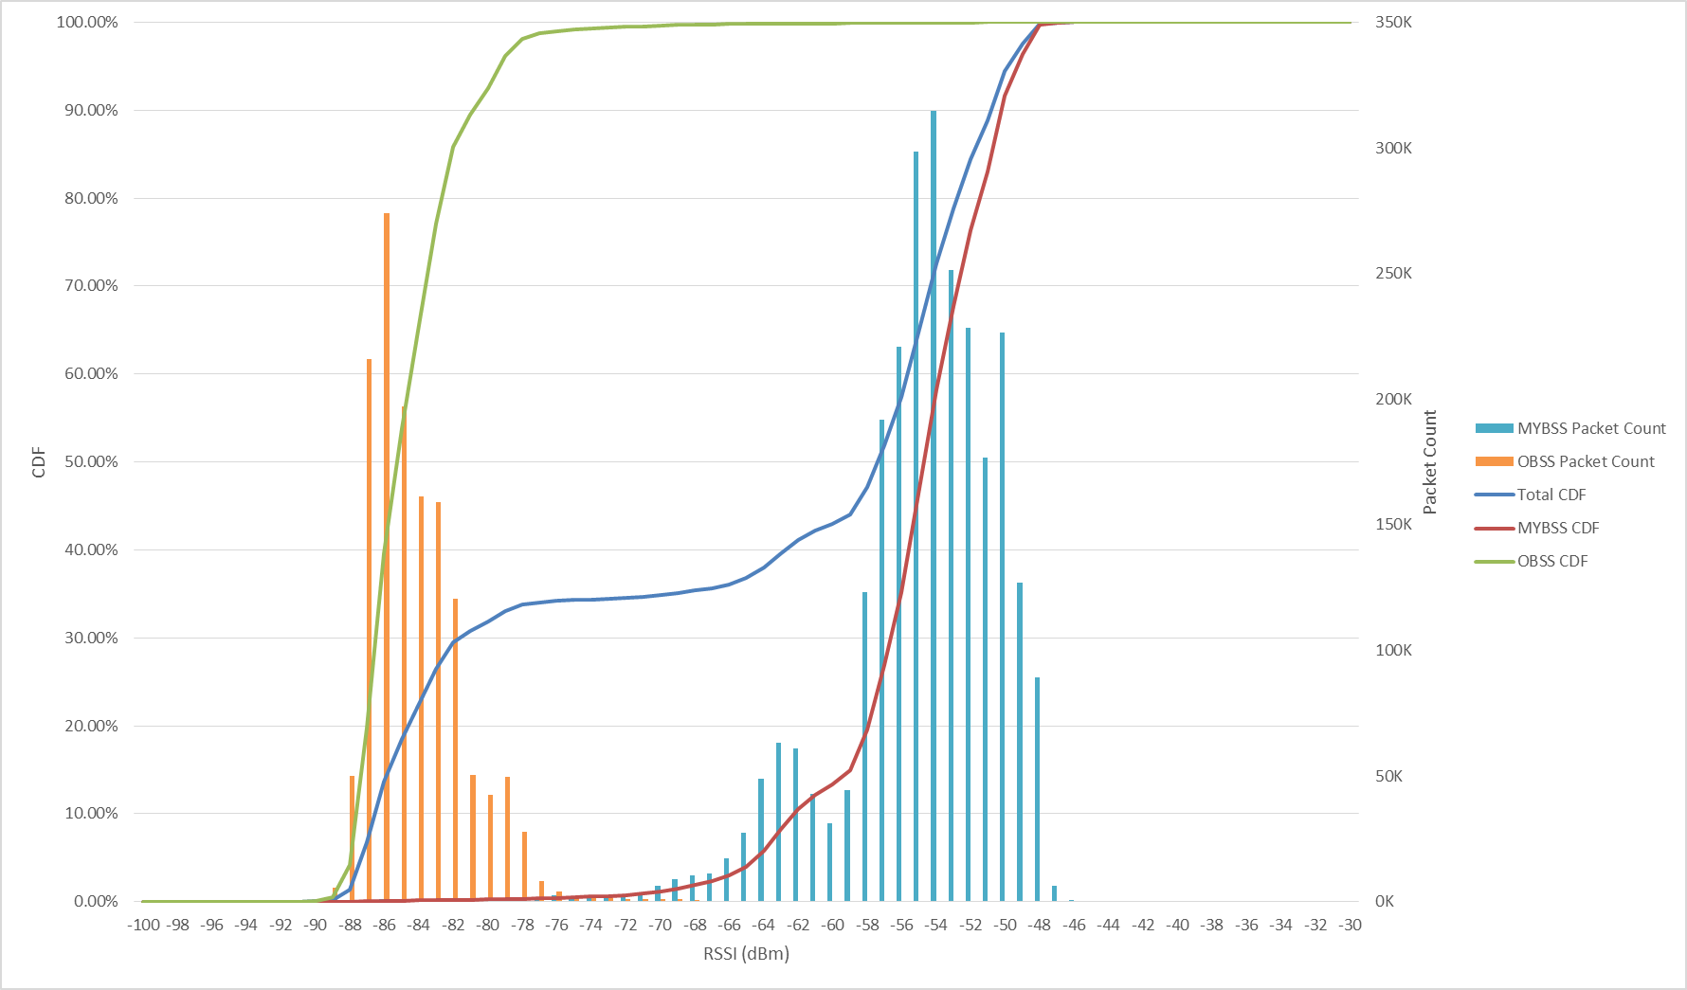
Measurement Results: Bay Area Enterprise (Channel 157+)
Duration: 16 min
Noise floor: -92dBm
MyBSSID Count: 3
OBSSID Count: 54
My STA Count: 63
OBSS STA Count: 250
Packets Captured:
  MyBSS: 2,652,961
  OBSS: 1,380,848
  Total: 4,033,809
Traffic below -72dBm:
  MyBSS: 0.8%
  OBSS: 99%
  MyBSS+OBSS: 35%
HP Enterprise

Slide 16
Indoor Enterprise
Microsoft Enterprise Network
HP Enterprise

Slide 17
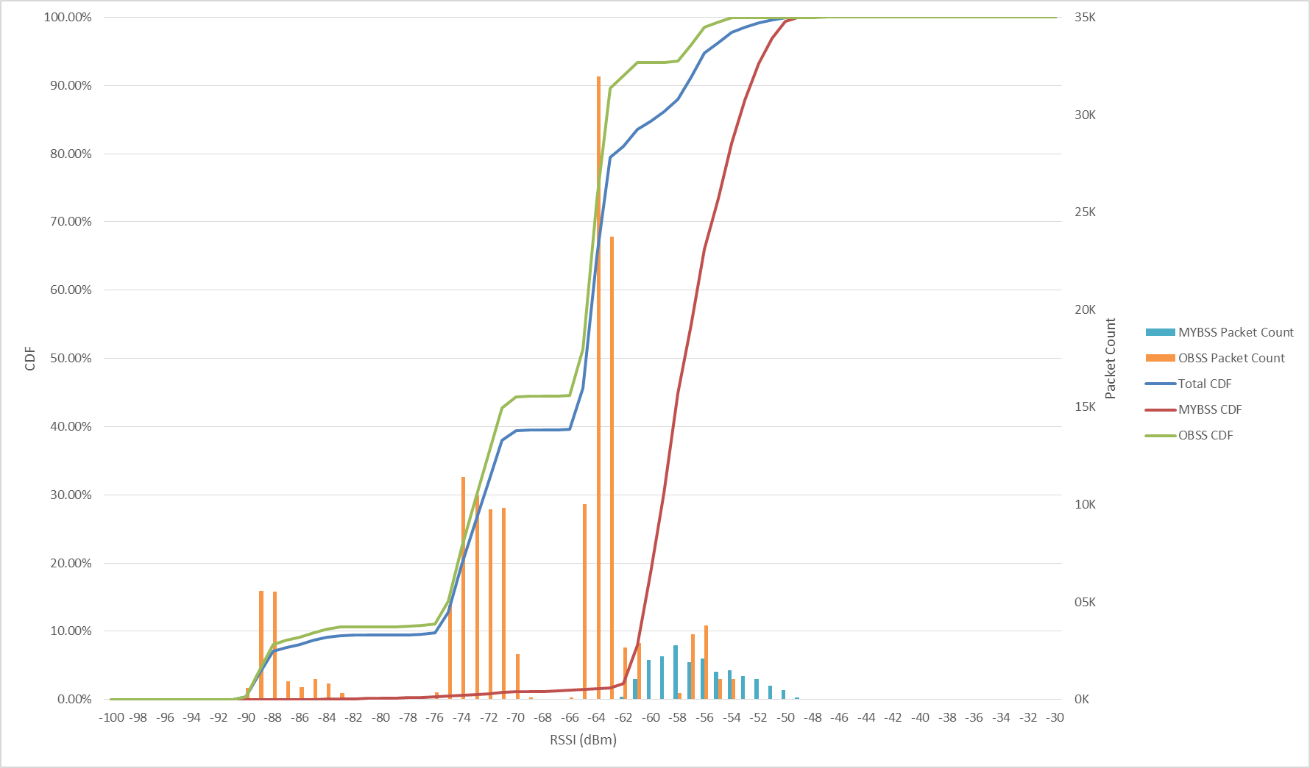
Measurement Results: Microsoft Enterprise Network (Channel 149+)
Duration: 5 min
Noise floor: -97dBm
MyBSSID Count: 3
OBSSID Count: 61
My STA Count: 2
OBSS STA Count: 11
Packets Captured:
  MyBSS: 19,028
  OBSS: 146,069
  Total: 165,097
Traffic below -72dBm:
  MyBSS: 0.9%
  OBSS: 36%
  MyBSS+OBSS: 32%
HP Enterprise

Slide 18
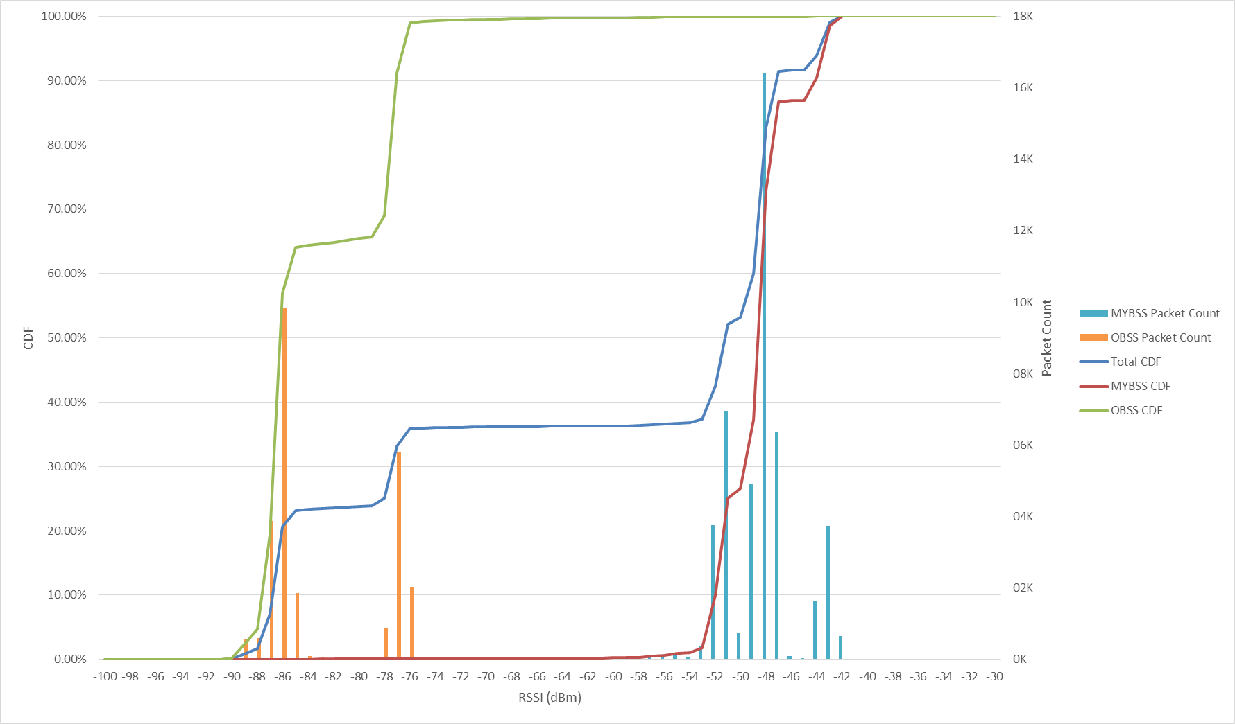
Measurement Results: Microsoft Enterprise Network (Channel 161-)
Duration: 5 min
Noise floor: -97dBm
MyBSSID Count: 2
OBSSID Count: 36
My STA Count: 4
OBSS STA Count: 7
Packets Captured:
  MyBSS: 46,106
  OBSS: 26,167
  Total: 72,273
Traffic below -72dBm:
  MyBSS: 0.2%
  OBSS: 99%
  MyBSS+OBSS: 36%
HP Enterprise

Slide 19
Large Public Venue
Levi’s Stadium
HP Enterprise

Slide 20
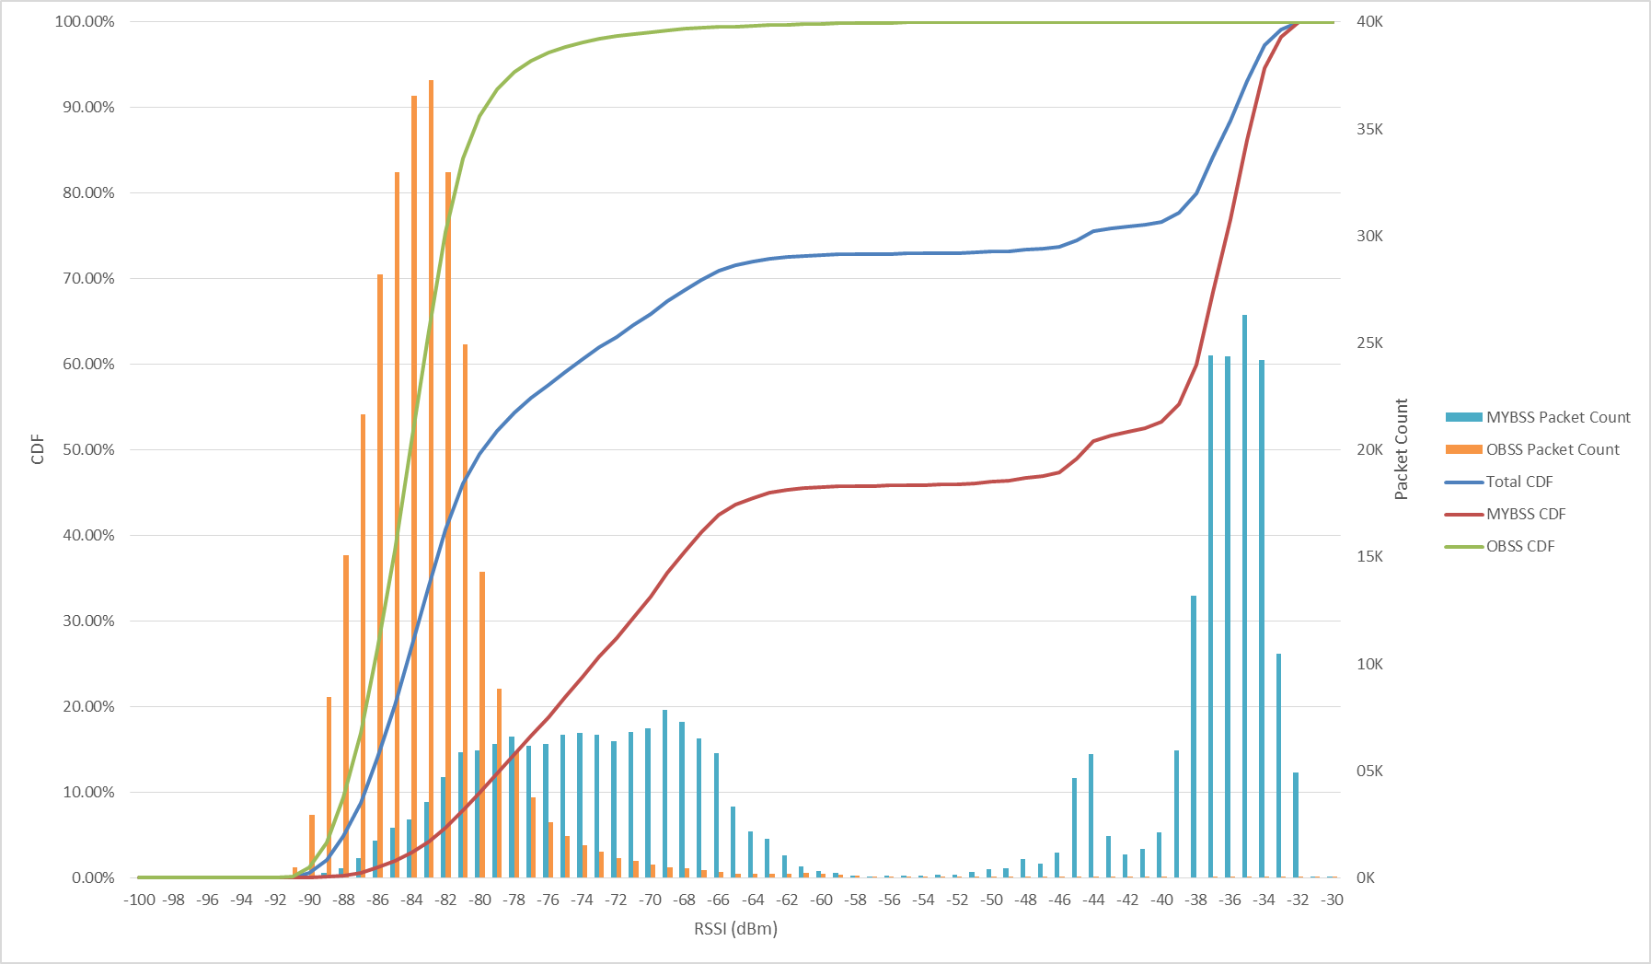
Measurement Results: Levi’s Stadium (Channel 149)
Section 405
Duration: 10 min
Noise floor: -92dBm
MyBSSID Count: 1
OBSSID Count: 68
My STA Count: 21
OBSS STA Count: 163
Packets Captured:
  MyBSS: 286,754
  OBSS: 287,437
  Total: 574,191
Traffic below -72dBm:
  MyBSS: 28%
  OBSS: 98%
  MyBSS+OBSS: 63%
HP Enterprise

Slide 21
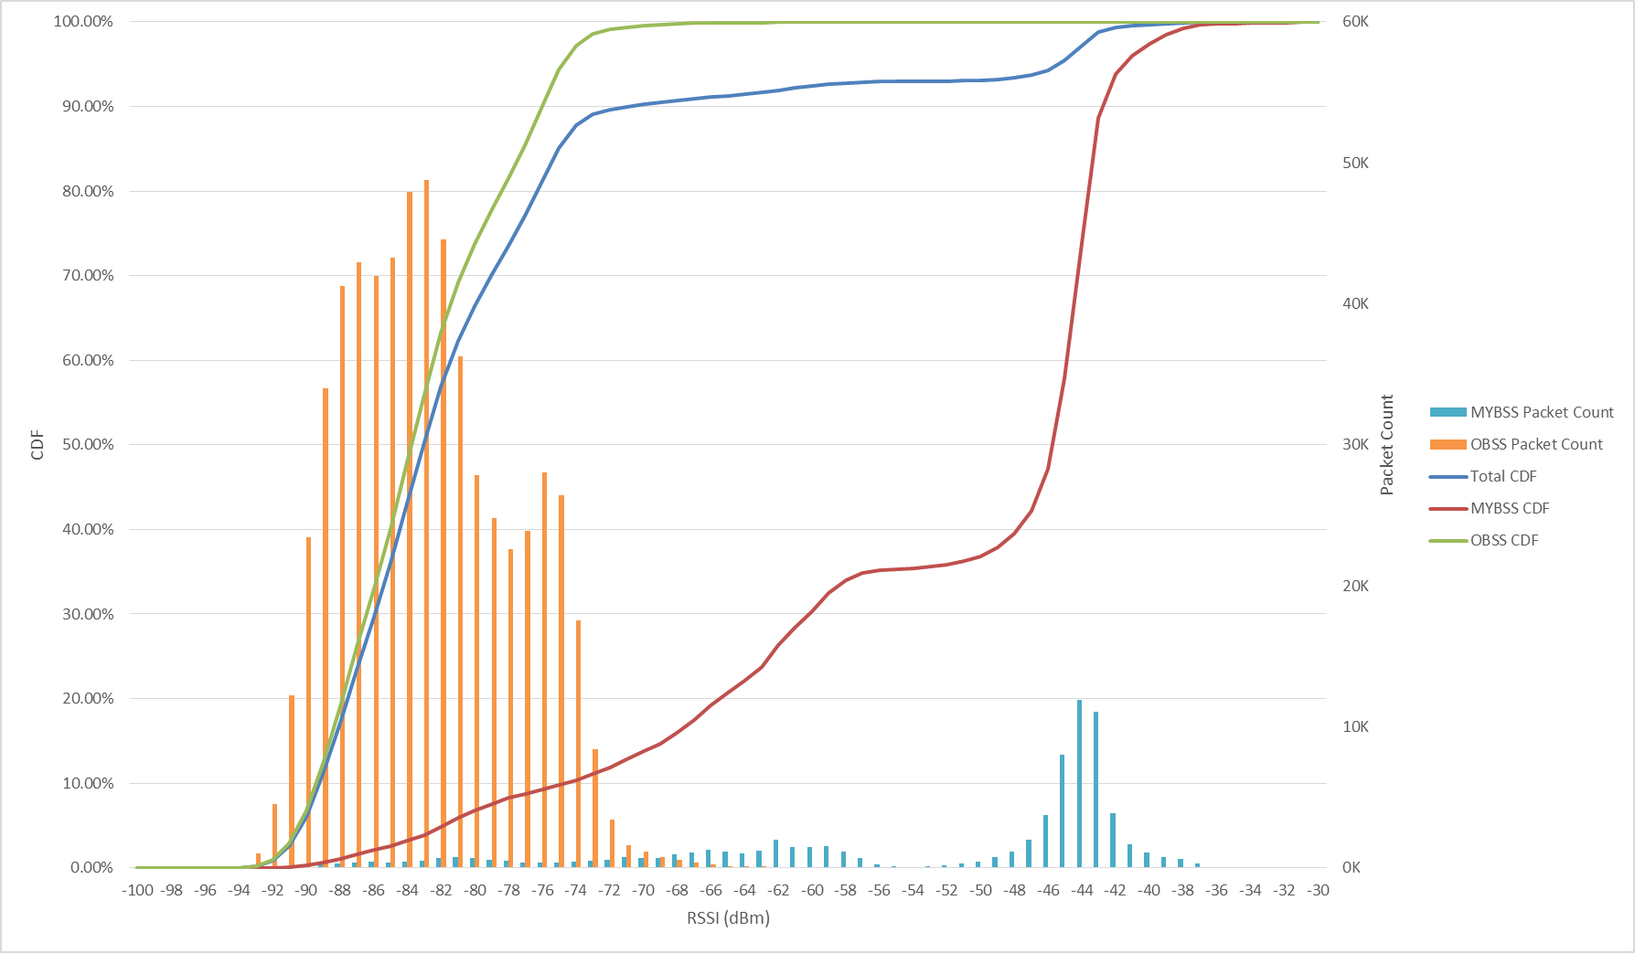
Measurement Results: Levi’s Stadium (Channel 157)
Section 115
Duration: 15 min
Noise floor: -92dBm
MyBSSID Count: 1
OBSSID Count: 75
My STA Count: 9
OBSS STA Count: 312
Packets Captured:
  MyBSS: 74,592
  OBSS: 610,511
  Total: 685,103
Traffic below -72dBm:
  MyBSS: 12%
  OBSS: 99%
  MyBSS+OBSS: 90%
HP Enterprise

Slide 22
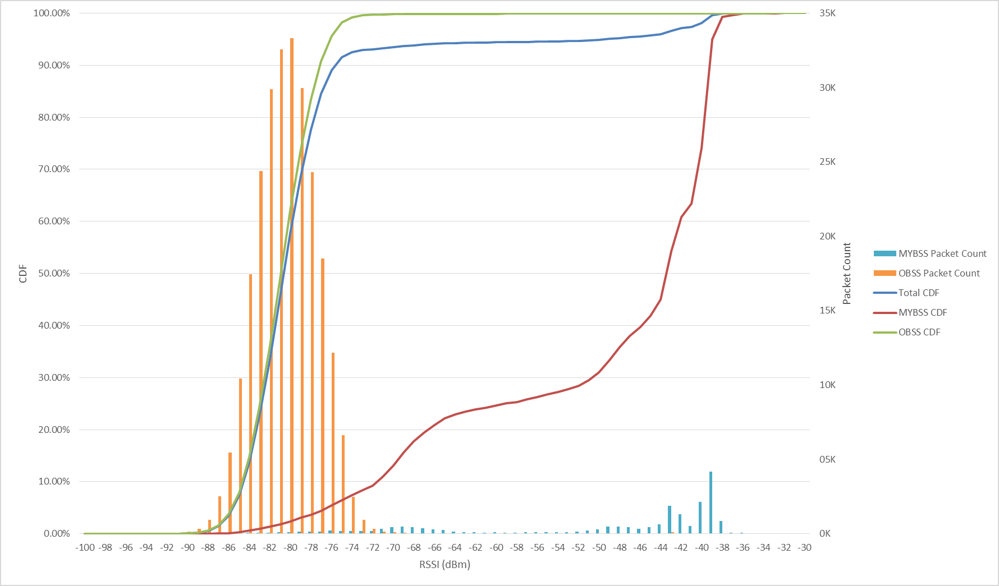
Measurement Results: Levi’s Stadium (Channel 161)
Section 216
Duration: 17 min
Noise floor: -92dBm
MyBSSID Count: 1
OBSSID Count: 116
My STA Count: 5
OBSS STA Count: 354
Packets Captured:
  MyBSS: 19,931
  OBSS: 253,567
  Total: 273,498
Traffic below -72dBm:
  MyBSS: 9.2%
  OBSS: 99%
  MyBSS+OBSS: 93%
HP Enterprise

