Slide 1
Low Complexity Resource Reassignment for Coexistence Management
Date: 2016-05-17
Authors:
Notice: This document has been prepared to assist IEEE 802.19. It is offered as a basis for discussion and is not binding on the contributing individual(s) or organization(s). The material in this document is subject to change in form and content after further study. The contributor(s) reserve(s) the right to add, amend or withdraw material contained herein.

Slide 2
Abstract
This document proposes spectrum transition scheme for IEEE P802.19.1a in order to enhance resource reassignment method with low reconfiguration complexity

Slide 3
Motivation: Why we need resource reassignment scheme with low reconfiguration complexity
PCAST indicates “The number of mobile devices could rise to 50 billion by 2020…One of the other important directions that spectrum policy must take is to create a marketplace that can accommodate the widest range of commercial users” [1]
We need to manage the large number of devices/networks.
In IEEE P802.19.1a case, calculation load at CM might be critical issue.
The issue might be occurred when calculation for resource reassignment to reconfigure the operating GCOs is triggered by new entrant GCOs.
➔ No low complexity solution in IEEE P802.19.1a so far.

Slide 4
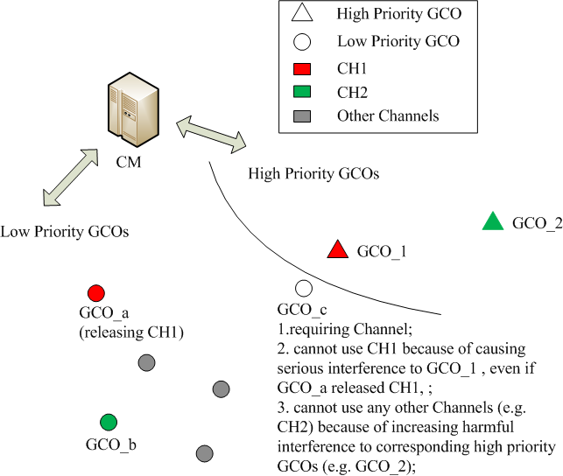
Example scenario
CM manages GCOs with different priorities (high/low).
One new entrant low-priority GCO requires channel.
In order to ensure the network performance of high priority GCOs even after the resource assignment for the new entrant low-priority GCO, CM calculates to reassign channels among only low-priority GCOs.
After calculation for reassignment, CM reconfigures the operational parameters of all the low-priority GCOs.
Fig 1. Example Problem

Slide 5
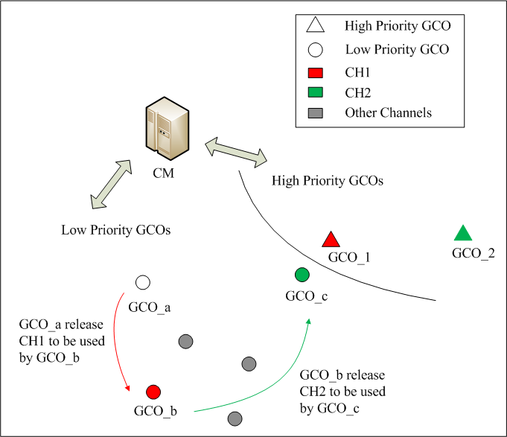
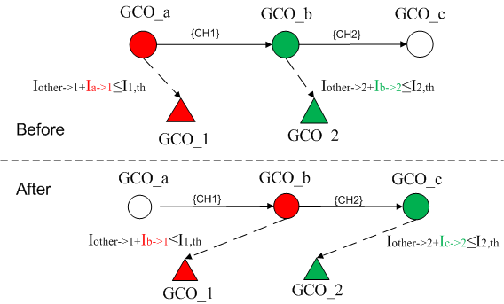
Solution: spectrum transition
Two key steps of the solution
Step 1. Guarantee that after the channel exchange, the newly aggregated interference is also kept below the threshold for any high priority GCO operating on the exchanged channel
Step 2. Find the minimum number of channel exchange (reconfiguration) from the GCO releasing channel to the GCO requiring channel
Fig 2. Example Solution

Slide 6
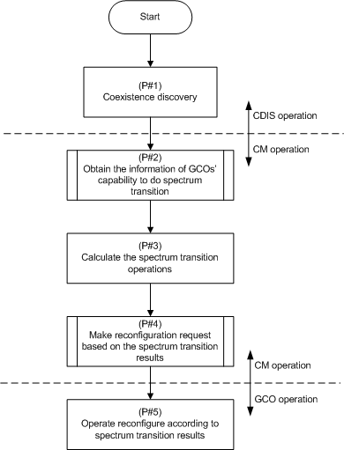
Flowchart

Slide 7
Objective of simulation
To demonstrate that the spectrum transition scheme can be used for resource reassignment with very low reconfiguration complexity

Slide 8
Simulation scenario and parameters
System Setting | Value
High Priority GCO (${GCO}_{hp}$) | Uniformly distributed in the circle where the radius $R_{hp}=10km$. ${NUM}_{{GCO}_{hp}}$=20.
Low Priority GCO (${GCO}_{lp}$) | Uniformly distributed in the circle where the radius $R_{lp}=10km$. ${NUM}_{{GCO}_{lp}}$is set as the maximum number of low-priority GCOs that meets requirement of aggregated interference to High Priority GCO,
Minimum distance b/n two regions | 0~15 (km)
Frequency | TV band
Channel Model | Okumara, Urban, $α=3.52$
Number of channels | 10
Traffic Model | Arrive in Poisson Procedure

Slide 9
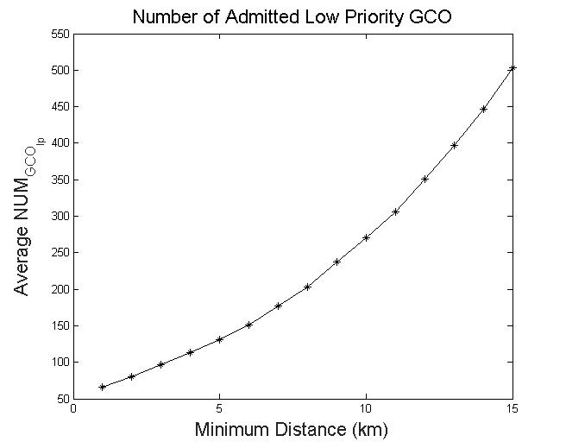
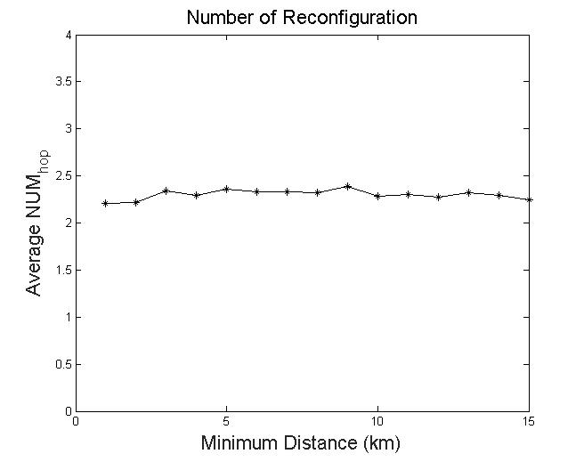
Simulation result: reduction of the number of reconfiguration
Observation
For given area, admitted ${NUM}_{{WSO}_{lp}}$increases with increasing the minimum distance b/n two regions;
The number of reconfiguration ${NUM}_{hop}$ is kept tiny and stable;

Slide 10
Conclusion
Spectrum transition scheme is quite efficient for reduction of the number of reconfiguration in channel reassignment
Spectrum transition scheme as well as related data, procedure, message should be introduced into IEEE 802.19.1a system

Slide 11
Reference
[1] PCAST, “REALIZING THE FULL POTENTIAL OF GOVERNMENT-HELD SPECTRUM TO SPUR ECONOMIC GROWTH,” July 2012

