Slide 1
Coexistence management with spectrum request modification
Date: 2016-05-16
Authors:
Notice: This document has been prepared to assist IEEE 802.19. It is offered as a basis for discussion and is not binding on the contributing individual(s) or organization(s). The material in this document is subject to change in form and content after further study. The contributor(s) reserve(s) the right to add, amend or withdraw material contained herein.

Slide 2
Introduction
GCOs that require coexistence management will subscribe to the IEEE 802.19.1a system and provide information on the available spectrum.
The CM by using various algorithm adjust the spectrum utilization such as power and channel within the available channel.
The coexistence management in terms of maximizing capacity etc. converts into a constrained optimization problem.
The constraints, i.e., the available channels, will influence the outcome of optimization.
Therefore, different available channels will bring different coexistence performance.

Slide 3
Application scenario
A number GCOs request available spectrum from the spectrum management database.
Different databases may employ different available spectrum calculation algorithms.
For example, the TVWS geolocation database in Europe might implement the calculation method based on the aggregate interference from multiple GCOs.
When different GCOs request available spectrum as different groups, the available spectrum will be different.
In such case, if the CM cannot achieve a desired coexistence optimization result, it can suggest the GCO to request available spectrum again by forming a different group.

Slide 4
System model
If GCOs A and B request spectrum together the available spectrum is different from the result when GCOs A and C request spectrum together

Slide 5
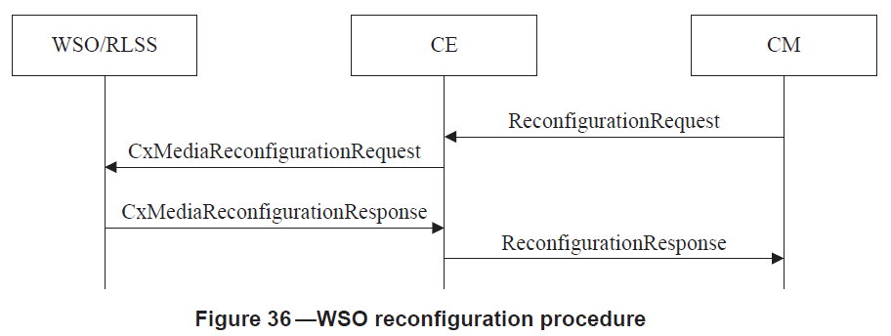
Procedures utilized
5.2.10.1 WSO reconfiguration procedure
This procedure is utilized to send to suggest available spectrum request by different groupings

Slide 6
Flowchart

