Slide 1
TG1a May 2016 Waikoloa Meeting Agenda
Date: 2016-05-18
Authors:
Notice: This document has been prepared to assist IEEE 802.19. It is offered as a basis for discussion and is not binding on the contributing individual(s) or organization(s). The material in this document is subject to change in form and content after further study. The contributor(s) reserve(s) the right to add, amend or withdraw material contained herein.

Slide 2
Agenda graphic

Slide 3
Meeting protocol
Please announce your affiliation when you first address the group during a meeting slot

Slide 4
Attendance
https://imat.ieee.org/my-site/home
Register
Indicate attendance

Slide 5
Agenda items for this week
Approval of meeting minutes
TG1a Opening report
Review and approve IEEE P802.19.1a-D0.2
Technical presentations
Revisit updated text proposals
Review project timeline
TG review procedure discussion
Motions
Review objectives for next meeting
Schedule for teleconferences

Slide 6
Tuesday AM1

Slide 7
Agenda for Tuesday AM1
TG1a meeting called to order
Call for secretary
Call for submissions and discussions
Approval of agenda
IEEE IPR statement
Approval of March 2016 TG1a meeting and conference call minutes
TG1a Opening report
Review and approve IEEE P802.19.1a-D0.2
Technical presentations
Recess

Slide 8
Call for secretary
Looking for volunteer of recording secretary

Slide 9
Call for technical contributions
WSO/GCO definition
  Doc. 19-16/0096r1: Text proposal on treatment of WSO definition (C. Sun)
Coexistence Managements
  Doc. 19-16/0069r1: Coexistence management considering spectrum release (C. Sun)
  Doc. 19-19/0083r0:: Text proposal on the coexistence management considering spectrum release( C. Sun)
  Doc. 19-16/0070r1: Coexistence management over a region by controlling the number of cochannel GCOs (C. Sun)
  Doc. 19-16/0084r0: Text proposal on the coexistence management over a region by controlling the number of cochannel GCOs (C. Sun)
  Doc. 19-16/0085r0: Coexistence management with spectrum request modification (C. Sun)
  Doc. 19-16/0086r0: Text proposal on Coexistence management with spectrum request modification (C. Sun)
  Doc. 19-16/0087r0: Low Complexity Resource Reassignment for Coexistence Management (C. Sun)
  Doc. 19-16/0088r0: Text proposal on Low Complexity Resource Reassignment for Coexistence Management (C. Sun)
Procedures and protocols
  Doc. 19-16/0089r0: Text proposal on Section 5 (S. Furuichi)
Entity operation
  Doc. 19-16/0090r0: Text proposal on amendment to Section 6 (S. Furuichi)
Coexistence mechanisms and algorithms
  Doc. 19-16/0091r0: Text proposal on Section 7 (S. Furuichi)
ASN.1 (Data types, Primitives and Messages)
  Doc. 19-16/0092r0: Text proposal on Annex A (S. Furuichi)
  Doc. 19-16/0093r0: Text proposal on Annex B (S. Furuichi)
  Doc. 19-16/0094r0: Text Proposal on Annex C (S. Furuichi)
Coexistence discovery
  Doc. 19-16/0098r0: A coexistence discovery mechanism (H. Kang)

Slide 10
Call for discussions
Candidate draft
  Doc. 19-16/0095r0: Editorial proposal (C. Sun)
TG review procedure
  Doc. 19-16/0097r0: Plan of TG review (N. Sato)

Slide 11
Approval of agenda
Motion to approve the agenda of the May 2016 TG1a meeting, document 19-16/0078r1
  Approved by unanimous consent

Slide 12
Patent Policy
http://standards.ieee.org/about/sasb/patcom/materials.html

Slide 13


Slide 14


Slide 15
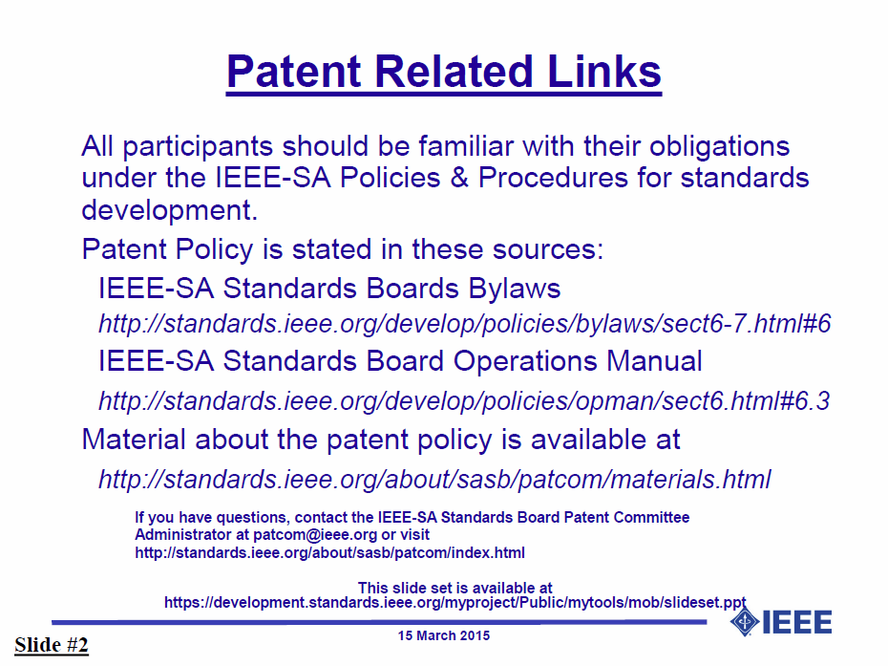

Slide 16


Slide 17


Slide 18
Approval of minutes
Motion to approve the minutes from the March 2016 TG1a meeting, document 19-16/0064r1, and teleconference call minutes on Apr. 27, 2016, document 19-16/0075r0
  Approved by unanimous consent

Slide 19
TG1a Opening report
May 2016 TG1a Opening Report (doc. 19-16/0081r0)

Slide 20
Review IEEE P802.19.1a-D0.2
The latest draft is presented by technical editor
Discussion
  Doc. 19-16/0095r0: Editorial proposal (C. Sun)

Slide 21
Motion #1
Approve IEEE P802.19.1a-D0.2 as the candidate draft
  Approved by unanimous consent

Slide 22
Technical presentation
WSO/GCO definition
  Doc. 19-16/0096r1: Text proposal on treatment of WSO definition (C. Sun)
Coexistence Managements
  Doc. 19-16/0069r1: Coexistence management considering spectrum release (C. Sun)
  Doc. 19-19/0083r0:: Text proposal on the coexistence management considering spectrum release( C. Sun)
  Doc. 19-16/0070r1: Coexistence management over a region by controlling the number of cochannel GCOs (C. Sun)
  Doc. 19-16/0084r0: Text proposal on the coexistence management over a region by controlling the number of cochannel GCOs (C. Sun)
  Doc. 19-16/0085r0: Coexistence management with spectrum request modification (C. Sun)
  Doc. 19-16/0086r0: Text proposal on Coexistence management with spectrum request modification (C. Sun)

Slide 23
Tuesday PM1

Slide 24
Agenda for Tuesday PM1
TG1a meeting called to order
Agenda review and update
Technical presentations
Recess

Slide 25
Technical presentation
Coexistence Managements
  Doc. 19-16/0087r0: Low Complexity Resource Reassignment for Coexistence Management (C. Sun)
  Doc. 19-16/0088r0: Text proposal on Low Complexity Resource Reassignment for Coexistence Management (C. Sun)
Procedures and protocols
  Doc. 19-16/0089r0: Text proposal on Section 5 (S. Furuichi)
Entity operation
  Doc. 19-16/0090r0: Text proposal on amendment to Section 6 (S. Furuichi)
Coexistence mechanisms and algorithms
  Doc. 19-16/0091r0: Text proposal on Section 7 (S. Furuichi)
ASN.1 (Data types, Primitives and Messages)
  Doc. 19-16/0092r0: Text proposal on Annex A (S. Furuichi)
  Doc. 19-16/0093r0: Text proposal on Annex B (S. Furuichi)
  Doc. 19-16/0094r0: Text Proposal on Annex C (S. Furuichi)

Slide 26
Wednesday AM1

Slide 27
Agenda for Wednesday AM1
TG1a meeting called to order
Agenda review and update
Technical presentations
Revisit updated text proposals
Recess

Slide 28
Approval of agenda
Motion to approve the agenda of the May 2016 TG1a meeting, document 19-16/0078r3
  Approved by unanimous consent

Slide 29
Technical presentation
Coexistence discovery
  Doc. 19-16/0098r0: A coexistence discovery mechanism (H. Kang)

Slide 30
Revisit updated text proposals
Doc. 19-16/0096r2: Text proposal on treatment of WSO definition (C. Sun)
Doc. 19-19/0083r1: Text proposal on the coexistence management considering spectrum release( C. Sun)
Doc. 19-16/0084r1: Text proposal on the coexistence management over a region by controlling the number of cochannel GCOs (C. Sun)
Doc. 19-16/0086r1: Text proposal on Coexistence management with spectrum request modification (C. Sun)
Doc. 19-16/0088r1: Text proposal on Low Complexity Resource Reassignment for Coexistence Management (C. Sun)
Doc. 19-16/0089r0: Text proposal on Section 5 (S. Furuichi)
Doc. 19-16/0090r1: Text proposal on amendment to Section 6 (S. Furuichi)
Doc. 19-16/0091r0: Text proposal on Section 7 (S. Furuichi)
Doc. 19-16/0092r1: Text proposal on Annex A (S. Furuichi)
Doc. 19-16/0093r1: Text proposal on Annex B (S. Furuichi)
Doc. 19-16/0094r0: Text Proposal on Annex C (S. Furuichi)

Slide 31
Wednesday PM1

Slide 32
Agenda for Wednesday PM1
TG1a meeting called to order
Agenda review and update
Revisit updated text proposals
Review project timeline
TG review procedure discussion
Motions
Review objectives for next meeting
Schedule for teleconferences
Adjourn

Slide 33
Project timeline
Project timeline document
  Doc. 19-15/0096r0: Timeline document (N. Sato)

Slide 34
TG review procedure discussion
Discussion document
  Doc.19-16/0097r0: Plan of TG review (N. Sato)

Slide 35
Motion #2

Slide 36
Review objectives for next meeting

Slide 37
Teleconference
Schedule (1hour)
  Wednesday, July 20, 2016: 2am EDT (8am CEST, 2pm CST, 3pm JST/KST)
Meeting Logistics
  Use “Join Me”
    Join the meeting: https://join.me/ieeesawg802.19
    On a computer, use any browser. Nothing to download.
    On a phone or tablet, launch the join.me app and enter meeting code:ieeesawg802.19
    Join the audio conference:
    Dial a phone number and enter access code, or connect via internet.
  The chair will send out a notification to IEEE 802.19 reflector in advance of the meeting

Slide 38
Adjourn

Slide 39
Time difference
Winter
  1am EST (6am UTC, 3pm JST/KST)
  7am EST (noon UTC, 9pm JST/KST)
  5pm EST (10pm UTC, 7am JST/KST + 1day)
Summer
  2am EDT (6am UTC, 3pm JST/KST)
  8am EDT (noon UTC, 9pm JST/KST)
  6pm EDT (10pm UTC, 7am JST/KST + 1day)

