Slide 1
Coexistence management over a region by controlling the number of cochannel GCOs
Date: 2016-05-16
Authors:
Notice: This document has been prepared to assist IEEE 802.19. It is offered as a basis for discussion and is not binding on the contributing individual(s) or organization(s). The material in this document is subject to change in form and content after further study. The contributor(s) reserve(s) the right to add, amend or withdraw material contained herein.

Slide 2
Application scenario
A CM manages a certain number of GCOs within a certain region
The CM can instruct the GCOs to access the GLDB in order to obtain available spectrum within a given region in stead of a single location.
By using statistical models, the CM can determine the network capacity over the number of co-channel GCOs.
Then, the optimal number of GCOs that can operate in a given area can be deduced.
Using this information, the CM can decide whether to allow a GCO to use a channel within the region by checking the number of active GCOs.

Slide 3
Example scenario
Each vehicle is assumed to have one TV band access point (AP) providing wireless network to its passengers.
The wireless network at each vehicle is considered as one GCO.
Even if there are multiple STAs transmission inside the vehicle, it is still considered as one GCO due to the contained space.
A software server (RLSS in 11af deployment scenario) controls the spectrum usage of the vehicles
For example one company managing its own vehicles.
Example of using 11af deployment

Slide 4


Calculation Simulation Model
Master WSD
P
Slave WSD
R
d
D = 20 km
R = 200 m
d = 30 m
D
Sony China Research Lab.

Slide 5
Other Parameters for Calculation
Parameter | Value
Frequency | 650 MHz
Channel bandwidth | 7.6 MHz
Receiver antenna height | 10 m
WSD antenna height | 20 m
Median wanted DTT field strength | 56.21 dB(µV/m)
Standard deviation of DTT and noise power | 5.5 dB
Location probability (LP) without interference from WSD | 95%
LP with interference from WSD | 94.9%
Acceptable degradation to LP | 0.1%
Protection ratio | 23.1 dB
Standard deviation of WSD power | 3.5 dB
Receiver polarization discrimination with respect to the WSD signal | 0 dB
Path loss exponent | 6
Receiver antenna directivity discrimination | -16 dB
Notes:
These are the other parameters used in this simulation.

Slide 6
Problem statement
N is the number of available channel for dynamic channel selection in order to avoid using the same channel between neighboring GCOs.
Excessive number of GCOs operating at the same frequency will make coexistence issue (degradation on the network capacity).

Slide 7
Solution
By limiting the number of GCOs we can optimize the network capacity
The optimal number of GCOs are the values of the proposed parameter
Optimal number of cochannel GCOs

Slide 8
Flowchart

Slide 9
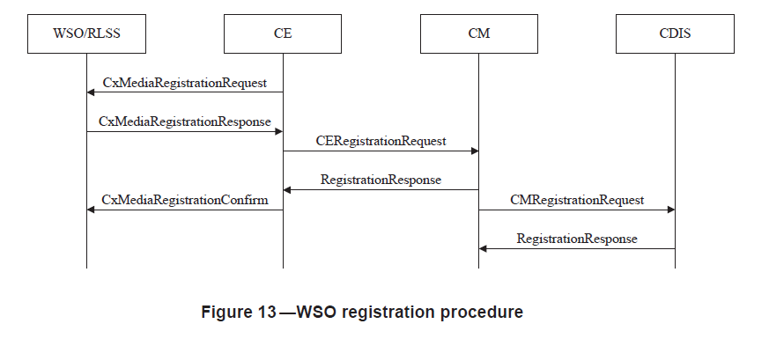
Procedures utilized (1/6)
5.2.2.1 WSO registration procedure
  Through this procedure, the information on the available channels over an region is sent to the CM/CDIS

Slide 10
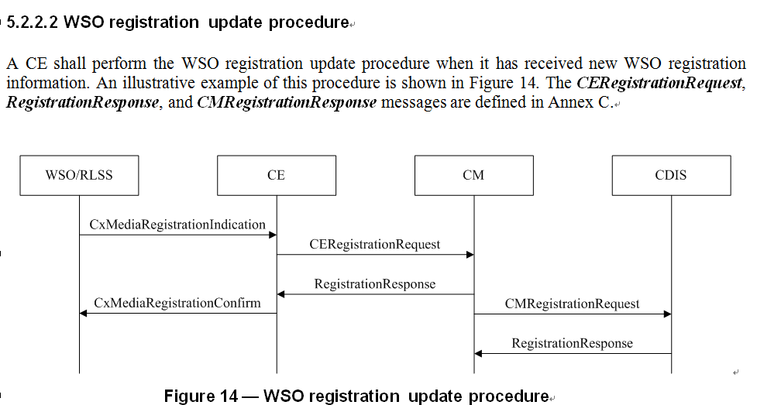
Procedure utilized (2/6)

Slide 11
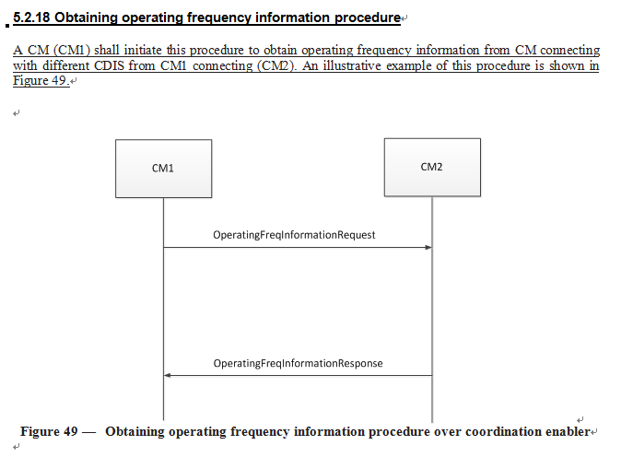
Procedure utilized (3/6)
For obtaining regarding to usage from another CM (approved text in D0.2)

Slide 12
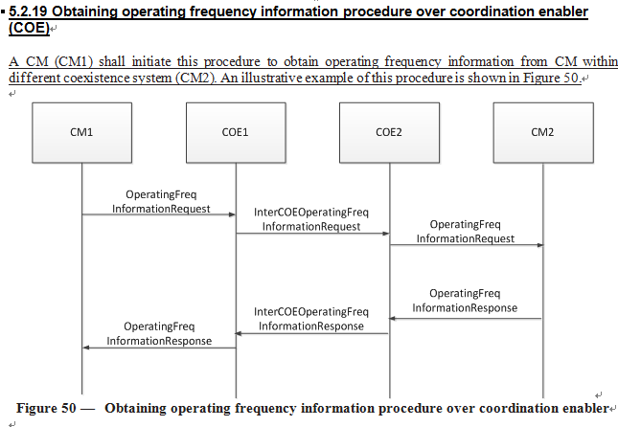
Procedure utilized (4/6)
For obtaining regarding to usage from another CM via COE (approved text in D0.2)

Slide 13
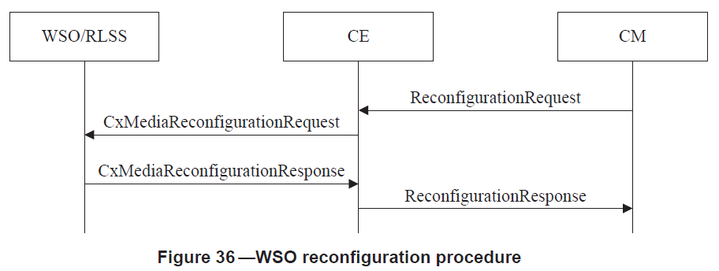
Procedure utilized (5/6)
5.2.10.1 WSO reconfiguration procedure
  This procedure is utilized to instruct the channel utilization of an GCO within an given region.

Slide 14
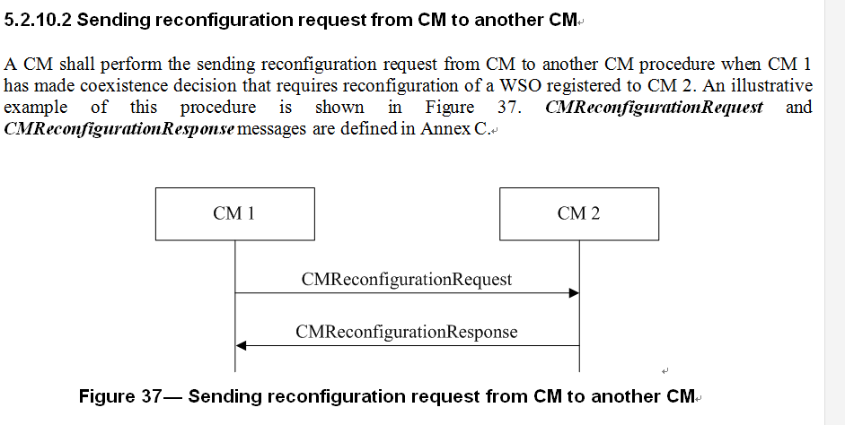
Procedure utilized (6/6)
Send limit on the number of GCOs

