Slide 1
Coexistence management over a region by controlling the number of cochannel GCOs
Date: 2016-04-26
Authors:
Notice: This document has been prepared to assist IEEE 802.19. It is offered as a basis for discussion and is not binding on the contributing individual(s) or organization(s). The material in this document is subject to change in form and content after further study. The contributor(s) reserve(s) the right to add, amend or withdraw material contained herein.

Slide 2
Application scenario
A CM manages a certain number of GCOs within a certain region
The CM can instruct the GCOs to access the GLDB in order to obtain available spectrum within a given region in stead of a single location.
By using statistical models, the CM can determine the network capacity over the number of co-channel GCOs.
Then, the optimal number of GCOs that can operate in a given area can be deduced.
Using this information, the CM can decide whether to allow a GCO to use a channel within the region by checking the number of active GCOs.

Slide 3
Example scenario
Each vehicle is assumed to have one TV band access point (AP) providing wireless network to its passengers.
The wireless network at each vehicle is considered as one GCO.
Even if there are multiple STAs transmission inside the vehicle, it is still considered as one GCO due to the contained space.
A software server (RLSS in 11af deployment scenario) controls the spectrum usage of the vehicles
For example one company managing its own vehicles.
Example of using 11af deployment

Slide 4
Problem statement
N is the number of available channel for dynamic channel selection in order to avoid using the same channel between neighboring GCOs.
Excessive number of GCOs operating at the same frequency will make coexistence issue (degradation on the network capacity).

Slide 5
Solution
By limiting the number of GCOs we can optimize the network capacity
The optimal number of GCOs are the values of the proposed parameter
Optimal number of cochannel GCOs

Slide 6
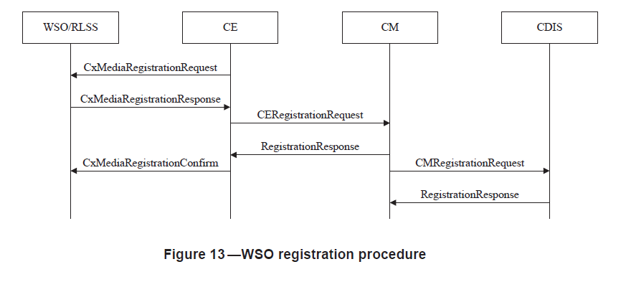
Procedures utilized (1/4)
5.2.2.1 WSO registration procedure
  Through this procedure, the information on the available channels over an region is sent to the CM/CDIS

Slide 7
Modified primitive
ListOfWSORegistrations ::= SEQUENCE OF SEQUENCE {
--New registration, registration update or deregistration
operationCode OperationCode OPTIONAL,
--WSO ID
wsoID OCTET STRING OPTIONAL,
--Network technology
networkTechnology NetworkTechnology OPTIONAL,
--Location
geolocation Geolocation OPTIONAL,
--Coverage area
coverageArea CoverageArea OPTIONAL,
-- Mobility information
mobilityInformation MobilityInformation OPTIONAL,
--Installation parameters
installationParameters InstallationParameters OPTIONAL,
--List of available frequencies
listOfAvailableFrequencies ListOfAvailableFrequencies OPTIONAL,
-- Operating frequency if available
operatingFrequency FrequencyRange OPTIONAL,
-- Upper limit of transmission power level of its operating frequency [dBm]
txPowerLimit REAL OPTIONAL,
--Maximum number of controllable WSO
maximumNumberOfControllableWSO INTEGER OPTIONAL,
--Range of activity in which the available frequencies are valid for
operationRange CHOICE {
--Information of the bounded area defined by the multiple geolocations
multipointRegion Region,
--Rectangular area defined by the upper-left and lower right points of the rectangular
rectangularRegion RectangularRegion}
}

Slide 8
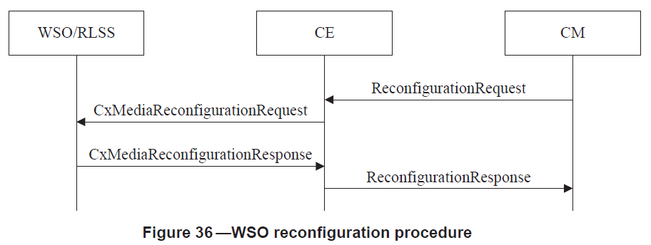
Procedures utilized (2/4)
5.2.10.1 WSO reconfiguration procedure
  This procedure is utilized to instruct the channel utilization of an GCO within an given region.

Slide 9
Updated message
--Reconfiguration request
ReconfigurationRequest ::= SEQUENCE OF SEQUENCE {
--WSO ID
wsoID OCTET STRING OPTIONAL,
--Operating frequency
operatingFrequency FrequencyRange OPTIONAL,
--List of operating channel number
listOfOperatingChNumber SEQUENCE OF INTEGER OPTIONAL,
--Transmission power limit [dBm]
txPowerLimit REAL OPTIONAL,
--Indication whether the channel is shared
channelIsShared BOOLEAN OPTIONAL,
--Transmission schedule
txSchedule TxSchedule OPTIONAL,
-- Channel classification information
chClassInfo ChClassInfo OPTIONAL,
-- Mobility information
mobilityInformation MobilityInformation OPTIONAL,
--Additionally operable network technology
addNetworkTechnology NetworkTechnology OPTIONAL,
-- Energy detection setup information
energyDetectionSetupInfo EnergyDetectionSetupInfo OPTIONAL,
--Interference leakage weighting factor describes the weight on the interference of a WSO to co-channel WSOs, where the value is limited from 0 to 1.
intLeakageFactor REAL OPTIONAL,
--List of reference point locations of the high priority general authorized system for each available channels that can be used to generate null pattern towards high priority general authorized system, e.g., reduced directivity gain.
listOfSpecUsageInfoOfRefPoints ListOfSpecUsageInfo OPTIONAL,
--List of cochannel neighbor WSOs location information for available channels that can be used to generate null pattern toward cochannel WSO for better coexistence.
listOfSpecUsageInfoOfNeightborWSOs ListOfSpecUsageInfo OPTIONAL,
--Limit on the maximum number of co-channel GCOs that shall operate simultaneously within a given region and frequency
coChGCOLimit CoCHGCOLimit,
...
}

Slide 10
New data type
CoChGCOLimit :: = SEQUENCE {
--Management area
operationRange CHOICE {
--Information of the bounded area defined by the multiple geolocations
multipointRegion Region,
--Rectangular area defined by the upper-left and lower right points of the
rectangular
rectangularRegion RectangularRegion},
--Operating frequency
operatingFrequency FrequencyRange,
--Transmission power limit [dBm]
txPowerLimit REAL,
--Limit on the maximum number of GCOs given by the coexistence management service
maxNumCoChGCO INTEGER}

Slide 11
Procedure utilized (3/4)
For obtaining regarding to usage from another CM

Slide 12
Updated datatype
CoexistenceReport ::= SEQUENCE OF SEQUENCE {
networkID OCTET STRING OPTIONAL,
networkTechnology NetworkTechnology OPTIONAL,
listOfOperatingChNumbers ListOfOperatingChNumbers OPTIONAL
}
ChannelPriority ::= SEQUENCE OF SEQUENCE {
channelNumber INTEGER OPTIONAL,
priority INTEGER OPTIONAL,
--Range of activity in which the available frequencies are valid for
operationRange CHOICE {
--Information of the bounded area defined by the multiple geolocations
multipointRegion Region,
--Rectangular area defined by the upper-left and lower right points of the rectangular
rectangularRegion RectangularRegion}
}

Slide 13
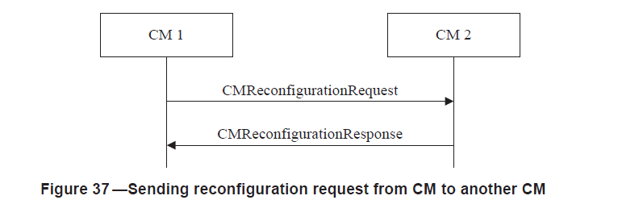
Procedure utilized (4/4)
Send limit on the number of GCOs

Slide 14
Updated message
CMReconfigurationRequest ::= SEQUENCE {
--Indication for CE to be reconfigured
reconfigTarget CxID OPTIONAL,
--List of operating channel number
listOfOperatingChNumber SEQUENCE OF INTEGER OPTIONAL,
--Transmission power limitation [dBm]
txPowerLimit REAL OPTIONAL,
--Indication whether the channel is shared
channelIsShared BOOLEAN OPTIONAL,
--Transmission schedule
txSchedule TxSchedule OPTIONAL,
-- Channel classification information
chClassInfo ChClassInfo OPTIONAL,
--Additionally operable network technology
newNetworkTechnology NetworkTechnology OPTIONAL,
wsoID OCTET STRING OPTIONAL,
cmID cxID OPTIONAL,
operatingFreqency OperatingFrequency OPTIONAL,
--Transmission power limit [dBm]
txPowerLimit REAL OPTIONAL,
--Limit on the maximum number of co-channel GCOs that shall operate simultaneously within a given region and frequency
coChGCOLimit CoChGCOLimit,
...
}

Slide 15
Flowchart

