Slide 1
Coexistence management considering spectrum release
Date: 2016-04-26
Authors:
Notice: This document has been prepared to assist IEEE 802.19. It is offered as a basis for discussion and is not binding on the contributing individual(s) or organization(s). The material in this document is subject to change in form and content after further study. The contributor(s) reserve(s) the right to add, amend or withdraw material contained herein.

Slide 2
Application scenario
CM manages both high priority and low priority GCOs.
To protect the high priority GCO, the CM calculate the aggregate interference from the low priority GCOs to the high priority GCO.
When a low priority releases spectrum, the interference high priority GCO is reduced which means that increased power at the remaining low priority GCOs can be tolerated at the high priority GCO.
Based on the location of the GCO that releases the spectrum, the CM can select the other GCOs for the spectrum reallocation based on the location proximity with the GCO that releases the spectrum

Slide 3
System model

Slide 4
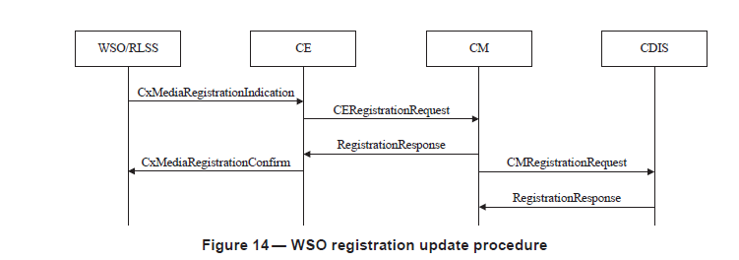
Utilized procedure
5.2.2.2 registration update procedure

Slide 5
Modified parameters
6.2.2.4 WSO registration
-----------------------------------------------------------
--Operation code for registration
-----------------------------------------------------------
--Operation code for registration
OperationCode ::= ENUMERATED {
--New registration
new,
--Update of registration information
update,
--Deregistration
delete,
--Inform the spectrum usage release
release}

Slide 6
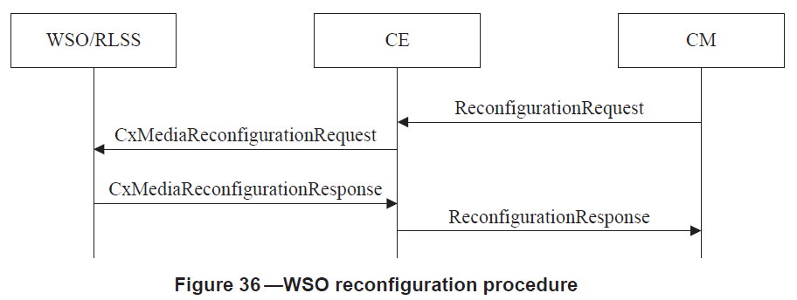
Procedures utilized (2/4)
5.2.10.1 WSO reconfiguration procedure
This procedure is utilized to send modified spectrum usage to the GCO

Slide 7
Flowchart

