Slide 1
Supplemental document for text proposal on amendment to entity operations
Date: 2016-03-15
Authors:
Notice: This document has been prepared to assist IEEE 802.19. It is offered as a basis for discussion and is not binding on the contributing individual(s) or organization(s). The material in this document is subject to change in form and content after further study. The contributor(s) reserve(s) the right to add, amend or withdraw material contained herein.

Slide 2
Abstract
This document provides supplemental information of text proposal on amendment to entity operations.

Slide 3
Background
In IEEE 802.19.1-2014 [1], only US rule of TVWS has been considered.
Currently, Ofcom UK has published regulatory rule for TVWS operation in UK, which is based on ETSI EN 301 598 [2].
And also, RFC 7545 (IETF Protocol to Access White Space database (PAWS))[3] can be considered as de-facto standard for interface between TVWS database and white space device.
As shown in 19-16/0018r0 [4], the interface between CM and CE (i.e. interface B1) is not compatible with RFC 7545 (depending on the implementation, compatibility is needed).
As such, IEEE 802.19.1-2014 may be needed to support TVWS operation in current situation.

Slide 4
Note
This proposal does not consider any text proposals that have already been approved in January F2F meeting.
  Ex) “WSO” is not renamed as “GCO” in this text proposal, which is included in the approved text.

Slide 5
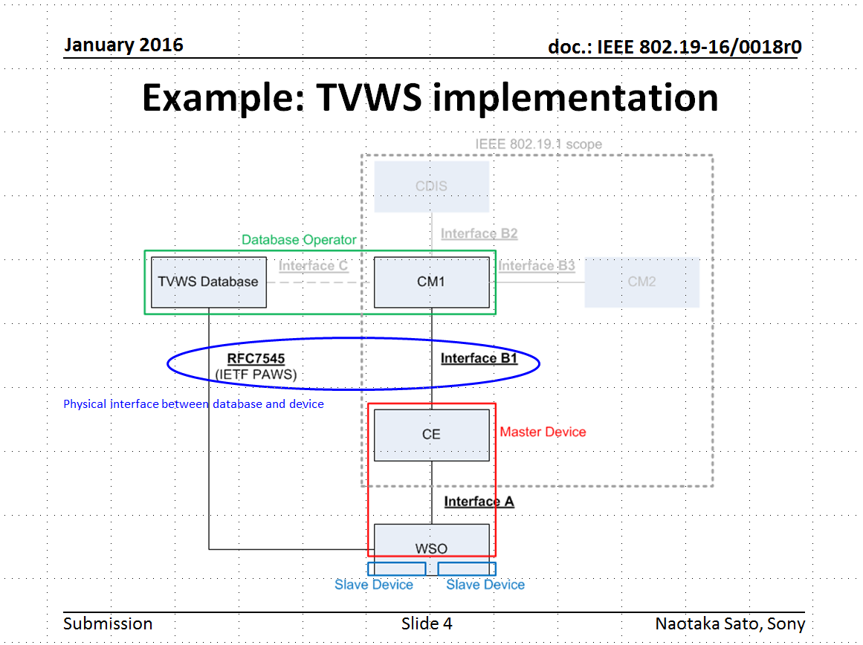
What is needed
To align with ETSI EN 301 598 and IETF RFC 7545
  Same message format as RFC 7545 is NOT needed.
  At least, same or similar information elements should be added.

Slide 6
What kind of information should be revised
Registration information
Operational parameters^{(*1)}
Channel usage parameters^{(*2)}
  *1: The meaning of “operational parameters” in European rule is almost same as “listOfAvailableFrequencies” in IEEE 802.19.1.
  *2: The meaning of “channel usage parameters” in European rule is almost same as “listOfOperatingFrequencies” in IEEE 802.19.1.

Slide 7
What kind of information should be revised
Registration information
Operational parameters^{(*1)}
Channel usage parameters^{(*2)}
  *1: The meaning of “operational parameters” in European rule is almost same as “listOfAvailableFrequencies” in IEEE 802.19.1.
  *2: The meaning of “channel usage parameters” in European rule is almost same as “listOfOperatingFrequencies” in IEEE 802.19.1.
In the following slides, parameters related to 802.19.1 (not included in 802.19.1) will be picked up from RFC 7545 and ETSI EN 301 598.

Slide 8
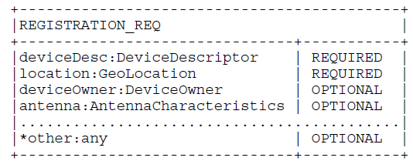

Comparison with device registration in RFC7545
Registration information should be aligned because these parameters are related to available spectrum information.

Slide 9
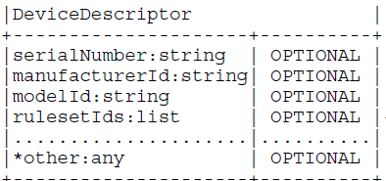
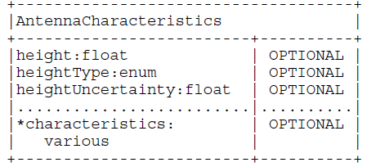
Comparison with REGISTRATION_REQ
[location]
Basically same information is included, but uncertainty information is needed in 19.1.
Similar to WSO ID
None in 19.1
[deviceOwner]
None in 19.1, but no need to be added
Existing
None in 19.1

Slide 10
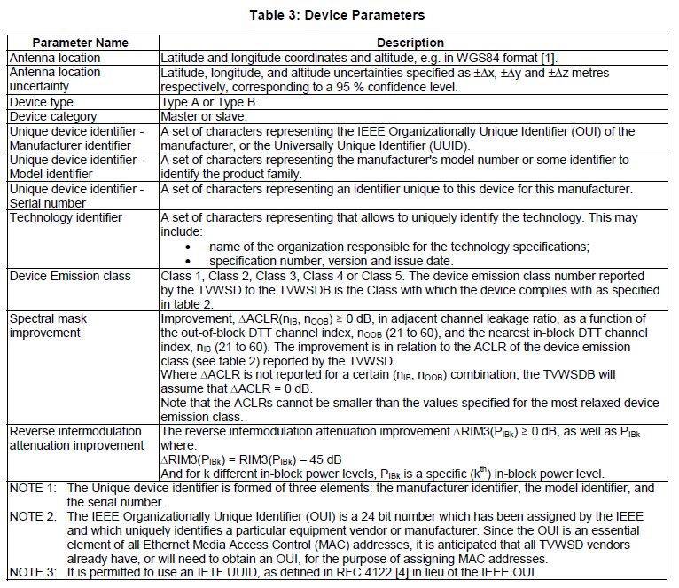
Additional registration information to comply with ETSI EN 301 598
The following parameters should be added as the device descriptor:
  Device type
    This kind of parameter
    already exists as
    “NetworkType”.
  Device category
    No definition
  Device emission class
    No definition

Slide 11
What kind of information should be revised
Registration information
Operational parameters^{(*1)}
Channel usage parameters^{(*2)}
  *1: The meaning of “operational parameters” in European rule is almost same as “listOfAvailableFrequencies” in IEEE 802.19.1.
  *2: The meaning of “channel usage parameters” in European rule is almost same as “listOfOperationalFrequencies” in IEEE 802.19.1.

Slide 12
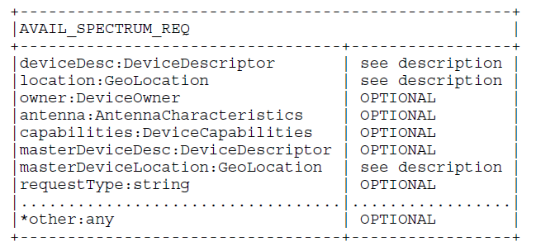
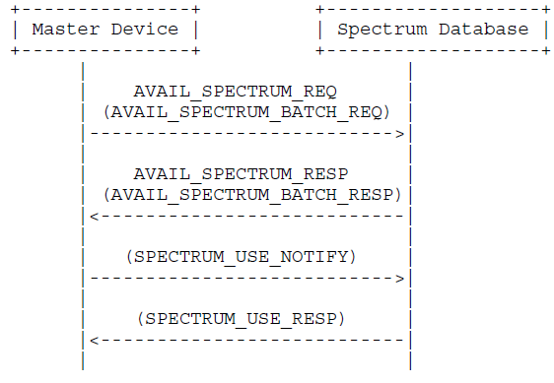
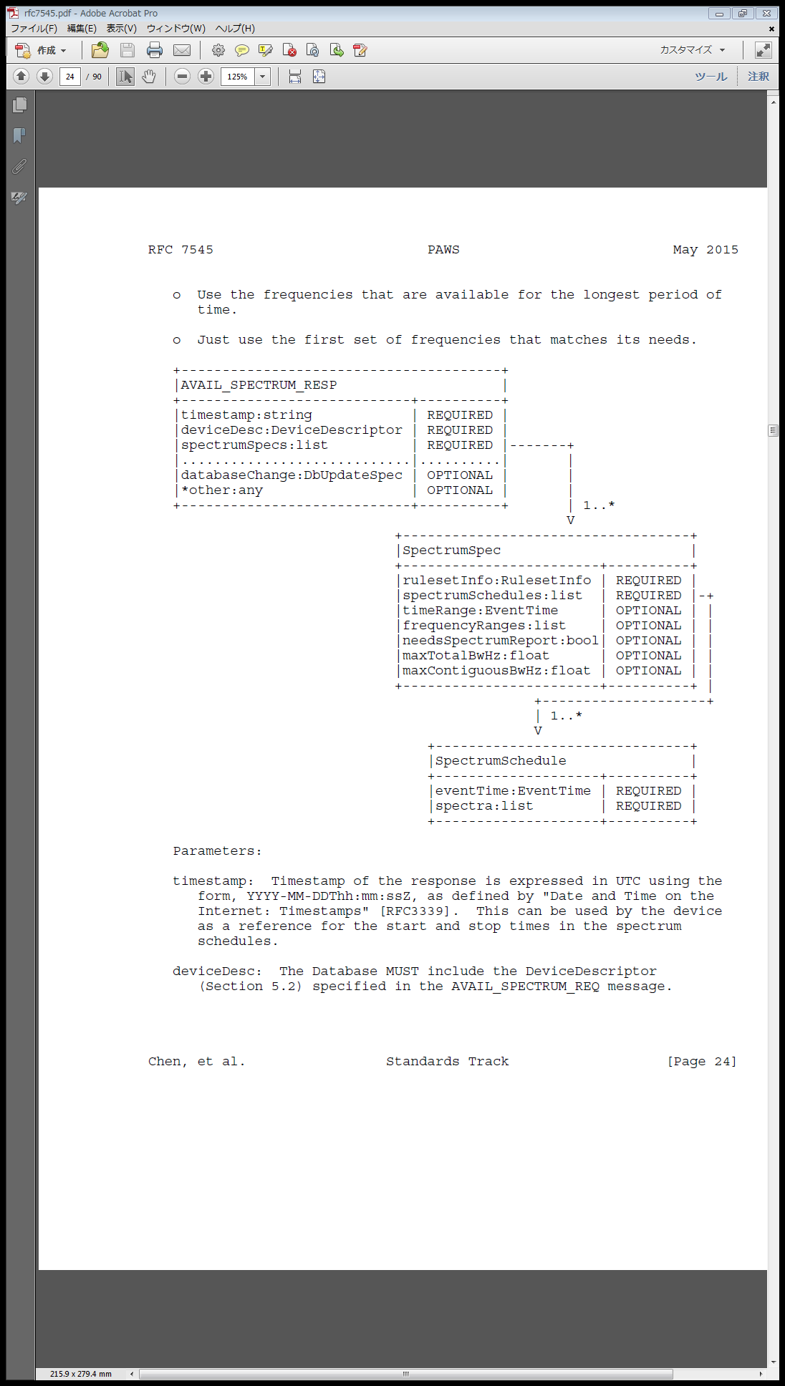
Comparison with Available Spectrum Query in RFC 7545
Procedure for obtaining available spectrum information
There are some lacked but important parameters for 802.19.1

Slide 13
Comparison with Available Spectrum Query in RFC 7545 (Cont’d)
[capabilities]
Almost same as “listOfSuppFrequencies” in 19.1
[masterDeviceDesc, masterDeviceLocation]
In the slave WSO case, these information might be needed also in 19.1.
[requestType]
See details in slide 15.
[timestamp]
Very important also in 19.1 because this information tells us when the spectrum information has been generated.
[spectrumSpecs]
See next page.

Slide 14
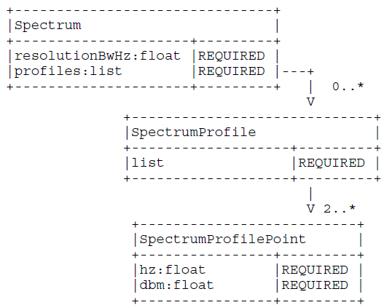
Comparison with Available Spectrum Query in RFC 7545 (Cont’d)
[resolutionBwHz] None in 802.19.1.
This parameter defines the resolution bandwidth (in
hertz) over which permissible power spectral density is defined. For example, FCC regulation would require one spectrum specification at a bandwidth of 6 MHz, and ETSI regulation would require two specifications, at 0.1 MHz and 8 MHz.
[maxTotalBwHz, maxContiguousBwHz] None in 802.19.1.
Constraint on the maximum total bandwidth (in hertz) allowed, and a constraint on the maximum contiguous bandwidth (in hertz) allowed.
These are also needed for coexistence management.

Slide 15
Additional operational parameters to comply with ETSI EN 301 598
ETSI EN 301 598 specifies two kind of operational parameters;
  Specific operational parameters
    operational parameters that a TVWSDB calculates using the device parameters of a specific TVWSD as input.
  Generic operational parameters
    operational parameters that any slave TVWSD in the coverage area of a serving master TVWSD can use.
“requestType”, in other words, “available spectrum type information” is needed also in 802.19.1
  Ex) “typeOfAvailableFrequency”: shall be set to indicate the type of available frequency as specified in regulation if available, “generic” or “specific”.

Slide 16
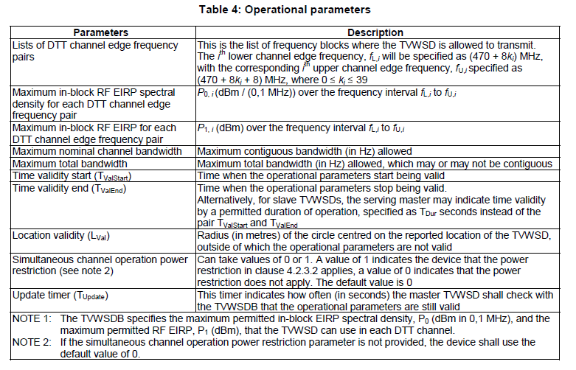
Additional operational parameters to comply with ETSI EN 301 598 (Cont’d)
[Location validity] None in 802.19.1.
This parameter indicates the range that the operational parameter is valid.
This parameter will be needed for coexistence management for “Type A” WSO.

Slide 17
What kind of information should be revised
Registration information
Operational parameters^{(*1)}
Channel usage parameters^{(*2)}
  *1: The meaning of “operational parameters” in European rule is almost same as “listOfAvailableFrequencies” in IEEE 802.19.1.
  *2: The meaning of “channel usage parameters” in European rule is almost same as “listOfOperationalFrequencies” in IEEE 802.19.1.

Slide 18
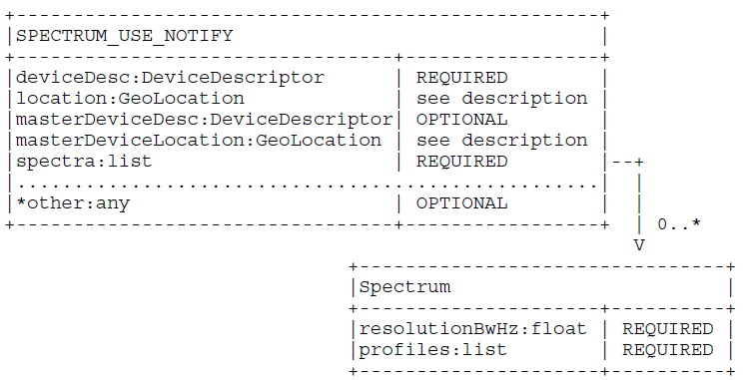
Comparison with Spectrum Use Notification in RFC 7545
Procedure for notifying operating frequency and power information

Slide 19
Comparison with Spectrum Use Notification in RFC 7545
Procedure for notifying operating frequency and power information
[resolutionBwHz] None in 802.19.1.
This parameter defines the resolution bandwidth (in
hertz) over which permissible power spectral density is defined. For example, FCC regulation would require one spectrum specification at a bandwidth of 6 MHz, and ETSI regulation would require two specifications, at 0.1 MHz and 8 MHz.

Slide 20
Additional channel usage parameters to comply with ETSI EN 301 598
No addition.

Slide 21
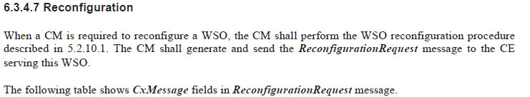
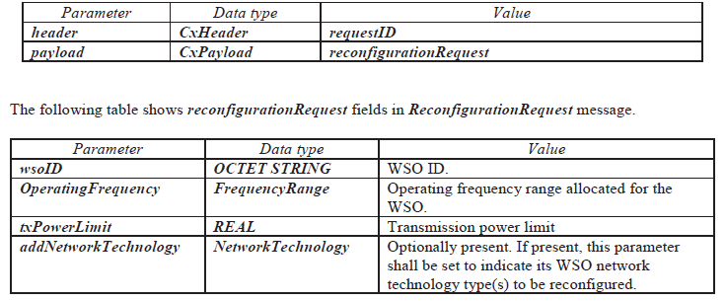
Other issues in 802.19.1
Operating frequency information in WSO reconfiguration request is not defined as list, as follows.
To support both contiguous and non-contiguous multiple channel operation (allowed by ETSI EN 301 598), “OperatingFrequency” should be replaced by “listOfRecommendedOperationFrequencies”.

Slide 22
Summary
This document provided the candidates of new parameters in IEEE 802.19.1 that are same or similar parameters specified in RFC 7545 and ETSI EN 301 598.
Please see details in 19-16/0053r1 for the actual text proposal.

Slide 23
Reference
[1] IEEE Standard Association, “IEEE Std 802.19.1-2014“, July 2014
[2] ETSI EN 301 598 v1.1.1, “White Space Devices (WSD); Wireless Access Systems operating in the 470 MHz to 790 MHz TV broadcast band; Harmonized EN covering the essential requirements of article 3.2 of the R&TTE Directive”, April 2014
[3] Internet Engineering Task Force (IETF) Request for Comments: 7545, “Protocol to Access White-Space (PAWS) Databases”, May 2015
[4] N.Sato, et al, “IEEE 802.19-16/0018r0 Liaison to Wireless Innovation Forum”, January 2016

