Slide 1
Text proposal for using receiver information
Date: 2016-02-23
Authors:
Notice: This document has been prepared to assist IEEE 802.19. It is offered as a basis for discussion and is not binding on the contributing individual(s) or organization(s). The material in this document is subject to change in form and content after further study. The contributor(s) reserve(s) the right to add, amend or withdraw material contained herein.

Slide 2
Abstract
In 16/23r0 we have proposed adding receiver information in the IEEE 802.19.1a system in order to improve the coexistence performance
As an example, we have shown that knowing the FBMC overlapping K factor of FBMC we can adjust the transmit power to assist the successive interference cancellation (SIC) receiver.
This document provides the proposed changes on the current IEEE 802.19.1 standards for adding receiver information

Slide 3
Why we need receiver information
PCAST: “Recommendation 3.1: The Secretary of Commerce working through the National Telecommunications and Information Administration (NTIA), in cooperation with the Federal Communications Commission (FCC), should establish methodologies for spectrum management that consider both transmitter and receiver characteristics to enable flexible sharing of spectrum. ” [1]
IEEE 802.19.1-2014 does not specify exchanging of receiver information for coexistence management

Slide 4
What is receiver information
Receiver type
  Linear receiver such as zero forcing
  Nonlinear receiver such as successive interference cancellation
  …
Modulation information
  OFDM
  FBMC
  …
Filter characteristics
  ACS (existing)
  Filter overlapping factor
  …

Slide 5
Use case
Consider a CM managing multiple wireless networks (WSOs).
The CM knows that some WSOs on the same channel.
Some WSOs employ SIC at the receiver side.
If the WSO transmitter employ FBMC, the CM can control or suggest the WSO transmitter to use different FBMC overlapping factors so that their transmit power difference is maximized.
By maximizing the difference, the SIC performance can be improved.

Slide 6
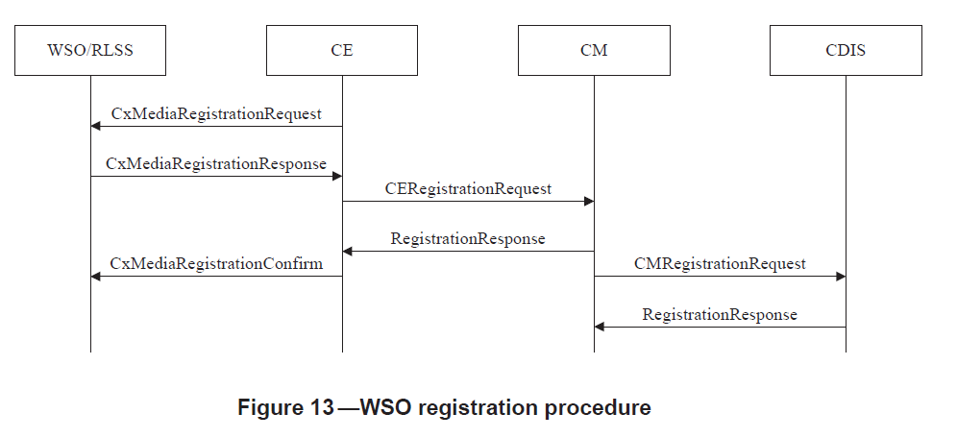
Procedure utilized (1/2)
5.2.2.1 WSO registration procedure

Slide 7
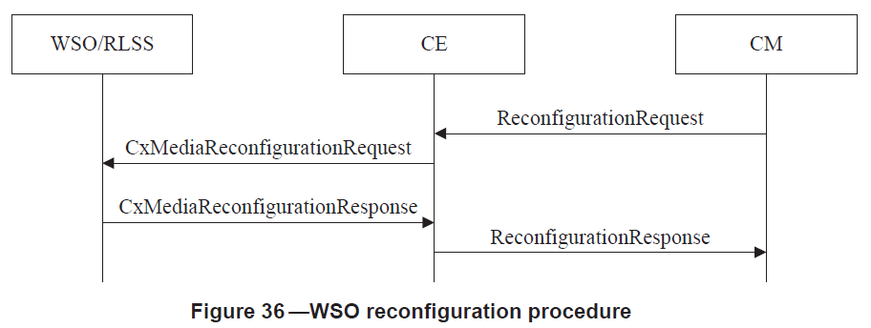
Procedures utilized (2/2)
5.2.10.1 WSO reconfiguration procedure

Slide 8
Updated message 1
--Installation parameters
InstallationParameters ::= SEQUENCE {
--Operating height of master station [m]
opMasterHeight REAL OPTIONAL,
--Operating height of slave station [m]
opSlaveHeight REAL OPTIONAL,
--Operating transmission power [dBm]
opTxPower REAL OPTIONAL,
--Adjacent channel selectivity of the WSO [dB]
aCS REAL OPTIONAL,
--Adjacent channel leakage ratio of the WSO [dB]
aCLR REAL OPTIONAL,
--Guaranteed QoS of backhaul connection of the WSO
guaranteedQoSOfBackhaulConnection GuaranteedQoSOfBackhaulConnection OPTIONAL,

Slide 9
Updated message 1 (cont’d)
--Receiver information
receiverInfo ENUMERATED{
SIC,
...},
--Modulation type
modulationType ENUMERATED{
OFDM,
FBMC,
...},
--Filter characteristics
filterCharacteristics SEQUENCE{
--Adjacent channel selectivity of the WSO [dB]
aCS REAL OPTIONAL,
--FBMC overlapping factor range as the maximum number
fbmcOverlappingFactor INTEGER OPTIONAL,
...
}

Slide 10
Updated message2
Annex C (normative) Messages
--Reconfiguration request
CxMediaReconfigurationRequest ::= SEQUENCE OF SEQUENCE {
...
--Modulation parameter
modulationParameter SEQUENCE OF CHOICE{
ofdm BOOLEAN,
--The overlapping K factor for FBMC
fbmcoverlappingFactor INTEGER,
...},
--Demodulation procedure
sicdemodulationProcedure ENUMERATED{
--demodulate desired signal directly procedure1,
--demodulate interference then desired signal
procedure2,
...} OPTIONAL
}

Slide 11
Updated message3
CxMediaReconfigurationRequest ::= SEQUENCE OF SEQUENCE {
...
--Modulation parameter
modulation CHOICE{
ofdm BOOLEAN,
--The overlapping K factor for FBMC
fbmc INTEGER,
…},
--Demodulation procedure
demodulationProcedure ENUMERATED{
--demodulate desired signal directly
procedure1,
--demodulate interference then desired signal
procedure2} OPTIONAL
}
}

Slide 12
Reference
[1] PCAST, “REALIZING THE FULL POTENTIAL OF GOVERNMENT-HELD SPECTRUM TO SPUR ECONOMIC GROWTH,” July 2012
[2] http://www.ict-phydyas.org/

Slide 13
Annex 1: FBMC’s signal power
When the value of filter overlapping factor (K) is different, the generated signal power is different.
When the K is set to 1, the generated signal power is minimal, and the
normalized transmit signal power is set to 1. When K is set to 2 , 3 or 4, the
ratio of generated signal power and the power when K is set to 1, as the
normalized signal power corresponding to the K.
Overlapping factor (K) | Normalized signal power
1 | 1
2 | k₁
3 | k₂
4 | k₃

Slide 14
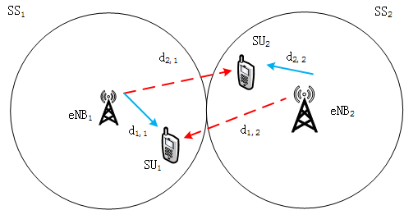
Simulation Scenario
2 SSs coexist, the cover radius are 100 m, and at a given time instance in each system there is only one pair of users.
SS₁, the transmitter is in the center and the receiver is uniformly distributed in the strong interference area, where the receiver can not succeed in decoding its own signal. The minimum SINR is set to 12 dB .
SS₂, the transmitter is in the center and the receiver is uniformly distributed in the each area.
The free space path loss are assumed.
Waveform parameters (power adjustment factor and filter overlapping factor), user’s location and minimum SINR is known by the eNB.

Slide 15
Annex 2: Transmit power
How to decide the filter overlapping factor and power adjustment factor of non-orthogonal spectrum sharing with FBMC and OFDM?
  Power adjustment factor (P): equivalent to the effect of transmitter power amplifier.
  The d_{i,j} represents the distance between i-th SU and j-th eNB.
  The represents the minimum SINR of the receiver.
    SU₁ decodes its own signal (called demodulation procedure 1). SU₂ decodes the SU₁’s signal before its own signal (called demodulation procedure 2)
    FBMC: K₁ (filter overlapping factor of SS₁ ) is 4, and K₂ is 1
    OFDM: K₁ is 1, and K₂ is 1.
    FBMC:
    OFDM:

Slide 16
Annex 2: Transmit power (2)
    SU₂ directly demodulate the useful signal (called demodulation procedure 1), SU₁ demodulate the interference signal firstly, and demodulate the useful signal secondly (called demodulation procedure 2)
    FBMC: K₁ is 1, and K₂ is 4;
    OFDM: K₁ is 1, and K₂ is 1.
    FBMC:
    OFDM:
    The power adjustment factor of orthogonal spectrum sharing
    for curve 1 based P1 and P2 for curve 2:
    Transmit power is equal to the product of the generated signal power and power adjustment factor.

Slide 17
Available bandwidth and transmit power as of different values of k
Case 1: SU1 and SU2 located in the strong interference area
Scenario | overlapping factor of SS₁ | overlapping factor of SS₂ | power adjustment factor of SS₁ | power adjustment factor of SS₂ | Transmit Power of SS₁ | Transmit Power of SS₂
Curve 2 | 1 | 1 | 265.9 | 13.38 | 0.13 | 0.0065
Curve 3 | 1 | 4 | 265.9 | 0.42 | 0.13 | 0.0065
Curve 4 | 4 | 1 | 8.32 | 13.38 | 0.13 | 0.0065
Curve 5 | 4 | 4 | 8.32 | 0.42 | 0.13 | 0.0065
Note:
The bandwidth and transmit power can be adjusted by different K factors
Notes:
Strong interference area 同P4所述

Slide 18
Available bandwidth and transmit power as of different values of k
Case 2: SU₁ located in the interference area, SU₂ located outside the
interference area.
Scenario | overlapping factor of SS₁ | overlapping factor of SS₂ | power adjustment factor of SS₁ | power adjustment factor of SS₂ | Transmit Power of SS₁ | Transmit Power of SS₂
Curve 2 | 1 | 1 | 10.88 | 515.74 | 0.0053 | 0.2521
Curve 3 | 4 | 1 | 0.34 | 515.74 | 0.0053 | 0.2521
Curve 4 | 1 | 4 | 10.88 | 16.13 | 0.0053 | 0.2521
Curve 5 | 4 | 4 | 0.34 | 16.13 | 0.0053 | 0.2521
The bandwidth and transmit power can be adjusted by different K factors
Note:

