Slide 1
TG1a February 2016 teleconference Agenda
Date: 2016-02-23
Authors:
Notice: This document has been prepared to assist IEEE 802.19. It is offered as a basis for discussion and is not binding on the contributing individual(s) or organization(s). The material in this document is subject to change in form and content after further study. The contributor(s) reserve(s) the right to add, amend or withdraw material contained herein.

Slide 2
Teleconference information
Time & Date: 1am EST, February 24, 2016
Join the meeting: https://join.me/ieeesawg802.19
On a computer, use any browser. Nothing to download.
On a phone or tablet, launch the join.me app and enter meeting code:ieeesawg802.19
Join the audio conference:
Dial a phone number and enter access code, or connect via internet.
By phone:
United States - Los Angeles, CA +1.213.226.1066
United States - Washington, DC +1.202.602.1295
Canada - Ottawa +1.613.699.9318
Germany - Berlin +49.30.2240.3071
Japan - Tokyo +81.3.4579.5983
Korea, Republic of - South Korea +82.26.022.2310
Sweden - Stockholm +46.8.4030.8819
Sweden - Stockholm +46.8.4030.9107
Access Code 543-324-473#
Other international numbers available
By computer via internet:
Join the meeting, click the phone icon and select 'Call via internet'. A small download might be required.
Start time by time zones

Slide 3
Attendance
Please send your name and affiliation to naotaka.sato@ieee.org

Slide 4
Agenda for February 24
TG1a meeting called to order
IEEE IPR statement
Call for submissions, discussions and approval of agenda
Technical presentations
  Text proposal for using receiver information (C. Sun)
AOB
Adjourn

Slide 5
Patent Policy
http://standards.ieee.org/about/sasb/patcom/materials.html

Slide 6


Slide 7


Slide 8
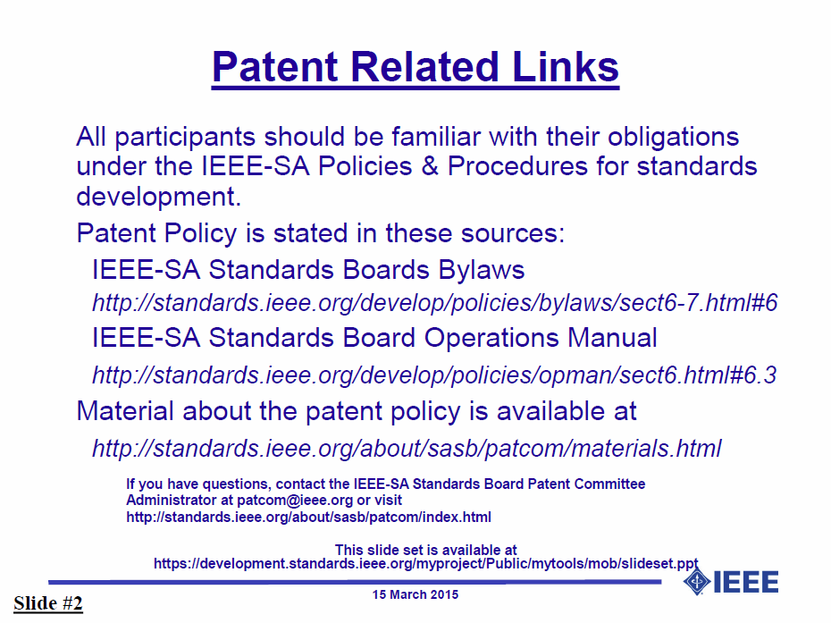

Slide 9


Slide 10


Slide 11
Call for submissions, discussions and approval of agenda
Submissions
  Text proposal for using receiver information (doc 19-16/0040r0)
Approve the agenda of the TG1a January 2016 teleconference, document 19-16/0039r0

Slide 12
AOB
Any Other Business?
Next meeting will be F2F in Macau from March 14 to 17.

Slide 13
Teleconferences
Schedule (1hour)
  Wednesday, February 3, 2016: 1am ET (6am UTC, 3pm JST/KST)
  Wednesday, February 24, 2016: 1am ET (6am UTC, 3pm JST/KST)
Meeting Logistics
  Use “Join Me”
  The chair will send out a notification to IEEE 802.19 reflector in advance of the meeting

Slide 14
Adjourn

