Slide 1
Wireless Coexistence in the Automotive Domain – Study group proposal
Date: 2016-01-19
Authors:
Notice: This document has been prepared to assist IEEE 802.19. It is offered as a basis for discussion and is not binding on the contributing individual(s) or organization(s). The material in this document is subject to change in form and content after further study. The contributor(s) reserve(s) the right to add, amend or withdraw material contained herein.

Slide 2
Abstract
This document defines the scope and the time plan of the proposed study group on Wireless coexistence in the automotive domain

Slide 3
Background
Five teleconferences^{[1,2,3,4,5]} were organized so far, which described the coexistence in the automotive domain in addition to channel modelling for in-car environment
The scope and the time plan were discussed briefly in document 19-15/0073r0
The wireless coexistence in this domain became important topic due to the fast increase on connectivity services in the vehicles
Therefore forming a studying group to study the wireless coexistence in this domain and provide recommendations for other WG (11 and 15)

Slide 4
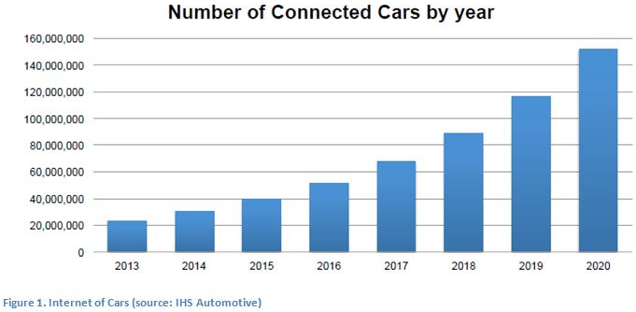
The Uniqueness of automotive Use case
Connected car prospect
Multiple access points and stations in a small cavity
Small distances between the vehicles on the roads (traffic jam)
Fast varying environment due to vehicle mobility
Low insertion loss between neighbouring cars
Growing demands for bandwidth in automotive domain

Slide 5
Scope of the Study group
The group will consider the following scenarios:
WiFi /WiFi interference in both inter-cars, Cars-other stationery WiFi and intra car scenarios
WiFi/Bluetooth interference in both inter-car and intra cars scenarios
Both frequency bands (2.4 and 5 Ghz) should be considered

Slide 6
Targets of the Study group
The proposed study group name is ‘Wireless automotive coexistence’
The target of the study group is:
  Define metrics for the performance of different coexistence techniques and test their effectiveness in different use cases
  Extensive measurements are needed to check the performance of both Bluetooth and WLAN in different scenarios in vehicle, covering both one and multiple vehicles
  Quantify the performance degradation due to coexistence issues

Slide 7
Study group outcomes
We have two options depending on intermediate results of the study group:
  Evaluate solutions within the current standardization framework
  Continue to from a PAR and CSD toward a task group under 802.19
Study group activity duration: 8 months

Slide 8
Straw poll
Do you support formation of the Wireless Automotive Coexistence study group, as described in slides 5-6-7?
yes: 17
No: 1
Don’t know: 4
Motion passed

Slide 9
Teleconferences
The following two conferences are planned:
February 9th at 10:00am ET
March 1st: 09:00am ET

