Slide 1
Feedback on 3GPP CRs: LAA Multi-Channel Access and Energy Detect (ED) Coexistence
Date: 2016-01-20
Authors:
Name | Affiliation | Address | Phone | Email
Baoguo Yang | Broadcom Corporation |  |  | verceg@broadcom.com
Vinko Erceg

Slide 2
Introduction
In this presentation we discuss few topics related to the 3GPP’s request for IEEE 802 to respond to LAA CRs (Change Requests)
Discussion in this presentation may be used as a basis for IEEE 802 LS (Liaison Statement) response
The following topics are discussed
  LAA channelization for Multi-Channel operation
  Detection levels
    ED (Energy Detect)
    PD (Preamble Detection)

Slide 3
Current 802.11ac 5 GHz Frequency Planning
80 MHz bandwidth 802.11ac devices are now common as well as older 40 MHz 802.11n devices
These devices follow multi-channel rules for good coexistence
  80 and 40 MHz operation is supported only on contiguous 20 MHz channels
  80 MHz channels are non-overlapping and hence multiple 80 MHz devices either operate on non-overlapping sets of 20 MHz channels or on fully overlapping sets of 20 MHz channels
These rules avoid the following issues
  Avoids a single 80 MHz from partially overlapping with the 80 MHz channels of 2 other (or more) nearby devices that do not conflict mutually with each other (adjacent in frequency)
  Avoids a single 40 MHz device from partially overlapping with multiple 40 MHz channels or 80 MHz channels
The following slide provide current information on the IEEE 5 GHz 802.11ac channels

Slide 4
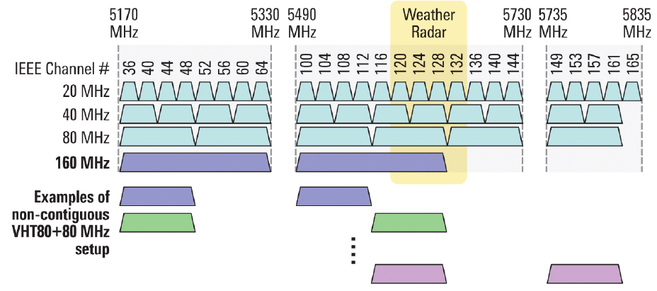
IEEE 5 GHz 802.11ac channels
Source: http://www.eetimes.com/document.asp?doc_id=1279218

Slide 5
LAA Multi-Channel Access
3GPP Rel-13 LAA supports DL only, with up to 4 unlicensed carriers combined with 1 licensed carrier (5 total is possible)
3GPP Rel-13 LAA defines two types of multi-channel access
  Type A: independent LBT on each channel
  Type B: 802.11ac like multichannel access but without the channel bonding rule restriction

Slide 6
LAA Multi-Channel Access Issues (1/2)
3GPP RAN1 devoted very limited time to actual multi-channel evaluation focusing almost entirely on single channel work and yet multi-channel operation is included and the planned mechanisms may not be so friendly to WLAN
LAA multi-channel plan is not required to align with the IEEE 802.11ac multi-channel plans
  That means that the single LAA eNB transmitting on 4 contiguous 20MHz unlicensed channels can potentially impact two nearby 11ac APs that operate in two 80MHz channels, for example
    Partial overlap issue

Slide 7
LAA Multi-Channel Access Issues (2/2)
3GPP RAN1 only recommends but does not requires the LAA eNB to use the 4 contiguous unlicensed channels
  In particular, there was a desire to support 4 unlicensed carriers by using 2 clusters of 2 channels each which might be widely separated in the 5 GHz band
    Similar to 40+40MHz (not present in WLAN specifications)
  This would have a negative effect of competing with 2x 80 MHz 802.11ac channels instead of just one 80MHz channel.
  Also, contention may be performed in parallel on the multiple channels with only limited constraints between the contending engines.

Slide 8
Coexistence Evaluation for Different LAA Multi-channel Scenarios
Non-replaced & replaced WLAN network
  Four 802.11ac 80 MHz APs in each network
  Each AP can operate on four contiguous 20 MHz channels
  This is a fully connected network and all devices are above ED threshold for all devices in the same channel
LAA network
  Four LAA eNBs
  Each can operate on four contiguous or non-contiguous channels
  Alternative 2 (Type A) LBT scheme: eNB performs Cat-4 based LBT on 4 unlicensed carriers - LBT’s are coupled to start/stop transmissions on all carriers together, any combination of carriers is allowed (unlike WLAN which uses bonding rules)
  Alternative 1 (Type B) LBT scheme: eNB performs Cat-4 based LBT on only one unlicensed carrier - The eNB shall choose the carrier requiring Cat-4 based LBT uniformly randomly before each transmission burst
    25us short LBT performed on remaining carriers
Total 16x 20 MHz channels (all occupied in the simulation)
Evaluation methodology
  Step 1: WLAN (non-replaced) coexists with WLAN (replaced with LAA in Step 2)
  Step 2: WLAN (non-replaced) coexists with LAA
  Measure both networks mean UPT in different system loadings
    f13f13 means the file (2MByte) average arrival time of Exponential distribution is 0.13s and 0.13s (for both networks), respectively.

Slide 9
WLAN Mean UPT for Different LAA Multi-Channel Scenarios for a Medium Load
Common clustering and alignment of channels between WLAN and LAA for multi-channel operation provides the most fair operation
LAA can achieve higher throughput with unfair multi-channel frequency selection

Slide 10
Proposed Changes for LAA Multi-Channel Access to be Fair to WLAN
For LAA operation with multiple 20 MHz channels with up to 4 channels in 5G unlicensed band, contiguous channels must be used
LAA must use the aggregation and channel alignment of 20 MHz channels to form 40 MHz and 80 MHz channels that are aligned with the 802.11ac channels in the 5G unlicensed band
To support high datarate operation, LAA multi-channel clustering must be performed up to 4 channels at a time before using more than 4 channels and forming a new cluster separated in frequency
  Similar to 80+80MHz in WLAN

Slide 11
LAA ED Threshold Agreements From 3GPP RAN1 #83
For the category 4 LBT procedure used by LAA:
If the absence of any other technology sharing the carrier can be guaranteed on a long term basis (e.g. by level of regulation), the maximum energy detection threshold used by LAA is
  Min(X, Y)
    X = -75 dBm/MHz+ 10*log10(BWMHz) + 10 dB
    Y =
      Maximum energy detection threshold defined by regulatory requirements when such requirements are defined
      Y = X, otherwise
Otherwise, LAA uses the maximum energy detection threshold of TH;
  TH = max(-72 dBm (20MHz), min(Tmax, Tmax – 10 dB + (P_{H} – P_{TX})))
If an LAA eNB uses channel access signals of other technologies for the purpose of LAA channel access, it shall continue to meet the LAA maximum energy detection threshold requirement. (Captured in 36.300)
The parameters used in the above proposal are defined as the following:
  P_{H} is a reference power equaling 23 dBm,
  P_{TX} is the configured maximum transmit power for the carrier in dBm
    Uses the configured maximum transmission power over a single carrier irrespective of whether single carrier or multi-carrier transmission is employed
  Tmax is defined as the following:
    T_{max} = -75 dBm/MHz+ 10*log10(BWMHz).
    BWMHz is the channel bandwidth in MHz

Slide 12
LAA ED Threshold Issues
The lowest LAA ED threshold requirement is -72dBm
  There are simulation results [1], [2], [3] that have shown that the LAA ED threshold needs be lower than -72dBm in order to ensure the fair coexistence with WLAN
The LAA ED threshold can increase up to -62dBm if the LAA configured maximum transmission power is lower than 23dBm for 20MHz bandwidth
  The increased LAA ED threshold above -72dBm can cause coexistence issues with WLAN
The defined LAA category 4 LBT procedure does not utilize the WLAN PHY preamble detection
  Incorporating both transmitting and detecting the WLAN PHY preamble can largely improve both LAA and WLAN coexistence performance [2], [3]

Slide 13
Proposed Changes for LAA ED Threshold
LAA LBT category 4 procedure must incorporate both transmitting and detecting the WLAN PHY preamble in order to improve both LAA and WLAN coexistence performance
For the category 4 LBT procedure that does not utilize the WLAN PHY preamble detection, LAA must use the fixed maximum energy detection threshold of TH = -77dBm (20MHz) that must not change with the configured maximum transmission power

Slide 14
APPENDIX

Slide 15
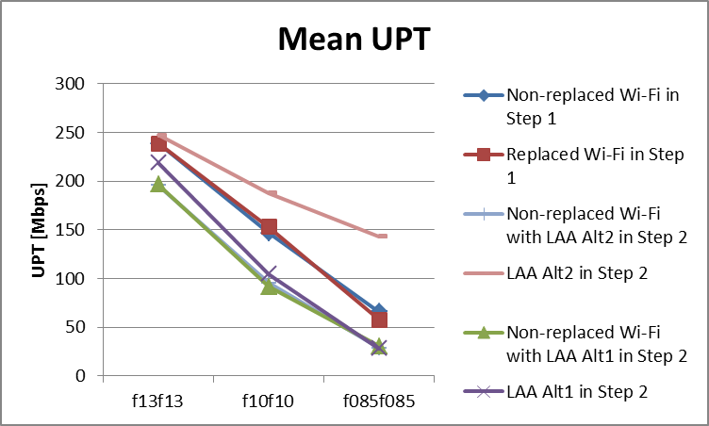
LAA selects single contiguous channel group but with channel offset (partially overlapping case)
Channel indexes for the 4 channels used by 802.11ac AP and LAA eNB for WLAN and LAA networks
LAA eNB using the single contiguous channel group but with offset relative to 802.11ac 80MHz channel could not ensure the fair coexistence with 802.11ac

Slide 16
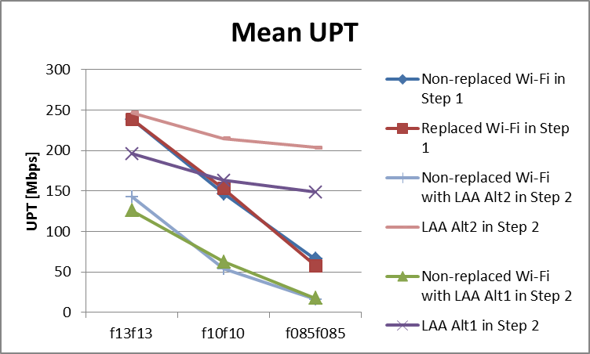
LAA selects evenly distributed non-contiguous channels
Channel indexes for the 4 channels used by 802.11ac AP and LAA eNB for WLAN and LAA networks
LAA eNB using the distributed non-contiguous channels could not ensure the fair coexistence with 802.11ac

Slide 17
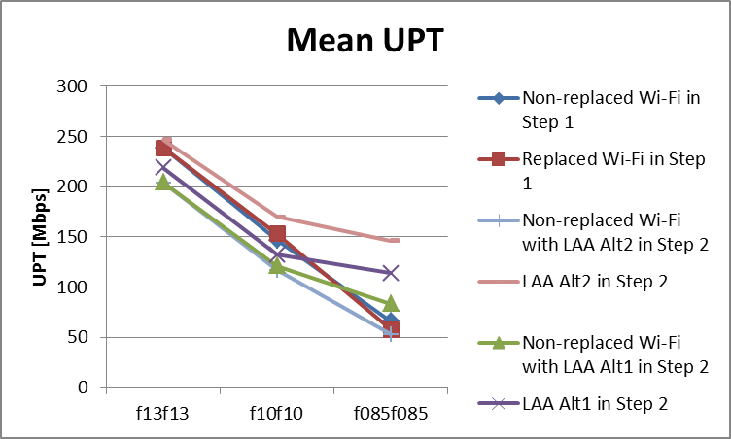
LAA selects two non-contiguous channel groups
Channel indexes for the 4 channels used by 802.11ac AP and LAA eNB for WLAN and LAA networks
LAA eNB using the two channel groups that reside in two sub-bands could not ensure the fair coexistence with 802.11ac

Slide 18
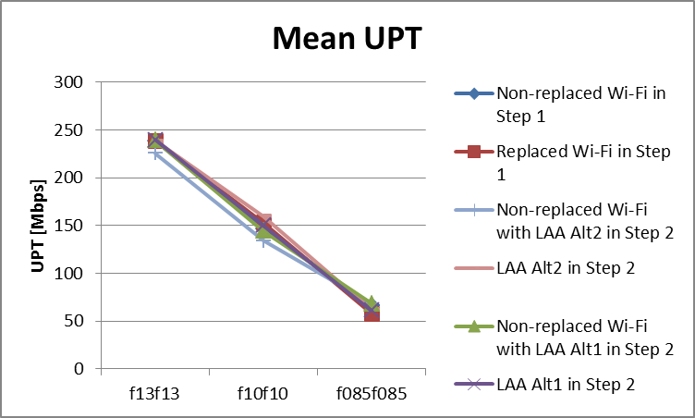
LAA selects single contiguous channel group without channel offset
Channel indexes for the 4 channels used by 802.11ac AP and LAA eNB for WLAN and LAA networks
LAA eNB using the single contiguous channel group that is fully aligned with 11ac 80MHz channel could ensure the fair coexistence with 802.11ac

Slide 19
References
[1] R1-155310, “Energy detection threshold for LAA”, Intel Corporation
[2] R1-152936, “Coexistence Evaluation Results Using LBT Category 4 for Wi-Fi DL and LAA DL only Scenario”, Broadcom Corporation
[3] R1-152937, “Coexistence Evaluation Results Using LBT Category 4 for Wi-Fi DL+UL and LAA DL only Scenario”, Broadcom Corporation

