Slide 1
Coexistence management with receiver information
Date: 2016-01-20
Authors:
Notice: This document has been prepared to assist IEEE 802.19. It is offered as a basis for discussion and is not binding on the contributing individual(s) or organization(s). The material in this document is subject to change in form and content after further study. The contributor(s) reserve(s) the right to add, amend or withdraw material contained herein.

Slide 2
Abstract
This document proposes adding receiver information in the IEEE 802.19.1a system in order to improve the coexistence performance
This document also considers coexistence management scenario with receiver information

Slide 3
Why we need receiver information
PCAST: “Recommendation 3.1: The Secretary of Commerce working through the National Telecommunications and Information Administration (NTIA), in cooperation with the Federal Communications Commission (FCC), should establish methodologies for spectrum management that consider both transmitter and receiver characteristics to enable flexible sharing of spectrum. ” [1]
IEEE 802.19.1-2014 does not specify exchanging of receiver information for coexistence management

Slide 4
What is receiver information
Receiver type
  Linear receiver such as zero forcing
  Nonlinear receiver such as successive interference cancellation
  …
Modulation information
  OFDM
  FBMC
  …
Filter characteristics
  ACS (existing)
  Filter overlapping factor
  …

Slide 5
Objective of simulation
To demonstrate that the receiver information can be used for coexistence management.
  As one of examples, we studied the performance of the coexistence management using SIC and FBMC as receiver information.

Slide 6
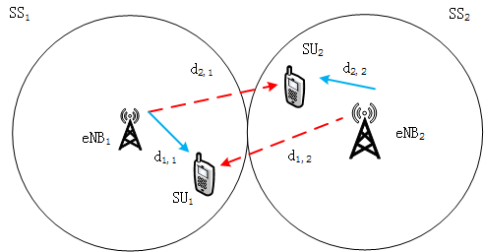
Simulation Scenario
2 SSs coexist, the cover radius are 100 m, and at a given time instance in each system there is only one pair of users.
SS₁, the transmitter is in the center and the receiver is uniformly distributed in the strong interference area, where the receiver can not succeed in decoding its own signal. The minimum SINR is set to 12 dB .
SS₂, the transmitter is in the center and the receiver is uniformly distributed in the each area.
The free space path loss are assumed.
Waveform parameters (power adjustment factor and filter overlapping factor), user’s location and minimum SINR is known by the eNB.

Slide 7
Simulation parameter
Parameters | Value
System frequency | 500 MHz
Minimum SINR required by the SU | 12 dB
Band rejection of PU | 40 dB
Bandwidth | 8 MHz
Filter overlapping factor (K) | 1 , 4
Notes:
K越小，带外泄漏越严重。

Slide 8
Filter overlapping factor K
Filter overlapping factor K is a kind of filter information
The filter overlapping factor is introduced to FBMC to adjust the attenuation of OFDM, and is the overlap coefficient of adjacent filter in the frequency domain.
In PHYDYAS (research project)[2], K is from 1 to 4. The smaller K is, the higher out of band attenuation will get, and with the increasing value of K, the signal power is increased. When K is set to 1, FBMC degenerated into OFDM.
K=4
K=1

Slide 9
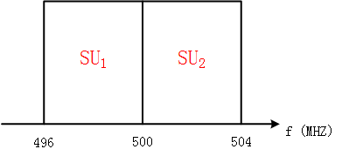
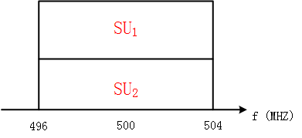
Band utilizations considered in the simulation
Spectrum allocation
Orthogonal
spectrum
sharing
Co-channel sharing (nonorthogonal spectrum sharing)

Slide 10
Simulation Result: Capacities of SUs
K: 1 & 1 , the overlapping factor of SSs are both 1.
K: 1 & 4, K is set according to the opposite principle of the invention.
K: 4 & 1, K is set according to the invention.
K: 4 & 4 , the K of SSs are both 4.
Locations of SUs are randomly generated
Capacity (Mbps)
PAPR：13.2 dB
(Observation 1) By changing the channel allocation and K factor we can adjust the performance of system capacity
Notes:
仿真生成说明：
场景与参数如P4、P5所示，PU代表PU_ Rx, SU代表SU_Tx, SU_Tx 位置随机均匀分布，仿真了2000次，得到的BER曲线。

Slide 11
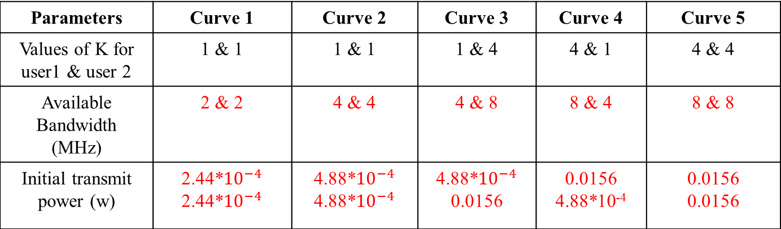
Available bandwidth and transmit power as of different values of k
Parameters | Curve 1 | Curve 2 | Curve 3 | Curve 4 | Curve 5
Values of K for user1 & user 2 | 1 & 1 | 1 & 1 | 1 & 4 | 4 & 1 | 4 & 4
Available Bandwidth (MHz) | 2 & 2 | 4 & 4 | 4 & 8 | 8 & 4 | 8 & 8
Initial transmit power (w) | 2.44*${10}^{−4}$ 2.44*${10}^{−4}$ | 4.88*${10}^{−4}$ 4.88*${10}^{−4}$ | 4.88*${10}^{−4}$ 0.0156 | 0.0156 4.88*10⁻⁴ | 0.0156 0.0156
Note:
Curve 1: blue line Curve 2: cyan line Curve 3: green line Curve 4: yellow line Curve 5: red line
(Observation 2) The bandwidth and transmit power can be adjusted by different K factors

Slide 12
Conclusion
By changing the channel allocation and K factor we can adjust the performance of system capacity
The bandwidth and transmit power can be adjusted by different K factors
We can use receiver parameter information for coexistence management

