Slide 1
Application scenario and text change proposal for coexistence management considering interference alignment
Authors:
Date: 2016-01-19
Notice: This document has been prepared to assist IEEE 802.19. It is offered as a basis for discussion and is not binding on the contributing individual(s) or organization(s). The material in this document is subject to change in form and content after further study. The contributor(s) reserve(s) the right to add, amend or withdraw material contained herein.

Slide 2
Abstract
In IEEE 802.19-15/0093r1 and IEEE 802.19-15/0094r1 we have shown that the knowing the channel state information (CSI) among cognitive radio systems (WSOs), we can use interference nulling methods to improve the performance of WSOs.
This document provides application scenario of these techniques and proposed changes on the current IEEE 802.19.1 standards.

Slide 3
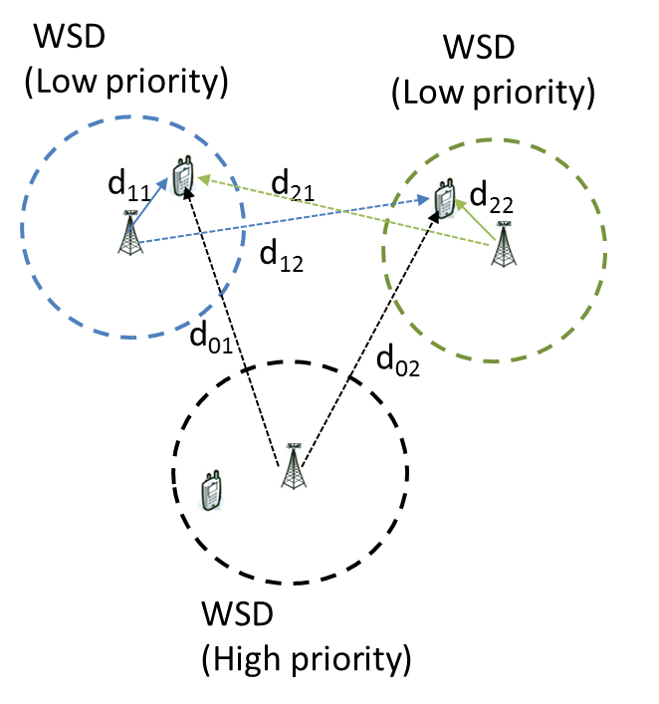
Application scenarios
In TV band, the general authorized devices can be the white space devices (WSD).
At shopping mall, some shops that use WSD to provide wireless network can pay more money to the service provider in order to have a better quality wireless network to customers.
Among all the WSDs that subscribed to IEEE 802.19.1a services, these WSDs are considered as high priority WSDs.
The service provide can manage resource allocation for these general authorized devices in order to achieve the QoS requirement of high priority general authorized devices.

Slide 4
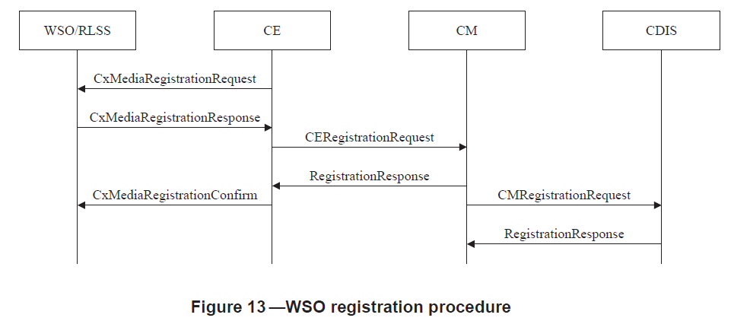
Procedure utilized (1/3)

Slide 5
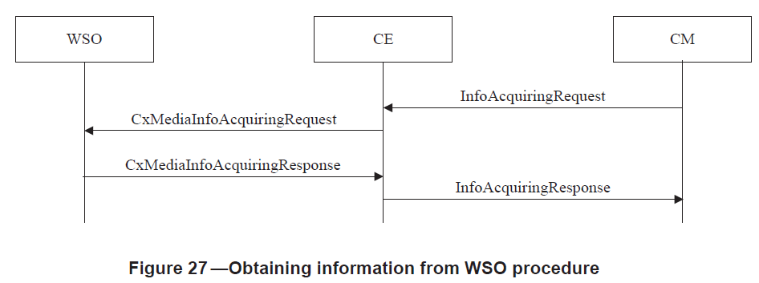
Procedures utilized (2/3)
5.2.6.1 Obtaining information from WSO procedure

Slide 6
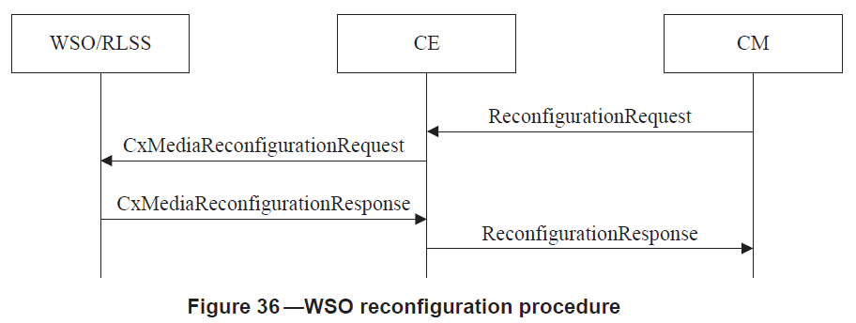
Procedures utilized (3/3)
5.2.10.1 WSO reconfiguration procedure

Slide 7
Updated data type
DiscoveryInformation ::= SEQUENCE {
…
--The number of antennas at the requesting WSO indicating the ability of mitigating the effect of interference spatially
numberOfAntennas INTEGER,
--The type of antenna array. Present if the number of antenna is two or more.
antennaType AntennaType OPTIONAL,
-- MIMO type. Present if the number of antenna is two or more.
mimoType ENUMERATED {
twoDimentional,
threeDimentional} OPTIONAL,
--Antenna processing capability includes directional beam forming and multiantenna precoding. Present if the number of antenna is two or more.
multiAntProCap MultiAntProCap OPTIONAL,
--Antenna boresight azimuth angle direction measured in degree against longitude facing north in clockwise direction. (i.e. an azimuth angle of zero degrees) is a horizontal line in the direction to the north pole, starting from the antenna. Present if the number of antenna is two or more.
azimuthAngle REAL OPTIONAL
}

Slide 8
New data type (1/4)
MultiAntProCap ::= ENUMERATED{
--Directional beam forming capability
beamforming,
--Multiple antenna precoding capability
precoding
}

Slide 9
New data type (2/4)
AntennaType ::= ENUMERATED{
--Linear array
linear,
--Planar array
planar,
--Circular
circular,
...
}

Slide 10
New data types (3/4)
- ListOfSpecUsageInfo
ListOfSpecUsageInfo ::= SEQUENCE OF SpecUsageInfo

Slide 11
New data types (4/4)
- SpecUsageInfo
SpecUsageInfo ::= SEQUENCE{
-- Start frequency
startFreq REAL,
-- Stop frequency
stopFreq REAL,
-- Geolocation information
geolocation SEQUENCE OF Geolocation
}
--ASN1STOP

Slide 12
Updated message
Annex C (normative) Messages
--Reconfiguration request
ReconfigurationRequest ::= SEQUENCE OF SEQUENCE {
.
.
.
--Interference leakage weighting factor describes the weight on the interference of a WSO to co-channel WSOs, where the value is limited from 0 to 1.
intLeakageFactor REAL,
--List of reference point locations of the high priority general authorized system for each available channels that can be used to generate null pattern towards high priority general authorized system, e.g., reduced directivity gain.
listOfSpecUsageInfoOfRefPoints ListOfSpecUsageInfo,
--List of cochannel neighbor WSOs location information for available channels that can be used to generate null pattern toward cochannel WSO for better coexistence.
listOfSpecUsageInfoOfNeightborWSOs ListOfSpecUsageInfo
}

