Slide 1
Use cases and text change proposal for adjustment of energy detection threshold over IP-network
Date: 2016-01-19
Authors:

Slide 2
Abstract
This document provides the proposed changes on the current IEEE 802.19.1 standards for implementation of energy detection adjustment for coexistence management

Slide 3
Background
There is a potential that different wireless systems will operate in the same frequency band
For example, the TV band, 3.5GHz in US and the 5GHz band
These different wireless systems might use different radio access technologies.
IEEE 802.19.1 or its enhanced system (802.19.1a) can manage these different wireless systems together for coexistence over IP-network.
In many cases, most of these wireless systems employ functionality of energy detection CCA.
Generally, it is obvious that the value of energy detection threshold affects the performance of wireless systems.
In such case, there might be merit that we adjust the performance of the wireless systems by controlling the energy detection threshold over IP-network.
In 802.19-15/0092r0[1] we have presented the simulation result of effect on the energy detection adjustment.

Slide 4
Action item from the last F2F meeting[2]
To provide a use case using this mechanism to understand how this mechanism effects the current IEEE 802.19.1-2014 systems architecture, procedures, messages, data types, and primitives.

Slide 5
Use case
Different operators have deployed different wireless network equipments at neighboring areas.
Different operators may use different radio access technologies. For example, operator 1 uses TD-LTE and operator 2 uses Wi-Fi
These systems employ energy detection before utilizing spectrum
Different systems can employ different energy detection thresholds for determination of channel availability.
A system with high detection threshold has a higher probability that it deems the channel is available than that of the system with a low detection threshold.
Therefore, they have different spectrum utilization opportunities.
In the management service, the centralized management entity can thus modify the detection threshold to adjust the spectrum utilization of different systems.

Slide 6
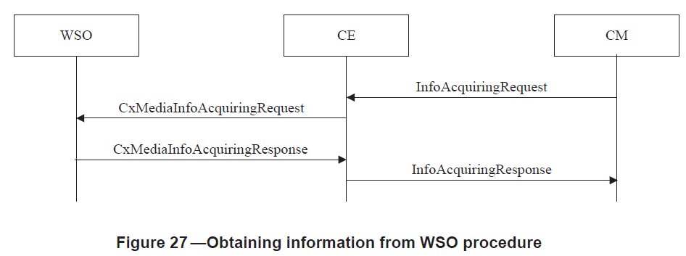
Procedures utilized (1/2)
5.2.6.1 Obtaining information from WSO procedure

Slide 7
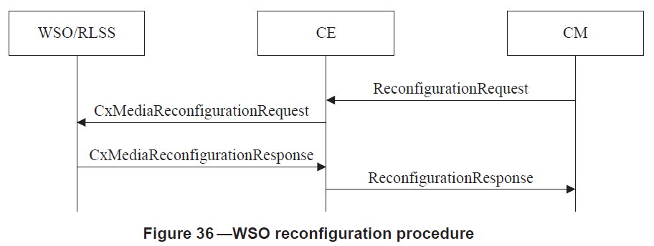
Procedures utilized (2/2)
5.2.10.1 WSO reconfiguration procedure

Slide 8
New data type
--Information of the bounded area defined by the multiple geolocations
minNumGeolocInfo INTEGER ::= 3
Region ::= SEQUENCE{
numGeolocInfo INTEGER,
geolocation Geolocation(SIZE(minNumGeolocInfo..numGeolocInfo))
}
RectangularRegion ::= SEQUENCE{
--Geolocation of the upper-left point of the rectangular
geolocationUpper Geolocation,
--Geolocation of the lower-right point of the rectangular
geolocationLower Geolocation
}

Slide 9
Updated data type
ReqInfoDescr ::= SEQUENCE OF ENUMERATED {
sinr,
desiredBandwidth,
desiredOccupancy,
desiredQoS,
desiredCoverage,
channelNumber,
subscribedService,
interferenceLevel,
fairness,
threshold,
mobilityInformation,
range,
energyDetectionSuccessfulRate,
activationRate
...
}

Slide 10
New data type
EnergyDetectionSetupInfo ::= SEQUENCE {
-- Energy detection threshold [dBm]
energyDetectionTh REAL,
...
}

Slide 11
Updated messages (2/2)
Annex C (normative) Messages
ReqInfoValue ::= SEQUENCE OF SEQUENCE {
.
.
.
--Management range information
range CHOICE {
--Information of the bounded area defined by the multiple geolocations
multipointRegion Region
--Rectangular area defined by the upper-left and lower right points of the rectangular
rectangularRegion RectangularRegion
}
--Energy detection successful rate in percentage [0 ~ 100]
energyDectionSuccessRate REAL,
--Percentage of activated cells of one operator [0 ~ 100]
activationRate REAL
}

Slide 12
Updated messages (1/2)
Annex C (normative) Messages
--Reconfiguration request
ReconfigurationRequest ::= SEQUENCE OF SEQUENCE {
.
.
.
-- Energy detection setup information
energyDetectionSetupInfo EnergyDetectionSetupInfo OPTIONAL,
...
}
EnergyDetectionSetupInfo ::= SEQUENCE {
-- Energy detection threshold [dBm]
energyDetectionTh REAL,
...
}

Slide 13
References
[1] IEEE 802.19-15/0092r0
[2] IEEE 802.19-15/0103r0, “November 2015 TG1a Minutes”

