Slide 1
Liaison to Wireless Innovation Forum
Date: 2016-01-19
Authors:
Notice: This document has been prepared to assist IEEE 802.19. It is offered as a basis for discussion and is not binding on the contributing individual(s) or organization(s). The material in this document is subject to change in form and content after further study. The contributor(s) reserve(s) the right to add, amend or withdraw material contained herein.

Slide 2
Abstract
This document shows that IEEE 802.19 Working Group need liaison to Wireless Innovation Forum

Slide 3
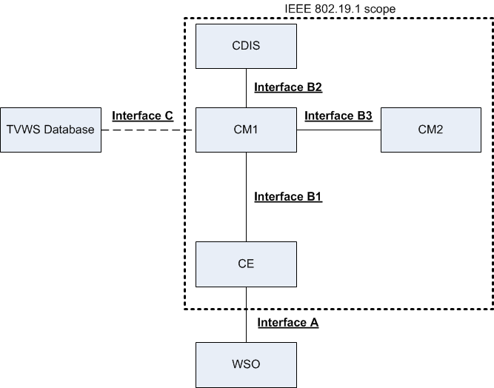
IEEE 802.19.1 system architecture

Slide 4
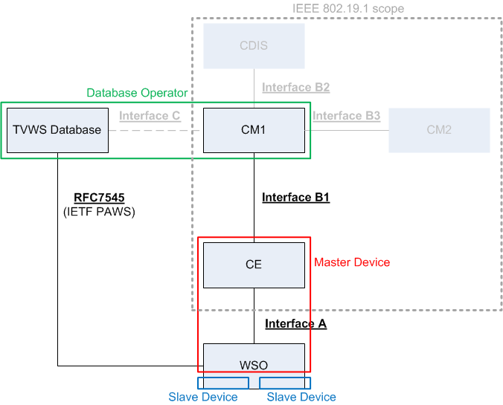
Example: TVWS implementation
Physical interface between database and device

Slide 5
Issues of IEEE Std. 802.19.1-2014
There is no interface certification program in TVWS
Some regulatory tests for TVWS devices
US: FCC part 15
UK: ETSI EN 301 598
Between database and TVWS device
IETF defined PAWS protocol (RFC7545)
IEEE Std. 802.19.1-2014 defined several logical interfaces
Interface B2 can be used for the physical interface between database and master device
No harmonization with IETF PAWS
No interface certification program

Slide 6
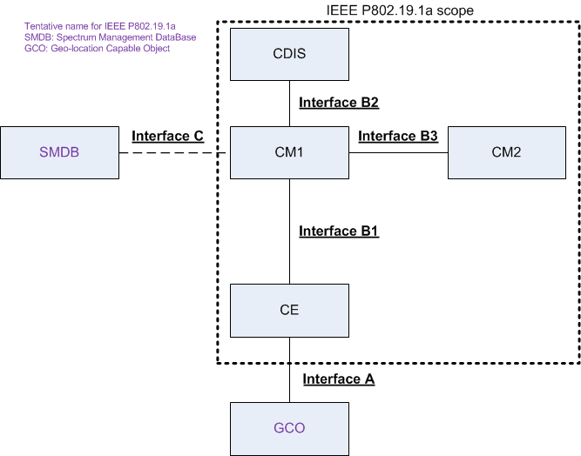
IEEE P802.19.1a system architecture

Slide 7
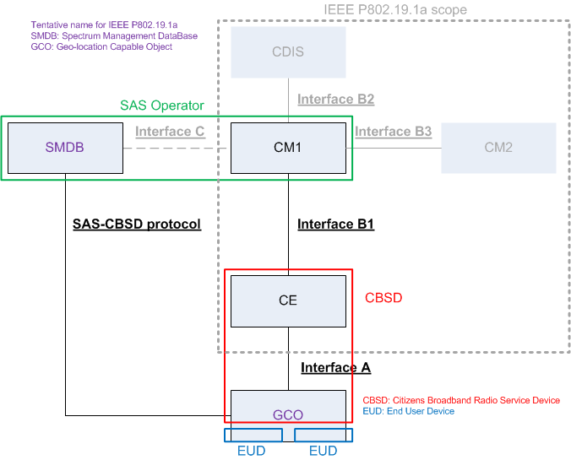
Example: SAS implementation
Coexistence among CBSDs which are operating under General Authorization Access (GAA)
Physical interface between SAS and CBSD

Slide 8
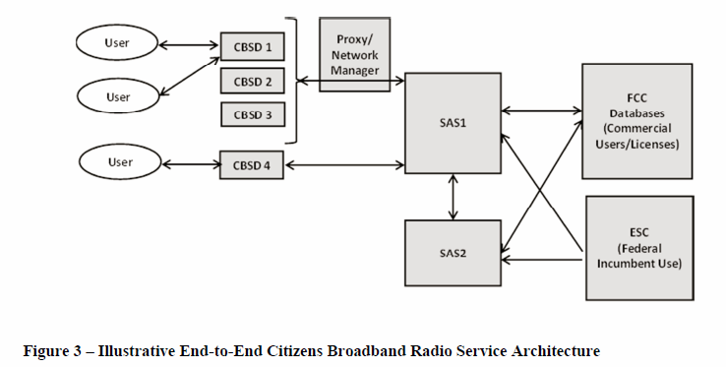
Spectrum Access System (SAS) Architecture
Source: FCC 15-47, 3.5GHz Order and FNPRM page 95

Slide 9
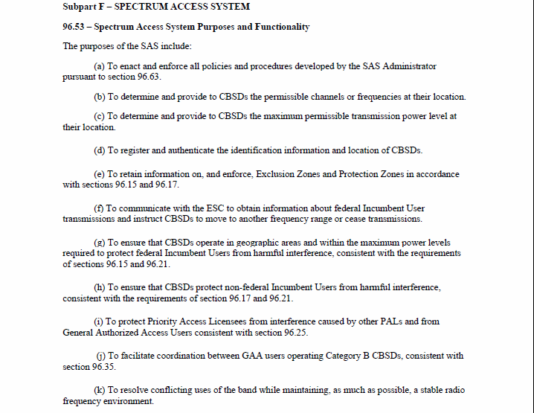
SAS requirements
Source: FCC 15-47, 3.5GHz Order and FNPRM page 159

Slide 10
Need for IEEE P802.19.1a
Certification program for IEEE P802.19.1a
IEEE 802.11 Working Group has good relationship with Wi-Fi Alliance (WFA)
IEEE 802.11 defined Wireless LAN PHY/MAC standards
WFA defines certification program for Wireless LAN based on IEEE 802.11 standards
We need some partners for certification program
Interface between database and device
Interface between databases or operators (under discussion)

Slide 11
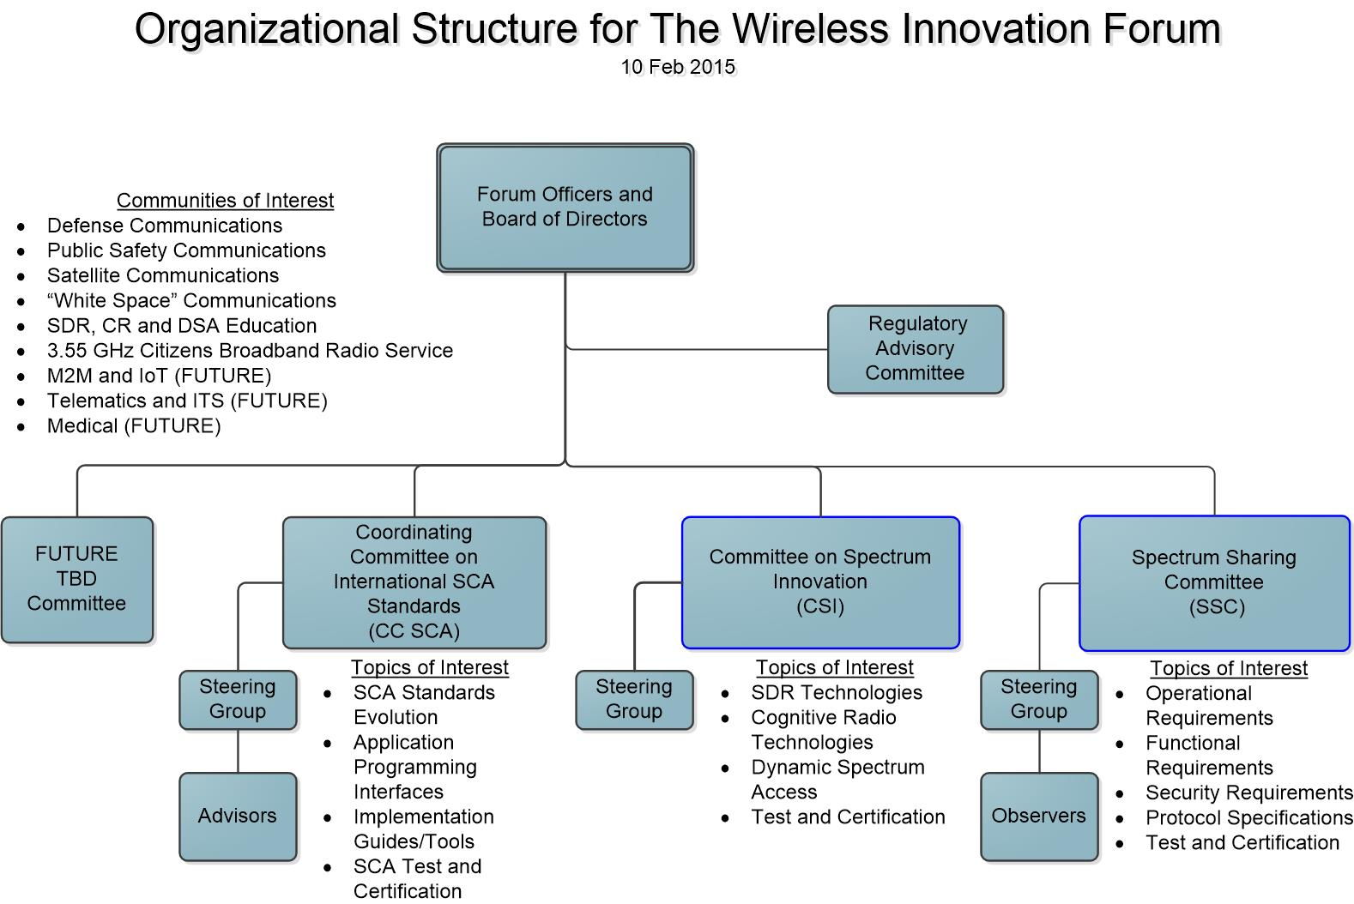
Wireless Innovation Forum (WInnF)
Source: http://www.wirelessinnovation.org/projects-committees

Slide 12
Spectrum Sharing Committee (SSC)
The Spectrum Sharing Committee is a committee of The Wireless Innovation Forum and will serve as a common industry and government standards body to support the development and advancement of spectrum sharing technologies based on the three-tier architecture proposed for the 3.55 GHz rulemaking activities. While the 3.55 GHz band is the main focus on the initial activities, the Wireless Innovation Forum aims to advance this technology for all applicable spectrum bands that can benefit from it.
This Committee is intended to facilitate the interpretation and implementation of FCC rulemaking to a level that allows industry and government parties to collaborate on implementation of a common, efficient, well functioning ecosystem around this technology.
The main activities that will be conducted in the committee include:
Detailing common industry and government functionality and architecture for Spectrum Access Systems (SAS), sensors, and devices
Interoperability requirements and protocol definition to allow for open competitive and well-functioning systems
Common framework for testing and integration of components of spectrum sharing technologies to allow for rapid certification and deployment and predictability, thus expanding the ecosystem and increasing utility of the spectrum
Details of requirements, processes, and methods for protection of incumbent users as required by the spectrum rules
Operational procedures definition for the well -functioning of the system as it pertains to spectrum assignment, managements, and interoperability
Source: http://www.wirelessinnovation.org/projects-committees

Slide 13
Committee Structure
Source: Notice of Expate, Filing by The Wireless Innovation Forum in 12-354 on 09/21/2015
http://apps.fcc.gov/ecfs/document/view?id=60001324626

Slide 14
WInnF SSC Working Group
Source: Notice of Expate, Filing by The Wireless Innovation Forum in 12-354 on 09/21/2015
http://apps.fcc.gov/ecfs/document/view?id=60001324626

Slide 15
Summary
WInnF will define US 3.5GHz SAS certification test
Protocol between SAS and CBSD
Protocol between SASs
IEEE P802.19.1a will cover the logical interfaces for coexistence in any frequency bands, also for coexistence in GAA of US 3.5GHz SAS
Interface B1 will be possible to include protocol between SAS and CBSD
New interface between databases/operators will be possible to include protocol between SASs
WInnF is good candidate to collaborate with us

