Slide 1
Proposal for CM discovery/selection/ association as CE operation
Date: 2016-01-19
Authors:
Notice: This document has been prepared to assist IEEE 802.19. It is offered as a basis for discussion and is not binding on the contributing individual(s) or organization(s). The material in this document is subject to change in form and content after further study. The contributor(s) reserve(s) the right to add, amend or withdraw material contained herein.

Slide 2
Abstract
This document proposes “CM discovery/selection/association” as a new functionality of coexistence enabler (CE).

Slide 3
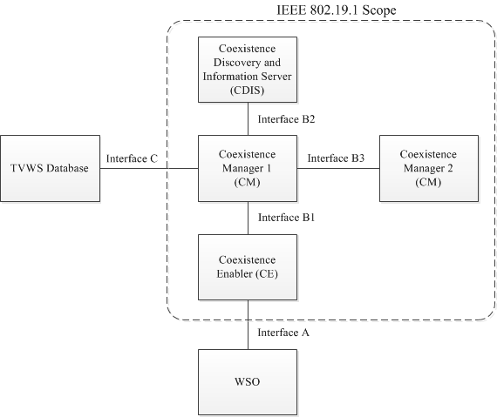
[Recap] System architecture defined in IEEE 802.19.1-2014 [1]
coexistence discovery and information server (CDIS): An entity that is responsible for determining for coexistence managers (CMs) those white space objects (WSOs) that may affect performance of the WSOs that the CMs serve.
coexistence manager (CM): An entity that is responsible for making coexistence decisions related to reconfiguration of white space objects (WSOs) to solve coexistence problems among them.
coexistence enabler (CE): An entity that represents a white space object (WSO) in the coexistence system and serves one WSO at a time.

Slide 4
Background
IEEE 802.19.1-2014 does not specify CM discovery, selection and association procedure as CE operation.
In the use case for professional installation of CE and WSO, this would not be a problem.
In the personal use case, this would be a problem because for example;
Wireless access point w/ CE or only CE might be sold in the store;
CE does not know which CM it should be associated with; and
No specification/description in the standard
CE does not know the association information of CM.
i.e. IP address

Slide 5
Problems to be solved and solutions
How to obtain CM information by CE (i.e. CM discovery)
Any methodologies should be acceptable (i.e. implementation dependent)
CE has list of CMs to be associated with by implementation.
CE can retrieve CM information from external database server (e.g. server operated by internet provider, wireless access point vendor and so on).
User can input the CM information manually via interface A.
etc...
At least, CE should obtain CM’s IP address by any methodologies for personal use case.
Example text) CE shall obtain association information of CM by any methodologies if the CE does not have it.
How to select CM by CE (i.e. CM selection)
Any criteria should be acceptable (i.e. implementation dependent)
How to associate with CM (i.e. CM association)
Association procedure is needed.

Slide 6
Summary
In the amendment, text regarding CM discovery/selection/association should be added.
CM discovery and selection should be implementation dependent.
Detailed text proposal on CM association procedure is presented in 802.19-16/0016r0.

