Slide 1
Discussion on Interface C
Date: 2016-01-19
Authors:
Notice: This document has been prepared to assist IEEE 802.19. It is offered as a basis for discussion and is not binding on the contributing individual(s) or organization(s). The material in this document is subject to change in form and content after further study. The contributor(s) reserve(s) the right to add, amend or withdraw material contained herein.

Slide 2
Abstract
This document discusses interface C.

Slide 3
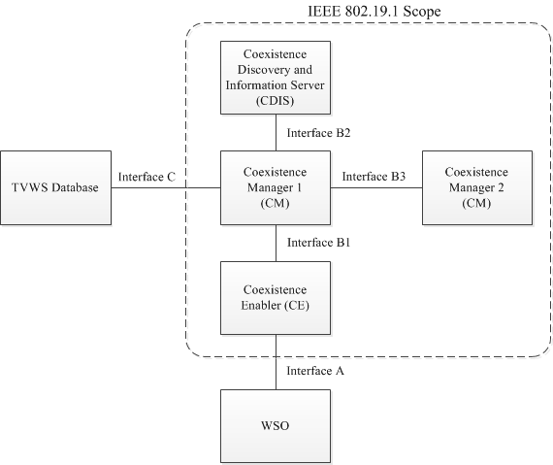
[Recap] System architecture defined in IEEE 802.19.1-2014 [1]
coexistence discovery and information server (CDIS): An entity that is responsible for determining for coexistence managers (CMs) those white space objects (WSOs) that may affect performance of the WSOs that the CMs serve.
coexistence manager (CM): An entity that is responsible for making coexistence decisions related to reconfiguration of white space objects (WSOs) to solve coexistence problems among them.
coexistence enabler (CE): An entity that represents a white space object (WSO) in the coexistence system and serves one WSO at a time.

Slide 4
Current text for interface C in the standard
Interface C between a CM and a TVWS database is not defined in this standard and is implementation dependent. One of the implementation examples of the interface C is Protocol to Access WS database (PAWS) specification.

Slide 5
Discussion
Interface C should be remained in the amendment standard as optional because database is needed in some target frequency bands.
TV band: Geo-location database/ TVWS database
3.5GHz bands: SAS database (Only in US)
5GHz bands: Geo-location database (possible in the future, under discussion. No database at this moment.)
900MHz, 2.4GHz band, etc: No database.
“TVWS database” should be renamed.
e.g. Spectrum management database, Spectrum administrative database, etc...

Slide 6
Reference
[1] IEEE Standard Association, “IEEE Std 802.19.1-2014“, July 2014

