Slide 1
System architecture for information exchange between independent IEEE 802.19.1 systems
Date: 2016-01-19
Authors:
Notice: This document has been prepared to assist IEEE 802.19. It is offered as a basis for discussion and is not binding on the contributing individual(s) or organization(s). The material in this document is subject to change in form and content after further study. The contributor(s) reserve(s) the right to add, amend or withdraw material contained herein.

Slide 2
Abstract
This document shows study and discussion results on system architecture for information exchange between independent IEEE 802.19.1 systems.

Slide 3
Objective of architecture discussion
To identify the appropriate architecture for realizing information exchange between independent IEEE 802.19.1 systems.
[Background]
We have confirmed in CUB SG that there is a scenario where different entities have their own coexistence system (i.e. IEEE 802.19.1 system)[1].
Entities: network operator, wireless internet provider, building administrator, infra-provider, etc...
The entities have the information that they do not want to disclose.
E.g. installation information
Moreover, each entity might implement different profile(s) in coexistence system.
We also have confirmed the necessity of information exchange between different coexistence systems by simulation in CUB SG discussion[2].
This result is one of the motivation to amend IEEE 802.19.1-2014.

Slide 4
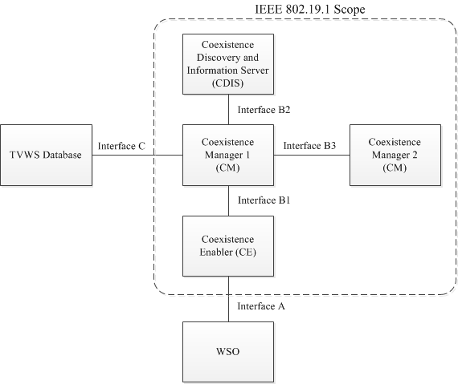
[Recap] System architecture defined in IEEE 802.19.1-2014 [3]
coexistence discovery and information server (CDIS): An entity that is responsible for determining for coexistence managers (CMs) those white space objects (WSOs) that may affect performance of the WSOs that the CMs serve.
coexistence manager (CM): An entity that is responsible for making coexistence decisions related to reconfiguration of white space objects (WSOs) to solve coexistence problems among them.
coexistence enabler (CE): An entity that represents a white space object (WSO) in the coexistence system and serves one WSO at a time.

Slide 5
Executive summary of discussion in the teleconferences
See details in the following documents
Technical contributions: 802.19-15/0108r1[4], 802.19-16/0002r1[5].
Teleconference minutes: 802.19-15/0109r0[6], 802.19-16/0005r1[7].
There were 4 options proposed as the architecture candidate.
Option 1: Addition of interface between different CDISs
CDIS communicates directly with the other CDIS in the different system.
Option 2: Addition of new entity for interface between different CDISs
CDIS communicates with the other CDIS in the different system via new entity .
Option 3: Use the interface B3
CM communicates directly with the other CM in the different system.
Same as no amendment.
Option 4: Addition of new entity for interface between different CMs in the different systems
CM communicates with the other CM in the different system via new entity.
As a discussion result, we decided to define architecture based on option 4.

Slide 6
Option 4. Addition of new entity for realizing interface between different CMs in the different systems.
System 1
System 2
New entity
It can be defined as “enabler for inter-system coordination ”, not as “decision maker”, because CM is already acting as “decision maker”.
In the interface between different CMs in the different systems via new entities, we can use similar (not same !) procedures and algorithms as defined in interface B3.

Slide 7
Proposal of overall architecture
New entity ➔ Coordination Enabler (COE)
New interfaces ➔ Interface B4, Interface B5
Red: new definition
Blue: amended (See details in 802.19-16/00xxr0)

Slide 8
Details
See text proposal document IEEE 802.19-16/00xxr0.

Slide 9
Next step
To define procedures for interface B4 and interface B5 if the architecture is approved.
New procedure(s) as CM operation
Define COE operation and the relevant procedure(s)

Slide 10
References
[1] Sho Furuichi, et al, “IEEE 802.19-15/0032r0 The new coexistence use cases for IEEE 802.19.1”, April 2015
[2] Sho Furuichi, et al, “IEEE 802.19-15/0054r0, Expected Performance Improvement in the New Coexistence Scenario and Use Cases for IEEE 802.19.1 – Simulation Result – ”, July 2015
[3] IEEE Standard Association, “IEEE Std 802.19.1-2014“, July 2014
[4] Sho Furuichi, “IEEE 802.19-15/0108r1 Discussion on possible architectures for information exchange between independent IEEE 802.19.1 systems”, Dec 2015
[5] Sho Furuichi, “IEEE 802.19-16/0002r1 Further consideration on possible architecture for information exchange between independent IEEE 802.19.1 systems”, Jan 2016
[6] Naotaka Sato, “IEEE 802.19-15/0109r0 TG1a Conference Call Minutes”, Dec 2015
[7] Naotaka Sato, “IEEE 802.19-16/0005r1 TG1a January Conference Call Minutes”, Jan 2016

