Slide 1
Wireless Coexistence in the Automotive Domain – Study group proposal
Date: 2016-01-19
Authors:
Notice: This document has been prepared to assist IEEE 802.19. It is offered as a basis for discussion and is not binding on the contributing individual(s) or organization(s). The material in this document is subject to change in form and content after further study. The contributor(s) reserve(s) the right to add, amend or withdraw material contained herein.

Slide 2
Abstract
This document defines the scope and the time plan of the proposed study group on Wireless coexistence in the automotive domain

Slide 3
Background
Five teleconferences^{[1,2,3,4,5]} were organized so far, which described the coexistence in the automotive domain in addition to channel modelling for in-car environment
The scope and the time plan were discussed briefly in document 19-15/0073r0
The wireless coexistence in this domain became important topic due to the fast increase on connectivity services in the vehicles
Therefore forming a studying group to study the wireless coexistence in this domain and provide recommendations for other WG (11 and15)

Slide 4
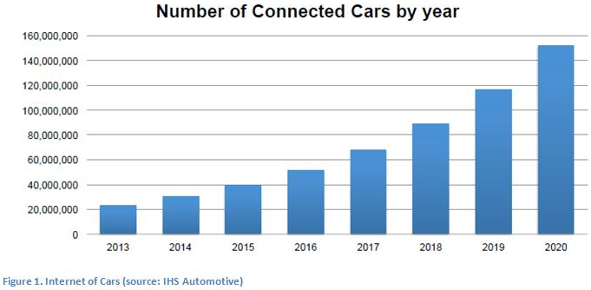
The Uniqueness of automotive Use case
Connected car prospect
Multiple access points and stations in a small cavity
Small distances between the vehicles on the roads (traffic jam)
Fast varying environment due to vehicle mobility
Low insertion loss between neighbouring cars
Growing demands for bandwidth in automotive domain

Slide 5
Scope of the Study group
The group will deal with the following scenarios:
WiFi /WiFi interference in both inter-cars and intra car scenarios
WiFi/Bluetooth interference in both inter-car and intra cars scenarios
Both frequency bands (2.4 and 5 Ghz) should be considered

Slide 6
Targets of the Study group
The proposed study group name is ‘Wireless automotive coexistence’
The target of the study group is:
  Define metrics for the performance of different coexistence techniques and test their effectiveness in different scenarios
  Extensive measurements are needed to check the performance of both Bluetooth and WLAN in different scenarios in vehicle, covering both one and multiple vehicles
  Both ISM frequencies (2.4 and 5 GHz) should be considered
  Quantify the performance degradation due to coexistence issues

Slide 7
Study group outcomes
We have two options depending on intermediate results of the study group:
  Evaluate solutions within the current standardization framework
  Continue to from a PAR and CSD toward a task group under 802.19
Study group activity duration: 8-12 months

Slide 8
References
[1] A. Mourad, Coexistence Management in the 2.4GHz ISM Band in the automotive environment, IEEE 802.19-15/0065r0, July 2015.
[2] A. Mourad, Coexistence Management in the 2.4GHz ISM Band in the Automotive Environment - Next Steps, IEEE 802.19-15/0071r0, Aug. 2015.
[3] A. Mourad, Wireless Coexistence in the Automotive Environment - Scope and time plan, IEEE 802.19-15/0073r0, Sept. 2015.
[4] A. Mourad, Wireless Coexistence in the Automotive Environment - System Model, IEEE 802.19-15/0081r0, Oct. 2015.
[5] I. Kotzer, On The Intra Vehicle Channel Model, IEEE 802.19-15/0084r0, Oct. 2015.

