Slide 1
Wireless Coexistence in automotive domain January 2016 Atlanta Meeting Agenda
Date: 2016-01-17
Authors:
Notice: This document has been prepared to assist IEEE 802.19. It is offered as a basis for discussion and is not binding on the contributing individual(s) or organization(s). The material in this document is subject to change in form and content after further study. The contributor(s) reserve(s) the right to add, amend or withdraw material contained herein.

Slide 2
Agenda graphic

Slide 3
Meeting protocol
Please announce your affiliation when you first address the group during the meeting slot
Attendance
  http://newton.meeting.verilan.com
  Register
  Indicate attendance

Slide 4
Agenda for Tuesday PM2
WG meeting called to order
Call for secretary
IEEE IPR statement
Presenting the document 19-16/10r0 on forming a study group about wireless coexistence in the automotive domain
A straw poll on forming a study group with the scope and time plan defined in the document 19-16/10r0
Recess

Slide 5
Call for secretary
Looking for volunteer of recording secretary

Slide 6
Patent Policy
http://standards.ieee.org/about/sasb/patcom/materials.html

Slide 7


Slide 8


Slide 9
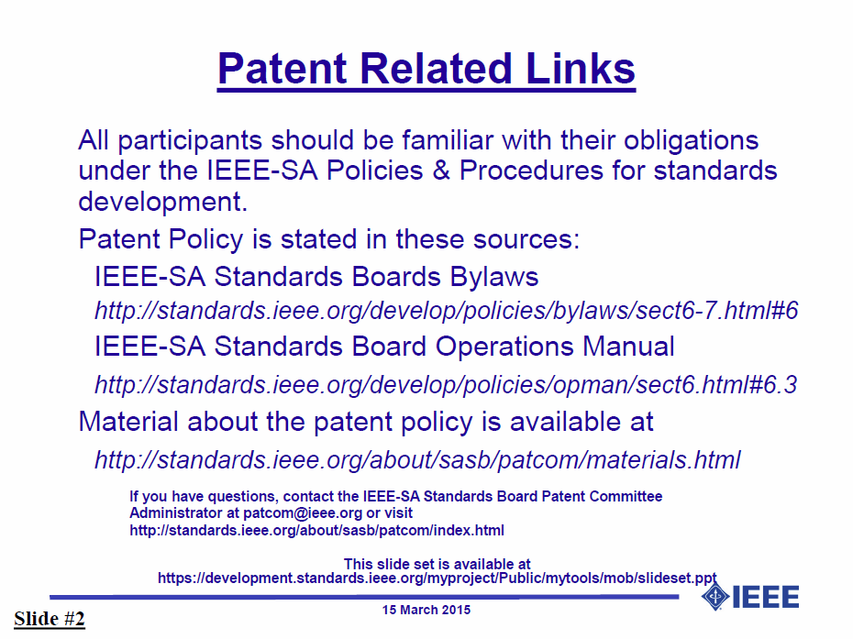

Slide 10


Slide 11
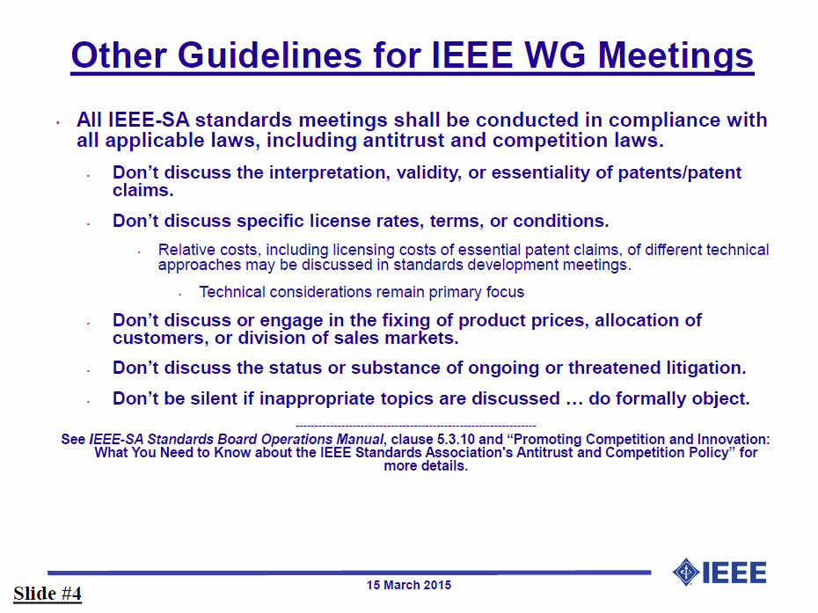

Slide 12
Adjourn

