Slide 1
TG1a January 2016 Atlanta Meeting Agenda
Date: 2016-01-19
Authors:
Notice: This document has been prepared to assist IEEE 802.19. It is offered as a basis for discussion and is not binding on the contributing individual(s) or organization(s). The material in this document is subject to change in form and content after further study. The contributor(s) reserve(s) the right to add, amend or withdraw material contained herein.

Slide 2
Agenda graphic

Slide 3
Meeting protocol
Please announce your affiliation when you first address the group during a meeting slot

Slide 4
Attendance
http://newton.meeting.verilan.com
Register
Indicate attendance

Slide 5
Tuesday AM1

Slide 6
Agenda for Tuesday AM1
TG1a meeting called to order
Call for secretary
Call for submissions and discussions
Approval of agenda
IEEE IPR statement
Approval of November 2015 TG1a meeting and conference call minutes
TG1a Opening report
Technical presentation
  System Architecture
    Doc. 19-16/0011r0: System architecture for information exchange between independent IEEE 802.19.1 systems (S. Furuichi)
    Doc. 19-16/0012r0: Discussion on Interface C (S. Furuichi)
    Doc. 19-16/0013r0: Text proposal on System Architecture (S. Furuichi)
  Terminology definitions
    Doc. 19-16/0014r0: Text proposal on terminology definitions in P802.19.1a (S. Furuichi)
Recess

Slide 7
Call for secretary
Looking for volunteer of recording secretary

Slide 8
Call for submissions and discussions
Submissions
  System Architecture
    Doc. 19-16/0011r0: System architecture for information exchange between independent IEEE 802.19.1 systems (S. Furuichi)
    Doc. 19-16/0012r0: Discussion on Interface C (S. Furuichi)
    Doc. 19-16/0013r0: Text proposal on System Architecture (S. Furuichi)
  Terminology definitions
    Doc. 19-16/0014r0: Text proposal on terminology definitions in P802.19.1a (S. Furuichi)
  CM association procedure
    Doc. 19-16/0015r0: CM association procedure (S. Furuichi)
    Doc. 19-16/0016r0: Text proposal on CM association procedure (S. Furuichi)
  Proxy coexistence service
    Doc. 19-16/0017r0: Proxy coexistence service (S. Furuichi)
  Energy detection
    Doc. 19-16/0019r0: Use cases and text change proposal for adjustment of energy detection threshold over IP-network (C. Sun)
    Doc. 19-16/0020r0 : Text proposal on Annex on energy detection parameters(C. Sun)
  Interference alignment
    Doc. 19-16/0021r0: Application scenario and text change proposal for coexistence management considering interference alignment (C. Sun)
    Doc. 19-16/0022r0 : Text proposal on Annex for supporting interference alignment (C. Sun)
  Coexistence management
    Doc. 19-16/0023r0: Coexistence management with receiver information (C. Sun)
Discussions
  Liaison
    Doc. 19-16/0018r0: Liaison to Wireless Innovation Forum (N. Sato)

Slide 9
Agenda items for this week
Approval of meeting minutes
TG1a Opening report
Discussion for Liaison to the Wireless Innovation Forum
Technical presentations
Motions
Review project timeline
Review objectives for next meeting
Schedule for teleconferences

Slide 10
Approval of agenda
Motion to approve the agenda of the November 2015 TG1a meeting, document 19-16/0006r1

Slide 11
Patent Policy
http://standards.ieee.org/about/sasb/patcom/materials.html

Slide 12


Slide 13


Slide 14
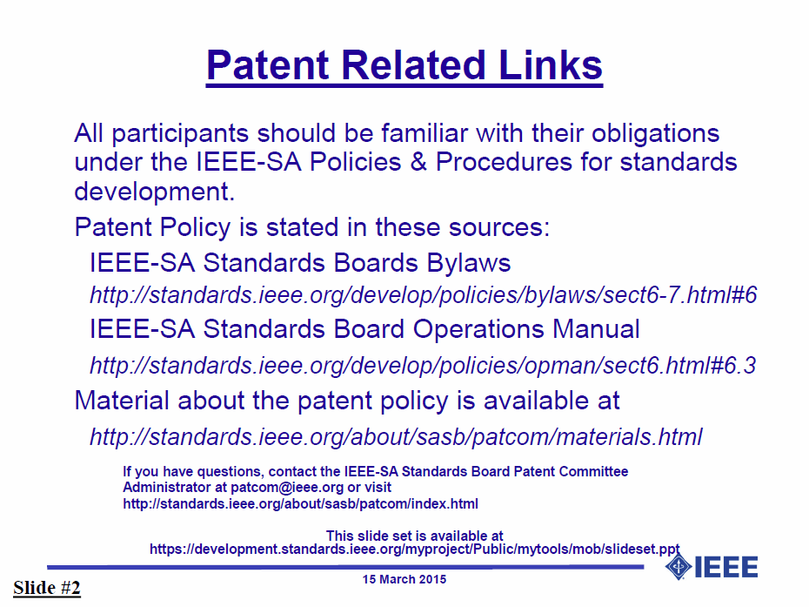

Slide 15


Slide 16


Slide 17
Approval of minutes
Motion to approve the minutes from the November 2015 TG1a meeting, document 19-15/0103r0, teleconference call minutes on Dec. 22, 2015, document 19-15/0109r0 and Jan. 12, 2016, document 19-16/0005r1

Slide 18
TG1a Opening report
January 2016 TG1a Opening Report (doc. 19-16/0007r1)

Slide 19
Tuesday PM1

Slide 20
Agenda for Tuesday PM1
TG1a meeting called to order
Agenda review and update
Discussion for Liaison to the Wireless Innovation Forum
    Doc. 19-16/0018r0: Liaison to Wireless Innovation Forum (N. Sato)
Technical presentation
  CM association procedure
    Doc. 19-16/0015r0: CM association procedure (S. Furuichi)
    Doc. 19-16/0016r0: Text proposal on CM association procedure (S. Furuichi)
  Energy detection
    Doc. 19-16/0019r0: Use cases and text change proposal for adjustment of energy detection threshold over IP-network (C. Sun)
    Doc. 19-16/0020r0 : Text proposal on Annex on energy detection parameters(C. Sun)
Recess

Slide 21
Discussion for Liaison to the Wireless Innovation Forum
Doc. 19-16/0018r0: Liaison to Wireless Innovation Forum (N. Sato)

Slide 22
Wednesday AM1

Slide 23
Agenda for Wednesday AM1
TG1a meeting called to order
Agenda review and update
Technical presentation
  Interference alignment
    Doc. 19-16/0021r0: Application scenario and text change proposal for coexistence management considering interference alignment (C. Sun)
    Doc. 19-16/0022r0 : Text proposal on Annex for supporting interference alignment (C. Sun)
  Proxy coexistence service
    Doc. 19-16/0017r0: Proxy coexistence service (S. Furuichi)
Recess

Slide 24
Wednesday PM1

Slide 25
Agenda for Wednesday PM1
TG1a meeting called to order
Agenda review and update
Technical presentation
  Coexistence management
    Doc. 19-16/0023r0: Coexistence management with receiver information (C. Sun)
Revisit updated text proposal
Recess

Slide 26
Thursday AM2

Slide 27
Agenda for Thursday AM2
TG1a meeting called to order
Agenda review and update
Revisit updated text proposal
Motions
Review project timeline
Review objectives for next meeting
Schedule for teleconferences
Adjourn

Slide 28
Motion #1
  Move:
  Second:
  Y: /N: /A:

Slide 29
Motion #2
  Move:
  Second:
  Y: /N: /A:

Slide 30
Project timeline
Project timeline document
  Doc. 19-15/0096r0: Timeline document (N. Sato)

Slide 31
Review objectives for next meeting

Slide 32
Teleconferences
Schedule (1hour)
  xxx, February xx, 2016: 1am EST (6am GMT, 3pm JST/KST)
  xxx, February xx, 2016: 1am EST (6am GMT, 3pm JST/KST)
Meeting Logistics
  Use “Join Me”
  The chair will send out a notification to IEEE 802.19 reflector in advance of the meeting

Slide 33
Adjourn

Slide 34
Time difference
Winter
  1am EST (6am UTC, 3pm JST/KST)
  7am EST (noon UTC, 9pm JST/KST)
  5pm EST (10pm UTC, 7am JST/KST + 1day)
Summer
  2am EDT (6am UTC, 3pm JST/KST)
  8am EDT (noon UTC, 9pm JST/KST)
  6pm EDT (10pm UTC, 7am JST/KST + 1day)

