Slide 1
Further consideration on possible architecture for information exchange between independent IEEE 802.19.1 systems
Date: 2016-01-12
Authors:
Notice: This document has been prepared to assist IEEE 802.19. It is offered as a basis for discussion and is not binding on the contributing individual(s) or organization(s). The material in this document is subject to change in form and content after further study. The contributor(s) reserve(s) the right to add, amend or withdraw material contained herein.

Slide 2
Abstract
This document considers possible architectures for information exchange between independent IEEE 802.19.1 systems further based on 802.19-15/0108r1[1].

Slide 3
Objective of architecture discussion
To identify the appropriate architecture for realizing information exchange between independent IEEE 802.19.1 systems.
[Background]
We have confirmed in CUB SG that there is a scenario where different entities have their own coexistence system (i.e. IEEE 802.19.1 system)[2].
Entities: network operator, wireless internet provider, building administrator, infra-provider, etc...
The entities have the information that they do not want to disclose.
E.g. installation information
Moreover, each entity might implement different profile(s) in coexistence system.
We also have confirmed the necessity of information exchange between different coexistence systems by simulation in CUB SG discussion[3].
This result is one of the motivation to amend IEEE 802.19.1-2014.

Slide 4
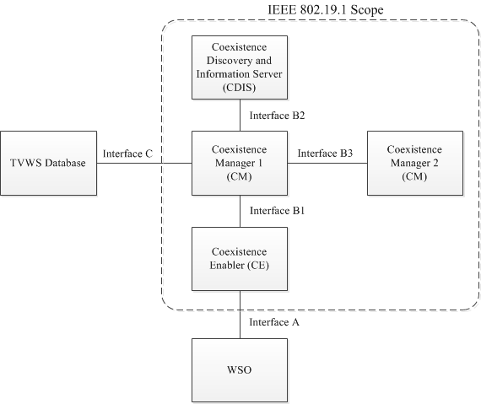
[Recap] System architecture defined in IEEE 802.19.1-2014 [4]
coexistence discovery and information server (CDIS): An entity that is responsible for determining for coexistence managers (CMs) those white space objects (WSOs) that may affect performance of the WSOs that the CMs serve.
coexistence manager (CM): An entity that is responsible for making coexistence decisions related to reconfiguration of white space objects (WSOs) to solve coexistence problems among them.
coexistence enabler (CE): An entity that represents a white space object (WSO) in the coexistence system and serves one WSO at a time.

Slide 5
Options proposed in 802.19-15/0108r0[1]
Option 1: Addition of interface between different CDISs
Option 2: Addition of new entity for interface between different CDISs
Option 3: Use the interface B3
Option 4: Addition of new entity for interface between different CMs in the different systems
We mainly discussed about option 3 and 4 in the last teleconference because option 1 and 2 are clearly not appropriate.
After the teleconference, we have studied option 3 and now we think using/amending interface B3 is not appropriate for the architecture.

Slide 6
Problems in using interface B3 (option 3)
No “mandatory” information to be exchanged
[Reason]
All the information elements exchanged between CMs (interface B3) are defined as “optional”.
Different system profiles define different necessary information elements to be exchanged and they use the same message format to exchange the information elements.
Possibility of no information exchange between different networks managed by different coexistence systems.
[Reason]
Information exchange might not be done between different coexistence systems because;
All the information elements are “optional”, and;
Each coexistence system might have the information that it does not want to disclose.
At least, some “mandatory” information should be defined in any profiles.
The expected coexistence performance in 802.19-15/00xxr0[2] cannot be achieved.

Slide 7
Problems in amending interface B3
Large specification impact
[Possible amendment and its demerit]
Change parameter status from “optional” to “mandatory” ➔ * Large impact on the existing message definition in each profile. * Increase of unnecessary overhead depending on profile.
Addition of new “mandatory” parameter(s) in the existing message(s) ➔ * Same impact as the above.
Addition of new “mandatory” procedure. ➔ * Same impact as the above and the previous slide.
Possibility of no information exchange between different networks managed by different coexistence systems.
[Possible amendment and its impact]
Addition of new “optional” procedure. ➔ * Same impact as the previous slide.

Slide 8
Things to be done for Option 4
Define new entity.
Define new interfaces.
Define new procedures.
Define this architecture as mandatory in any profiles
➔ No amendment (= impact) to the existing interface B3 and the related procedures will be required.

Slide 9
Summary
Option 3 (Use the interface B3) is not appropriate for information exchange between independent IEEE 802.19.1 systems.
Amendment to the interface B3 is not appropriate for information exchange between independent IEEE 802.19.1 systems.
We should discuss the architecture based on option 4.

Slide 10
Next step
Architecture discussion based on option 4.

Slide 11
Reference
[1] Sho Furuichi, et al, “IEEE 802.19-15/0108r1 Possible architecture for information exchange between independent IEEE 802.19.1 systems”, December 2015
[2] Sho Furuichi, et al, “IEEE 802.19-15/0032r0 The new coexistence use cases for IEEE 802.19.1”, April 2015
[3] Sho Furuichi, et al, “IEEE 802.19-15/0054r0, Expected Performance Improvement in the New Coexistence Scenario and Use Cases for IEEE 802.19.1 – Simulation Result – ”, July 2015
[4] IEEE Standard Association, “IEEE Std 802.19.1-2014“, July 2014

