Slide 1
TG1a December 2015 teleconference Agenda
Date: 2015-12-22
Authors:
Notice: This document has been prepared to assist IEEE 802.19. It is offered as a basis for discussion and is not binding on the contributing individual(s) or organization(s). The material in this document is subject to change in form and content after further study. The contributor(s) reserve(s) the right to add, amend or withdraw material contained herein.

Slide 2
Teleconference information
Time & Date: 1am ET, December 22, 2015
Join the meeting: https://join.me/ieeesawg802.19
On a computer, use any browser. Nothing to download.
On a phone or tablet, launch the join.me app and enter meeting code:ieeesawg802.19
Join the audio conference:
Dial a phone number and enter access code, or connect via internet.
By phone:
United States - Los Angeles, CA +1.213.226.1066
United States - Washington, DC +1.202.602.1295
Canada - Ottawa +1.613.699.9318
Germany - Berlin +49.30.2240.3071
Japan - Tokyo +81.3.4579.5983
Korea, Republic of - South Korea +82.26.022.2310
Sweden - Stockholm +46.8.4030.8819
Sweden - Stockholm +46.8.4030.9107
Access Code 543-324-473#
Other international numbers available
By computer via internet:
Join the meeting, click the phone icon and select 'Call via internet'. A small download might be required.
Start time by time zones

Slide 3
Attendance
Please send your name and affiliation to naotaka.sato@ieee.org

Slide 4
Agenda for December 22
TG1a meeting called to order
IEEE IPR statement
Call for submissions, discussions and approval of agenda
Technical presentations
  Discussion on possible architectures for information exchange between independent IEEE 802.19.1 systems (Sho Furuichi)
AOB
Adjourn

Slide 5
Patent Policy
http://standards.ieee.org/about/sasb/patcom/materials.html

Slide 6


Slide 7


Slide 8
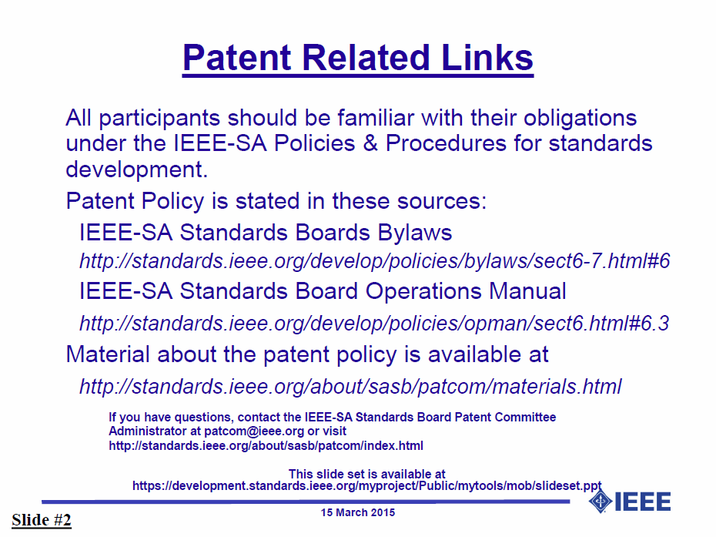

Slide 9


Slide 10


Slide 11
Call for submissions, discussions and approval of agenda
Submissions
  Discussion on possible architectures for information exchange between independent IEEE 802.19.1 systems (doc. 19-15/0108r0)
Approve the agenda of the TG1a December 2015 teleconference, document 19-15/0107r1

Slide 12
AOB
Any Other Business?

Slide 13
Teleconferences
Schedule (1hour)
  Tuesday, December 22, 2015: 1am ET (6am UTC, 3pm JST/KST)
  Tuesday, January 12, 2016: 1am ET (6am UTC, 3pm JST/KST)
Meeting Logistics
  Use “Join Me”
  The chair will send out a notification to IEEE 802.19 reflector in advance of the meeting

Slide 14
Adjourn

