Slide 1
Coexistence Management Considering Interference Alignment
Authors:
Date: 2015-11-06
Notice: This document has been prepared to assist IEEE 802.19. It is offered as a basis for discussion and is not binding on the contributing individual(s) or organization(s). The material in this document is subject to change in form and content after further study. The contributor(s) reserve(s) the right to add, amend or withdraw material contained herein.

Slide 2
Abstract
This document proposes utilizing interference alignment (IA) to accommodate more coexisting users for coexistence management.

Slide 3
Objective of simulation
To show the performance gain with interference alignment (IA) for coexistence management
  IEEE 802.19.1 system is a kind of frequency coordination system for coexistence.
  In this document, we show the simulation results for evaluating such new scenarios.

Slide 4
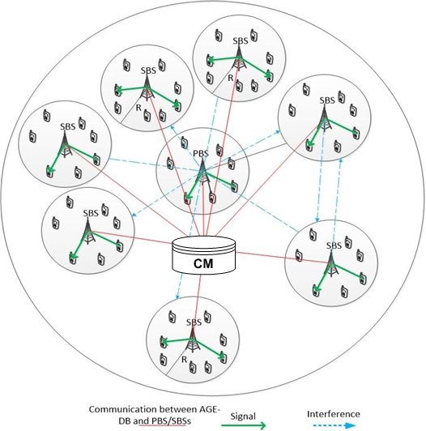
Simulation Scenario
1 PS and SSs coexist.
The radius of the whole system is set as 200 m, and the radius of each Secondary Radio System (SRS) is set as 20 m.
The number of the transmitting antennas is set as 4-8.
Rayleigh channel model and the free space path loss are assumed.
The complete CSI is known at SU’s transmitter .

Slide 5
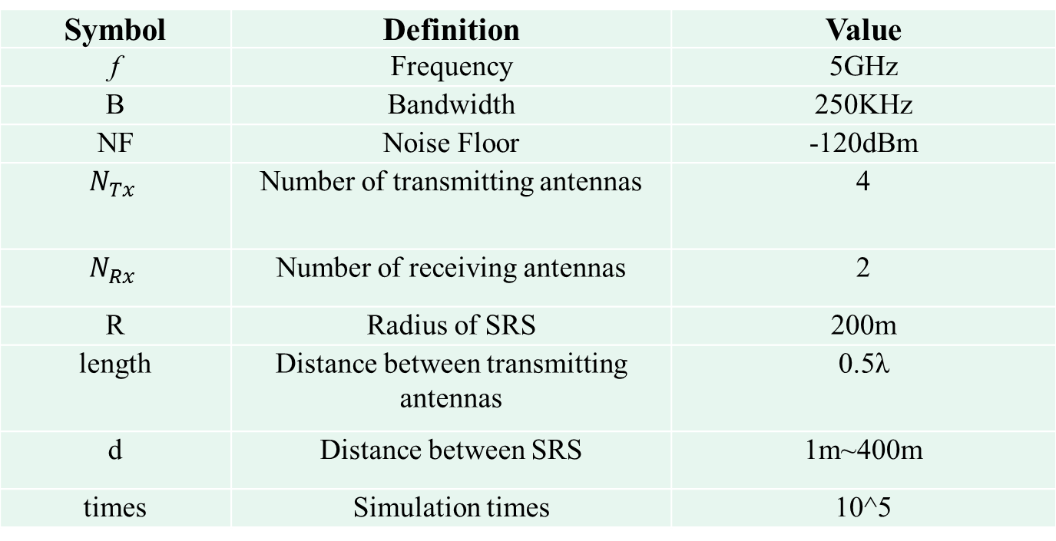
Simulation Parameters
Symbol | Definition | Value
f | Frequency | 5 GHz
B | Bandwidth | 250 KHz
NF | Noise Floor | -120 dBm
 | Number of transmitting antennas | 4
 | Number of receiving antennas | 2
R | Radius of SRS | 200 m
length | Distance between transmitting antennas | 0.5λ
d | Distance between SRS | 1 m~400 m
times | Simulation times | 10^5

Slide 6
Simulation Result 1: Allowed number of users
When the number of transmitted antennas increases, the allowed access number of users is significantly improved.
The total allowed number of users achieves a significant improvement using IA-based channel admission control algorithm.
Tolerable INR with coexisting users (dB)

Slide 7
Reference
[1] IEEE 802.19-15/0032r0, “The new coexistence use cases for IEEE 802.19.1”
[2] Nosrat-Makouei, Behrang, Jeffrey G. Andrews, and Robert W. Heath Jr. "A simple SINR characterization for linear interference alignment over uncertain MIMO channels." Information Theory Proceedings (ISIT), 2010 IEEE International Symposium on. IEEE, 2010, pp: 2288-2292
[3] Vin, H., Pawan Goyal, and Alok Goyal. "A statistical admission control algorithm for multimedia servers." Proceedings of the second ACM international conference on Multimedia. ACM, 1994

Slide 8
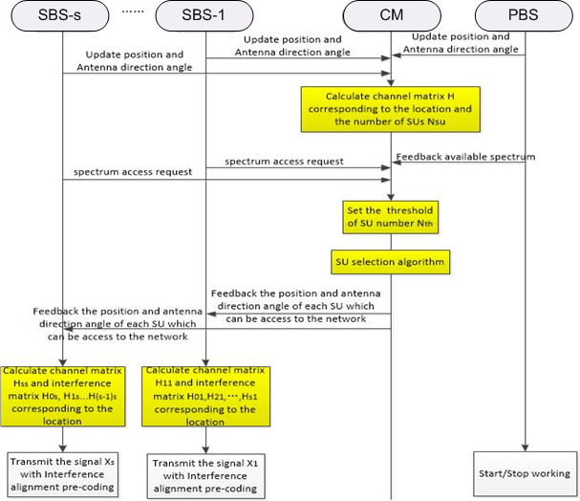
Annex: Flowchart and information exchange
The threshold of the SUs’
number under the channel
state can be calculated to
deal with frequent changes
in the network, such as the
SUs’ accessing or leaving
the network.

Slide 9
Simulation Result 2: BER performance
IA can significantly improve the BER performance of PU.
When the PU is working, the SU’s performance significantly decreases but QoS can also be ensured by IA.

