Slide 1
Coexistence Management Considering Pre-coding and Priority
Date: 2015-11-06
Authors:
Notice: This document has been prepared to assist IEEE 802.19. It is offered as a basis for discussion and is not binding on the contributing individual(s) or organization(s). The material in this document is subject to change in form and content after further study. The contributor(s) reserve(s) the right to add, amend or withdraw material contained herein.

Slide 2
Abstract
This document proposes utilizing location or antenna information to obtain the channel information of pre-coding for coexistence management.
Interference weighting factor (IWF) based on user priority level is introduced to ensure different QoS requirements.

Slide 3
Objective of simulation
To show our method can mitigate PU’s received interference (PUI) and relax the limitation of SU’s transmit power.
To demonstrate our method can ensure different QoS requirements (e.g. SINR, throughput) of prioritized users.

Slide 4
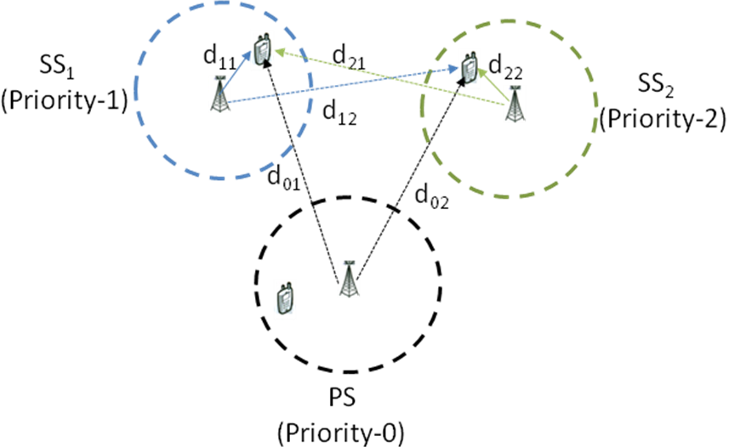
Simulation Scenario
1 PS and 2 SSs coexist, and at a given time instance in each system there is only one pair of users.
PS and SSs are different prioritized small cells, and the cover radius are 30 m.
The transmitter is in the center and the receiver is all uniformly distributed in each area.
Rayleigh channel model, the free space path loss and BPSK modulation are assumed.
The complete CSI is known at SU’s transmitter .

Slide 5
Simulation parameter
Parameters | Value
System frequency | 3.5 GHz
Bandwidth | 10 MHz
Noise Figure at PU/SU receiver | 5 dB
Transmit power of PU | -10 dBm
Transmit power of SU | -10 dBm
Number of PU TX antenna | 2
Number of PU RX antenna | 2
Number of SU TX antenna | 2 (unless stated otherwise)
Number of SU RX antenna | 2

Slide 6
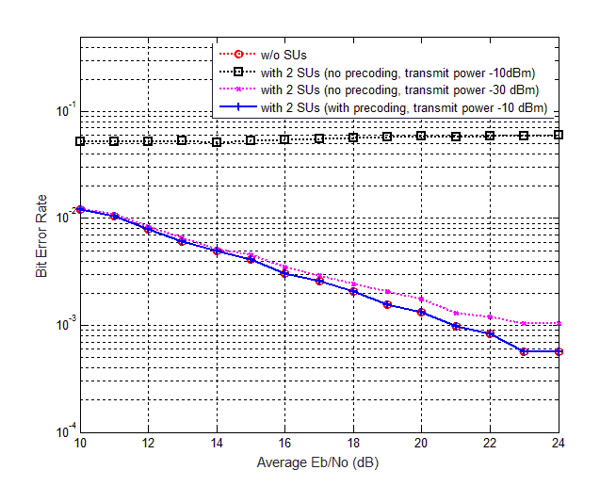
Simulation Result 1: PU’s BER performance
PUI can be mitigated completely by Pre-coding.
SP-PSLNR algorithm can guarantee the PU’s QoS and especially can relax the limitation of SU’s transmit power about 20dB at the same time.
Note: 1. No channel estimation error is considered
2. Although higher transmit power could be used, the transmit power of -10dBm is set in this simulation to guarantee the SNR of 21dB could be achieved by the receivers at the edge of the signal coverage area
6
Notes:
SU location is randomly distributed, run 2000 times.

Slide 7
Simulation Result 2: SU’s maximum allowed transmit power
The channel estimation error is considered to be e_{ij} ~ CN (0, σ²) which is a complex Gaussian random variable with zero mean and σ² variance.
When the variance is 0.05, 0.01 the transmit power can increase by about 23 ~ 30 dB, 38 ~ 45 dB, respectively.
The error variance is smaller, the allowed transmit power is higher, such as the pink line is about 15 dB higher than the blue line.
Notes:
1.The antenna number of transmitter is 8.
2. If the SU can get the perfect CSI, the SP precoding can mitigate the PUI completely in theory, so there is no limitation in the transmit power of SU. While in practice the estimated channel matrix usually has some errors. In the above figure the elements of error matrix is considered to be e_{ij} ~ CN (0, σ²) which is a complex Gaussian random variable with zero mean and σ² variance.
3. INR (Interference to Noise Ratio) threshold of PU is set 0 dB.
仿真生成说明：
场景与参数如P4、P5所示，PU代表PU_ Rx, SU代表SU_Tx, SU_Tx 位置随机均匀分布，仿真了20000次，得到的CDF曲线。
其中设置每个SU对PU的干扰:I<=N, 而得到SU最大发射功率。每条线为两个SU 的平均值。

Slide 8
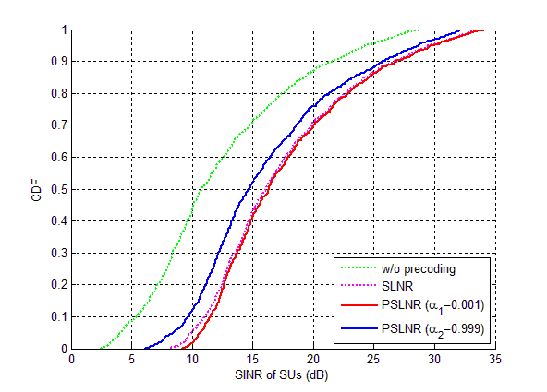
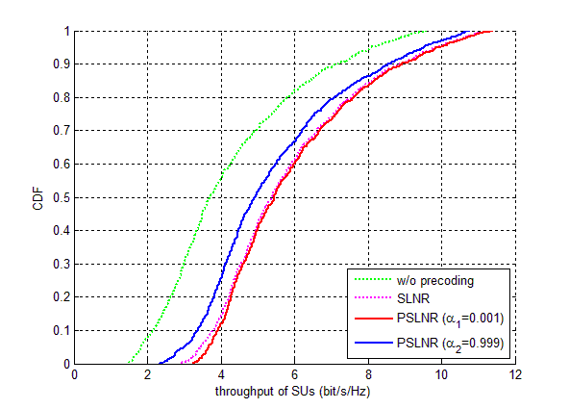
Simulation Result 3: SINR and Throughput of SUs
IWF (α) is a factor to weight the user’s leakage power in the objective function of the optimization problem.
Through adjusting IWF, our scheme can adjust the QoS of SUs with different priorities.
The higher prioritized user (with smaller weight) has better SINR and throughout than the lower prioritized user.
Notes:
仿真生成说明：
场景与参数如P4、P5所示，PU代表PU_Tx, SU代表SU_Rx, SU_Tx在SS中心。SU_Rx 位置随机均匀分布，仿真了20000次，得到的CDF曲线。
既有PU对SU 干扰，也有SU间干扰。

Slide 9
Reference
[1] IEEE 802.19-15/0032r0, “The new coexistence use cases for IEEE 802.19.1”
[2] Ekram Hossain, Mehdi Rasti, Hina Tabassum, and Amr Abdelnasser, “Evolution toward 5G multi-tier cellular wireless networks: An interference management perspective.” IEEE Wireless Communications, Jun. 2014, vol. 21, no. 3, pp. 118-127
[3] Wooseok Nam, Dongwoon Bai, Jungwon Lee, and Inyup Kang, “Advanced interference management for 5G cellular networks.” IEEE Communications Magazine, May 2014, vol. 52, no. 5, pp. 52-60

Slide 10
Annex 1: IWF
How to decide the value of IWF?
  Firstly, find the affected area of the objective SU according to the transmit power of the SU.
  Secondly, find all the active SUs (the SUs in communication) in this area, and sort their priority.
  Thirdly, using the proportional allocation method in [0,1] determines the approximate value based on the priority level of the objective SU, such that the sum of the weights is 1.
For example
  If there are 2 different prioritized users, and if we set the ratio of them is 1/99, then the weight of higher prioritized user is 0.01, the other is 0.99.

Slide 11
Annex 2: Optimization Problem
Where , and P_{i} represents the first and second stage precoding vector and transmit power of i-th SU, respectively.
The α_{i} represents the weight of i-th SU.
The numerator of PSLNR_{i} represents the expected signal power of i-th SU.
The first part of denominator of PSLNR_{i} represents the leakage power of i-th SU, and the second part of denominator represents the noise power.

