Slide 1
Explanation of IEEE 802.19.1-2014
Date: 2015-11-06
Authors:

Slide 2
Abstract
This presentation explains the current technical aspects of the IEEE 802.19.1-2014 and shows the target areas for amendment.

Slide 3
Background
IEEE 802.19.1-2014 [1] was developed considering the US regulation of TVWS operation
Although the standard says the standard can be implemented in other frequency bands
The parameters/procedures seem to be not sufficient for capturing the latest rapid development of general authorized operation in different regulatory domains and different bands

Slide 4
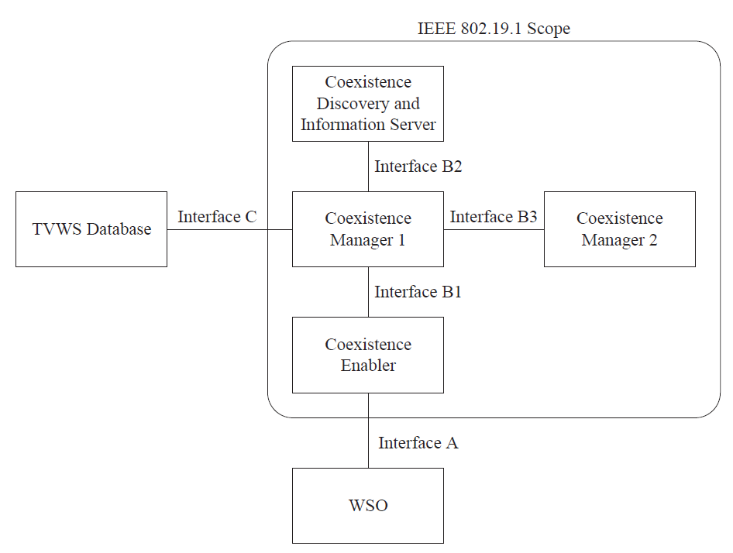
System architecture
The coexistence discovery and information server (CDIS) provides coexistence discovery service to the coexistence managers (CM).
The CM provides either information or management service to the WSOs it serves.
Communication between the CM and the WSOs is performed via their coexistence enablers (CEs).
Note: Actually interface C is not defined in the current standard

Slide 5
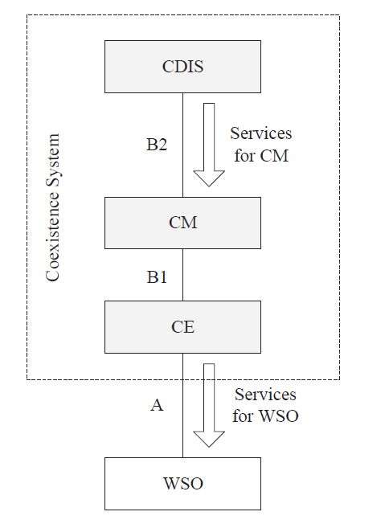
Coexistence services
Services for WSOs
Within information service the CM provides the WSO information about its potential neighbors including their operating frequencies, potential interference levels, etc.
Within the management service the CM provides the WSO reconfiguration requests that create such configuration of this WSO that its operation is improved according to some criteria.
Services for CM
The coexistence discovery service provides coexistence set information to the CM for WSOs served by this CM including inter-CM and intra-CM coexistence discovery

Slide 6
Coexistence algorithms
Coexistence discovery algorithms are used by CDIS and CM to discover WSOs that may affect each other performance.
Coexistence decision algorithms are used by a CM to make coexistence decisions related to WSO reconfiguration.
Note: no restrictions on the implementation

Slide 7
Procedures
Typical procedures and protocols among coexistence system entities (CE, CM, and CDIS) and with external entities (WSO) are defined

Slide 8
Entity operations
Defining the interactions of service provider and servicer user at the service access points of the logical entities for realizing the procedures.
Including common operation such as those at the transport SAP
As well as, the entity-specific operations including CDIS operation, CM operation and CE operation
Each entity supports at least one of the three profiles, i.e., different operation flows
If CMs use different profiles, CMs exchange operational channel information
CMs using same profiles, decision making topology between CMs depends of the profile implemented.
Autonomous, distributed or centralized (master/slave) operation

Slide 9
Annex
Normative sections:
Data type (ASN.1)
Primitives
Messages
Informative sections:
Use cases
Algorithms
Measurements and reporting

Slide 10
Possible changes in P802.19.1a
Data types
IEEE 802.19.1-2014 was developed considering the US regulation of TVWS operation.
Consideration for parameters in European regulations of TVWS operation are also needed.
Consideration for parameters for operation in other frequency bands such as 3.5GHz and 5GHz are also needed.

Slide 11
Possible changes in P802.19.1a
Procedures
Procedures for coexistence management considering new operations in TVWS under European regulation are needed.
Also procedures for operation in other frequency bands such as 3.5GHz and 5GHz are needed.

Slide 12
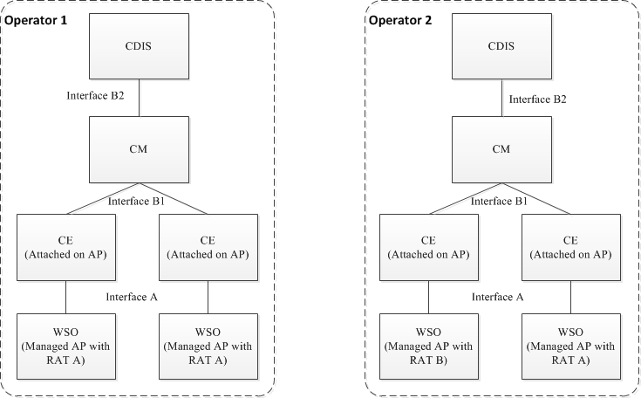
Adding new features in P802.19.1a
New features might be needed [1]
Different system operators/administrators might implement different CDIS and limit information exchange among operators/administrators
Current CMs discover each other via a common CDIS
Information exchange between system operators/administrators is needed
Discovery procedure between CMs needs to be changed

Slide 13
Adding new features in P802.19.1a
Algorithms
New algorithms can be added

Slide 14
Adding new features in P802.19.1a
Test procedure
Coexistence test procedure might be added?

Slide 15
Reference
[1] 19-2014
[2] sony contribution
[3] PAR

