Slide 1
On The Intra-Vehicle Channel Model
Date: 21-Oct-2015
Authors:

Slide 2
Abstract
In this submission the wireless channel inside a vehicle is discussed.

Slide 3
Introduction
Wireless LAN is becoming a leading standard in vehicular communications
  Many vehicle models today have a built in WLAN communication
    WLAN is present in virtually every consumer electronic device
    Vehicle manufacturers adapt the vehicles to the changes in consumer electronics
    WLAN is used in intra-vehicle infotainment systems
    WLAN can also be used for vehicular sensor linking
The number of vehicle models equipped with WLAN is constantly increasing
We should aim that both the driver and the passengers get a good connectivity experience comparable to the connectivity experience in the office or at home

Slide 4
WLAN Unique Scenarios in Automotive Infotainment
Traffic jams
  Each WLAN equipped vehicle is an AP
  In traffic jams the distance between vehicles is small and the AP density is high
  The vehicular APs are typically not jointly controlled or managed
  In traffic jams there is a slow movement of the vehicles
  Implications:
  OBSS (overlapping BSSs)
  High interference levels
  Interferers channels change at the speed the vehicles move

Slide 5
WLAN Unique Scenarios in Automotive Infotainment (Cont’d)
Communication between a static AP and a STA in a moving vehicle
  The intra vehicle channel is affected by the vehicle’s surrounding
  Although the direct path between the AP and the STA is mostly static, the multipath can be affected by the mobility
  Implications:
  Long delay spread
  Doppler PDF proportional to the movement profile and speed

Slide 6
Intra-Vehicle Wireless Channel Measurement Setup
The wireless channel measurements were performed using the following equipment:
  GM vehicles: compact size, SUV and a large SUV
  Network analyser
  4 omni-directional WiFi antennas in a 2x2 configuration
  Distance between each set of 2 antennas is 10 cm
  Measured frequency bands: 2.4GHz-2.5GHz, 5.150GHz-5.250GHz
  Vehicle is parked in a stationary environment
In this setup there were no driver or passengers in the vehicle

Slide 7
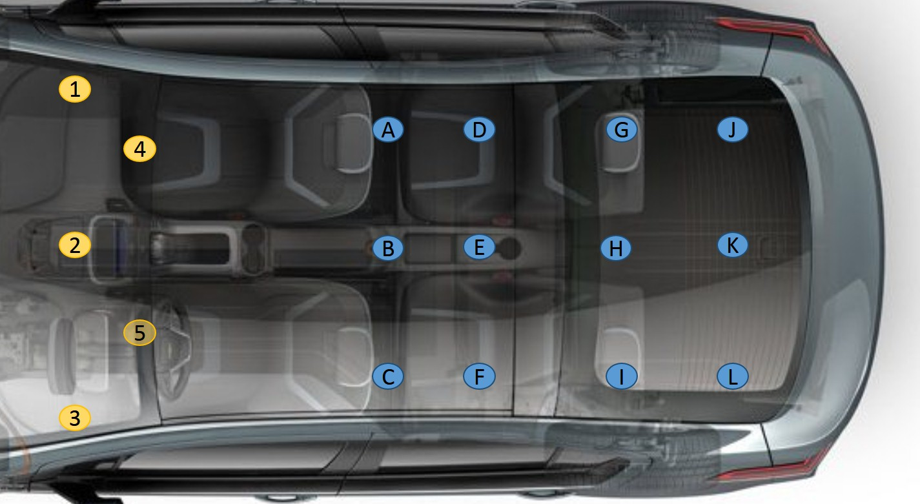
Compact Vehicle Channel Measurement Locations

Slide 8
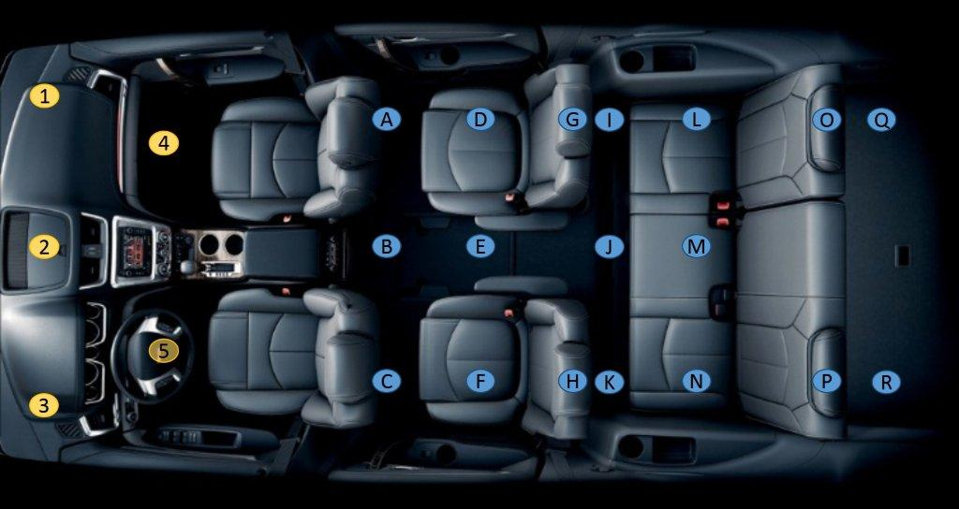
SUV Channel Measurement Locations

Slide 9
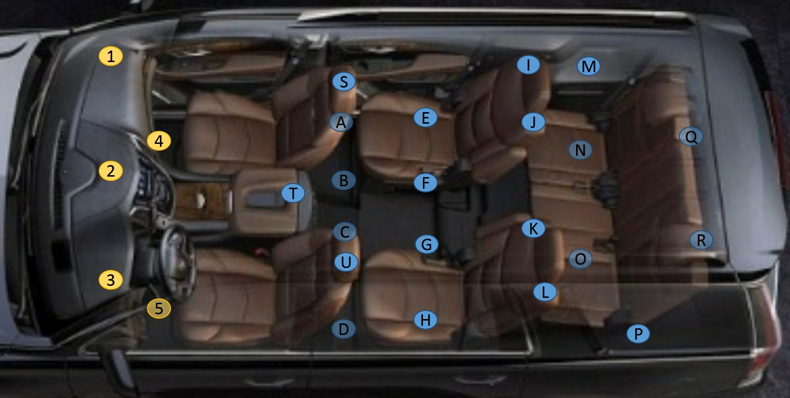
Large SUV Channel Measurement Locations

Slide 10
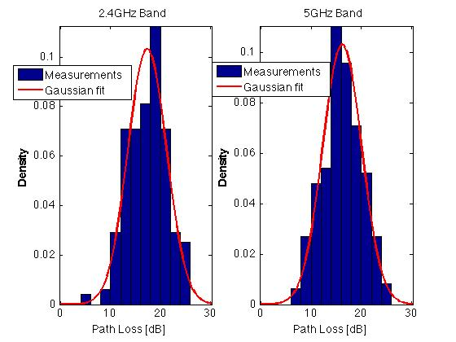
Compact Vehicle Channel Path Loss

Slide 11
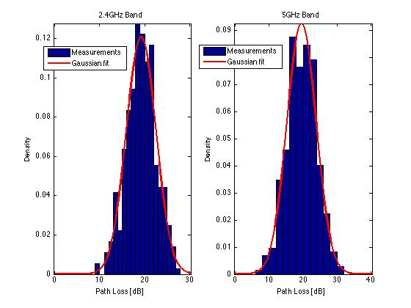
SUV Channel Path Loss

Slide 12
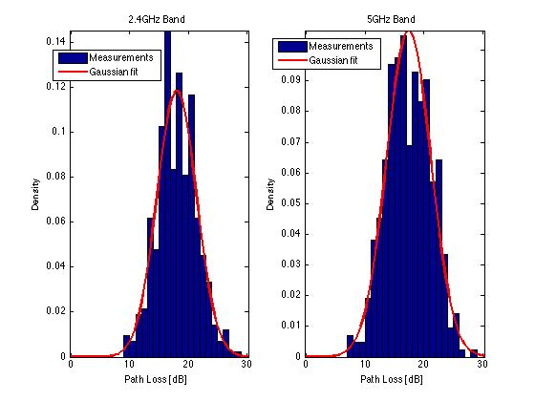
Large SUV Channel Path Loss

Slide 13

Intra-Vehicle Wireless Channel Path Loss
Measurement results fit the model: $L\left(d\right)=L_{m}\left(d\right)+s$
  $L\left(d\right)$ - total path loss
  $L_{m}\left(d\right)$ - mean path loss
  $s$ – shadowing, log normal zero mean r.v.

Slide 14
Intra-Vehicle Wireless Channel Path Loss Log Normal Fit Summary
 |  | Compact Vehicle | SUV | Large SUV
2.4GHz | Mean path loss | 17.3dB | 19.2dB | 18.0dB
 | Shadowing variance | 14.9dB | 10.9dB | 11.3dB
5GHz | Mean path loss | 16.2dB | 19.5dB | 17.4dB
 | Shadowing variance | 15.0dB | 18.5dB | 14.0dB

Slide 15
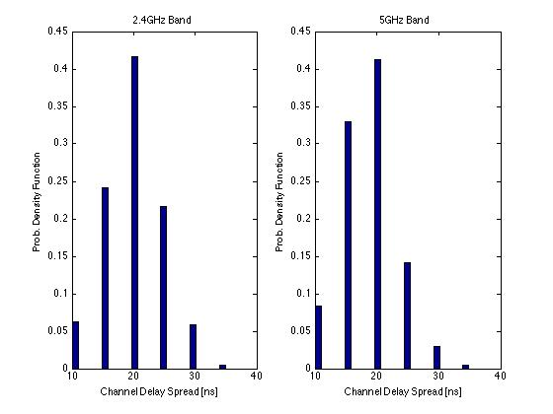
Compact Vehicle Channel Delay Spread

Slide 16
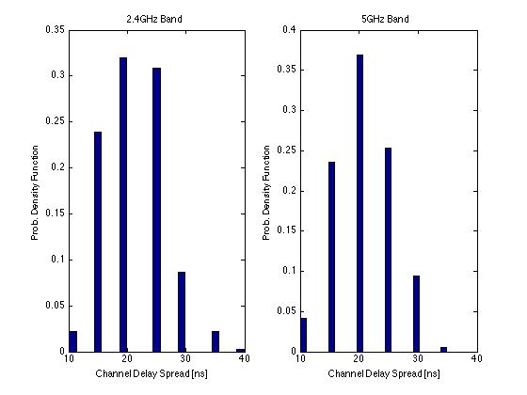
SUV Channel Delay Spread

Slide 17
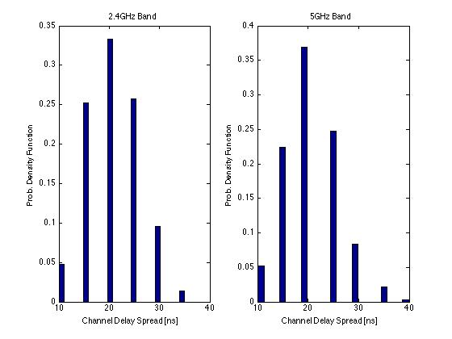
Large SUV Channel Delay Spread

Slide 18
Intra-Vehicle Wireless RMS Channel Delay Spread Summary
No clustering effect was seen
 | Compact Vehicle | SUV | Large SUV
2.4GHz | 20.5ns | 22.0ns | 21.4ns
5GHz | 19.1ns | 21.3ns | 21.5ns

Slide 19
Intra-Vehicle MIMO Channel Matrix Condition Number and Rank
All of the measured 2x2 MIMO channel matrices have a rank of 2
The channel matrix’s condition number varies significantly between bands and within bands.
  Based on the measurements the condition number varies between 0dB to 30dB

Slide 20
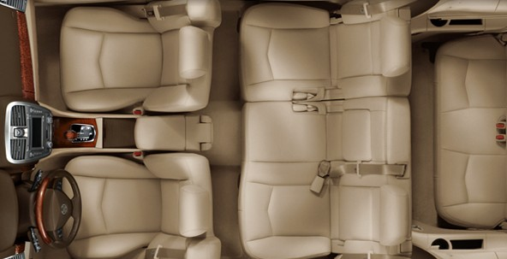
Intra-Vehicle Wireless Channel Measurements Locations
1
4
I
E
A
M
O
J
B
5
F
Trunk
2
6
K
G
C
N
P
3
L
H
D
7

Slide 21
Intra-Vehicle Wireless Channel Matrix Condition Number and Rank

Slide 22
Intra-Vehicle Wireless Channel
Discussion
The RX power of an intra-vehicle WLAN system is strong relative to indoor scenarios, that is the system is not Rx power limited
The variance of the path loss shadowing in the 5GHz band is higher in large vehicles than the 2.4GHz band variance
Intra-vehicle delay spread in nomadic confined area scenarios is shorter than current WLAN indoor channel models, hence supported by current standards

Slide 23
Intra-Vehicle Wireless Channel
Discussion (2)
The intra-vehicle channel delay spread is very short, thus it is possible to shorten the CP and gain efficiency
It is theoretically possible to achieve full 2x2 MIMO, however due to large changes in the streams’ power it is hard to implement practically. Addressing this issue, especially in a non Rx power limited environment can increase performance.

