Slide 1
Wireless Coexistence in the Automotive Environment – System Model
Date: 2015-10-07
Authors:
Notice: This document has been prepared to assist IEEE 802.19. It is offered as a basis for discussion and is not binding on the contributing individual(s) or organization(s). The material in this document is subject to change in form and content after further study. The contributor(s) reserve(s) the right to add, amend or withdraw material contained herein.

Slide 2
Abstract
This document describes the system model and the different scenarios for wireless coexistence in the automotive domain

Slide 3
Background
The number of vehicles with connectivity services has been significantly increased in the recent years, and it is expected that the number will increase drastically in the coming years
The main use of these systems is infotainment applications
The used wireless systems in the vehicles in the ISM band (2.4GHz) are:
WLAN
Bluetooth, BLE in the future ?
Kleer

Slide 4
Kleer
Kleer is a system used for high quality wireless audio transmission between portable audio devices ^{[1]}
It delivers full CD-quality audio with transmission of 16-bit, 44.1KHz sampled stereo audio, Lossless codec
Kleer manufacture claims good coexistence strategy compared to Bluetooth
Dynamic frequency hopping is used
Bandwidth: 3 MHz (official), however measurements show strong side lobes
Sixteen channels in the 2.4GHz band (2.403GHz-2.478GHz)

Slide 5
Scenarios
The worst case, when all the systems are active in the vehicle, should be considered with two distinguished cases:
The interference from the surrounding environment is ignored
The interference form the surrounding environment is considered
The second scenario is more challenging due to the large impact of the external interferers. In this submission, the focus is on the first case

Slide 6
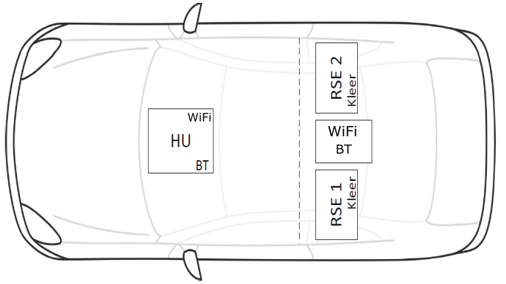
Current Situation
The luxury cars have the following chips nowadays:
Two WiFi chips
Two Bluetooth chips
Two kleer chips
All the systems work in the 2.4GHz frequency band
It is expected that theses systems will be available in the majority of the vehicles in the future

Slide 7
Current Situation
WiFi: one chip is used as a hotspot, in order to provide connection to the internet (via cellular systems), second chip is used for WiFi direct applications (like Miracast)
In order to guarantee the QoS, every chip should use different channel
Bluetooth: it is mainly used for handsfree calling, audio streaming and transferring data (like contact book) from mobile phones to the vehicle head unit
Kleer: It is used for audio streaming for RSE (rear seat entertainment), each audio stream needs a separate chip
Channel Utilization?

Slide 8
Current Situation
The supported Bluetooth profiles are hands free profile (HFP), which requires 700 Kbps and Advanced Audio Distribution Profile (A2DP) for music streaming which requires 700Kbps
The WiFi access point data rate is limited with LTE (in general cellular network) supported speed, 50Mbps is an expected value
Internet browsing
Video streaming (depends on video quality)
Apps for automotive (A4A)
WiFi direct is used for Miracast, each device needs 15Mbps; and touch command, each device needs 15 Mbps

Slide 9
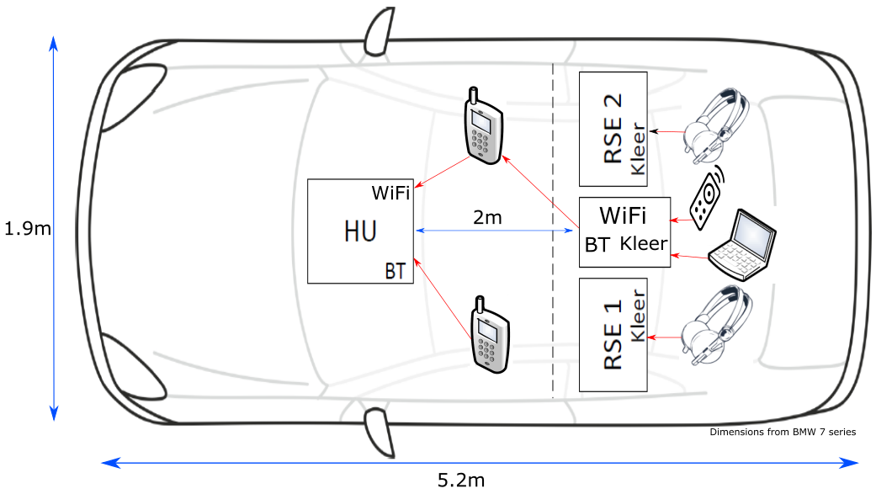
Current Situation

Slide 10
Worst case scenario
The available bandwidth in the 2.4GHz band is 83.5 MHz, in the worst case scenario, all the systems in the vehicle are running simultaneously:
Two WLAN connections with 2*20MHz (40MHz is optional in case of 802.11n) bandwidth
Two Bluetooth master with 2*20MHz bandwidth
Two kleer connections with 2*3MHz (practically 2*5MHz, sidelobes)
In this scenario the needed bandwidth is: 40+40+6=86 MHz>83.5MHz
In case of 11n with 40MHz bandwidth, only two WLAN connections can be supported in the whole band
sidelobes plays an important role due to the short distances in the car

Slide 11
Channel Model
The distances between the devices is very small in the vehicle due to the small volume, typical distances<2m
Compared to indoor environment, different materials and smaller volume, glass penetration loss <2dB
Wireless channel measurements inside the vehicle were performed by GM ^{[2]} in order to evaluate the channel characteristics
Different positions in the car were considered
The RMS channel delay spread is 22ns which is much smaller than typical values for indoor environment (40-600ns)

Slide 12
Channel Model
The measurement results fit the following model:
$L\left(d\right)=L_{m}\left(d\right)+s$ with:
L(d) is the total path loss
L_{m}(d) is the mean path loss
S is the shadowing with log normal distribution and zero mean
The results are from [2]

Slide 13
Channel Model
It is clear that the path loss is quite small in the vehicles compared to a typical indoor environment
Therefore Power control plays an important role to reduce the interference to the surrounding environment
It is clear that the wireless systems inside the vehicle is not power limited, it is more interference limited

Slide 14
Conclusion
The system model was presented taking into account only the systems inside the vehicle
It is clear that the density of the wireless devices is very high inside the car, and the bandwidth at the 2.4GHz ISM band is limited (only 83.5MHz is available), therefore the problem is quite challenging
Wireless sensor network (BLE/ZigBee) will increase the problem
Measurements should be done in order to check the performance of different systems taking into account different scenarios, for example how effective the Bluetooth AFH in such dense scenario?
Performance metrics should be defined

Slide 15
References
[1] Wireless Digital Audio Quality for Portable Audio Application, KLEER KLR0000-WP1-1.4, available at:
http://ww1.microchip.com/downloads/en/DeviceDoc/Kleer_AudioQuality.pdf (last access: 24 March 2015), 2007b.
[2] “Extended Intra-Vehicle Channel Model”, Igal Kotzer (General Motors), IEEE 11-14/0088r0.

