Slide 1
Discussion of issues related to EN 301 893 revision
16 September 2015
Name | Company | Phone | email
Andrew Myles | Cisco | +61 2 84461010 +61 418 656587 | amyles@cisco.com

Slide 2
The European regulators are refining EN 301 893 in ETSI BRAN for operation in the 5GHz band
  EN 301 893 describes the European regulations for the 5GHz band
  Previously it contained specifications that:
    Explicitly allowed IEEE 802.11 to operate
    Defined another protocol that was never used and has been shown to not work in many circumstances
  As a result of the RE-Directives, EN 301 893 is being revised by ETSI BRAN with a goal of finishing the revision this year
  The revision of EN 301 893 should enable both IEEE 802.11 and LAA to operate and to share the band “fairly”

Slide 3
Various companies have made recommendations to ETSI BRAN based on IEEE 802 submission to 3GPP
  A group of companies have developed a submission to ESTI BRAN for the revision of EN 301 893 that is completely aligned with the recommendations that IEEE 802 made to the 3GPP LAA Workshop
    See BRAN(15)000121r1 (embedded)
  The companies sponsoring the submission include Cisco, CableLabs, Ruckus Wireless, HP, Google, Broadcom and Mediatek
  Other companies are considering adding their support in the future
    Contact Andrew Myles to do so
  There is a competing submission in ETSI BRAN authored Qualcomm, Ericsson, Nokia and Vodafone that is not aligned with the IEEE 802 recommendations
    See BRAN(15)000126

Slide 4
The topic for today is discussion of a variety of issues beyond the scope of the IEEE 802 submission
  IEEE 802 could/should support the principles behind the Cisco et al submission to ETSI BRAN because they are aligned with those in the 3GPP LAA Workshop submission
  The only possible question from IEEE 802’s perspective in terms of whether it should support this ETSI BRAN submission is whether the recommendations are appropriate as part of European regulations
  However, support from IEEE 802 for this submission is not a question that is being put up for discussion today
  Rather the topics for discussion today are various issues beyond the scope of the IEEE 802’s 3GPP LAA Workshop submission that are currently being discussed in both 3GPP and ETSI BRAN

Slide 5
The topic for today is discussion of a variety of issues beyond the scope of the IEEE 802 submission
  The topics include:
    UL access mechanisms
    Multi-channel access mechanisms
    Energy Detect
    Control frames

Slide 6
IEEE 802 should discuss UL access mechanisms in LAA
  IEEE 802 did not reach agreement on UL LBT for the 3GPP LAA Workshop because many IEEE 802 folk rejected the idea of LBT for PIFS on UL
  UL was not a priority because LAA R13 is DL only – although they are planning to discuss UL at least conceptually
  It appears 3GPP are now going down paths for which there was significant disagreement in IEEE 802 (see following page for details)
    No LBT
    PIFS LBT
    Short LBT
  IEEE 802 probably need to agree on a position to enable progress in ETSI BRAN and 3GPP
    Note that we probably want to enable 802.11ax, which seems to be focused on at least some UL LBT

Slide 7
3GPP have a working assumption for UL access mechanisms
From RAN1 Chairman’s notes (working assumption)
  For self-carrier scheduling, the following UL LBT candidate procedures should be considered
    A CCA duration of 25 us before the transmission burst
      The sensing duration can be less than the CCA duration
    A category 4 LBT scheme with a defer period of 25 µs including a defer duration of 16 us followed by one CCA slot, and a maximum contention window size of X={3, 4, 5, 6, 7}, respectively
      FFS: The random backoff counter is generated at the eNB and is signalled to the UE
      The UL maximum contention window size should be smaller than for DL category 4 LBT
      Note that X = 7 can be revisited later after DL LBT discussions, if necessary
    FFS: Transmission without LBT when UL transmission burst follows DL transmission burst with a gap of at most 16 µs between the two bursts

Slide 8
IEEE 802 should discuss multi-channel access mechanisms in LAA
  802.11 has a multichannel access mechanism based on the use of a primary channel and a secondary channel
  It appears LAA might have a different mechanism based on one of two options (see following pages for descriptions):
    Alt1 + Alt2
    Alt2 only
  It is possible that this different mechanism may give LAA an advantage over 802.11
    No simulations or other studies are apparent
  IEEE 802 probably need to agree on or at least discuss a position
    Should we ask for an IEEE 802.11-like scheme unless evidence is provided?

Slide 9
3GPP has agreed on two multi-carrier alternatives
From RAN1 Chairman’s notes (agreement)
  Alt1: eNB performs Cat-4 based LBT on only one unlicensed carrier
    When the eNB completes LBT on a carrier, the eNB can sense other configured carriers for a period, e.g., PIFS (25 microseconds), immediately before the completion of LBT on the carrier.
    The eNB is allowed to transmit DL data burst(s) on the carriers sensed idle according to above procedure.
    FFS: How fast the eNB can change the carrier requiring Cat-4 based LBT
    FFS: Whether to apply the Wi-Fi channel bonding rule
    FFS: Energy detection threshold used on channels not performing Cat-4 based LBT

Slide 10
LAA has agreed on two multi-carrier alternatives
From RAN1 Chairman’s notes (agreement)
  Alt2: eNB performs Cat-4 based LBT on more than one unlicensed carriers
    The eNB is allowed to transmit DL data burst(s) on the carriers that has completed Cat-4 based LBT with potential self-deferral (including idle sensing for a single interval) to align transmission over multiple carriers.
    FFS: If the eNB can receive on a carrier while transmitting on another carrier, freeze backoff counter(s) for the carrier(s) not transmitting while other carrier(s) is transmitting if the carriers are within X MHz apart
      FFS: X MHz

Slide 11
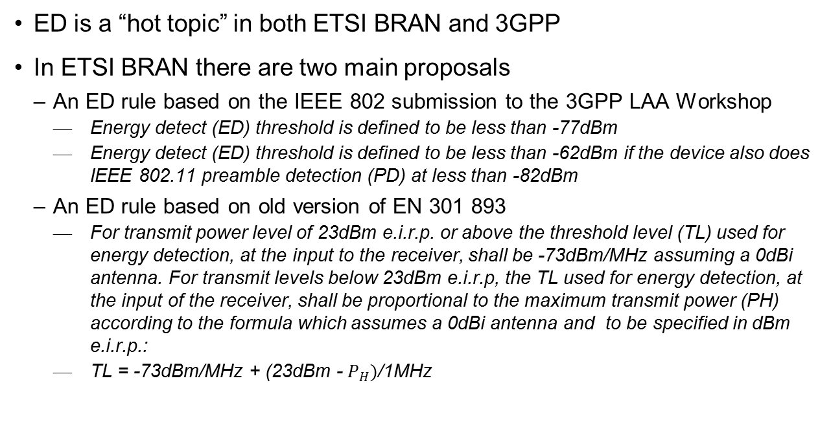
IEEE 802 should discuss because it is a “hot topic” just about everywhere
  ED is a “hot topic” in both ETSI BRAN and 3GPP
  In ETSI BRAN there are two main proposals
    An ED rule based on the IEEE 802 submission to the 3GPP LAA Workshop
      Energy detect (ED) threshold is defined to be less than -77dBm
      Energy detect (ED) threshold is defined to be less than -62dBm if the device also does IEEE 802.11 preamble detection (PD) at less than -82dBm
    An ED rule based on old version of EN 301 893
      For transmit power level of 23dBm e.i.r.p. or above the threshold level (TL) used for energy detection, at the input to the receiver, shall be -73dBm/MHz assuming a 0dBi antenna. For transmit levels below 23dBm e.i.r.p, the TL used for energy detection, at the input of the receiver, shall be proportional to the maximum transmit power (PH) according to the formula which assumes a 0dBi antenna and to be specified in dBm e.i.r.p.:
      TL = -73dBm/MHz + (23dBm - $P_{H})$/1MHz

Slide 12
IEEE 802 should discuss because it is a “hot topic” just about everywhere
  3GPP do not really have a specific proposal (Chairman’s agreement)
    RAN1 shall identify adaptation rules for LAA to adaptively lower the maximum energy detection threshold to ensure co-existence with other RATs including Wi-Fi and good performance of LAA
      Technologies that ensure co-existence with other RATs including Wi-Fi, using alternative means not requiring lowering of the maximum energy detection threshold, are not precluded.
    At least the following shall be considered in defining the adaptation rules of the maximum energy detection threshold:
      Antenna gain and number of transmit antennas
      Coexistence with LAA in absence of other RATs including Wi-Fi
      The maximum rated EIRP of the LAA transmission point within unlicensed band
      The maximum EIRP within the transmission burst following the LBT procedure
      The transmission bandwidth
      Measured ambient noise floor
      Deployment scenario: Indoor, outdoor
      Estimated Load on the operating channel
      Feasibility of the co-existence test
      Single global solution

Slide 13
Should IEEE 802 submit its position on ED to ETSI BRAN too?
  The IEEE 802 position is based on
    15 years of Wi-Fi experience
    3GPP simulations that showed ~-77dBm was required to achieve fairness
  The competing position in ETSI BRAN is not supported by any evidence
    The best evidence is that it represents the status quo
    However, that is in an environment when most devices follow the IEEE 802 position
  3GPP do not really have a position
    Although they seem to be hoping to find a magic box
  Is there any reason not to propose the IEEE 802 position to ETSI BRAN in addition to 3GPP?

Slide 14
IEEE 802 should discuss control frames
  The IEEE 802 position submitted to 3GPP is to allow short control frames without LBT (eg ACK) immediately after a data frame
  There is a move in ETSI BRAN to allow control frames to access the medium without LBT with a 5% duty cycle
  This might be OK, but that depends on the definition of a control frame
    Note: many 3GPP folk would consider a Beacon to be a control frame
  Thoughts?

