Slide 1
Unlicensed LTE/WiFi Coexistence Testbed
Date: 2015-07-06
Authors:

Slide 2
Abstract
Propose an Unlicensed-LTE/Wi-Fi testbed for coexistence characterization.

Slide 3
Intro to Unlicensed-LTE testbed
Goal was to design a RF environment that was flexible for handling variety of test Unlicensed LTE/LTE-LAA/LTE-U/Wi-Fi scenarios.
Based on our understanding the requirements for a wireless contention test bed are:
High Isolation from external devices
Good control over power levels across devices
Multipath Environment to test MIMO STA’s
Ability to test real applications (VoIP, Video streaming, file transfer, etc)
Flexibility to test high channel load environments
Repeatability and in a lab environment
Focused on simple scenario:
Wi-Fi AP-STA baseline with added Wi-Fi or LTE eNB traffic

Slide 4
Coexistence Testbed with multipath
Goals:
-OTA Coexistence testing
-Multi Path Emulation (Can be bypassed)
-Wi-Fi traffic to clients benchmarked before and after LTE introduced
-Wi-Fi sniffer helps diagnose channel loading/packet timing
-Can be used to test real life applications (video streaming, VoIP, etc).
-Attenuation helps tune power received on STA’s.
-Splitter enables testing of two 4 stream Wi-Fi AP’s or a 4x4 Wi-Fi AP with a 2x2 LTE device.
LTE monitor
OTA
Ethernet, HDMI, USB Ports
4
Wi-Fi STAs
LTE STAs
Wi-Fi sniffer
Multi-Path Emulation
802.11 AP
Attenuator
4
Wi-Fi
Ethernet
MIMO RF Splitter (8:4)
Ethernet
Attenuator
LTE
LTE eNB

Slide 5
Coexistence Testbed w/o multipath
Goals:
-Similar to multipath testbed, but without splitters.
-AP and eNB couple OTA in top box via antennas.
LTE monitor
OTA
Attenuator
Ethernet, HDMI, USB Ports
Wi-Fi STAs
LTE STAs
Wi-Fi sniffer
6-8
802.11 AP
Wi-Fi
4
Ethernet
Ethernet
LTE
2-4
LTE eNB

Slide 6
Extra Slides

Slide 7
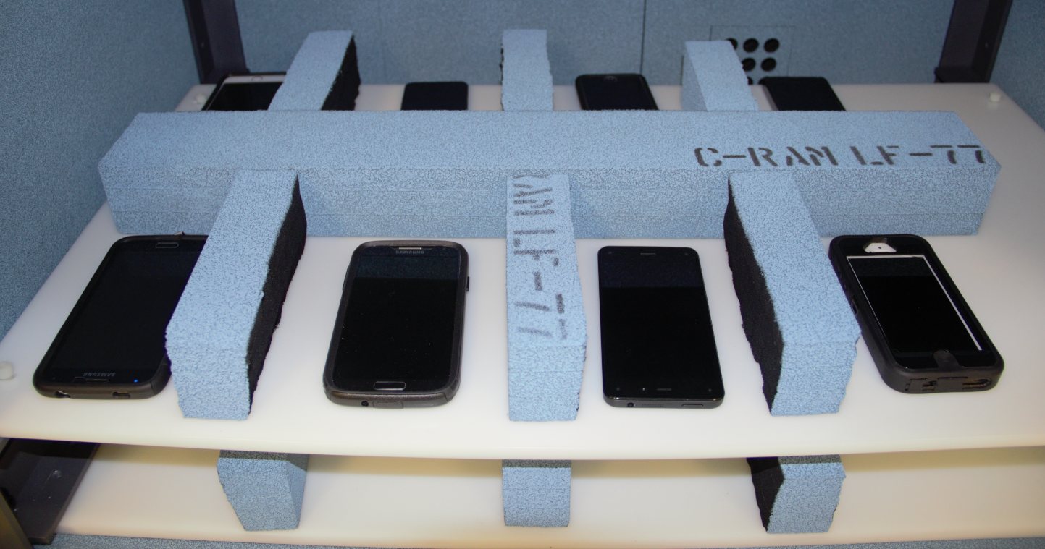
Possible STA arrangement
10 dB loss
Absorptive foam provides RX RSSI diversity to help test receiver sensitivity.

Slide 8
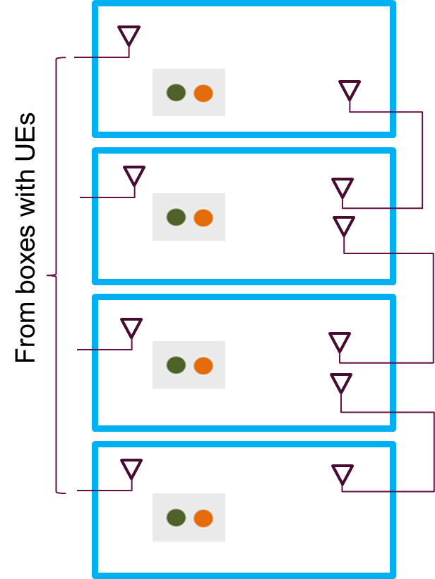
Multiple Small Cell Testbed
LTE-U Indoor Simulation Scenarios (SI5-8)
-Based on test scenarios provided by 3GPP (See 1)
-Chaining chambers expands wireless loading/environment
-Multiple AP’s, Small Cells operating co-channel

Slide 9
Multiple Small Cell Testbed
Client Box 1
Client Box 2
Client Box 3
Attenuator
Attenuator
Attenuator
Wi-Fi/LTE STAs
Wi-Fi/LTE STAs
Wi-Fi/LTE STAs
Wi-Fi
Wi-Fi
Wi-Fi
LTE
LTE
LTE
AP Box 1
AP Box 2
AP Box 3

Slide 10
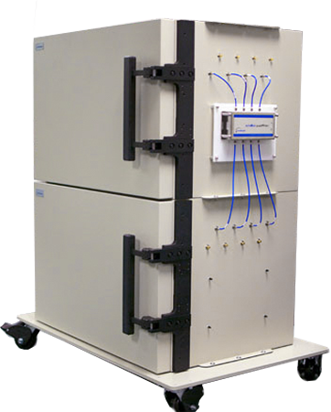
Possible Multiple Small Cell/Enterprise loading configuration
RF daisy-chain coupling to emulate space among AP/eNB pairs

Slide 11
References
[1] LTE-LAA 3GPP Document 36.889-011

