Slide 1
Expected Performance Improvement in the New Coexistence Scenario and Use Cases for IEEE 802.19.1
Date: 2015-05-13
Authors:
Notice: This document has been prepared to assist IEEE 802.19. It is offered as a basis for discussion and is not binding on the contributing individual(s) or organization(s). The material in this document is subject to change in form and content after further study. The contributor(s) reserve(s) the right to add, amend or withdraw material contained herein.

Slide 2
Abstract
This document considers simulation assumptions for performance improvement in the new coexistence scenario and use cases.
At this moment, no simulation results are included in this document.
Based on discussion, this document will be updated.

Slide 3
Objective of simulation
To show the necessity of developing the amendment of IEEE 802.19.1.
In the previous teleconference, we showed new coexistence scenarios and use cases for IEEE 802.19.1.
IEEE 802.19.1 system is a kind of frequency coordination system for coexistence.
In this document, we show the simulation assumptions for evaluating such new scenarios and use cases with and without frequency coordination.

Slide 4
[Recap] The new coexistence use cases for IEEE 802.19.1 [1]

Slide 5
Assumption 1: Overview
With or without frequency coordination between different networks (i.e. CMs) with different CDIS
In other words, “a network operator (or CM) knows the information of communication nodes managed by the other network operator, or does not know.”

Slide 6
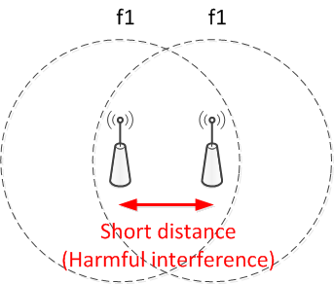
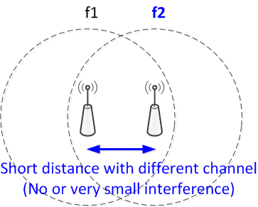
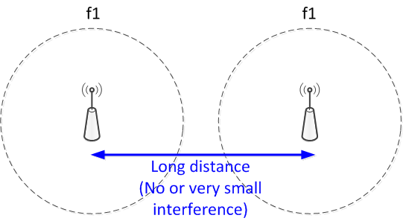
Assumption 2: Frequency coordination
Frequency coordination shall be treated as “node deployment coordination” in this simulation.
The objective of simulation is NOT to evaluate “frequency coordination algorithms”.
Any frequency coordination algorithm would result in the following situation.
No coordination
Two kind of coordination results

Slide 7
Assumption 2 (Cont.)
No frequency coordination in this simulation;
Nodes are uniformly and randomly distributed without any considerations on the location of adjacent nodes and their channel.
Frequency coordination in this simulation;
Nodes are uniformly and randomly distributed with considerations on the location of adjacent nodes and their channel.
No coordination
Two kind of coordination results

Slide 8
Assumption 3: Scenarios
Case for adopting no IEEE 802.19 system
Scenario 1
Only 1 channel available
No frequency coordination among different operator-networks
Scenario 2
Multiple channels available
Frequency coordination in each operator-network
No frequency coordination among different operator-networks
Scenario 3
Multiple channels available
Frequency coordination in each operator-network
Frequency coordination between operator #1 and #2 networks
No frequency coordination between operator #3 and other network.
Scenario 4
Multiple channels available
Frequency coordination in each operator-network
Frequency coordination among different operator-networks (#1, #2 and #3)
Case for adopting IEEE 802.19.1
Case for adopting the amendment of IEEE 802.19.1
Case for adopting the amendment of IEEE 802.19.1
.

Slide 9
Assumption 3: Metric
Evaluation metric shall be “SINR at x-percentile CDF” as a function of “the number of node per operator”.
Image of the result
SINR at x-percentile CDF
Scenario 4
Scenario 3
Scenario 2
Scenario 1
Number of node per operator

Slide 10
Reference
[1] IEEE 802.19-15/0032r0, “The new coexistence use cases for IEEE 802.19.1”

Slide 11
Appendix: Simulation parameter candidates
 | Scenario 1 | Scenario 2 | Scenario 3 | Scenario 4
Freq. band | 3.5GHz
Num. of channel | 1 | 3
Bandwidth per channel | 10MHz
Num. of coexistence system operator | 3
Num. of AP | 1 ~ 100
Minimum inter-AP distance within operator | R= 10, D = $2\sqrt{R^{2}−\frac{R^{2}}{4}}$ | R = 10, Co-channel:$D_{co−ch}=4\sqrt{R^{2}−\frac{R^{2}}{4}}cos\frac{π}{6}$ Other channel:$D_{other−ch}= 2\sqrt{R^{2}−\frac{R^{2}}{4}}$
Considerations of minimum inter-AP distance with other operators | No consideration |  | Operator 1 and 2 considers each other. Operator 3 doesn’t consider other operators’ AP. | All the operators consider other operators’ AP
AP distribution area size | 300m x 300m
Geo-location of AP | Uniformly and randomly distributed with satisfying the above minimum inter-AP distance and considerations
Transmission power of AP | 18 dBm

Slide 12
Appendix: Simulation parameter candidates (Cont.)
 | Scenario 1 | Scenario 2 | Scenario 3 | Scenario 4
Antenna Height | AP: 3.0 m, UE: 1.5m
Channel model | Pathloss model PL(d) = 40.05 + 20*log10(fc/2.4) + 20*log10(min(d,10)) + (d>10) * 35*log10(d/10) – d = max(3D-distance [m], 1) – fc = frequency [GHz] Shadowing Log-normal with 5 dB standard deviation, i.i.d across all links
Fading model | No small-scale fading is assumed.
AP selection criteria | Max reception power within the same operator-network
Adjacent channel interference | Assumes no interference

